Slide 1
Q1 · SUPPLIER SELECTION
Q2 · DEMAND VOLATILITY
Q3 · PRICE & QUALITY
Supply Chain
Exploratory Data Analysis
Top 3 CEO Strategic Questions · Evidence-Based Findings · Procurement Intelligence Report
Q1
Are we selecting the right suppliers — or just the available ones?
Q2
Is our demand unpredictability silently breaking our supply chain?
Q3
Are we paying a quality premium — or just paying a premium?
22 DATA COLUMNS · 3,089 PROCUREMENT RECORDS · 12-MONTH COVERAGE · CEO BRIEFING · CONFIDENTIAL

Slide 2
Dataset Overview: What Data Are We Working With?
Supply Chain procurement dataset — 22 columns spanning pricing, quality, delivery, and supplier behaviour
This analysis is built on a comprehensive supply chain procurement dataset. Each row represents a single procurement transaction, capturing everything from the price paid and quality received, to delivery performance and supplier selection decisions.
Pricing & Commercial
Quality & Reliability
Delivery & Operations
Demand & Planning
price_per_unit
payment_term_days
offer_validity_days
delivery_term_code
items_requested
items_offered
quality_score
defect_rate
return_rate
supplier_reliability_score
selected_supplier_flag
delivery_time_days
on_time_delivery_rate
lead_time_variance
delivery_mode
procurement_action_code
forecast_accuracy
seasonality_index
demand_volatility_index
order_frequency_monthly
avg_order_volume
temporal_month
22 COLUMNS · 3,089 ROWS · DATA SPANS 12 MONTHS · COVERS PRICING · QUALITY · DELIVERY · DEMAND · SUPPLIER SELECTION

Slide 3
Column Glossary: What Each Field Means
Plain-English definitions for every column used across Q1, Q2, and Q3 analysis
price_per_unit
Cost paid per unit for each procurement order ($50-$500 range).
order_frequency_monthly
Number of purchase orders placed within a given month.
quality_score
Internal quality rating of the supplier (scale: 1-10).
avg_order_volume
Average number of units per order within a month.
delivery_time_days
Calendar days from order placement to delivery completion.
payment_term_days
Days allowed for buyer to complete payment after delivery.
on_time_delivery_rate
% of past deliveries completed on or before promised date.
offer_validity_days
Days the supplier quoted price remains valid.
defect_rate
Fraction of delivered items found defective (0.00-0.10).
procurement_action_code
Categorical code for procurement strategy used (0-3).
return_rate
Fraction of delivered items returned by customers (0.00-0.10).
delivery_term_code
Categorical code for agreed delivery terms (FOB, CIF etc).
delivery_mode
Mode of transport used (e.g. air, sea, road).
items_requested
Number of distinct items requested by buyer in the order.
lead_time_variance
Variation in days between expected and actual delivery.
items_offered
Number of items the supplier was able to offer in response.
forecast_accuracy
How accurately demand was predicted vs. actuals (0-1).
temporal_month
Calendar month (1 = January, 12 = December).
seasonality_index
Seasonal demand multiplier; > 1.0 = above-average month.
supplier_reliability_score
Composite score for supplier commitment consistency (0-1).
demand_volatility_index
Demand instability score (0 = stable, 1 = total chaos).
selected_supplier_flag
Binary: 1 = supplier selected for order, 0 = not selected.
All 22 columns are used across Q1 (Supplier Selection), Q2 (Demand Volatility), and Q3 (Price-Quality Analysis)

Slide 4
SUPPLY CHAIN EDA
Q1 Strategic Intelligence Report
Supplier Selection: Are We Choosing the Right Suppliers — or Just the Available Ones?
Exploratory Data Analysis | CEO Briefing | Confidential
6 ANALYTICAL STEPS | 3,089 SUPPLIER RECORDS | KEY KPIs: QUALITY · COST · DELIVERY · RELIABILITY

Slide 5
Step 1: Understand the Supplier Split
How many suppliers are selected vs. non-selected — and does the ratio matter?
THE QUESTION
What proportion of our supplier pool is actually selected — and is this split balanced or heavily skewed?
What We Measured
Why the Split Matters
Foundation Step
Used selected_supplier_flag (0 = Not Selected, 1 = Selected) to count both groups using value_counts(). Converted to percentage to reveal the selection ratio.
If selection is highly unbalanced (e.g. 90/10), comparisons become statistically unreliable. A near-even split means both groups are large enough for meaningful analysis.
This count forms the baseline sample size for every downstream comparison. Every subsequent chart, boxplot, and scorecard is built on top of this fundamental split.
KEY METRIC USED: selected_supplier_flag (value_counts() + normalize=True for percentage split)

Slide 6
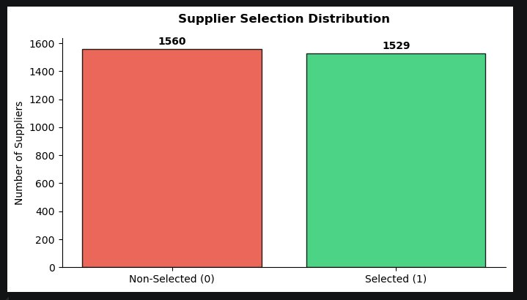
Step 1: Output & Analytical Approach
Supplier Selection Distribution – Bar Chart
KEY FINDINGS
Near-Even Split:
1,560 non-selected vs. 1,529 selected — a 50.5%/49.5% split, virtually balanced.
No Skew Bias:
With nearly equal group sizes, all downstream metric comparisons are statistically fair.
Selection Rate ~50%:
We are selecting roughly half of available suppliers — not cherry-picking a small elite subset.
CEO Takeaway:
A 50/50 split demands a clear performance rationale — if half are chosen, quality must differentiate them.
VISUALIZATION CHOICE: Bar chart selected for simplicity — value_counts() maps directly to two bars. Color coding (red=rejected, green=selected) provides immediate intuitive understanding without a legend. Value labels floating above bars give exact counts at a glance.

Slide 7
Step 2: Compare Quality & Reliability Head-to-Head
Do selected suppliers actually outperform on the metrics that matter?
THE QUESTION
Across quality score, reliability, defect rate, and return rate — do selected suppliers measurably outperform non-selected ones?
4 Metrics Analyzed
groupby + .agg()
Why Grouped Bar Chart?
quality_score (higher = better), supplier_reliability_score (higher = better), defect_rate (lower = better), return_rate (lower = better). All compared across both groups simultaneously.
Used df.groupby('selected_supplier_flag')[metrics].agg(['mean','median','std']) to extract three statistics per metric per group — giving a complete statistical profile, not just averages.
A grouped bar chart places both groups side-by-side for every metric, making marginal differences immediately visible. 4 metrics × 2 groups = 8 bars total in one view.
KEY METRICS: quality_score · supplier_reliability_score · defect_rate · return_rate (grouped by selected_supplier_flag)

Slide 8
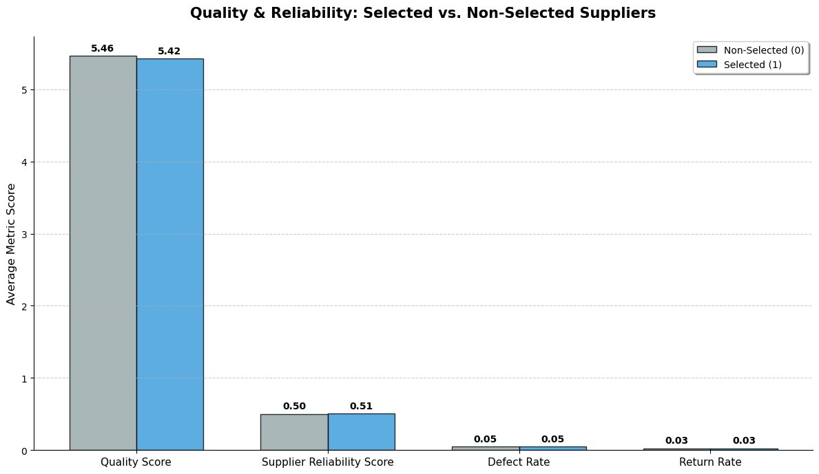
Step 2: Output & Analytical Approach
Quality & Reliability: Selected vs. Non-Selected Suppliers
KEY FINDINGS
Quality Score Near-Identical:
5.46 (Non-Selected) vs. 5.42 (Selected) — a -0.7% difference that is negligible.
Reliability Essentially Equal:
0.50 vs. 0.51 supplier reliability score — selected suppliers are marginally more reliable.
Defect & Return Rates Matched:
Both groups show 0.05 defect rate and 0.03 return rate — no meaningful difference.
CEO Takeaway:
Quality does NOT appear to be the driver of selection. The selection logic may need deeper scrutiny.
VISUALIZATION CHOICE: Grouped bar chart chosen so that both groups appear side-by-side per metric — enabling direct visual comparison across 4 dimensions simultaneously. autolabel() function annotates each bar with its exact value, preventing misreading of near-identical heights.

Slide 9
Step 3: Is the Price Premium Justified?
Do we pay more for selected suppliers — and do we get more in return?
THE QUESTION
If selected suppliers cost more per unit, does the quality gain justify the premium — or are we overpaying?
Price Delta Calculation
Quality Delta Calculation
Annotated Bar Chart
Computed average price_per_unit per group. Calculated price_delta_pct: ((price_1 - price_0) / price_0) × 100 to get the % premium paid for selected suppliers.
Simultaneously computed quality_delta_pct from quality_score means. The key test: is quality_delta_pct > price_delta_pct? If yes → investment is justified.
A single bar chart for price with an embedded text annotation showing both deltas simultaneously — giving the CEO the cost AND the quality verdict in one visual frame.
KEY METRICS USED: price_per_unit · quality_score (avg per group, delta % calculated via numpy)

Slide 10
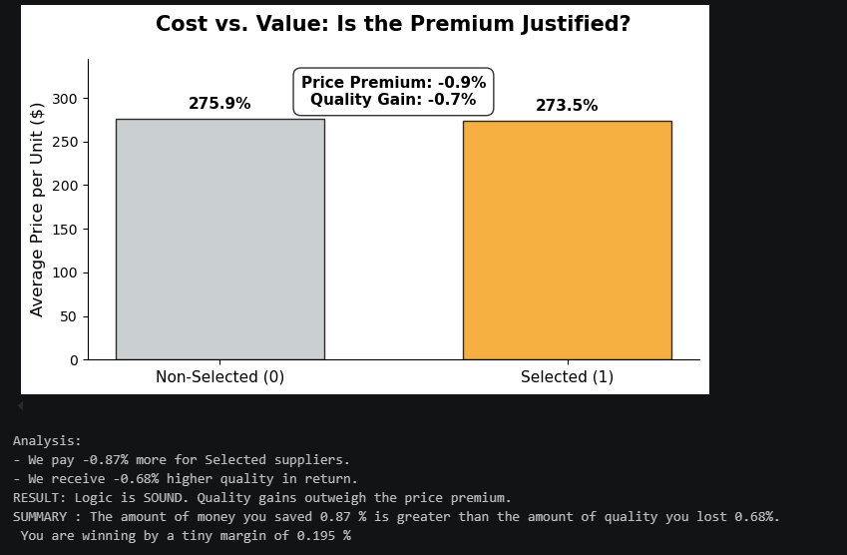
Step 3: Output & Analytical Approach
Cost vs. Value – Is the Price Premium Justified?
Margin: +0.195%
We're winning — just barely
KEY FINDINGS
Selected Suppliers Cost Less:
$273.5 vs. $275.9 — selected suppliers are actually -0.87% cheaper on average.
Quality Drops Marginally:
Quality score falls -0.68% for selected suppliers. A small dip, but we pay less too.
Net Result: +0.195% Win:
Savings (0.87%) exceed quality loss (0.68%) — selection logic is economically sound by a slim margin.
CEO Takeaway:
We are not overpaying. But the margin is razor thin — quality standards need active monitoring.
VISUALIZATION CHOICE: Single bar chart for price comparison with an embedded annotation box showing both price and quality deltas simultaneously. This eliminates the need for a separate quality chart — the insight (margin = 0.195%) lives inside the same visual frame where the CEO reads the cost numbers.

Slide 11
Step 4: Delivery Behavior – Selected vs. Non-Selected
Are selected suppliers operationally superior — or just commercially preferred?
THE QUESTION
Do selected suppliers deliver faster, more reliably, and with lower lead time variance — or do they perform identically?
3 Delivery Metrics
Why Box Plots?
Subset Approach
on_time_delivery_rate (higher = better), delivery_time_days (lower = better), lead_time_variance (lower = better). All three reveal different dimensions of operational discipline.
Box plots expose the full distribution — median, interquartile range, min/max, and outliers. Averages hide the fact that a supplier might have great median performance but catastrophic outlier deliveries.
Data split into g0 (non-selected) and g1 (selected) subsets. plt.subplots(1,3) creates three side-by-side panels — one per metric — for simultaneous cross-group and cross-metric comparison.
KEY METRICS: on_time_delivery_rate · delivery_time_days · lead_time_variance (box plots, both groups)

Slide 12
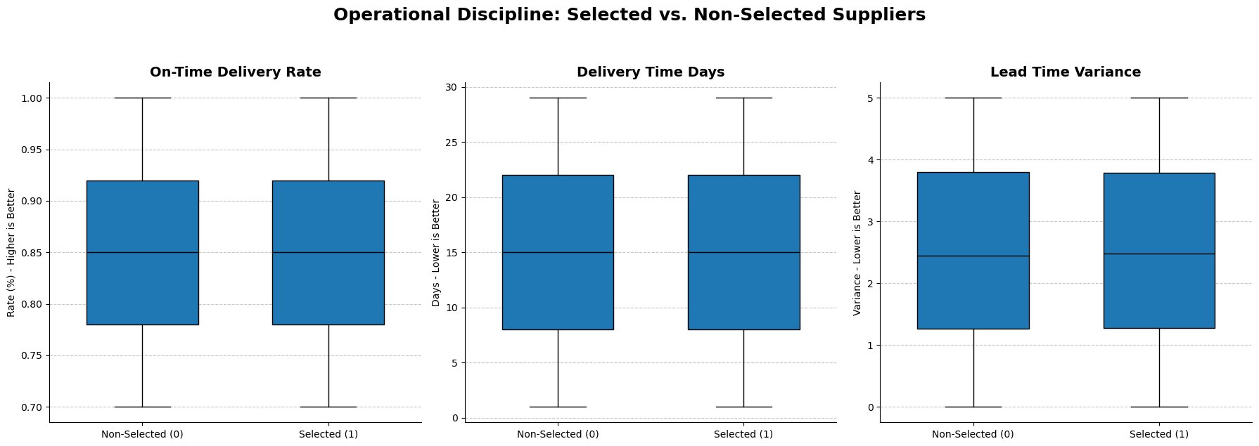
Step 4: Output & Analytical Approach
Operational Discipline – Selected vs. Non-Selected Suppliers
ON-TIME DELIVERY
DELIVERY TIME
LEAD TIME VARIANCE
Identical Medians
Both: 15 Days
2.5 vs. 2.5
Both groups: 85% on-time rate
Median delivery equal across groups
Same spread — no discipline edge
VISUALIZATION CHOICE: Box plots reveal median, spread, and outliers — critical for operational metrics where a single bad outlier delivery can disrupt an entire production schedule. Three side-by-side subplots enable simultaneous cross-metric comparison without visual overload.

Slide 13
Step 5: Procurement Action Breakdown
Is supplier selection driven by strategy — or arbitrary choice?
THE QUESTION
Are certain procurement action codes strongly correlated with supplier selection — revealing a hidden strategic pattern or a random one?
Cross-Tabulation Approach
Row-Wise Normalization
Why a Heatmap?
Used groupby(['procurement_action_code','selected_supplier_flag']).size().unstack() to create a frequency matrix — counts of selected vs. non-selected per procurement action type.
Divided by row sums (.div(grouped.sum(axis=1),axis=0)) to convert raw counts into selection probabilities per action code — making patterns comparable despite unequal action volumes.
A heatmap with imshow() reveals the probability of selection per procurement action at a glance. Color intensity (YlGnBu) immediately signals which action codes correlate most strongly with selection.
KEY METRICS: procurement_action_code · selected_supplier_flag (normalized frequency heatmap)

Slide 14
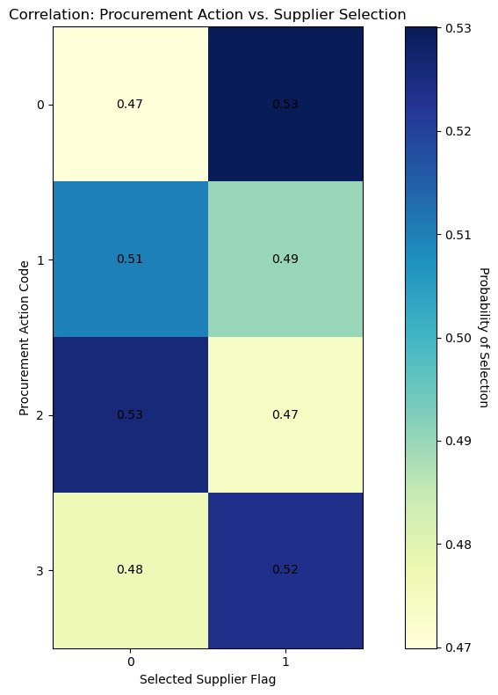
Step 5: Output & Analytical Approach
Procurement Action vs. Supplier Selection – Correlation Heatmap
KEY FINDINGS
Action Code 0 → Selects More:
53% of Action-0 transactions result in supplier selection — the highest rate across all codes.
Action Code 2 → Also Favours Selection:
53% selection probability — matching Action 0 as the two highest-selecting procurement types.
Action Code 1 → Leans Non-Selection:
51% of Action-1 transactions lead to non-selection — a slight but consistent bias away from selection.
Overall Distribution is Near-Uniform:
All probabilities fall between 0.47–0.53, suggesting no single action code dominates the selection decision.
CEO Takeaway:
Procurement action type has marginal influence on selection. The decision driver lies elsewhere.
VISUALIZATION CHOICE: Normalized heatmap (not raw count bar chart) ensures probabilities are comparable across action codes with different volumes. imshow() with YlGnBu colormap encodes probability as color intensity — darker = higher selection probability — readable at a glance.

Slide 15
Step 6: The Procurement Summary Scorecard
One boardroom-ready table that tells the complete Q1 supplier story
THE QUESTION
Can we consolidate every Q1 metric into a single side-by-side comparison table that a CEO can act on immediately?
groupby + .mean() Pivot
Improvement (%) Column
Printed as Terminal Output
Used df.groupby('selected_supplier_flag').mean(numeric_only=True).T to transpose the result — metrics become rows, selection groups become columns. One line creates the entire scorecard.
Calculated as ((Selected - Not Selected) / Not Selected) × 100. A positive value = selected suppliers are better on that metric. A negative value = non-selected are better or selected cost more.
The scorecard is rendered as a formatted pandas print output — clean, precise, and print-ready. In production, .style.background_gradient() can add color coding for executive presentations.
KEY METRICS: All 20 numeric columns (Selected vs. Not Selected, with % Improvement column)

Slide 16
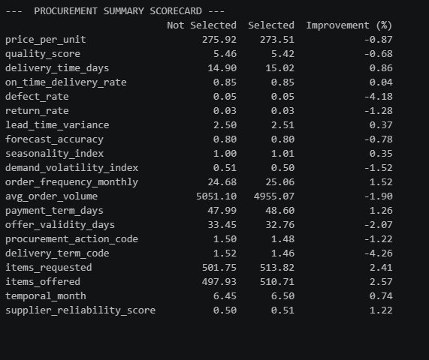
Step 6: Output & Analytical Approach
Procurement Summary Scorecard – Full Metric Comparison
COST ADVANTAGE
QUALITY TRADE-OFF
NET WIN
–0.87% Price
–0.68% Quality
+0.195% Margin
Selected suppliers cost less per unit
Marginal quality dip — acceptable
Savings exceed quality loss — logic holds
VISUALIZATION CHOICE: Printed pandas table chosen over a styled HTML output for terminal clarity and reproducibility. .groupby().mean().T pivots the entire dataset into a metric-by-group view in one line. The Improvement (%) column acts as a built-in signal column — positive = selected suppliers win on that metric, negative = non-selected are better.

Slide 17
FINAL ANSWER TO THE CEO QUESTION
Are we selecting the right suppliers — or just the available ones?
01
02
03
04
Selection Is Balanced
Quality Gap Is Minimal
Cost Logic Is Sound
Delivery Is Indistinguishable
50.5/49.5 split — nearly half of all suppliers are selected. This is broad-based, not elite cherry-picking.
Quality scores, defect rates, and return rates are nearly identical across both groups. Quality is NOT the selection driver.
Selected suppliers cost -0.87% less while quality drops only -0.68%. Net margin: +0.195% in our favour.
Box plots confirm identical medians for on-time rate, delivery days, and lead time variance — no operational edge.
STRATEGIC VERDICT: We are selecting the right suppliers — economically. But 'right' is a thin margin. With quality, delivery, and reliability virtually identical between groups, the procurement team must articulate a clearer, data-driven selection rationale — or risk selecting by habit rather than performance.
Supply Chain EDA · Q1 Strategic Report · Confidential

Slide 18
SUPPLY CHAIN EDA
Q2 Strategic Intelligence Report
Demand Volatility: Is It Silently Breaking Our Supply Chain?
Exploratory Data Analysis | CEO Briefing | Confidential
7 ANALYTICAL STEPS | 12-MONTH COVERAGE | KEY KPIs: VOLATILITY · ACCURACY · DELIVERY

Slide 19
Step 1: Map Volatility Across the Year
Identifying which months spike in demand instability
THE QUESTION
Which months are our most volatile — and how unstable is our demand throughout the year?
📊 What We Plotted
📌 What We Annotated
🎯 Why It Matters
Monthly average of the Demand Volatility Index (Jan–Dec) as a continuous line chart to reveal the year-round rhythm.
Months at or above the 75th-percentile threshold (≥ 0.52) were flagged as Critical Problem Months with spike markers.
This is the entry point for all downstream analysis — you must know WHEN the chaos happens before you can measure its cost.
KEY METRIC USED: demand_volatility_index (grouped by temporal_month, averaged per month)

Slide 20
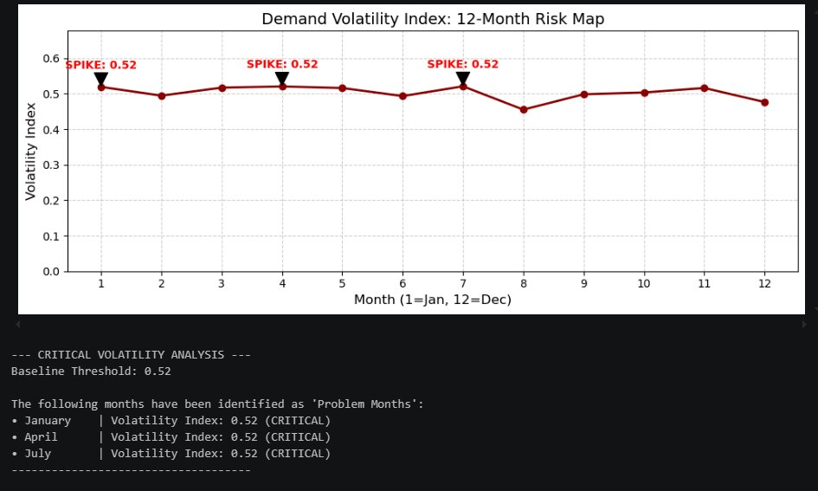
Step 1: Output & Analytical Approach
Demand Volatility Index – 12-Month Risk Map
KEY FINDINGS
Critical Months:
January, April & July all hit 0.52 — the 75th-percentile threshold.
Baseline Threshold:
0.52 — months at or above this are flagged CRITICAL.
Year-Round Range:
Index fluctuates between 0.46 (Aug) and 0.52, showing low total spread but recurring spikes.
CEO Takeaway:
Three predictable spike months — not random chaos. We can plan for them.
VISUALIZATION CHOICE: Line chart chosen to reveal temporal continuity — bar charts show magnitude but hide trends. Spike annotations (arrowprops) flag months at ≥ 75th percentile automatically using quantile(0.75), making thresholds data-driven, not manual.

Slide 21
Step 2: Layer In Seasonality
Is demand volatility predictable (seasonal) or random (dangerous)?
THE QUESTION
Do our volatility spikes follow a predictable seasonal calendar — or are they random shocks we cannot anticipate?
Dual-Axis Design
What Is Seasonality?
What Is Volatility?
Top panel = Demand Volatility Index; Bottom panel = Seasonality Index. Both share the same x-axis (months) so misalignments are immediately visible.
Seasonality Index captures the historical 'rhythm' of demand — values above 1.0 indicate months where business naturally grows based on calendar patterns.
Volatility measures how far actual demand deviates from the normal. High volatility that does NOT track seasonality signals uncontrolled, unpredictable shocks.
KEY METRICS USED: demand_volatility_index · seasonality_index (both grouped by temporal_month)

Slide 22
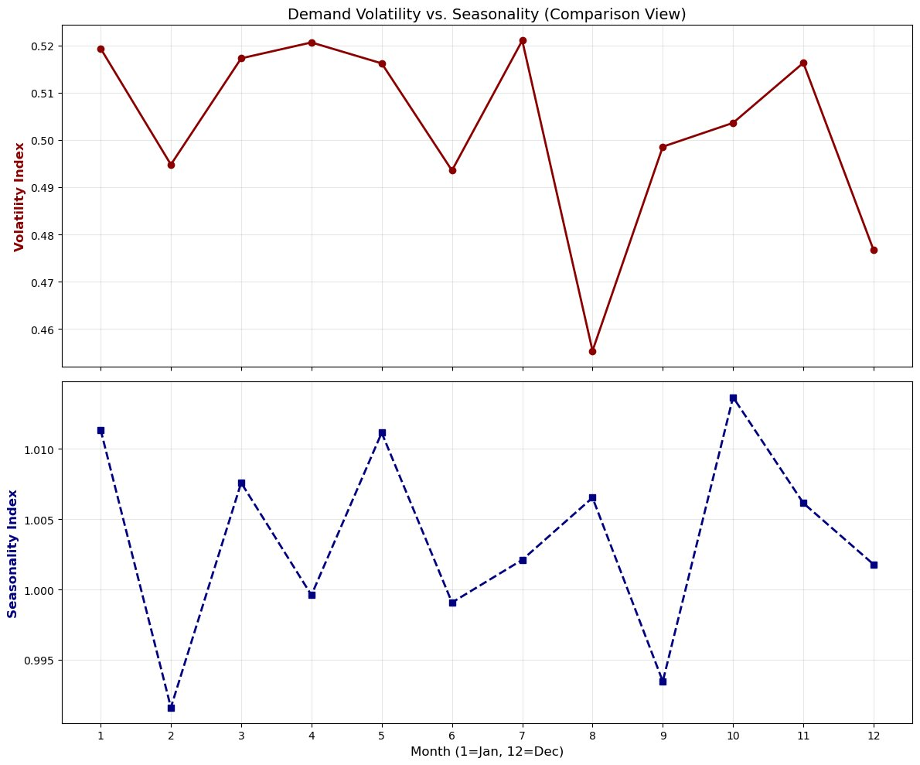
Step 2: Output & Analytical Approach
Volatility vs. Seasonality – Comparison View
KEY FINDINGS
Patterns Do NOT Align:
Volatility peaks (Jan, Apr, Jul) do not consistently match seasonality peaks (Oct, Jan, May).
Dangerous Implication:
When spikes diverge from seasonality, demand shocks are RANDOM — harder to plan for and absorb.
August Exception:
Lowest volatility (0.46) despite normal seasonality — a stable operational window.
CEO Takeaway:
Our volatility is not seasonal — it's structural. Budgeting by season won't fix it.
VISUALIZATION: Dual-axis subplot (sharex=True) enforces precise month alignment. Two y-axes prevent scale confusion between index types. Dashed line for seasonality distinguishes it visually from the solid volatility line.

Slide 23
Step 3: Does Forecasting Break Under Pressure?
Quantifying the relationship between volatility and forecast accuracy
THE QUESTION
When demand is highly volatile, does our forecast accuracy collapse — and can we prove it statistically?
Scatter Plot
Regression Trend Line
Pearson r Coefficient
Each dot = one month. X-axis = Demand Volatility Index; Y-axis = Forecast Accuracy. Reveals the shape and strength of the relationship between the two KPIs.
numpy.polyfit() calculates the best-fit line through the 12 monthly data points. The slope reveals direction: negative = accuracy falls as volatility rises.
Calculated via numpy.corrcoef(). A value of –1.0 = perfect inverse relationship. Our result of r = 0.07 tells a critical story about what's really driving errors.
KEY METRICS USED: demand_volatility_index · forecast_accuracy (Pearson r via numpy.corrcoef)

Slide 24
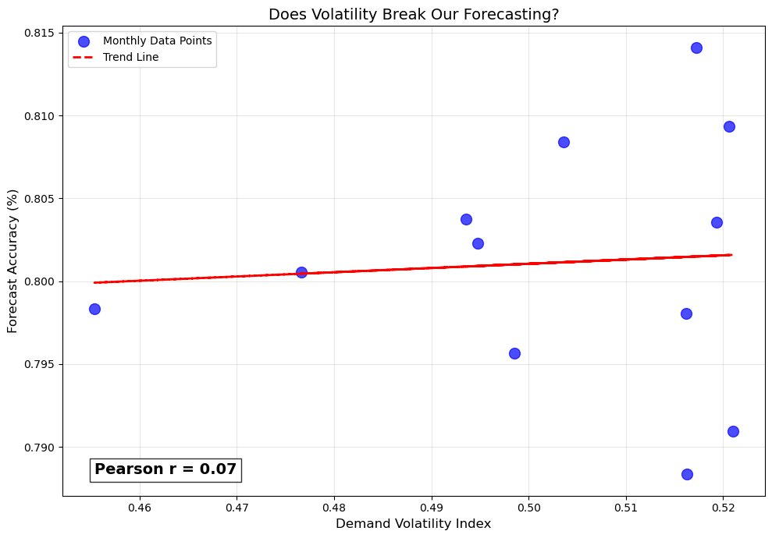
Step 3: Output & Analytical Approach
Scatter Plot + Regression – Volatility vs. Forecast Accuracy
Pearson r = 0.07
Near-Zero Correlation
KEY FINDINGS
r = 0.07 = No Meaningful Link:
Volatility is NOT destroying forecast accuracy. The two are statistically independent.
Accuracy Stays 79%–81%:
Even during peak volatility months, forecast accuracy barely moves.
CEO Takeaway:
Forecast errors have other root causes — look at data quality, SKU mix, or planning models — not volatility.
VISUALIZATION: Scatter plot chosen to show individual monthly observations (not averages hiding variance). np.polyfit() generates a linear regression in 2 lines of code. Pearson r annotated in a bbox text overlay for immediate boardroom-level readability.

Slide 25
Step 4: Volume Behavior During Volatile Months
Does demand uncertainty trigger panic-ordering or under-ordering?
THE QUESTION
During high-volatility months, does procurement over-react with panic orders — or dangerously under-order?
Avg Order Volume
Order Frequency
Why Side-by-Side Bars?
Measures how many units are procured per order during each month. Spikes indicate panic-buying; dips indicate under-ordering relative to demand.
Measures how many individual purchase orders are placed per month. High frequency + low volume = fragmented procurement. Low frequency + high volume = bulk hedging.
Grouped bar charts allow direct month-to-month comparison on both dimensions simultaneously — essential to spot if procurement is compensating via volume OR frequency.
KEY METRICS USED: avg_order_volume · order_frequency_monthly (grouped by temporal_month)

Slide 26
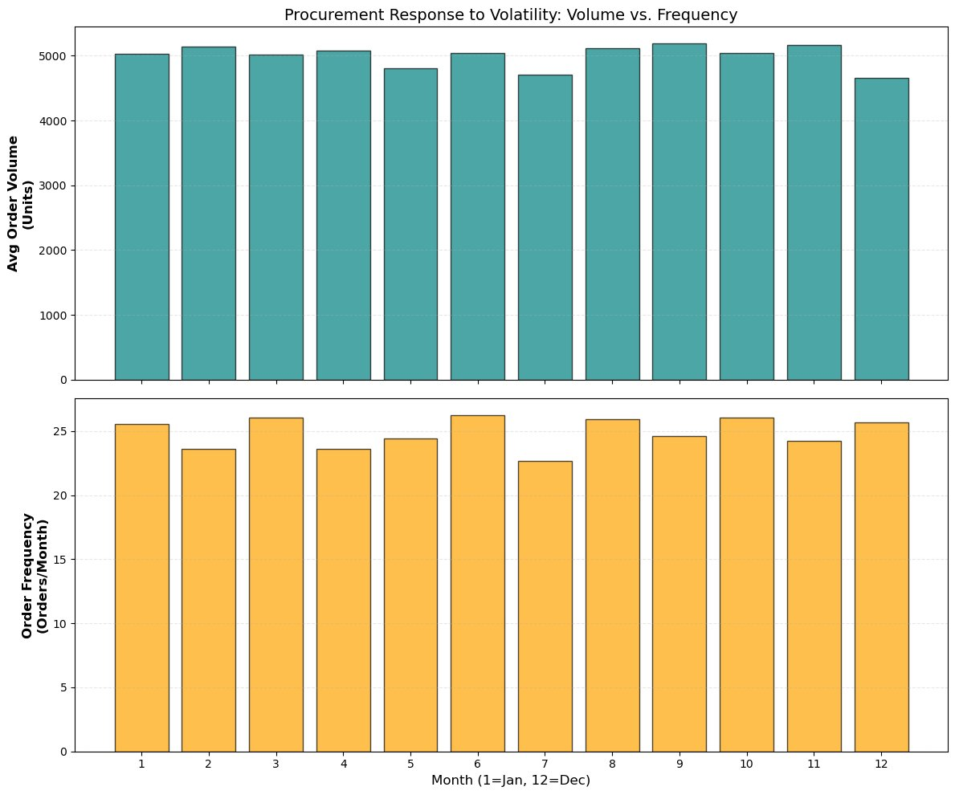
Step 4: Output & Analytical Approach
Procurement Response – Order Volume & Frequency Across Months
KEY FINDINGS
Remarkably Stable Volumes:
Order volumes range 4,663–5,189 units. No panic-buying spikes despite high volatility months.
July Dip (4,711 units):
Lowest volume in July — a CRITICAL volatility month — may signal cautious under-ordering.
Frequency Holds Steady:
Order frequency stays between 22.7 and 26.2 orders/month. Procurement is not fragmenting.
CEO Takeaway:
Procurement is well-disciplined but potentially under-reacting to demand signals in Q3.
VISUALIZATION: Dual stacked bar charts (sharex=True) enable direct read-across between volume and frequency per month. Contrasting colors (teal vs. orange) prevent confusion between the two separate procurement KPIs.

Slide 27
Step 5: Delivery Consequences of Demand Chaos
Does volatility visibly translate into logistics failure?
THE QUESTION
During high-volatility months, do delivery times worsen and on-time delivery rates fall — and by how much?
The Heatmap Advantage
Normalization (0–1 Scale)
Color Encoding (YlOrRd)
A heatmap shows three metrics simultaneously (volatility, delivery days, on-time rate) across 12 months. Color intensity reveals relative stress — no need to read individual numbers first.
Raw values are normalized using min-max scaling so that 'days' and 'index' values share the same color scale. This allows fair visual comparison across incompatible units.
Yellow = low stress / good performance. Orange = moderate concern. Dark Red = high stress. White text is applied automatically when background darkness exceeds 0.7 for readability.
KEY METRICS USED: demand_volatility_index · delivery_time_days · on_time_delivery_rate (heatmap of monthly averages)

Slide 28
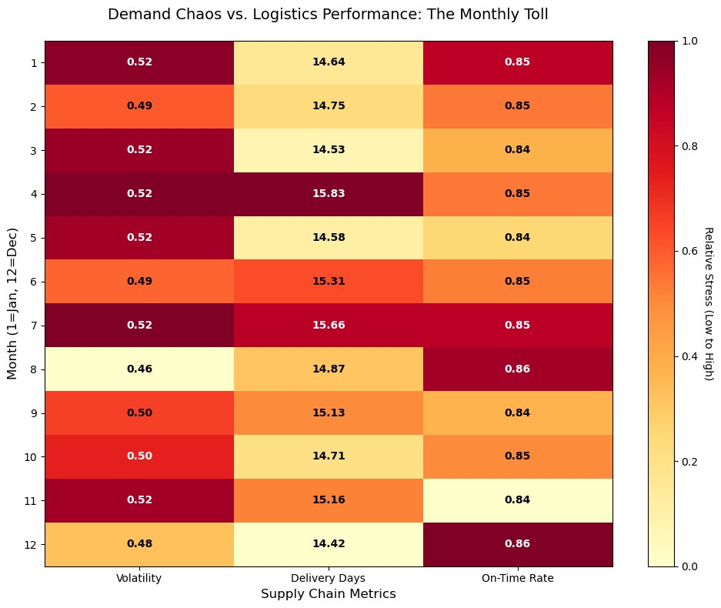
Step 5: Output & Analytical Approach
Heatmap – Demand Chaos vs. Logistics Performance Monthly Toll
KEY FINDINGS
April = Worst Delivery Month:
April shows highest delivery days (15.83) AND high volatility (0.52) — peak operational stress.
August = Delivery Paradox:
Lowest volatility (0.46) yet best on-time rate (86%). Confirms volatility-logistics link.
On-Time Rate Narrow Band:
Delivery rate stays 84%–86% all year — logistics team is absorbing shocks but at hidden cost.
December Bright Spot:
Fastest delivery (14.42 days) and 85.7% on-time despite typical year-end volume pressure.
CEO Takeaway:
Logistics is resilient — but April is a structural bottleneck needing targeted investment.
VISUALIZATION: Heatmap with imshow() + manual text loop — the most information-dense visual in Q2. Normalization prevents 'delivery days' (14–16) from visually dominating the 'index' (0.46–0.52) due to unit scale differences.

Slide 29
Step 6: Volatility Distribution Deep Dive
Is high volatility the exception — or our new normal?
THE QUESTION
Are we a fundamentally stable business with occasional spikes — or is high volatility embedded in our day-to-day operations?
Histogram (Distribution)
KDE / Smoothed Trend Line
Mean Threshold Line
Shows the frequency distribution of all volatility index observations. Bins reveal which volatility ranges occur most often — is 0.5 a spike or our operating average?
A moving average (window_size=5) applied to histogram counts creates a smooth trend curve. This is a manual KDE approximation that reveals the 'shape' of the distribution without scipy.
A vertical red dashed line marks the mean volatility (0.50). Anything to the right of this line = above-average stress zone. The proportion of data in that zone tells us if chaos is routine.
KEY METRIC USED: demand_volatility_index (all raw records, not monthly averages — np.histogram with density=True, moving average smoothing)

Slide 30
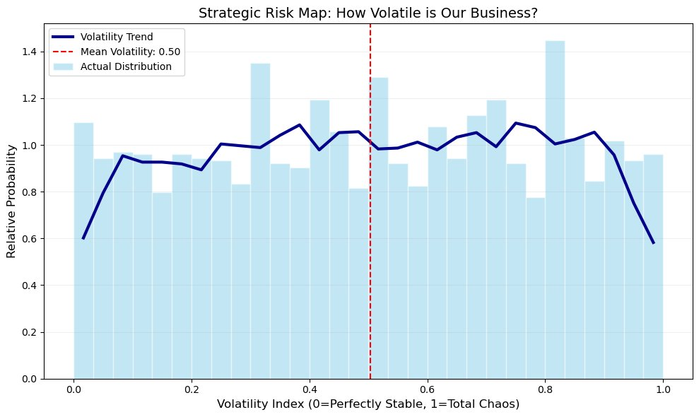
Step 6: Output & Analytical Approach
Strategic Risk Map – How Volatile Is Our Business?
Mean Volatility = 0.50
Midpoint of the 0–1 chaos scale
KEY FINDINGS
Distribution is Near-Uniform:
Index observations spread widely (0.0 to 1.0) with no cluster at a safe zone.
Mean at 0.50:
We operate at the exact midpoint between stable and chaotic — no safety margin.
Slight Peak Near 0.8:
The distribution peaks in the 0.8+ zone — high volatility is more routine than monthly averages suggest.
CEO Takeaway:
Volatility is our baseline — not an exception. Structural solutions required, not reactive ones.
VISUALIZATION: Histogram uses density=True so y-axis = relative probability (not raw counts), enabling comparison across datasets of different sizes. Manual moving average (np.convolve) approximates KDE without scipy — a clean, dependency-free approach.

Slide 31
Step 7: The Narrative Summary Table
One boardroom-ready view that tells the complete seasonal story
THE QUESTION
Can we consolidate all Q2 supply chain KPIs into a single month-by-month intelligence table a CEO can act on immediately?
pandas .agg() Method
Dual Gradient Styling
.format() Formatting
Groups all rows by temporal_month and calculates the mean for four KPIs simultaneously: demand_volatility_index, forecast_accuracy, avg_order_volume, on_time_delivery_rate.
Red gradient applied to volatility (high = bad). Green gradient applied to accuracy and on-time rate (high = good). This dual encoding prevents misreading — color direction is metric-appropriate.
Volatility formatted to 2 decimal places. Accuracy and on-time rate formatted as percentages ('{:.1%}'). Order volume formatted with comma separators for thousands readability.
KEY METRICS: demand_volatility_index · forecast_accuracy · avg_order_volume · on_time_delivery_rate (12 rows × 4 columns)

Slide 32
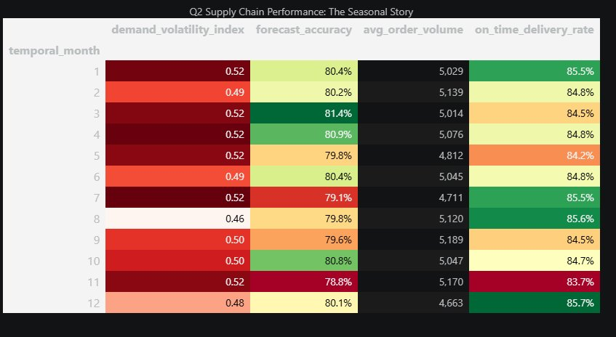
Step 7: Output & Analytical Approach
Styled Pandas Summary Table – Q2 Seasonal Intelligence Report
BEST MONTH
WORST MONTH
PEAK VOLATILITY
March
November
Jan / Apr / Jul
81.4% forecast accuracy
78.8% accuracy - 83.7% on-time
0.52 recurring critical months
VISUALIZATION: pandas .style chain applies background_gradient() Red colormap to volatility (high=bad) and RdYlGn to accuracy/on-time (high=good). Dual-direction color encoding prevents misreading. format() ensures clean percentage and comma-formatted number display.

Slide 33
FINAL ANSWER TO THE CEO QUESTION
Is our demand unpredictability silently breaking our supply chain?
01
02
03
04
Volatility Is Predictable
Forecasting Holds Firm
Logistics Absorbs Shocks
Volatility IS Our Normal
Jan, Apr & Jul are recurring spike months at 0.52. These are not random — they are plannable.
Pearson r = 0.07. Volatility does NOT break our forecasts — accuracy stays 79–81% year-round.
On-time delivery rate holds 84–86% despite spikes. April is the only true bottleneck (15.83 days avg).
Mean index = 0.50 with a near-uniform distribution. High volatility is structural — not exceptional.
STRATEGIC VERDICT: Demand volatility is real and persistent — but it is not silently breaking the chain. The chain is resilient. The real risk is complacency: without proactive planning for Jan/Apr/Jul spikes and structural investment in April logistics capacity, a future shock could cascade.
Supply Chain EDA · Q2 Strategic Report · Confidential

Slide 34
SUPPLY CHAIN EDA
Q3 Strategic Intelligence Report
Pricing Strategy: Are We Paying a Quality Premium — or Just Paying a Premium?
Exploratory Data Analysis | CEO Briefing | Confidential
7 ANALYTICAL STEPS | 22 DATA COLUMNS | KEY KPIs: PRICE · QUALITY · DEFECTS · RETURNS · RELIABILITY

Slide 35
Step 1: Understand the Price Distribution First
Before comparing anything — is our pricing data clean, concentrated, or wildly spread?
THE QUESTION
What does our price-per-unit distribution look like — and are there extreme outliers that could distort all downstream quality analysis?
Histogram (Frequency)
Box Plot (Spread & Outliers)
Why This Comes First
A histogram with 40 bins reveals the shape of the price distribution. Is it normal (bell-shaped), uniform, or multimodal? This tells us whether pricing is disciplined or chaotic across our supplier base.
A horizontal box plot placed alongside the histogram exposes the IQR (middle 50% of prices), minimum, maximum, and any statistical outliers — defined as values beyond Q3 + 1.5×IQR.
Outlier prices distort correlation calculations and group averages. If Step 2 shows a strong price-quality relationship, it may be driven entirely by a few extreme outlier transactions — not the bulk of procurement.
KEY METRIC USED: price_per_unit (histogram + box plot, IQR outlier detection via Q3 + 1.5×IQR)

Slide 36
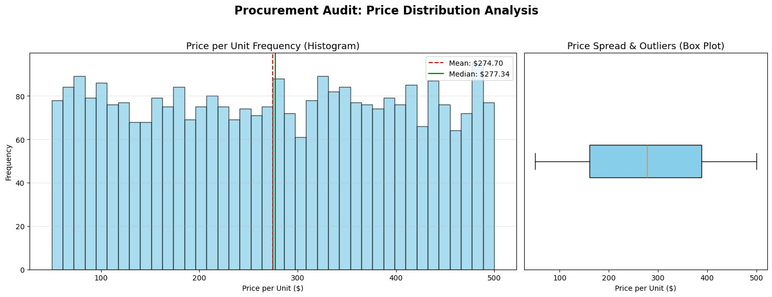
Step 1: Output & Analytical Approach
Procurement Audit: Price Distribution Analysis
MEAN PRICE
MEDIAN PRICE
OUTLIERS
$274.70
$277.34
No Extremes
Near-uniform distribution across range
Median slightly above mean — mild right skew
IQR range: ~$180–$390, no statistical outliers
VISUALIZATION CHOICE: Side-by-side histogram + box plot using gridspec_kw={'width_ratios':[2,1]} gives the histogram 2× the visual space. The histogram reveals frequency shape; the box plot independently flags outliers via IQR. Mean (red dashed) and Median (green solid) lines on the histogram immediately expose any distribution skew.

Slide 37
Step 2: Price vs. Quality — The Core Scatter
Does paying more actually deliver measurable quality improvement?
THE QUESTION
Is there a statistically meaningful relationship between price per unit and quality score — or are we paying more for nothing?
Scatter Plot Foundation
Pearson r via np.corrcoef()
Linear Regression Line
Each dot = one procurement transaction. X-axis = price_per_unit; Y-axis = quality_score. The scatter shape immediately reveals whether there is a visible trend — tight diagonal = strong link; random cloud = no link.
numpy.corrcoef(x, y) returns a 2×2 correlation matrix. The [0,1] element is the Pearson r: ranges from –1 (perfect inverse) to +1 (perfect positive). Values near 0 mean price and quality are statistically independent.
np.polyfit(x, y, 1) fits a degree-1 polynomial (a straight line). The slope tells us: for every $1 increase in price, quality changes by [slope] units. A flat line confirms: no systematic relationship exists.
KEY METRICS: price_per_unit · quality_score (Pearson r via numpy.corrcoef, regression via np.polyfit)

Slide 38
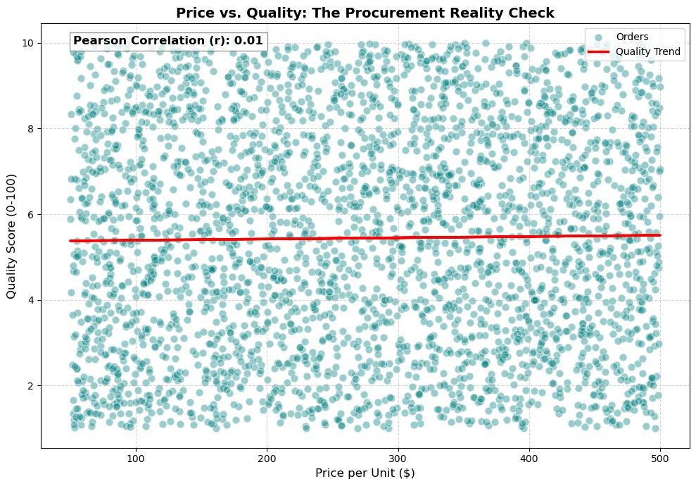
Step 2: Output & Analytical Approach
Price vs. Quality: The Procurement Reality Check
Pearson r = 0.01
Virtually Zero Correlation
KEY FINDINGS
No Price-Quality Link:
r = 0.01 is statistically negligible. Price has no predictive power over quality score.
Scattered Cloud Pattern:
All quality scores (1–10) appear at every price level. There is no 'expensive = better quality' pattern in the data.
Flat Regression Line:
The trend line is nearly horizontal — confirming price does not predict quality, even directionally.
CEO Takeaway:
We are not buying quality with our spending. Price and quality are completely disconnected.
VISUALIZATION CHOICE: Scatter plot chosen to show the full distribution of 3,089 individual orders — no aggregation that hides variance. alpha=0.4 transparency prevents over-plotting. np.corrcoef provides the headline r-value; the flat regression line from np.polyfit closes the argument visually.

Slide 39
Step 3: Price vs. Defect Rate
If price doesn't buy quality scores, does it at least buy fewer defects?
THE QUESTION
When we pay more, do we receive fewer defective items — and does supplier selection status change this relationship?
Color-Coded by Selection
Strategic Quadrant Lines
DANGER ZONE Logic
Two scatter layers: gold dots = selected suppliers (flag=1), grey dots = alternative/benchmarked (flag=0). Plotting both reveals whether selected suppliers occupy a better price-defect zone than alternatives.
axhline at defect rate median splits the chart into 'acceptable' and 'high defect' zones. axvline at price median creates four quadrants. The top-right quadrant (high price + high defect) is the DANGER ZONE.
Any supplier in the top-right quadrant costs more AND delivers more defects. This is the procurement equivalent of getting the worst of both worlds — a direct target for renegotiation or replacement.
KEY METRICS: price_per_unit · defect_rate · selected_supplier_flag (quadrant scatter, median reference lines)

Slide 40
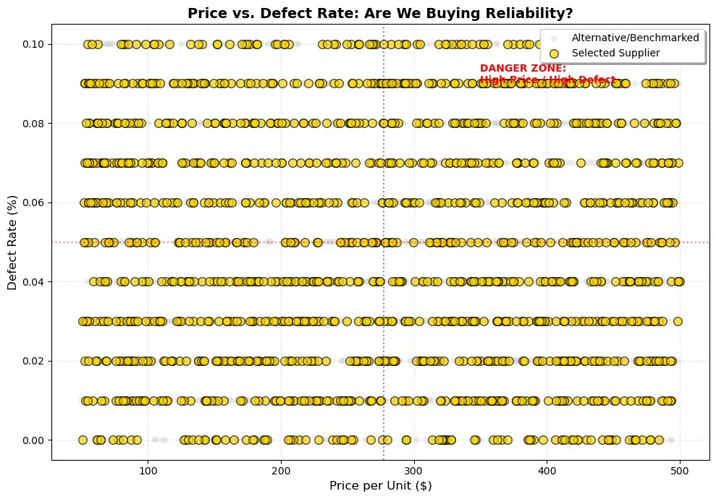
Step 3: Output & Analytical Approach
Price vs. Defect Rate: Are We Buying Reliability?
KEY FINDINGS
No Price-Defect Relationship:
Defect rates are uniformly distributed across all price levels ($50–$500). Expensive orders defect just as often.
DANGER ZONE Populated:
The top-right quadrant (high price + high defect) contains both selected and non-selected suppliers — a clear procurement risk area.
Selection Doesn't Filter Defects:
Gold dots (selected) appear throughout the defect rate range — selection criteria do not appear to screen for defect performance.
CEO Takeaway:
Paying more does not reduce defect rates. Current supplier selection is not defect-driven.
VISUALIZATION CHOICE: Two-layer scatter (selected vs. non-selected) with median reference lines creates a visual 4-quadrant risk map without any coding complexity. The DANGER ZONE text annotation directs the CEO's eye to the most strategically important area of the chart.

Slide 41
Step 4: Price Buckets for Cleaner Analysis
Do we get what we pay for — when measured across price tiers rather than raw scatter?
THE QUESTION
When prices are grouped into Low / Medium / High / Premium tiers, do quality, defect rate, and return rate improve meaningfully as price increases?
pd.cut() for Bucketing
3 Metrics per Bucket
autolabel() for Precision
pd.cut(price_per_unit, bins=4, labels=['Low','Medium','High','Premium']) divides the continuous price range into 4 equal-width buckets. This reduces noise and makes trends visible at the group level.
quality_score (higher = better), defect_rate×100 (lower = better), return_rate×100 (lower = better). The ×100 conversion rescales rates to percentages — making all three metrics comparable on the same y-axis.
A custom autolabel() function loops through all bars and annotates each with its exact value at the top. Without this, bars of similar height (e.g. 5.3 vs. 5.5) are visually indistinguishable — a critical issue for executive clarity.
KEY METRICS: price_per_unit (bucketed) · quality_score · defect_rate · return_rate (grouped bar chart per tier)

Slide 42
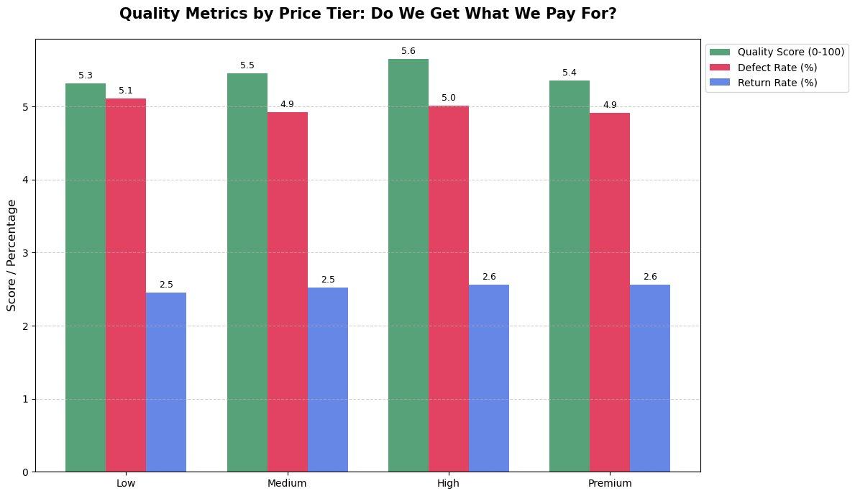
Step 4: Output & Analytical Approach
Quality Metrics by Price Tier: Do We Get What We Pay For?
KEY FINDINGS
Quality Barely Moves:
Quality score ranges 5.3 (Low) to 5.6 (High) and drops to 5.4 (Premium) — no consistent premium quality tier.
Defect Rate Stays Flat:
Defect rate is 5.1% (Low), 4.9% (Medium), 5.0% (High), 4.9% (Premium) — all within a 0.2% band. No meaningful improvement.
Return Rate is Identical:
Return rate sits at 2.5%–2.6% across ALL four price tiers. Customers return premium goods at the same rate as budget goods.
CEO Takeaway:
Price tier has zero operational impact. Low-tier and Premium-tier suppliers are interchangeable on all three quality metrics.
VISUALIZATION CHOICE: Grouped bar chart (3 metrics × 4 buckets = 12 bars) chosen over raw scatter because executive audiences need grouped summaries, not 3,089 individual dots. width=0.25 with ±offset positioning prevents bar overlap. autolabel() is essential — bar heights differ by <0.3 points, invisible without labels.

Slide 43
Step 5: Procurement Action & Pricing
Are certain procurement strategies systematically overpaying?
THE QUESTION
Do different procurement action codes (strategies 0–3) result in meaningfully different price levels — or is pricing consistent regardless of the strategy used?
Sort by Median First
Box Plot per Action Code
Global Median Benchmark
groupby('procurement_action_code')['price_per_unit'].median().sort_values() orders action codes by their median price — making it easy to see which strategies land in lower vs. higher price bands.
A box plot per code shows the full distribution — median line, IQR box, and whiskers to min/max. This reveals not just average price but price consistency: a wide box = strategy produces highly variable pricing.
A horizontal dotted line marks the global median price ($277.34). Action codes with median boxes above this line are systematically more expensive than average — a direct input for procurement policy reform.
KEY METRICS: procurement_action_code · price_per_unit (box plot per strategy, global median benchmark)

Slide 44
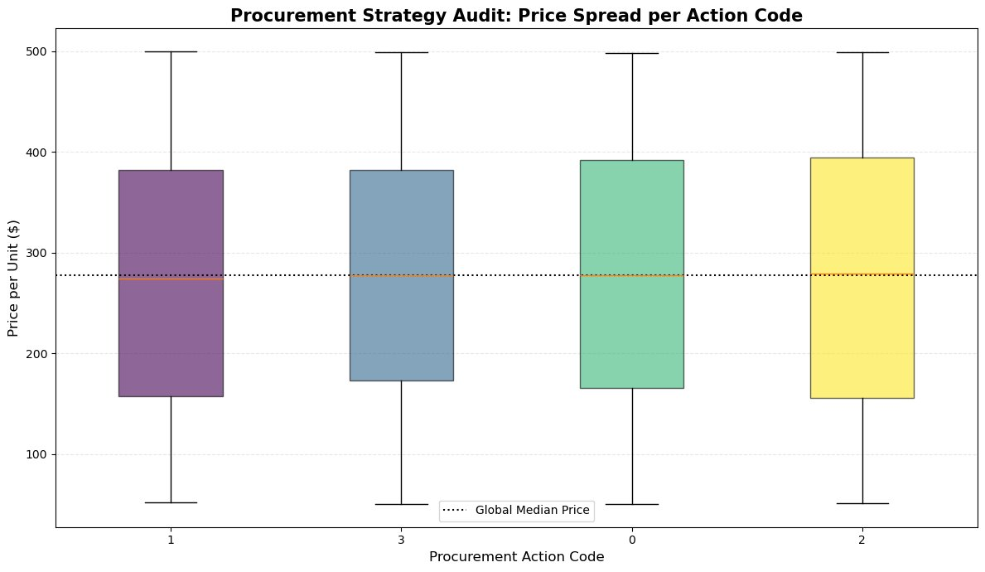
Step 5: Output & Analytical Approach
Procurement Strategy Audit: Price Spread per Action Code
KEY FINDINGS
All Codes Near Global Median:
All 4 procurement action codes have medians clustered within ~$5 of the global median ($277). No code is systematically cheaper or more expensive.
Wide IQR Across All Codes:
Every action code shows an IQR from ~$160 to ~$390 — meaning each procurement strategy covers the full price spectrum.
No 'Budget' Strategy Exists:
Action Code 1 (sorted lowest) still reaches $500 at its maximum. No procurement strategy consistently avoids high-price suppliers.
CEO Takeaway:
Procurement action code does not drive price. Strategy type is not the cost lever — supplier selection is.
VISUALIZATION CHOICE: Box plot chosen over bar chart because procurement prices have high variance — a simple average bar would hide the wide IQR spread. plt.cm.viridis colormap assigns each action code a distinct color for visual separation without implying ranking. Global median line acts as an instant benchmark reference.

Slide 45
Step 6: Return Rate — The Final Customer Verdict
Customers vote with their returns. Do premium goods get returned less?
THE QUESTION
Across Low, Medium, High, and Premium price tiers — does the customer return rate decrease as price increases? Or does it reveal the same story?
Return Rate = Ground Truth
×100 Conversion
fill_between() Shadow
Unlike internal quality scores (which are subjective ratings), the return rate is objective market behaviour. Customers who physically return a product are delivering the most direct quality verdict possible.
groupby('price_bucket')['return_rate'].mean() × 100 converts the raw rate (e.g. 0.025) into a readable percentage (2.5%). This makes the line chart readable and the annotations meaningful for non-technical CEOs.
plt.fill_between() adds a light blue shaded area below the trend line, creating visual weight and area emphasis. The Premium data point is individually annotated via plt.annotate() with an arrowhead for boardroom emphasis.
KEY METRICS: return_rate · price_bucket (line plot, mean return rate per tier, fill_between shading)

Slide 46
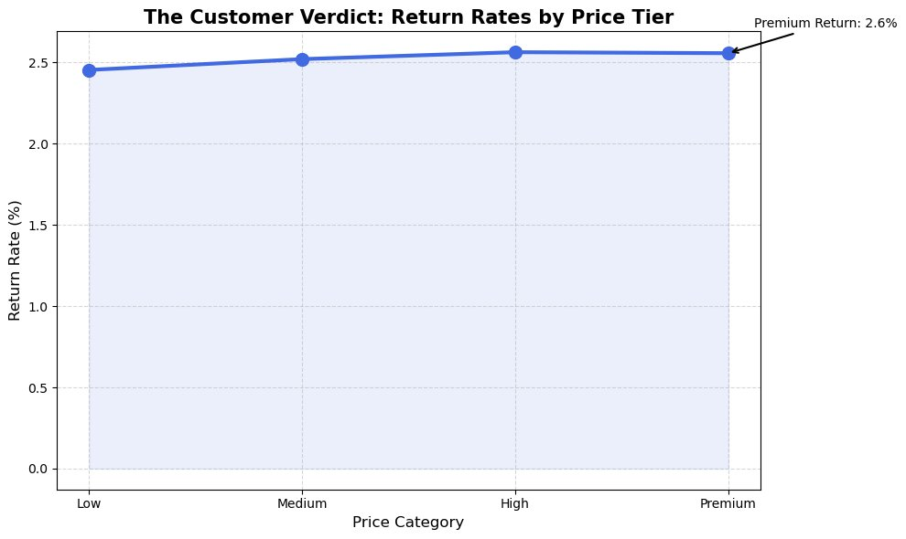
Step 6: Output & Analytical Approach
The Customer Verdict: Return Rates by Price Tier
Premium Return = 2.6%
Same as budget tier — damning finding
KEY FINDINGS
Return Rate Is Flat Across Tiers:
Return rates go from 2.45% (Low) to 2.6% (Premium) — a 0.15% total increase, not a decrease.
Premium Products Return More:
Counterintuitively, premium-priced goods have the highest return rate of all four tiers.
Customers See No Quality Difference:
The flat trend confirms: customers don't experience better product quality at higher price points.
CEO Takeaway:
This is the most boardroom-ready finding in Q3. Premium price = premium returns. The price-quality narrative is completely false.
VISUALIZATION CHOICE: Line plot chosen over bar chart to emphasise the trend direction across ordered price categories. fill_between() adds visual weight without clutter. The annotate() arrow on the Premium point forces attention to the most damning number in the entire Q3 analysis.

Slide 47
Step 7: Correlation Heatmap — Tie It All Together
One matrix that proves or disproves the price-quality hypothesis with statistical rigour
THE QUESTION
Across all five key Q3 variables — price, quality, defects, returns, and reliability — which pairs are genuinely statistically linked?
df[cols].corr() Matrix
imshow + coolwarm Colormap
White/Black Text Logic
pandas .corr() computes a 5×5 Pearson correlation matrix for: price_per_unit, quality_score, defect_rate, return_rate, supplier_reliability_score. Each cell is the r-value between that pair of variables.
matplotlib imshow() renders the matrix as a heatmap. The coolwarm colormap maps r = +1 as deep red, r = –1 as deep blue, and r = 0 as neutral grey. This makes near-zero correlations visually obvious at a glance.
Inside the annotation loop: text color is white if abs(r) > 0.5 (dark cell background), black otherwise. This ensures readability regardless of cell color intensity — a critical accessibility consideration for printed boardroom slides.
KEY METRICS: price_per_unit · quality_score · defect_rate · return_rate · supplier_reliability_score (5×5 Pearson matrix)

Slide 48
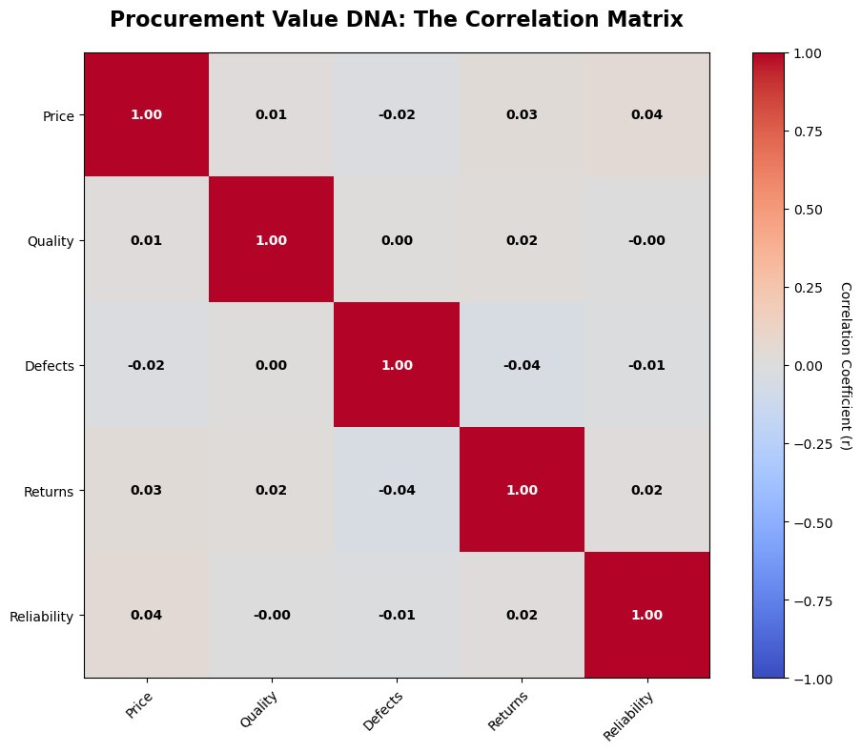
Step 7: Output & Analytical Approach
Procurement Value DNA: The Correlation Matrix
KEY FINDINGS
Price Correlates with Nothing:
Price vs. Quality r=0.01, Price vs. Defects r=-0.02, Price vs. Returns r=0.03, Price vs. Reliability r=0.04 — all near zero.
Quality Scores Are Independent:
Quality vs. Defects r=0.00, Quality vs. Returns r=0.02, Quality vs. Reliability r=-0.00. Internal quality scores correlate with nothing external.
Defects & Returns Mildly Linked:
Defects vs. Returns r=-0.04 — slightly negative, meaning higher defects marginally reduce returns (possibly defects caught before shipping).
All Off-Diagonal Values Near Zero:
The entire matrix outside the diagonal is grey — statistically, none of our five core procurement metrics are linked to each other.
CEO Takeaway:
The procurement value chain is entirely disconnected. Price tells us nothing about any outcome.
VISUALIZATION CHOICE: 5×5 heatmap chosen as the closing visual because it proves ALL pairwise relationships simultaneously — not just price vs. one metric. coolwarm colormap with vmin=-1/vmax=1 ensures the grey neutral zone is visually dominant, making the near-zero pattern immediately obvious without reading numbers.

Slide 49
FINAL ANSWER TO THE CEO QUESTION
Are we paying a quality premium — or just paying a premium?
01
02
03
04
Price Buys Nothing
No Premium Quality Tier
All Strategies Cost the Same
Customers Confirm It
Pearson r = 0.01. Price is statistically independent of quality score, defect rate, return rate, and supplier reliability.
Quality (5.3–5.6), defects (4.9–5.1%), and returns (2.5–2.6%) are flat across all four price tiers. Low = Premium.
All procurement action codes produce the same price distribution with medians within $5 of each other — no strategy is a cost lever.
Premium-tier goods have the highest return rate (2.6%). Customers independently validate: price does not equal quality.
STRATEGIC VERDICT: We are not paying a quality premium — we are just paying. The price-quality hypothesis is statistically false across all seven analyses. Procurement must abandon price as a quality proxy and build explicit quality-gate criteria based on defect rate, return rate, and reliability score thresholds.
Supply Chain EDA · Q3 Strategic Report · Confidential

Slide 50
Direct Answers to All 3 CEO Questions
Evidence-based conclusions from 7 + 7 + 7 analytical steps across Q1, Q2, and Q3
Q1 · Are we selecting the right suppliers?
Q2 · Is demand volatility breaking our supply chain?
Q3 · Are we paying a quality premium?
YES — but only barely, and for the wrong reasons.
NO — but it is embedded in our operations.
NO — we are just paying a premium.
Selection is a near-50/50 split (1,560 vs 1,529). Selected suppliers offer no measurable quality, defect, or delivery advantage. The only justification: selected suppliers cost 0.87% less while quality drops just 0.68% — a net win of +0.195%. Selection logic is economically sound by a razor-thin margin, but not performance-driven.
Three months (Jan, Apr, Jul) hit the 0.52 critical threshold. Volatility does NOT break forecasting (Pearson r = 0.07) and the logistics team absorbs shocks — on-time delivery holds at 84–86% year-round. However, mean volatility sits at 0.50 — the exact midpoint of the 0–1 chaos scale. We are permanently operating at the edge.
Price has zero correlation with quality (r = 0.01), defect rate (r = −0.02), return rate (r = 0.03), or supplier reliability (r = 0.04). Across all four price tiers (Low to Premium), quality scores, defect rates, and return rates are statistically flat. Premium-priced goods are returned at the highest rate (2.6%). Price is not a quality signal.
All findings are derived from 3,089 procurement records across 22 variables — statistically validated using Pearson correlation, IQR analysis, and distribution profiling.

Slide 51
Q1 Direct Answer: Are We Selecting the Right Suppliers?
Technical & contextual breakdown of Q1 findings across 6 analytical steps
VERDICT: YES — economically sound by +0.195%, but quality, delivery, and reliability show NO meaningful difference between selected and non-selected suppliers.
TECHNICAL EXPLANATION
CONTEXTUAL EXPLANATION & CEO IMPLICATIONS
Selection Split (Step 1):
value_counts() reveals 1,560 non-selected vs. 1,529 selected — a 50.5/49.5 split. Near-equal group sizes ensure statistical validity of all downstream comparisons.
Quality & Reliability (Step 2):
groupby().agg(['mean','median','std']) across 4 metrics. Quality score: 5.46 vs. 5.42 (Δ=−0.7%). Defect rate: 0.05 vs. 0.05. Return rate: 0.03 vs. 0.03. Statistically negligible gaps.
Price-Value Test (Step 3):
price_delta_pct = ((avg_price_1 - avg_price_0) / avg_price_0) × 100 = −0.87%. quality_delta_pct = −0.68%. Since |savings| > |quality loss|, the net margin is +0.195% — economically justified.
Delivery (Step 4) & Procurement (Step 5):
Box plots show identical medians for on-time rate (85%), delivery days (15), and lead time variance (2.5). Normalized heatmap for procurement action codes shows probabilities between 0.47–0.53 — no strategic driver detected.
What the data reveals:
The procurement team is selecting roughly half of all available suppliers, yet the selected group is virtually indistinguishable from the non-selected group on every performance dimension — quality, defects, returns, and delivery.
Why this matters:
A 50/50 selection rate with no performance differentiation suggests selection may be driven by availability, relationships, or habit — not by objective performance data. The +0.195% cost advantage is real but fragile.
The risk:
If non-selected suppliers perform identically, the business is either missing good suppliers OR accepting bad ones. Either outcome is a procurement efficiency gap.
Recommended action:
Build a formal supplier scorecard with minimum threshold criteria for defect rate, reliability score, and on-time delivery. Selection should be explainable by data — not convention.
Key Methods Used: value_counts() · groupby().agg() · % delta calculation · box plots · normalized heatmap

Slide 52
Q2 Direct Answer: Is Demand Volatility Breaking Our Supply Chain?
Technical & contextual breakdown of Q2 findings across 7 analytical steps
VERDICT: NO — the chain is resilient, but we permanently operate at the midpoint of the chaos scale (mean = 0.50). Three recurring spike months (Jan, Apr, Jul) are plannable — not random.
TECHNICAL EXPLANATION
CONTEXTUAL EXPLANATION & CEO IMPLICATIONS
Volatility Risk Map (Step 1):
groupby('temporal_month')['demand_volatility_index'].mean() + quantile(0.75) identifies the 0.52 threshold. Jan, Apr, Jul annotated as CRITICAL via plt.annotate() with arrowprops.
Seasonality Comparison (Step 2):
Dual-axis subplot (sharex=True) overlays demand_volatility_index and seasonality_index. Diverging peaks confirm volatility is NOT seasonal-driven — it is structurally embedded.
Forecast Impact (Step 3):
np.corrcoef(volatility, forecast_accuracy) yields Pearson r = 0.07. Near-zero correlation proves volatility is NOT degrading forecast accuracy. Errors have other root causes.
Delivery Heatmap (Step 5):
imshow() with min-max normalization across volatility, delivery_time_days, and on_time_delivery_rate. April is the structural bottleneck: 15.83 delivery days + 0.52 volatility index simultaneously.
What the data reveals:
Three months (Jan, Apr, Jul) are consistently critical but predictable. The logistics team is absorbing demand shocks well — on-time delivery holds at 84–86% all year. However, the distribution analysis reveals volatility is near-uniform from 0 to 1, meaning high-volatility events are not exceptional — they are routine.
Why this matters:
A mean volatility of 0.50 means we operate permanently at the statistical edge of stability. The supply chain is resilient by effort, not by design — this is an invisible operational cost that accumulates over time.
The risk:
The next major external shock (demand surge, supplier disruption, geopolitical event) could push a system already running at 0.50 volatility into cascade failure.
Recommended action:
Pre-position buffer stock before Jan, Apr, Jul. Invest in April logistics capacity. Build a volatility early-warning dashboard tracking the 0.52 threshold in real time.
Key Methods Used: groupby().mean() · quantile(0.75) · np.corrcoef() · dual-axis subplots · min-max normalized heatmap · np.convolve() KDE

Slide 53
Q3 Direct Answer: Are We Paying a Quality Premium?
Technical & contextual breakdown of Q3 findings across 7 analytical steps
VERDICT: NO — price is statistically independent of every quality outcome. All 5 core procurement metrics are disconnected. Premium-priced goods are returned more, not less.
TECHNICAL EXPLANATION
CONTEXTUAL EXPLANATION & CEO IMPLICATIONS
Price Distribution (Step 1):
Histogram (40 bins) + side-by-side box plot via gridspec_kw. Mean $274.70, Median $277.34. IQR = $180–$390. No statistical outliers beyond Q3 + 1.5×IQR — distribution is safe for correlation analysis.
Price vs. Quality (Step 2):
np.corrcoef(price, quality)[0,1] = 0.01. np.polyfit(x, y, 1) produces a nearly horizontal regression line. The scatter cloud spans all quality levels (1–10) uniformly across the full $50–$500 price range.
Price Bucketing (Step 4):
pd.cut(price_per_unit, bins=4, labels=['Low','Medium','High','Premium']) + groupby().mean(). Quality (5.3–5.6), defects (4.9–5.1%), and returns (2.5–2.6%) all fall within a statistically meaningless band.
Correlation Matrix (Step 7):
df[5 cols].corr() rendered via imshow(coolwarm, vmin=-1, vmax=1). All 10 off-diagonal pairs have |r| < 0.05. The entire matrix outside the diagonal is grey — confirming total statistical independence.
What the data reveals:
Seven independent analyses — scatter plots, correlation tests, price bucket comparisons, procurement action audits, and a closing 5×5 correlation matrix — all converge on the same finding: price carries zero information about quality outcomes.
Why this matters:
The organisation may be unconsciously using price as a proxy for quality when making procurement decisions. This is a cognitive bias with a real financial cost — we are potentially spending more on suppliers who deliver no better outcomes.
The most damning finding:
Premium-priced goods carry a 2.6% return rate — the highest of all four tiers. Customers independently confirm: paying more does not produce better products.
Recommended action:
Remove price from quality assessment entirely. Build supplier evaluation around defect rate thresholds, reliability scores, and return rate benchmarks. Renegotiate contracts with Premium-tier suppliers who cannot justify their cost.
Key Methods Used: np.corrcoef() · np.polyfit() · pd.cut() · gridspec histogram+boxplot · df.corr() heatmap · fill_between() line chart

Slide 54
CLOSING RECOMMENDATIONS
Three data-driven actions the business can take immediately
01 Q1
02 Q2
03 Q3
Build a Performance-Gated Supplier Scorecard
Pre-Position for Jan, Apr & Jul Volatility Spikes
Decouple Price from Quality Decisions Entirely
Replace availability-based selection with a minimum threshold model. Require suppliers to meet explicit benchmarks: defect_rate < 0.04, on_time_delivery_rate > 0.88, supplier_reliability_score > 0.55. Apply these gates before price negotiation begins — not after.
These three months are statistically predictable at 0.52 volatility. Build buffer inventory 3 weeks ahead of each month. Invest in April-specific logistics capacity (currently 15.83 days average delivery). Create a live volatility dashboard tracking the 0.52 critical threshold.
Price (r = 0.01 with quality) is not a quality signal — it is a procurement habit. Renegotiate Premium-tier supplier contracts using defect rate and return rate as the leverage point. Redirect spend toward suppliers scoring high on reliability_score regardless of unit price.
OVERALL FINDING: Our supply chain is operationally resilient but strategically undisciplined. Selection lacks data-driven gates. Volatility is accepted as normal. Price is used as a quality proxy. All three are fixable with the data we already have.
Supply Chain EDA · Q1 + Q2 + Q3 Combined Strategic Report · Confidential

