Slide 1

Zelda
Your New Travel Companion

Slide 2
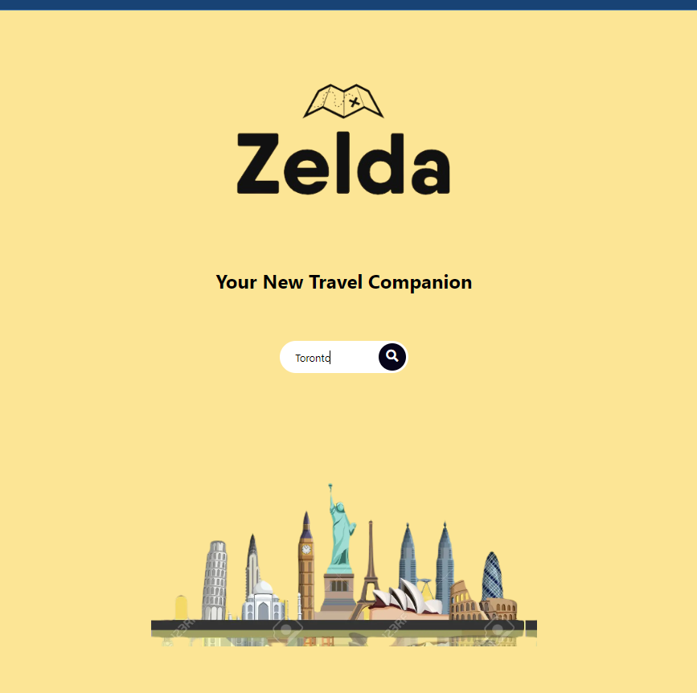
Why Zelda?
Our App helps tourists or even locals who need to find popular events and hotels in a given city.

Slide 3
Our Concept
Description:
Zelda has a User-friendly interface and is very easy to you. There are 2 pages the home page (with a search bar) and the search results page that shows destinations and provides general info about them.

Slide 4
Our Concept
Motivation:
We realized that tourists or even locals struggle to find hotels or thing to do in their host city, so we created Zelda.
The name was inspired by the Game “The Legend of Zelda”. We thought that using a name synonymous with adventure and exploration is a good branding practice.

Slide 5
Our Concept
User Story: (Home Page)
When a user open the homepage, then they see the Logo and a search bar with instructions explaining the functionality of the site
When a user hovers over the search icon the search bar appear, and the user can enter a city name

Slide 6
Our Concept
User Story: (Search Results Page)
When a user types the city name in the are presented with an Map Api with markers of Hotels and upcoming Events.
When the user hovers over the marker a pop up opens showing basic info about the hotel/ event and the user can see the rating availability and date of the event.
When the user hovers over an event marker they can click on a link to buy tickets
When the user click on the link to buy ticket, they are directed to the event organizers website to learn more about that event or buy tickets.

Slide 7
Process
Technologies Used:
GitHub:
VS Code:
APIs:
Tailwind CSS:
JavaScript:
HTML:

Slide 8
Process
Breakdown of tasks and roles:
Fraser: Group Leader? Backend Developer? Api Manager? Research Manager?
Qais: Branding and Styling
Trevor: [please explain your task]
Sebastian: [please explain your task]

Slide 9
Process
Breakdown of tasks and roles:
Fraser: Group Leader? Backend Developer? Api Manager? Research Manager?
Qais: Branding and Styling
Trevor: [please explain your task]
Sebastian: [please explain your task]

Slide 10
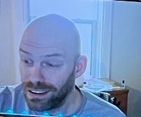
Fraser
About Me:
What I contributed:
Challenges Faced:
What I found Special in other teammembers:

Slide 11
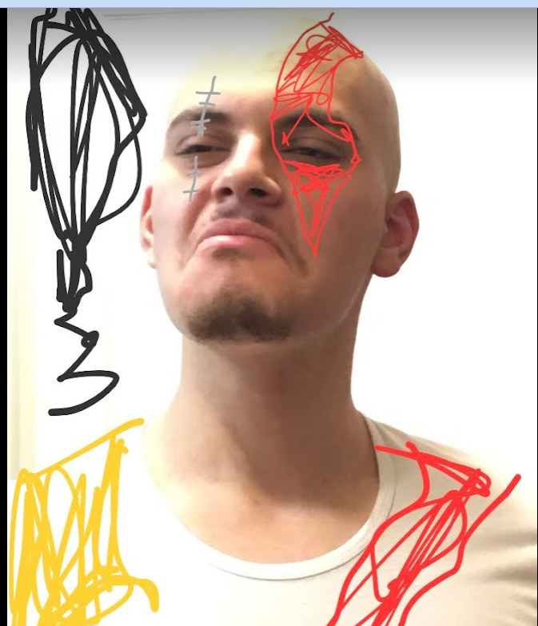
Qais
About Me:
2nd Year Mech Engineering Dropout. Marketing Agency Owner. Experienced in Building Landing Pages and Styling.
Main Strength: CSS, Styling, Research, UX design, creating merge errors.
Weakness: Using Bash, Pushing or pulling code
Challenges Faced: I was a bit behind so I did not know a lot about APIs and GitHub. My teammates helped me use my over come by short comings and utilize my skillsets in the project.
What I found Special in other team members:
Everybody provided something unique. Fraser was very active and charismatic and guided the whole project. Sebastian and Trevor, also contributed a lot to configuring the page, APIs and everyone was patient with me even when I asked repetitive questions and helped me grow.

Slide 12
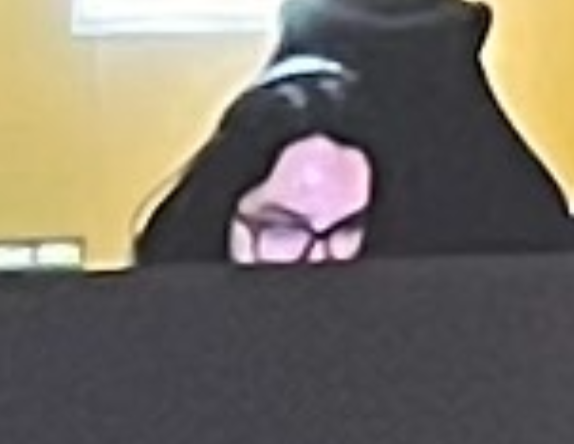
Sebastian
About Me:
2nd Year Mech Engineering Dropout. Marketing Agency Owner. Experienced in Building Landing Pages and Styling.
Main Strength: CSS, Styling, Research, UX design, creating merge errors.
Weakness: Using Bash, Pushing or pulling code
Challenges Faced: I was a bit behind so I did not know a lot about APIs and GitHub. My teammates helped me use my over come by short comings and utilize my skillsets in the project.
What I found Special in other team members:
Everybody provided something unique. Fraser was very active and charismatic and guided the whole project. Sebastian and Trevor, also contributed a lot to configuring the page, APIs and everyone was patient with me even when I asked repetitive questions and helped me grow.

Slide 13
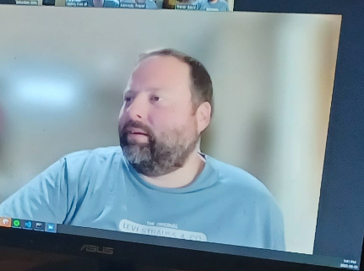
Trevor
About Me:
2nd Year Mech Engineering Dropout. Marketing Agency Owner. Experienced in Building Landing Pages and Styling.
Main Strength: CSS, Styling, Research, UX design, creating merge errors.
Weakness: Using Bash, Pushing or pulling code
Challenges Faced: I was a bit behind so I did not know a lot about APIs and GitHub. My teammates helped me use my over come by short comings and utilize my skillsets in the project.
What I found Special in other team members:
Everybody provided something unique. Fraser was very active and charismatic and guided the whole project. Sebastian and Trevor, also contributed a lot to configuring the page, APIs and everyone was patient with me even when I asked repetitive questions and helped me grow.

Slide 14
Process
Challenges: [Fraser you know better than me about this man ☺]

Slide 15
Process
Successes: [we completed the project without ending up in mental asylum]

Slide 16
Demonstration

Slide 17

Direction for Future Development
Given the time constrains, the function we integrated into the website were fairly limited.
Home Page would have filters (type of places, radius, city suggestions)
Map (more aesthetic with more functions, a filter, a way to give directions to a place, a booking page/ online payments)

Slide 18
Resources & Links
Deployed
GitHub repo
https://ydennekrf.github.io/Node-Aero/
https://github.com/Ydennekrf/Node-Aero

