Slide 1
Web Development
With Qamar Abbas
Karachi Institute of Technology

Slide 2
Basic Concepts
Internet V/S Web
The Internet is a network of connected computers. No company owns the Internet; it is a cooperative effort governed by a system of standards and rules. The purpose of connecting computers together, of course, is to share information. There are many ways information can be passed between computers, including email, file transfer (FTP), and many more specialized modes upon which the Internet is built. These standardized methods for transferring data or documents over a network are known as protocols.
Karachi Institute of Technology

Slide 3
CONTINUE..
Internet V/S Web
The Web (originally called the World Wide Web, thus the “www” in site addresses) is just one of the ways information can be shared over the Internet. It is unique in that it allows documents to be linked to one another using hypertext links—thus forming a huge “web” of connected information. The Web uses a protocol called HTTP (HyperText Transfer Protocol).
The Web is a subset of the Internet. It is just one of many ways information can be transferred over networked computers.
Karachi Institute of Technology

Slide 4
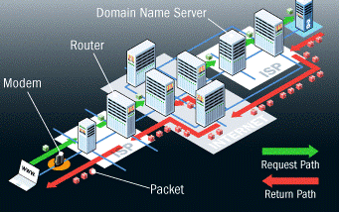
CONTINUE..
How does the Internet works?
Server and Client
Web Server
Karachi Institute of Technology

Slide 5
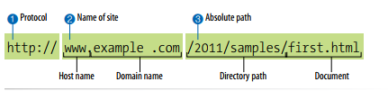
CONTINUE..
URL
A complete URL is generally made up of three components: the protocol, the site name, and the absolute path to the document or resource
Sometimes you’ll see a URL that begins with https://. This is an indication that it is a secure server transaction. Secure servers have special encryption devices that hide delicate content, such as credit card numbers, while they are transferred to and from the browser.
Karachi Institute of Technology

