Slide 1
Egypt Real Estate AI
AI-Powered Property Valuation for the Egyptian Market
119,916 Listings | R2 = 0.7061 | 6 Governorates

Slide 2
Agenda
1. The Problem
2. Our Solution
3. Dataset & Model
4. Tech Stack
5. Features Overview
6. Live Demo Screenshots
7. Results & Performance
8. Competitive Analysis
9. Future Roadmap

Slide 3
The Problem
Difficulty in Valuing Properties
Buyers and sellers struggle to determine fair prices in Egypt.
No Standardized Valuation
Egypt lacks a reliable AI-powered valuation tool like Zestimate.
Market Opacity
Prices vary wildly across districts with no clear benchmark.
Language Barrier
Most tools are English-only, ignoring 100M+ Arabic speakers.

Slide 4
Our Solution
- AI-powered price estimation using CatBoost
- Trained on 119,916 real Egyptian listings
- Full Arabic (RTL) + English support
- Instant results with confidence intervals
- Comprehensive market analysis & ROI
- Dark mode + mobile-friendly design
- Free PDF reports & shareable links
- Property comparison & favorites

Slide 5
Key Metrics
0.7061
40.52%
119,916
R2 Score
MAPE
Listings
6
573
881
Governorates
Districts
Compounds

Slide 6
Dataset
119,916 Listings from 7 Data Sources
Governorate
Listings
%
Cairo
65,674
54.8%
Giza
30,374
25.3%
Matrouh
10,545
8.8%
Red Sea
6,253
5.2%
Alexandria
4,122
3.4%
Suez
2,948
2.5%

Slide 7
Machine Learning Model
CatBoost Regressor
Gradient Boosting on Decision Trees
Algorithm:
CatBoost Regressor
Training Set:
95,932 listings (80%)
Test Set:
23,984 listings (20%)
Features:
32 engineered features
R2 Score:
0.7061
MAPE:
40.52%

Slide 8
Tech Stack
Frontend
Streamlit
ML Model
CatBoost
Data Processing
Pandas, NumPy
Charts
Plotly
Maps
Folium
PDF Generation
ReportLab
Styling
Custom CSS
Deployment
Streamlit Cloud

Slide 9
Key Features (1/2)
AI Price Estimator
5-level location + 32 features
Property Gallery
5 sample images per property type
Price History & Forecast
2020-2027 with interactive chart
Property Location
Interactive Leaflet map
Investment Analysis (ROI)
6 metrics including yield & payback
Neighborhood Insights
Schools, hospitals, transport

Slide 10
Key Features (2/2)
Market Analysis
7 interactive charts + filters
Advanced Mortgage Calculator
Pie & balance charts, amortization
Compare Properties
Side-by-side 2-4 properties
Favorites + Export/Import
Save searches & property alerts
Chat with Agent
Built-in UI for agent contact
Dark Mode + Arabic RTL
Full bilingual support

Slide 11
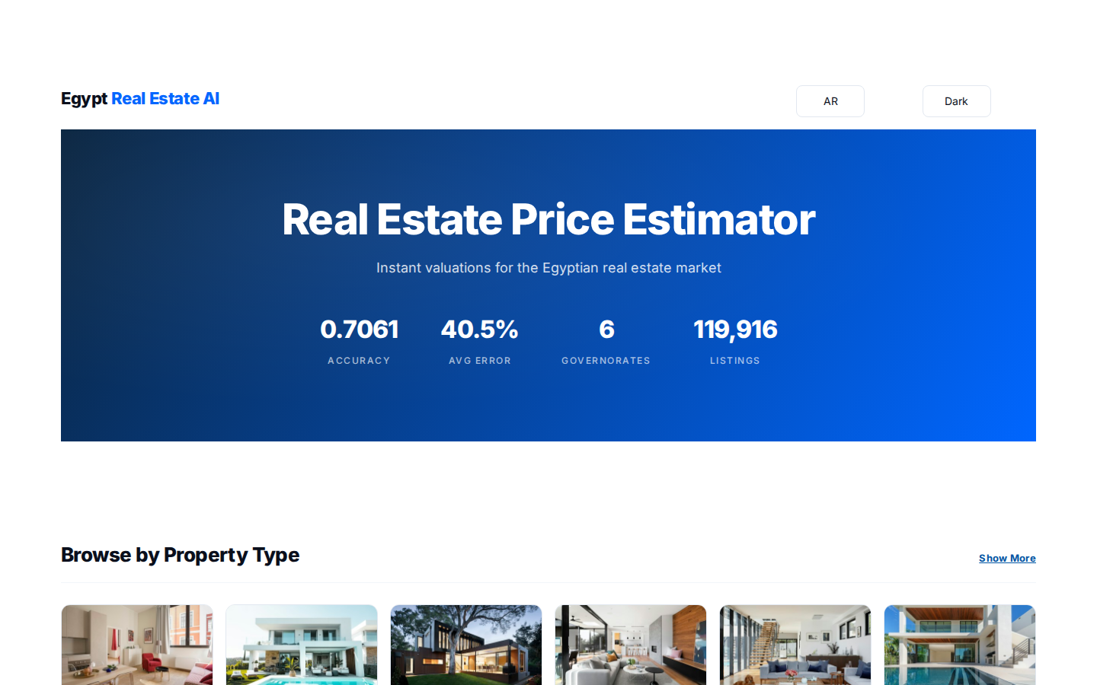
Live Demo - Homepage

Slide 12
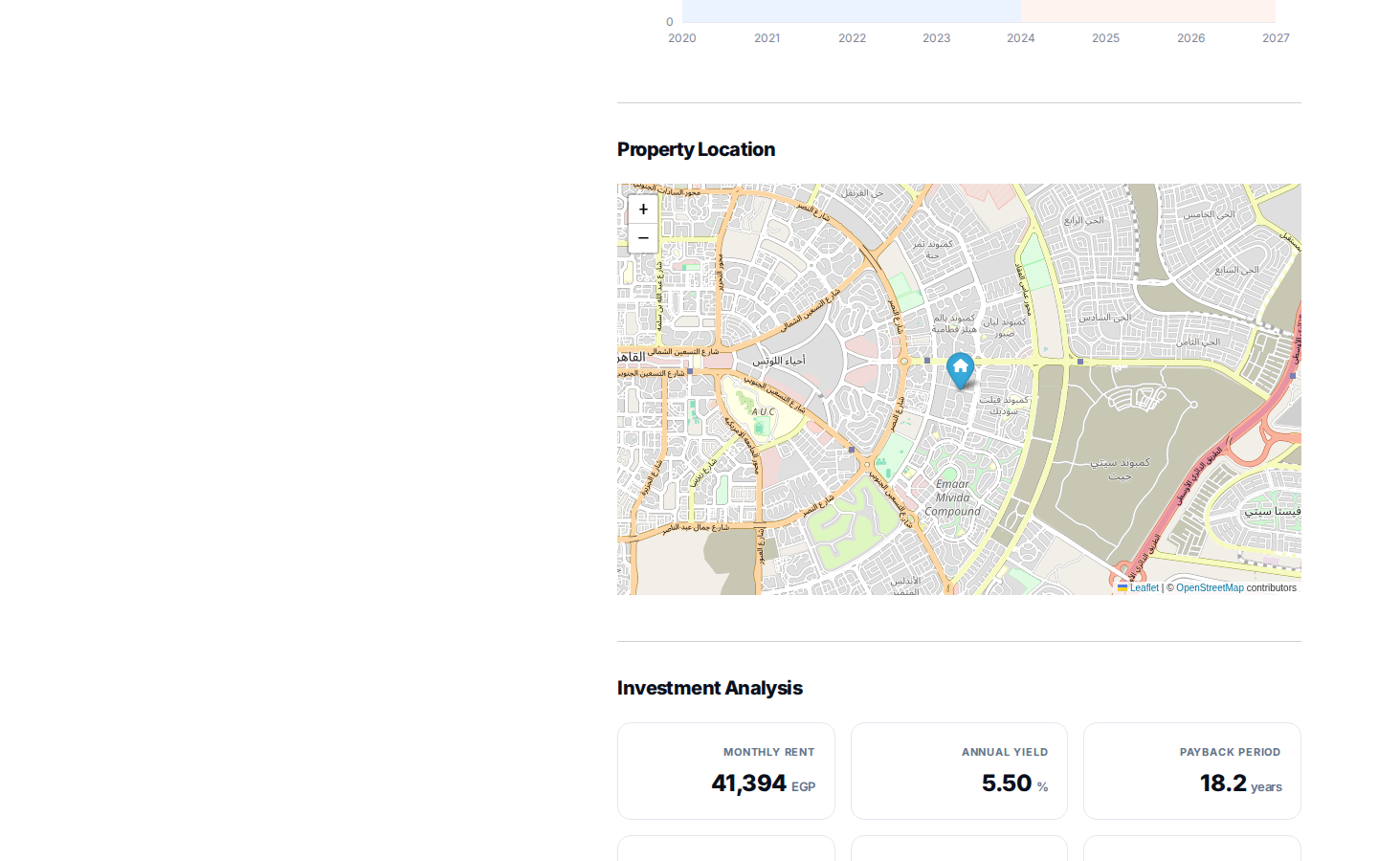
Live Demo - Estimation Result

Slide 13
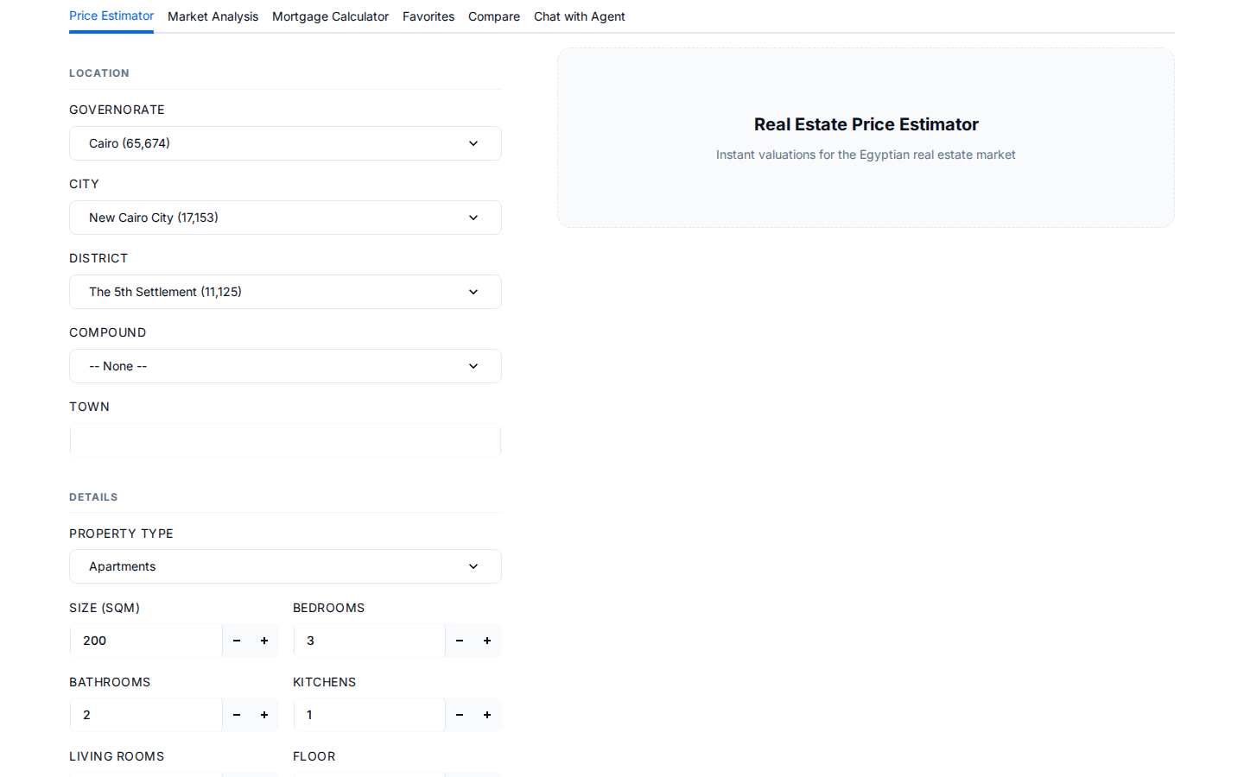
Live Demo - Property Types

Slide 14
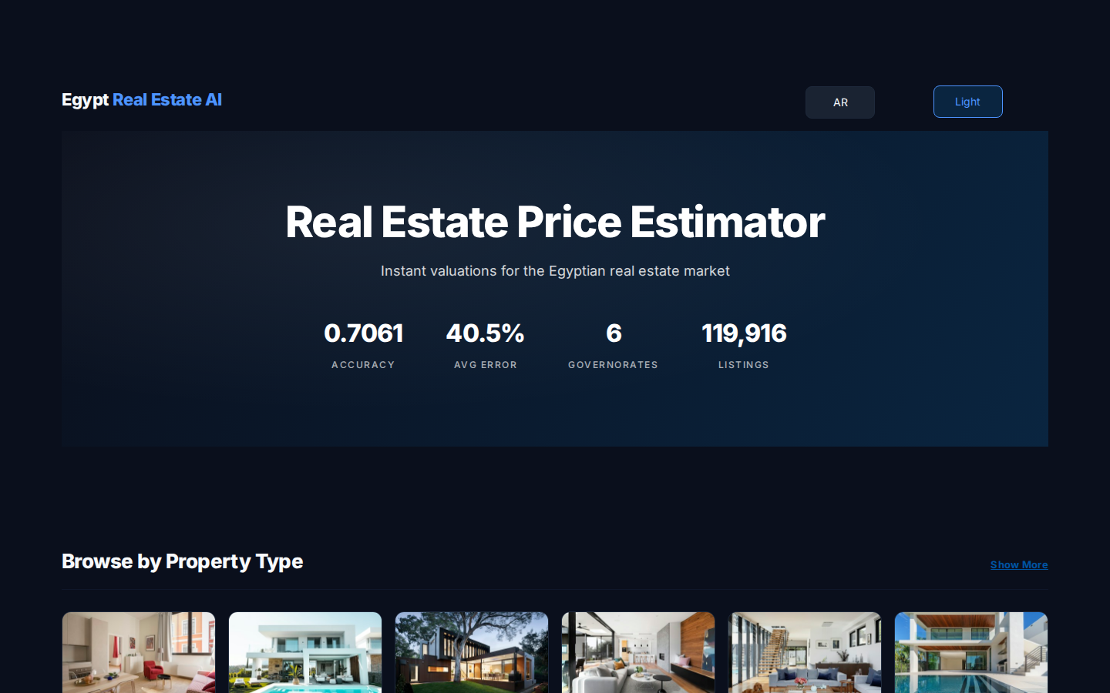
Live Demo - Dark Mode

Slide 15
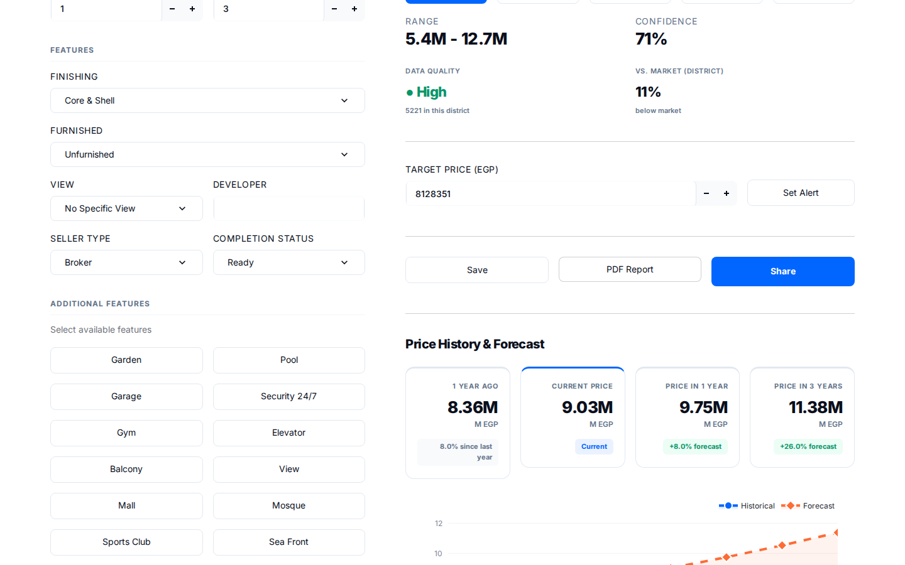
Live Demo - Investment Analysis

Slide 16
Results & Performance
R2 Score
0.7061
70.6% variance explained
MAPE
40.52%
Average error margin
Sample Size
119,916
Real listings from Egypt
Coverage
6
Governorates with data
Inference Time
< 2s
Instant predictions
Accuracy
High
On Cairo, Giza, Alexandria

Slide 17
Competitive Analysis
How we compare to industry leaders:
Feature
Zillow
Nawy
Aqarmap
Ours
AI Estimate
Yes
No
No
Yes
Price History
Yes
Yes
No
Yes
ROI Analysis
Yes
No
No
Yes
Arabic Support
No
Yes
Yes
Yes
Dark Mode
Yes
Yes
Yes
Yes
PDF Reports
Yes
No
No
Yes

Slide 18
System Architecture
User Interface
Streamlit + Custom CSS (Nawy Theme)
Business Logic
Python: Prediction, Charts, Maps, PDF
ML Model
CatBoost Regressor (12 MB)
Data Layer
119,916 listings + Geography hierarchy

Slide 19
Future Roadmap
Phase 1 (Done)
Phase 2 (Done)
Phase 3 (Next)
- AI Price Estimator
- Market Analysis
- Real Property Photos
- Property Gallery
- Mortgage Calculator
- Property Details Page
- Price History
- Compare
- 3D Tours
- ROI Analysis
- Chat UI
- Mobile App

Slide 20
Key Takeaways
First AI-powered bilingual property valuation for Egypt
Trained on 119,916 real listings (largest dataset in market)
R2 = 0.7061 - comparable to international standards
Full Arabic support - targeting 100M+ users
Competes with Zillow, Nawy, Aqarmap on core features
Ready for commercial deployment

Slide 21
Thank You
Egypt Real Estate AI
Live Demo: smart-house-price-predictor-77.streamlit.app
GitHub: github.com/qamarsobhy7-source/Smart-House-Price-Predictor
Contact: qamarsobhy7@gmail.com

