Slide 1


Slide 2
What is GIT
Git is a distributed version control system.
Each developer has a copy of the source repository on their dev machine.
Developers can commit each set of changes on their dev machine and perform version control operations such as history and compare without a network connection.
Branches are lightweight.
Branches are pointer based.

Slide 3
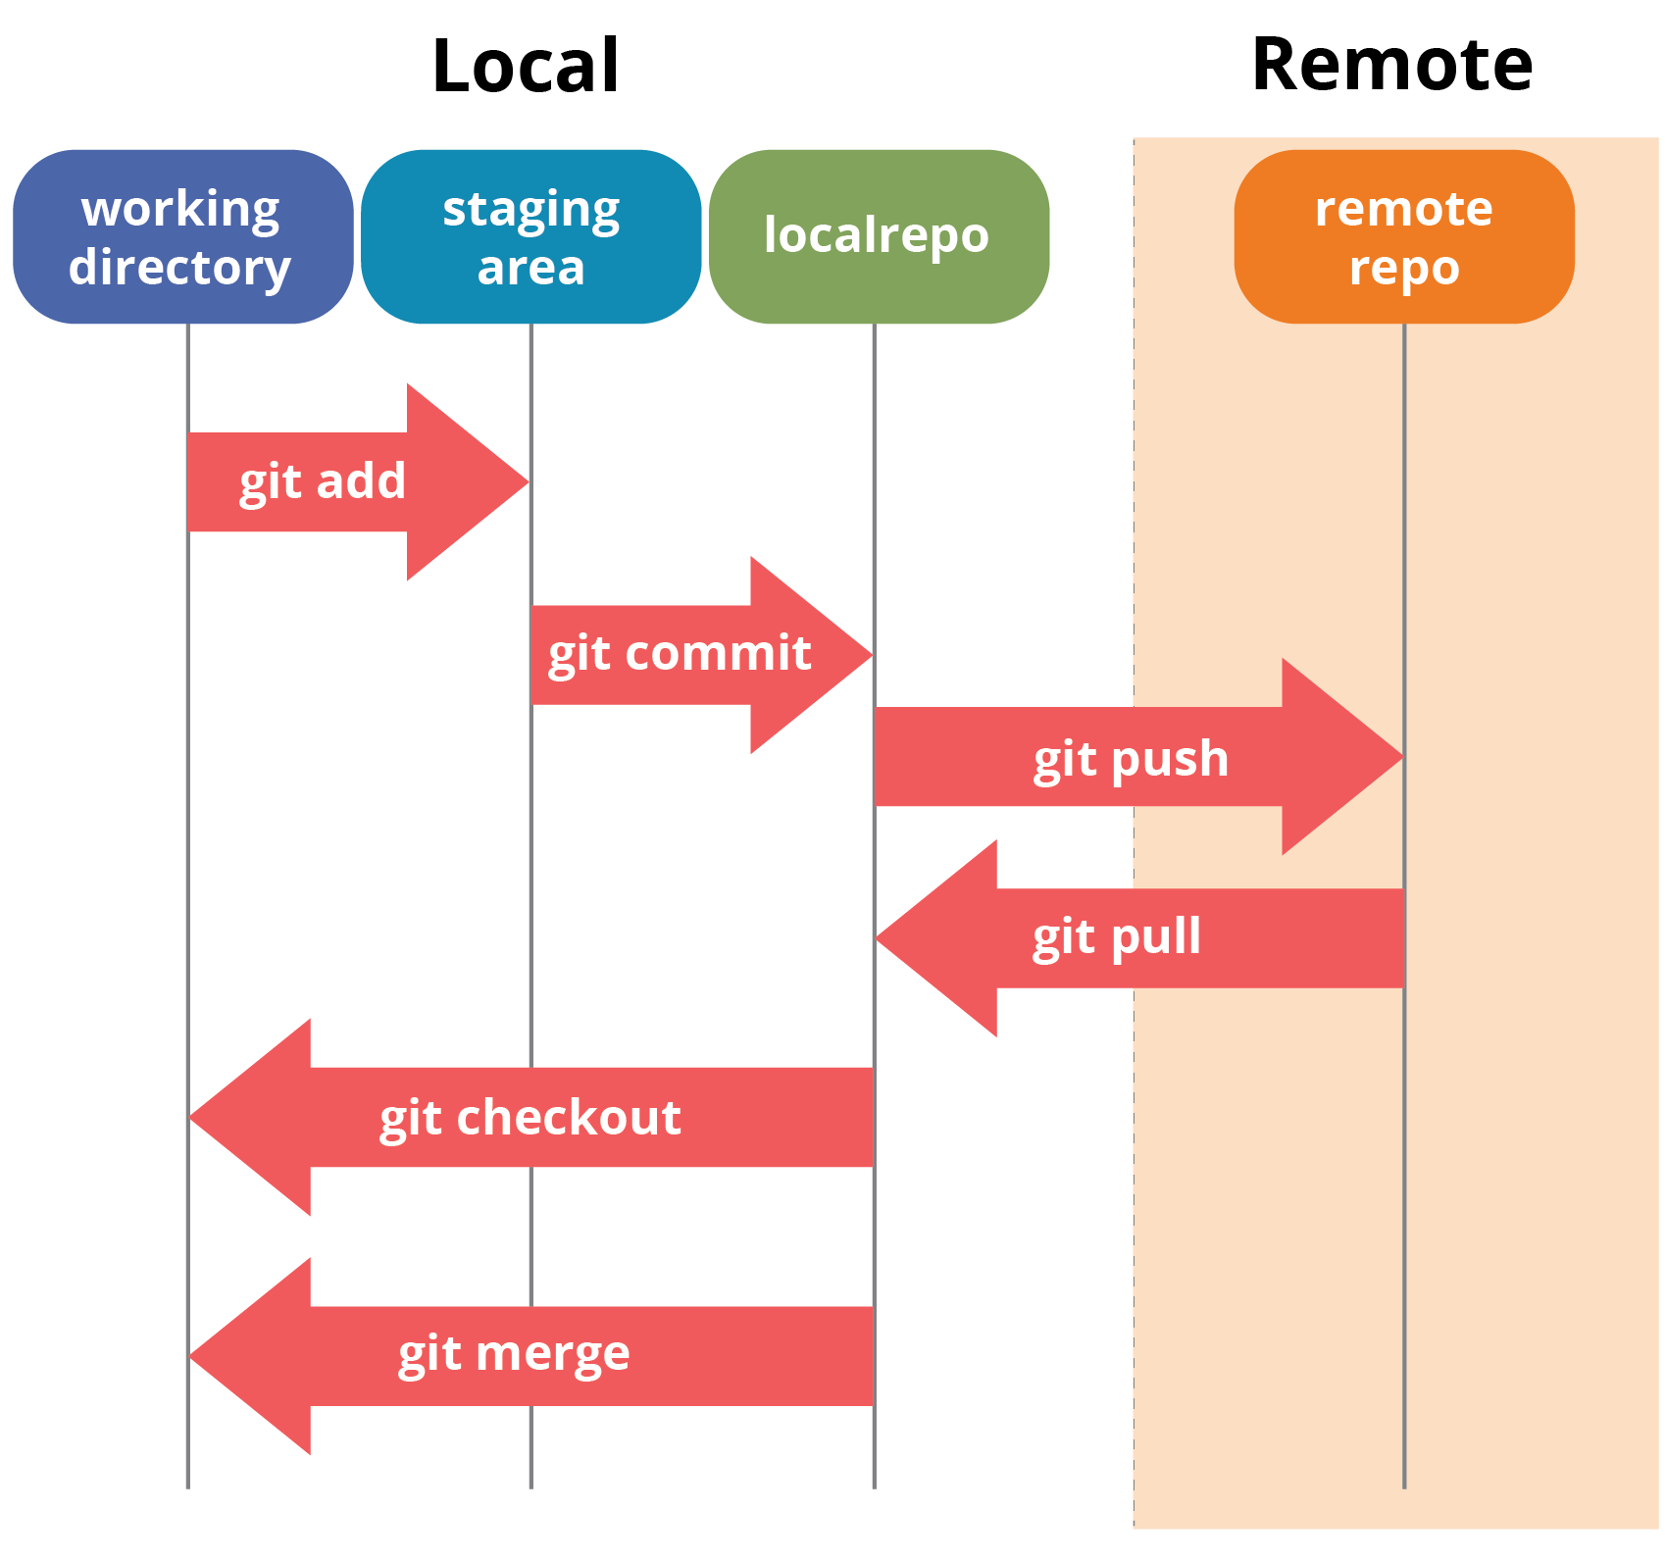
Git Work Flow

Slide 4
How to connect with Git Using Visual Studio
Open Visual Studio.
Click on Team Explorer.
Click on manage connection.
Click on Add Azure Devops server.
Enter Server URL and click on Add.
Click on your Git Project.
Enter the path where you want to clone your project and click on clone.
Wait it will take some time to get Git project on local machine.

Slide 5
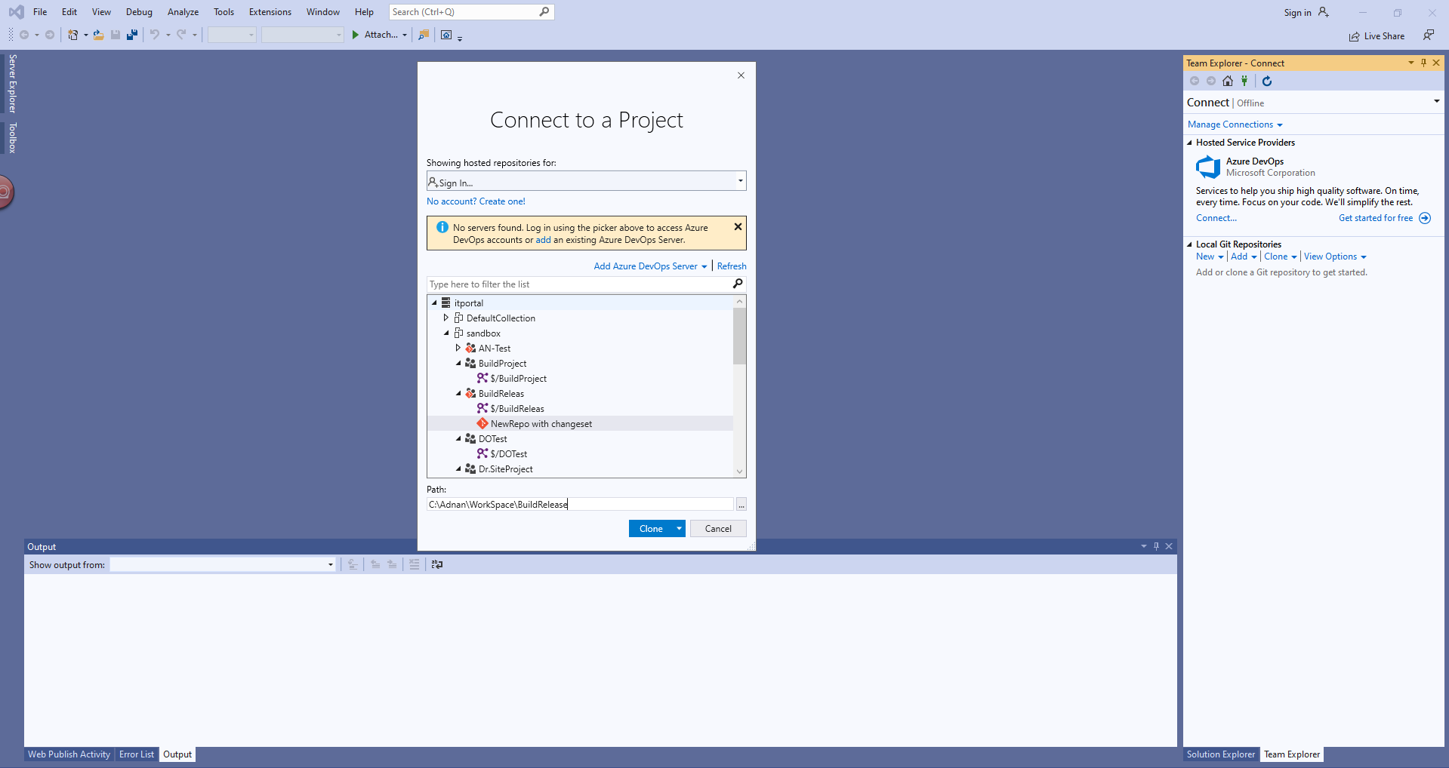
How to connect with Git Using Visual Studio

Slide 6
Get Remote Branches to local machine
Click on Home button in Team Explorer.
Click on Branches.
Expend remote/origin.
Right Click on Dev Branch and checkout
You get Dev branch on your local machine.

Slide 7
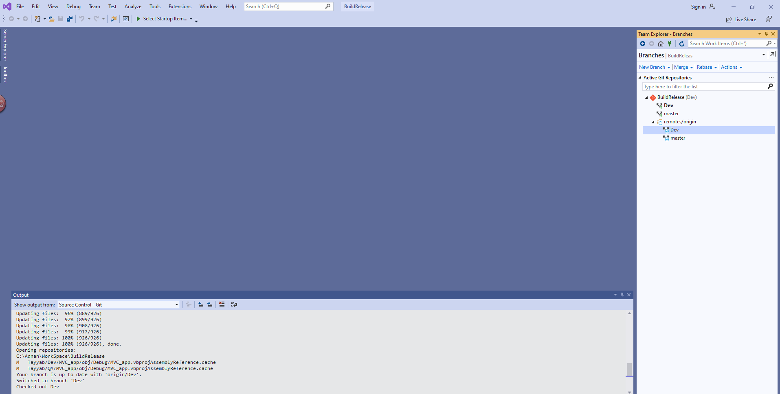
Get Remote Branches to local machine

Slide 8
Open Project solutions
Click on Home in team explorer.
From solutions section open your solution file.
We can also open solutions from folder where we clone the project.

Slide 9
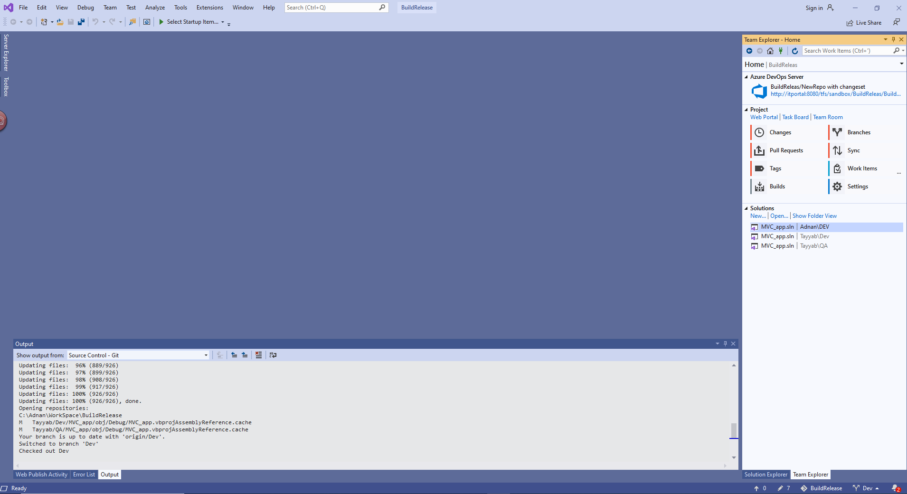
Open Project solutions

Slide 10
How to Commit your changes
Click on Solution Explorer
Open your file where you want changes
Edit/add your changes and save it.
Click on team explorer.
Click on Changes.
In changes you see your edit file.
Right Click on file that you want to commit and click on stage.
Enter your commit and click on commit staged.

Slide 11
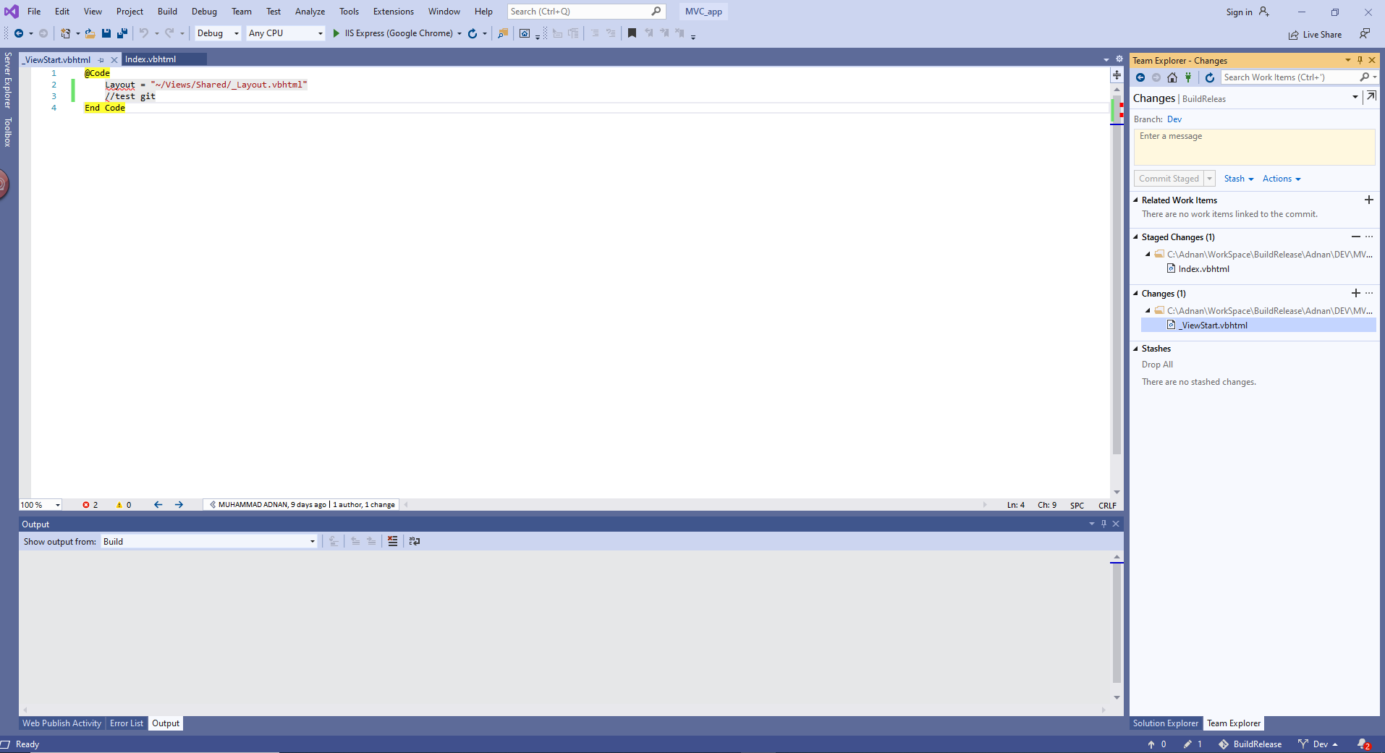
How to Commit your changes

Slide 12
How to push changes to remote branch
Click on Home in team explorer.
Click on sync.
Click on push in outgoing commits section.
Your Changes push to remote branch successfully.

Slide 13
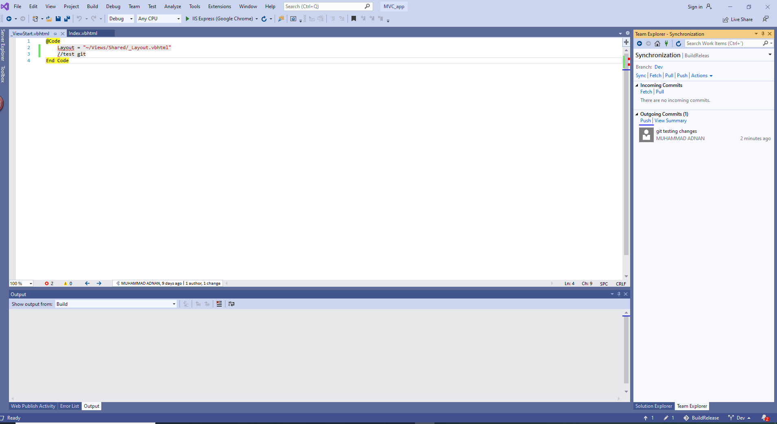
How to push changes to remote branch

Slide 14
How to get other user changes into your local branch
Click on home in team explorer.
Click on Sync.
In incoming commit section click on fetch it will show you other users changes.
Click on pull.
Other users changes updated on your local branch.

Slide 15
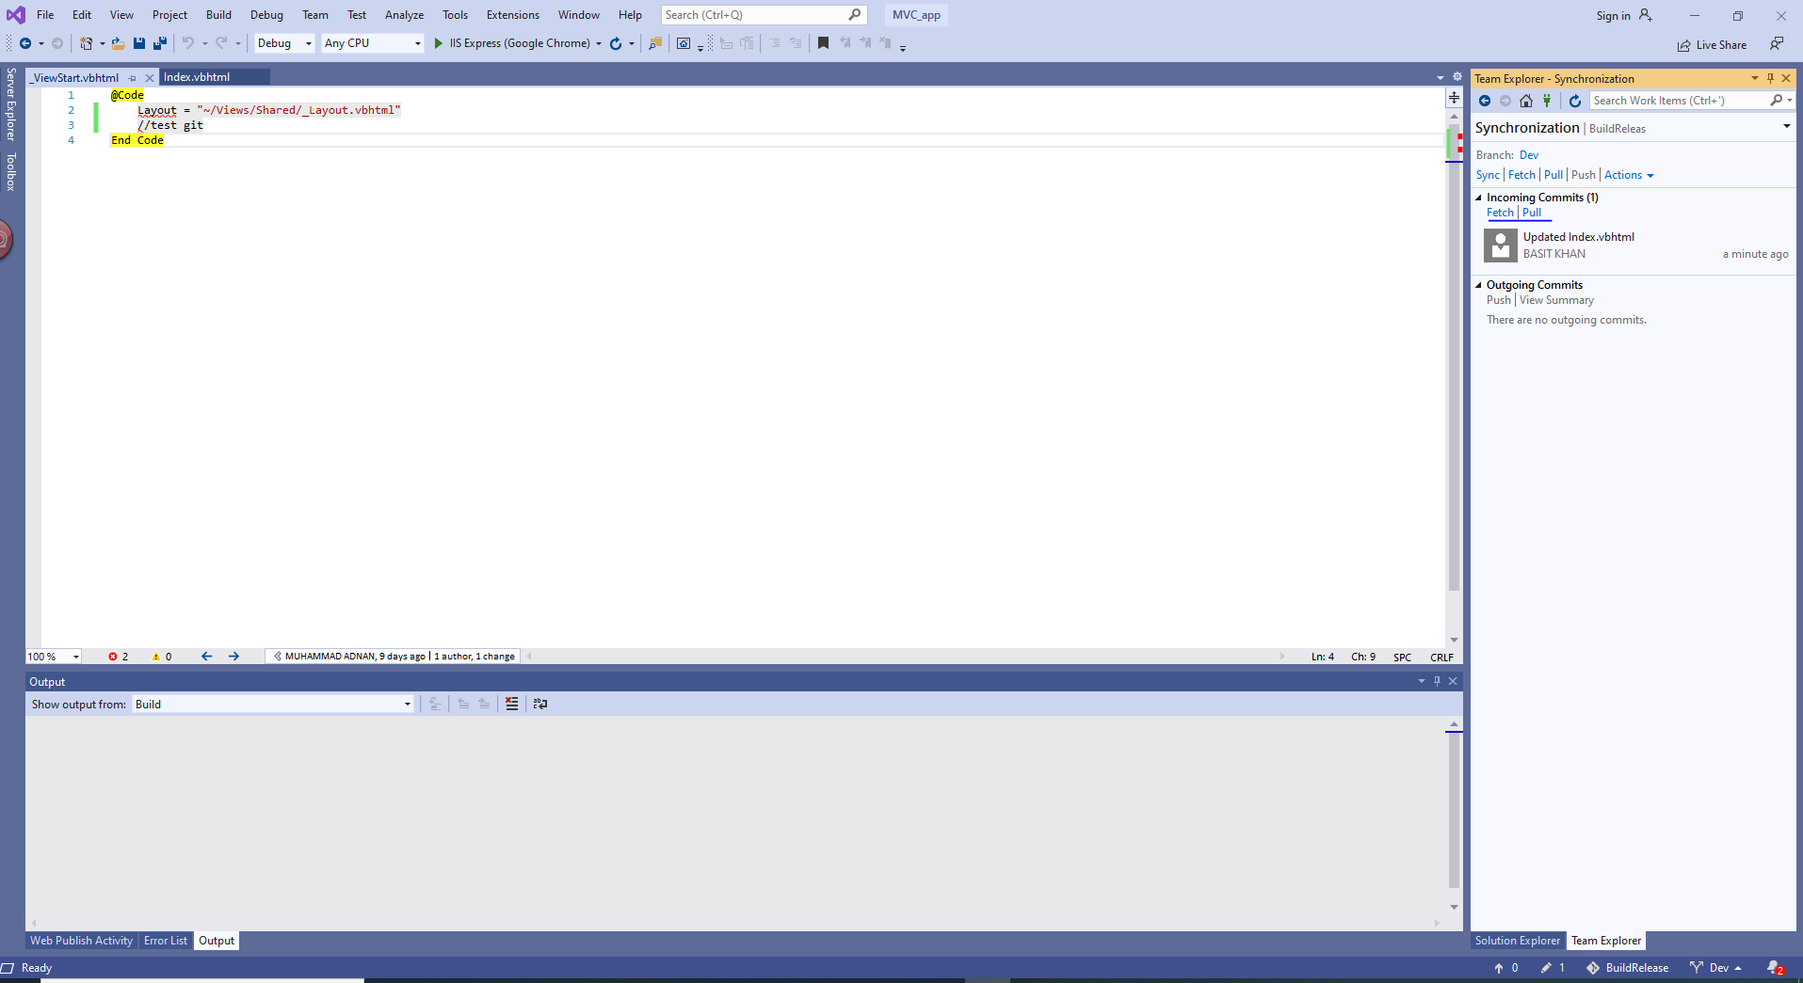
How to get other user changes into your local branch

Slide 16
How to checkout to other branches
Click on home in team explorer.
Click on branches.
Right click on branch where you want to checkout.

Slide 17
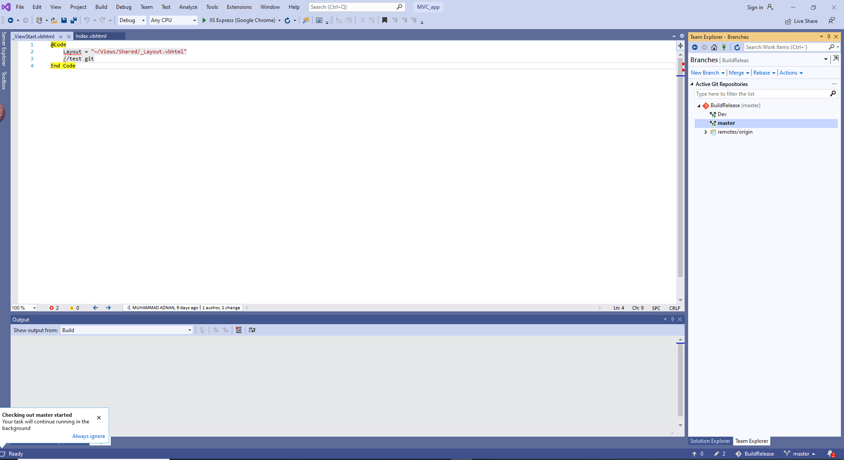
How to checkout to other branches

Slide 18
How to view change set history
Click on home in team explorer.
Click on branches.
Right click on branch.
Click on view history.

Slide 19
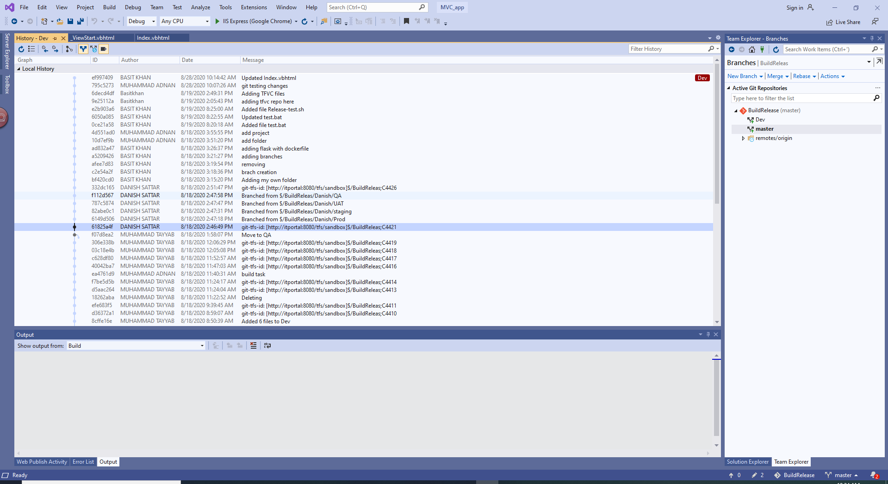
How to view change set history

Slide 20
Merge selected changeset using cherry-pick
Checkout the branch where you want to merge the code.
Open the history of branch from where you merge the code. e.g. (if you want to merge code from dev to master checkout to master branch and view history of dev branch).
Right click on commit which you want to merge.
Click on cherry-pick.
Click on home and then click on sync
It show changes in outgoing commits section, click on push to move changes to remote branch.

Slide 21
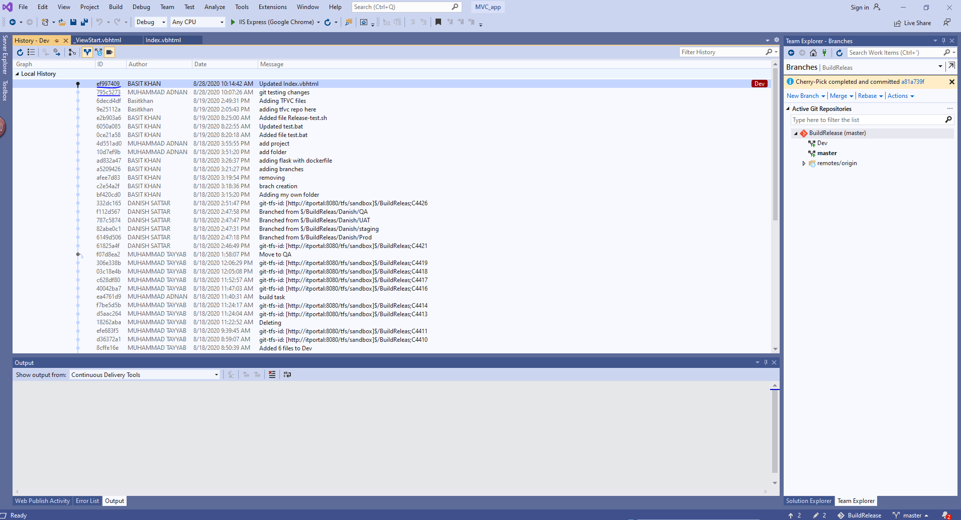
Merge selected changeset using cherry-pick

Slide 22
Merge selected changeset using cherry-pick

Slide 23
Merge All changeset using Pull Request
Click on home in team explorer.
Click on pull requests.
Click on new pull request.
It will show it portal screen change the source branch.
Enter Reviewers name and click on new pull request.
New pull request will be created.

Slide 24
Merge All changeset using Pull Request
New window will be open Reviewer review the code and approve it.
When all reviewer approve it then click on complete.
When click on complete a popup window will appear check the button if you want to delete the source branch other uncheck it.
Click on complete merge.

Slide 25
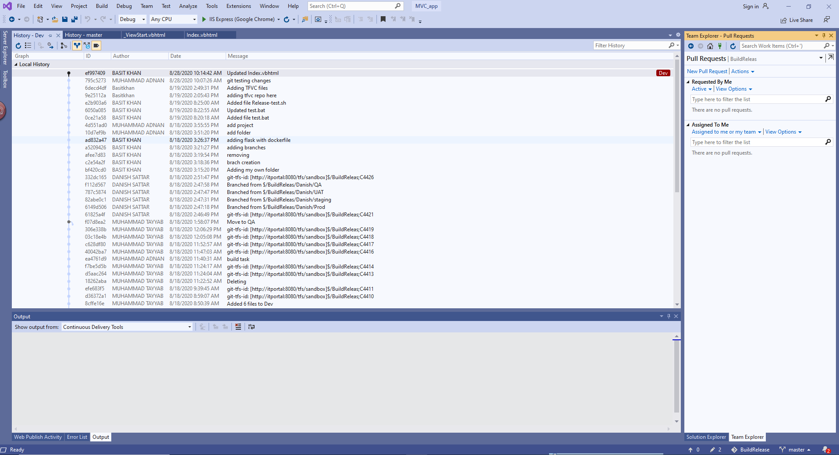
Merge All changeset using Pull Request

Slide 26
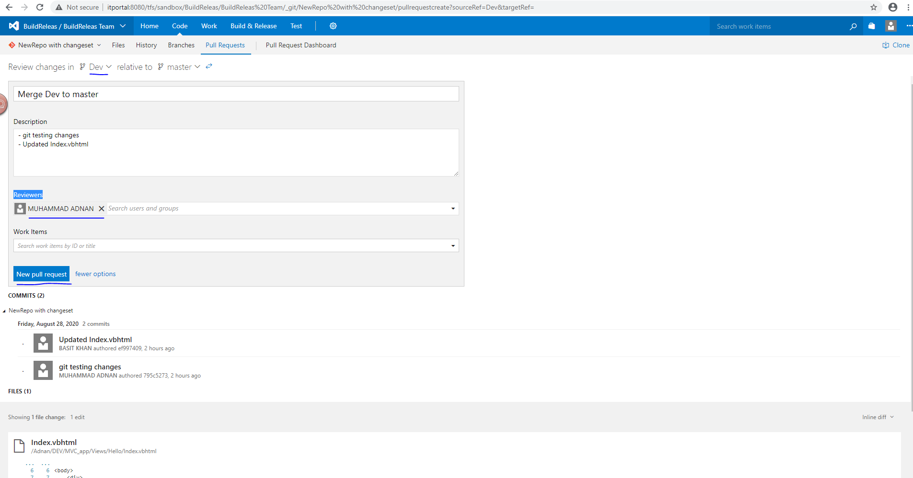
Merge All changeset using Pull Request

Slide 27
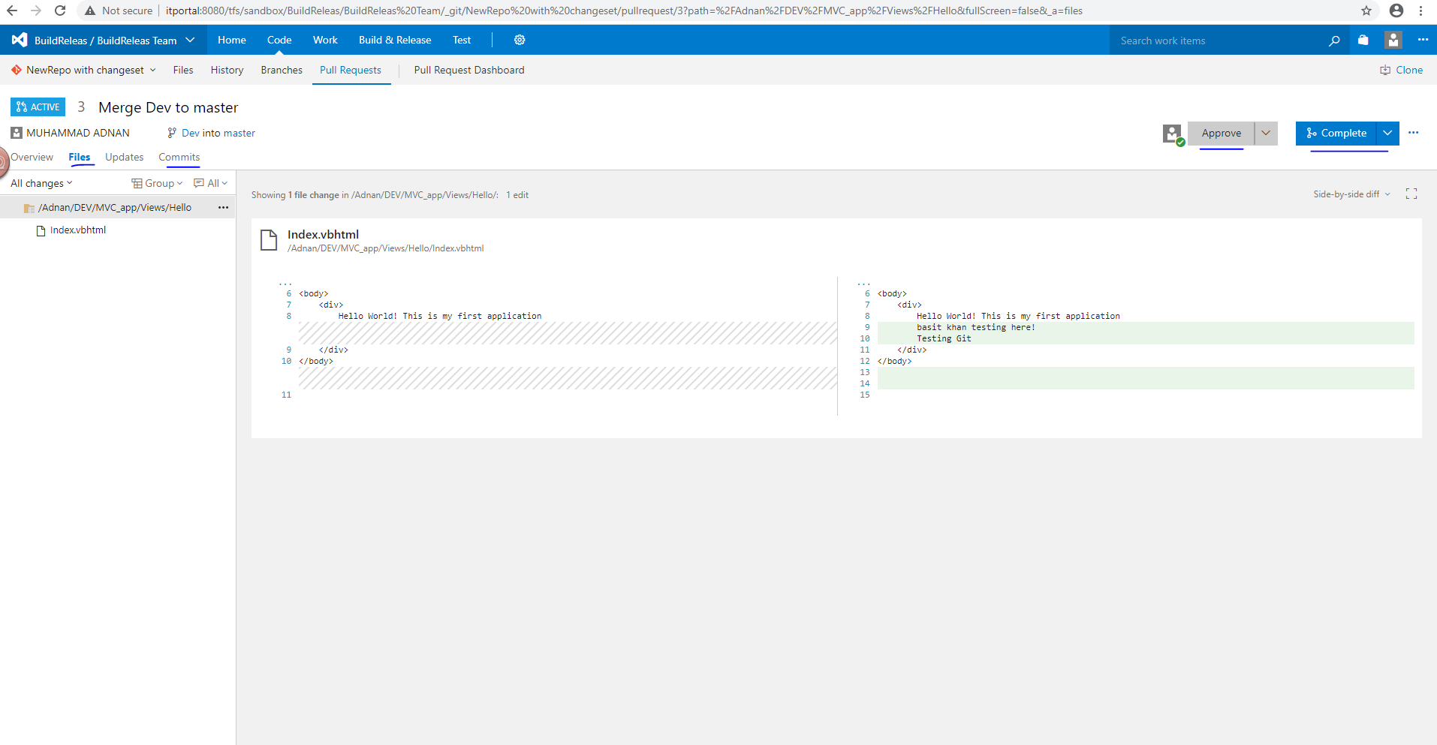
Merge All changeset using Pull Request

Slide 28
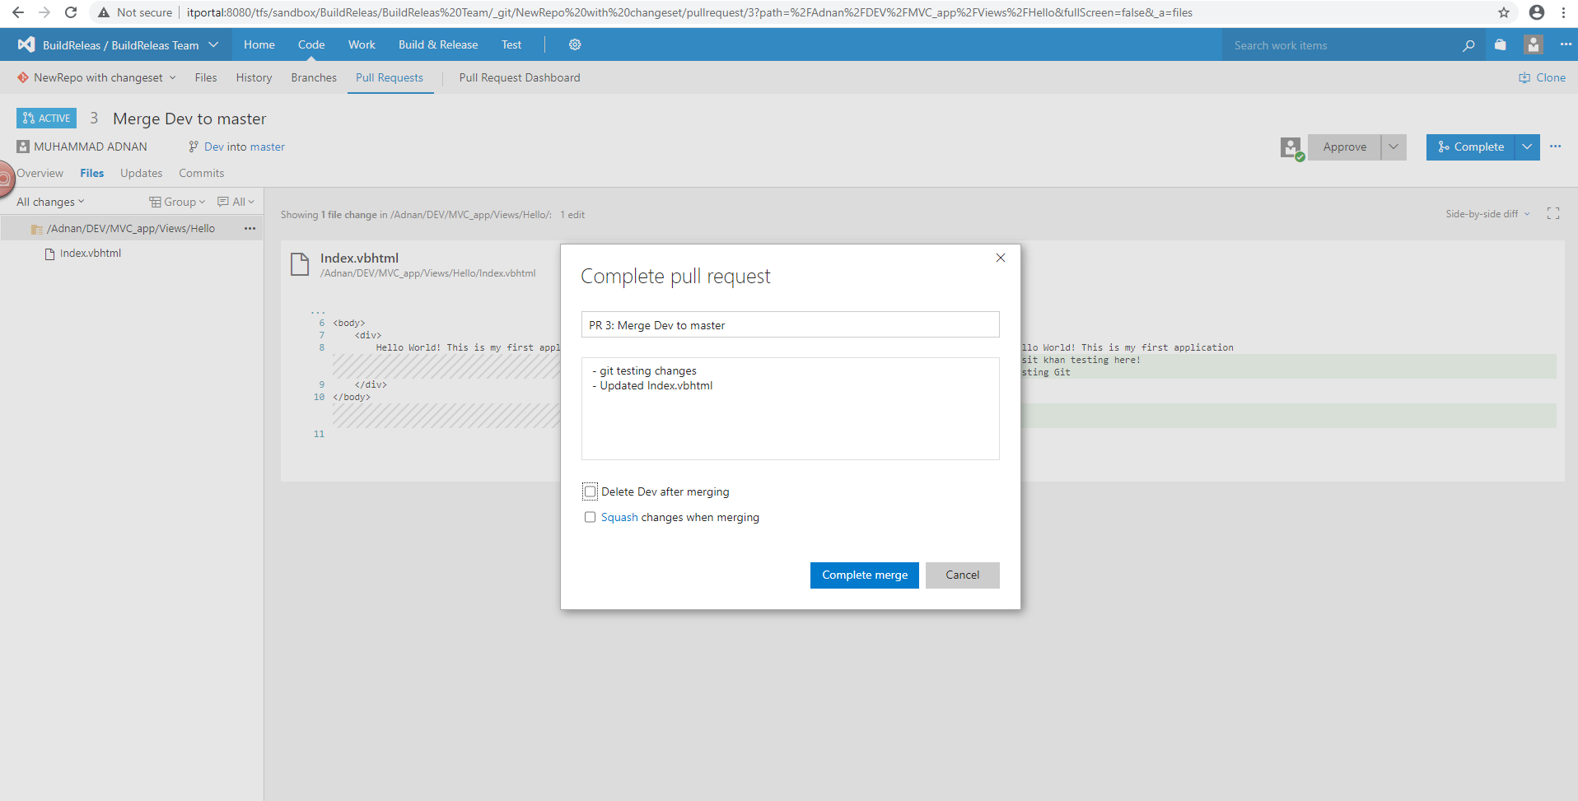
Merge All changeset using Pull Request

Slide 29
Create New Branch
Click on branches.
Right click on branch from where you want to create new branch.
Click on New local branch.
Enter your branch name.
Check the option if you want to checkout to new branch or uncheck if you don’t checkout to new branch.
Click on create branch.
New local branch will be created.

Slide 30
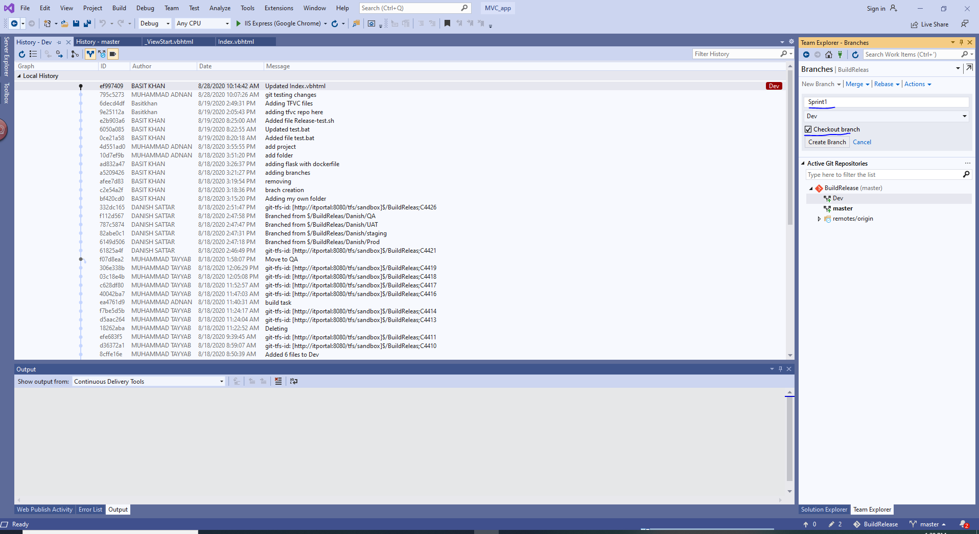
Create New Branch

Slide 31
Merge Branch
Click on Branches.
Checkout to the branch.
Click on merge.
Select the branch from where you want to merge.
Click on merge button to merge the branch.

Slide 32
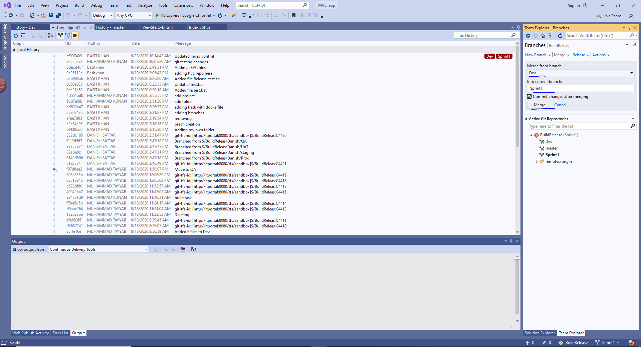
Merge Branch

Slide 33
Delete Branch
Click on Branches.
Checkout to another branch.
Right Click on the branch you want to delete.
Click on delete.

Slide 34
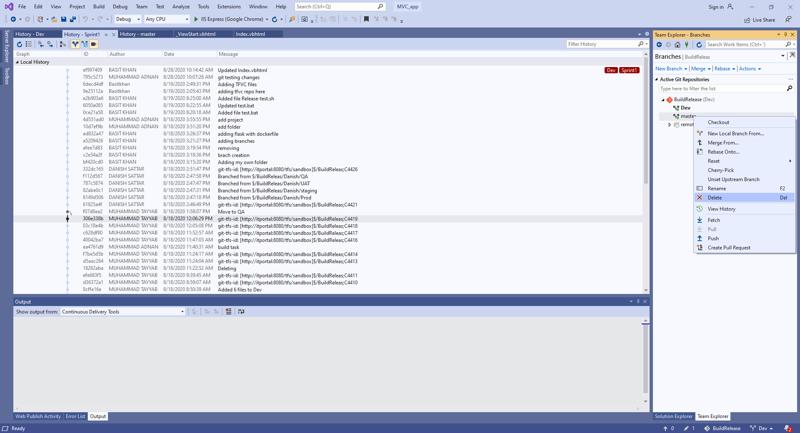
Delete Branch

Slide 35
How to Stash your changed Files
Git provide a stash option the file you changed but you don’t commit into branch you can stash these files.
Click on home then on changes.
Select your file that you want to stash.
Click on stash and stash all.
Stash files are saved.

Slide 36
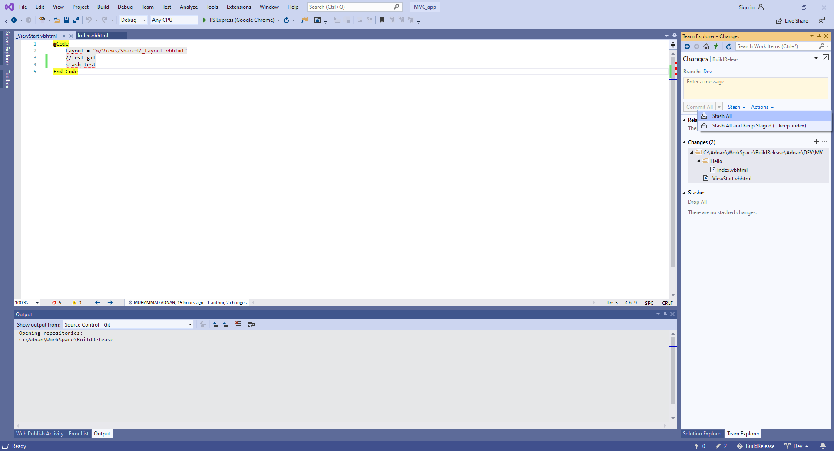
How to Stash your changed Files

Slide 37
How to restore stash files
You can be restore your file that you stash.
Click on changes from home.
In the stashes section right click on stash file.
View Changes: Allows you to view the changes of the Stash.
Apply: Applies the changes to the code branch and keeps the Stash.
Apply and Restore Staged: Applies changes to code branch and ensures staging of previously staged files again.
Apply All as Unstaged: Applies changes to code branch and won't stage files that were staged before.
Drop: Deletes the Stash.
Pop: Applies the changes to the code branch and deletes the Stash.
Pop and Restore Staged: Pops changes to code branch and ensures staging of previously staged files again.
Pop All as Unstaged: Pops changes to code branch and won't stage files that were staged before.
You can choose option according to your requirement.

Slide 38
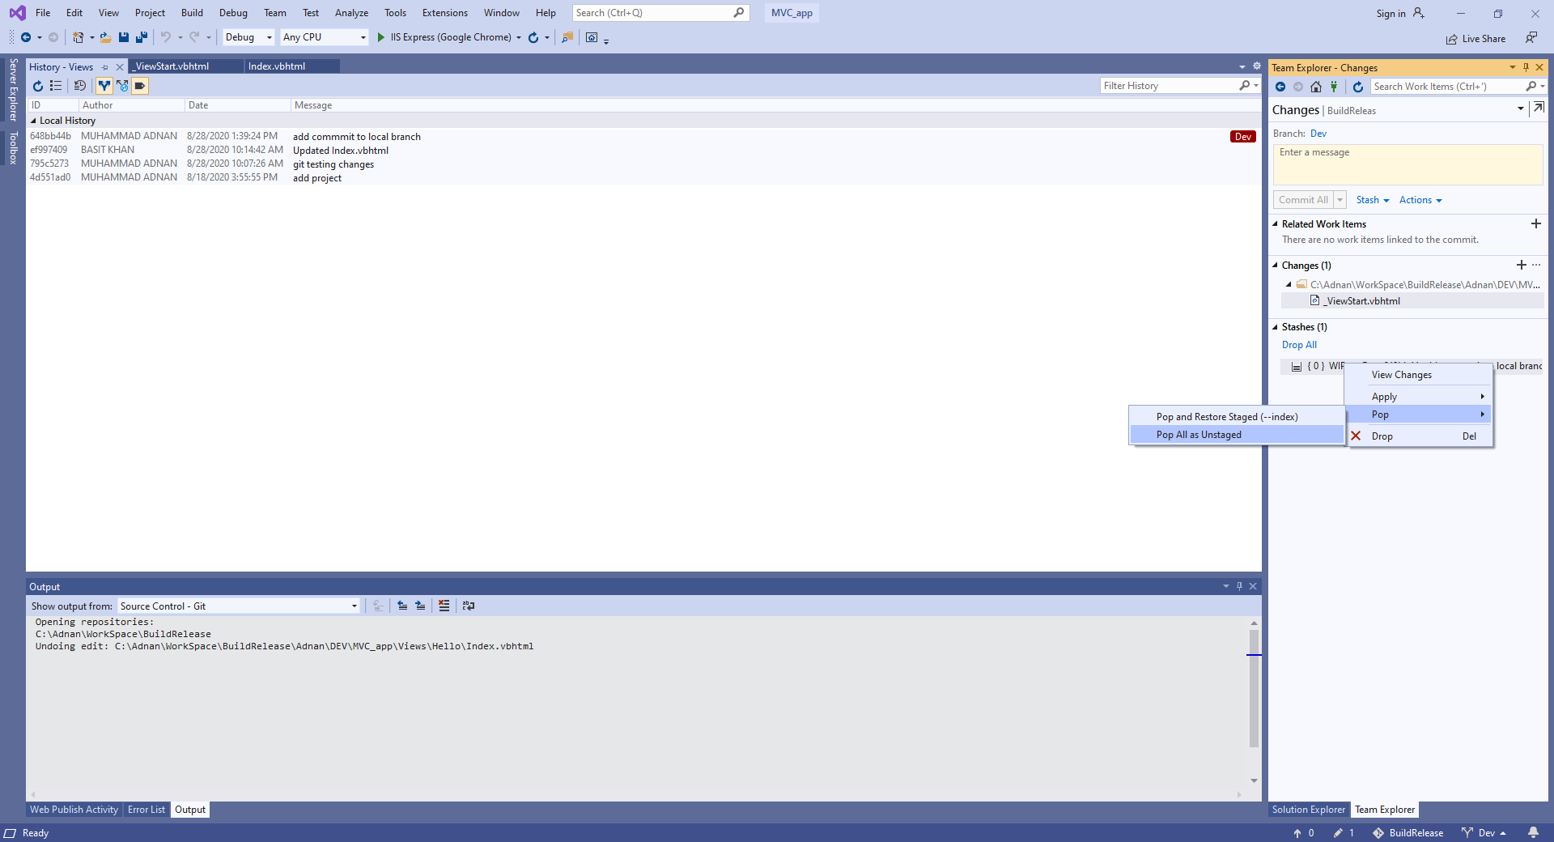
How to restore stash files

Slide 39
Git Commands
git config:
This command sets the author name and email address respectively to be used with your commits
Usage: git config –global user.name “[name]”
Usage: git config –global user.email “[email address]”
git init:
This command is used to start a new repository.
Usage: git init [repository name]
git clone:
This command is used to obtain a repository from an existing URL.
Usage: git clone [url]

Slide 40
Git Commands
git add:
This command adds a file to the staging area.
Usage: git add [file]
This command adds one or more to the staging area.
Usage: git add *
git commit:
This command records or snapshots the file permanently in the version history.
Usage: git commit -m “[ Type in the commit message]”
This command commits any files you’ve added with the git add command and also commits any files you’ve changed since then.
Usage: git commit -a

Slide 41
Git Commands
git diff:
This command shows the file differences which are not yet staged.
Usage: git diff
This command shows the differences between the files in the staging area and the latest version present.
Usage: git diff –staged
This command shows the differences between the two branches mentioned.
Usage: git diff [first branch] [second branch]

Slide 42
Git Commands
git reset:
This command unstages the file, but it preserves the file contents.
Usage: git reset [file]
This command undoes all the commits after the specified commit and preserves the changes locally.
Usage: git reset [commit]
This command discards all history and goes back to the specified commit.
Usage: git reset –hard [commit]
git status:
This command lists all the files that have to be committed.
Usage: git status

Slide 43
Git Commands
git rm:
This command deletes the file from your working directory and stages the deletion.
Usage: git rm [file]
git log:
This command is used to list the version history for the current branch.
Usage: git log
This command lists version history for a file, including the renaming of files also.
- git log –follow[file]
git show:
This command shows the metadata and content changes of the specified commit.
Usage: git show [commit]

Slide 44
Git Commands
git tag:
This command is used to give tags to the specified commit.
Usage: git tag [commitID]
git branch:
This command lists all the local branches in the current repository.
Usage: git branch
This command creates a new branch.
Usage: git branch [branch name]
This command deletes the feature branch.
Usage: git branch -d [branch name]

Slide 45
Git Commands
git checkout:
This command is used to switch from one branch to another.
Usage: git checkout [branch name]
This command creates a new branch and also switches to it.
Usage: git checkout -b [branch name]
git merge
This command merges the specified branch’s history into the current branch.
Usage: git merge [branch name]
git remote
This command is used to connect your local repository to the remote server.
Usage: git remote add [variable name] [Remote Server Link]

Slide 46
Git Commands
git push:
This command sends the committed changes of master branch to your remote repository.
Usage: git push [variable name] master
This command sends the branch commits to your remote repository.
Usage: git push [variable name] [branch]
This command pushes all branches to your remote repository.
Usage: git push –all [variable name]
This command deletes a branch on your remote repository.
Usage: git push [variable name] :[branch name]

Slide 47
Git Commands
git pull:
This command fetches and merges changes on the remote server to your working directory.
Usage: git pull [Repository Link]
git stash:
This command temporarily stores all the modified tracked files.
Usage: git stash save
This command restores the most recently stashed files.
Usage: git stash pop
This command lists all stashed changesets.
Usage: git stash list
This command discards the most recently stashed changeset.
Usage: git stash drop

Slide 48


