Slide 1
CryptoShare - Viva
Caching, trading activity, Encryption, And mobile app

Slide 2
Caching
2 API Modes.
Internal fetches data from Yahoo Finance directly.
External uses a third-party / middle-man, which fetches data from Yahoo.

Slide 3
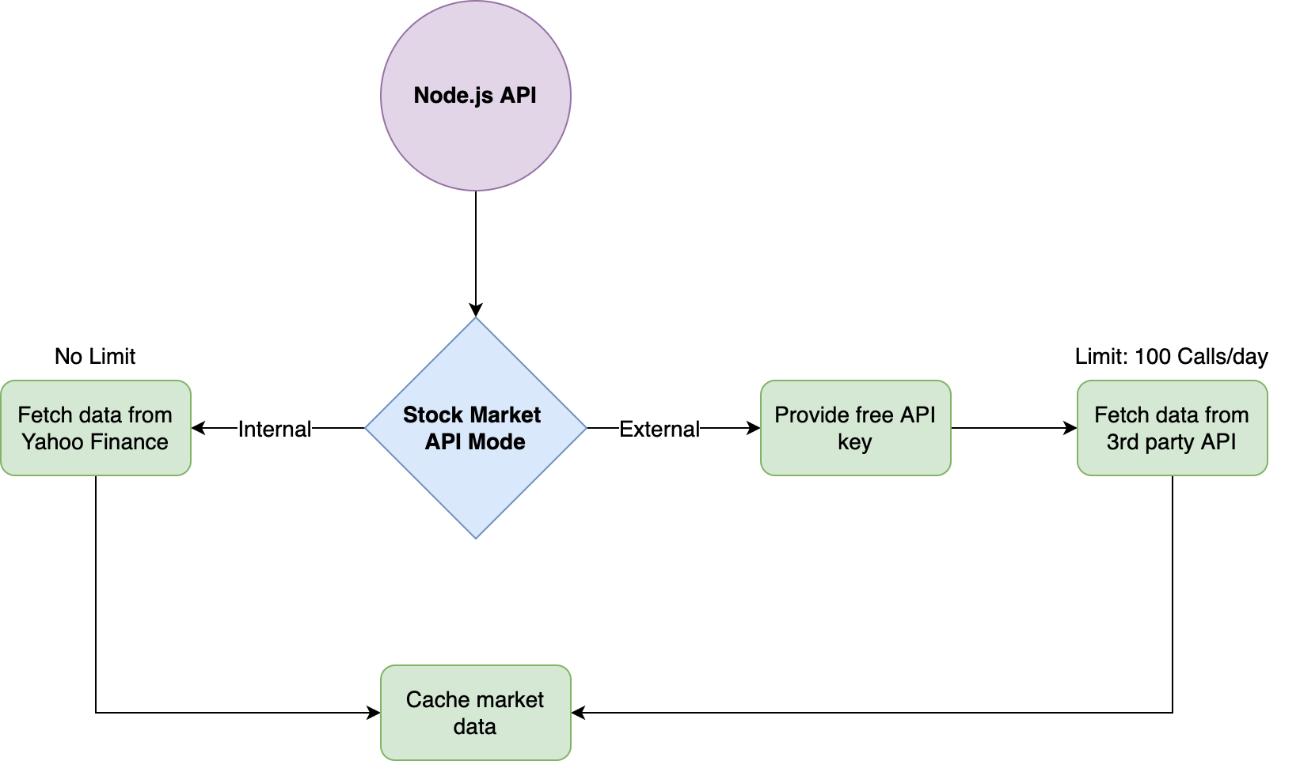
Internal would be used by a few people.
External would allow for scaling, and each user would need a free API key.
Caching mitigates limits.

Slide 4
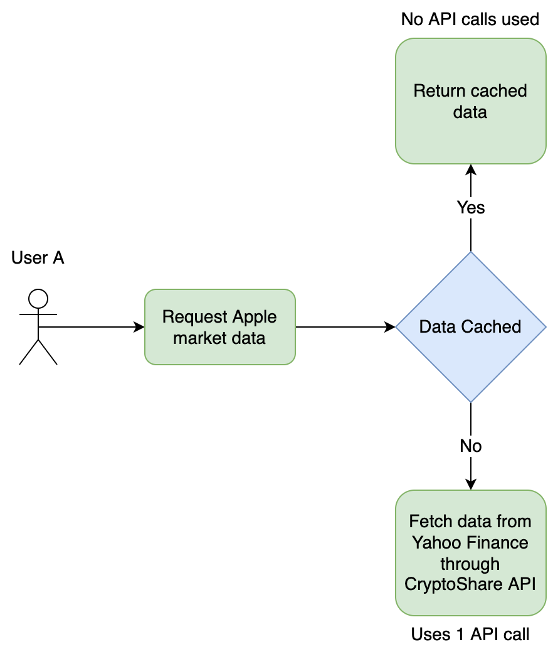
Cached data is considered “valid” and “recent” if it is less than 24h old.
Users are not tied to cached data, so it can be shared between users.
Cached data does not include personal information.

Slide 5
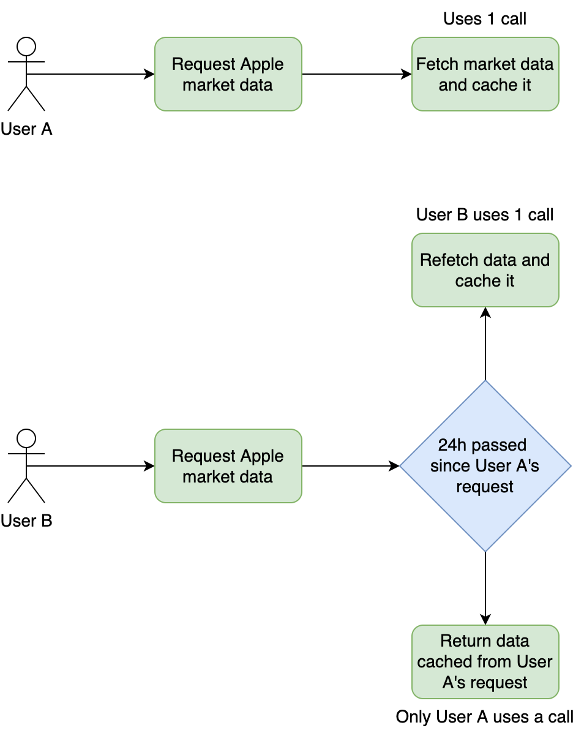
Only 1 user needs to use 1 of their 100 API calls/day per stock.
More users = Less limits.
Crowdsourced market data.

Slide 6
Trading Activity
Parses and calculates 1 year of trading activity / transactions.
Buy + Sell orders supported (i.e. bought 5 AAPL shares last month, sold 2 last week, 3 left, changes reflected on daily chart).
Asset price can be provided, or based on closing price of the day.
Code: js/functions/holdings.js:776

Slide 7
Encryption
Client-side symmetric encryption using AES to protect user data.
Asymmetric encryption using RSA to account for hosts that may not have HTTPS / an SSL certificate.
Protection against MITM attacks, server hijacking, sabotage etc.

Slide 8
Mobile App
As much functionality as the web and desktop apps.
Safer than web app (impossible to sabotage/hijack if downloaded from a safe place or once installed).

