Slide 1
FUTURISTIC
Here starts your presentation

Slide 2
REJA
A slide structure based on a multi-purpose presentation, which you can easily adapt to your needs. For more info on how to edit the template, please visit Slidesgo School or read our FAQs.
An assortment of illustrations and pictures that are suitable for use in the presentation can be found in the alternative resources slide.
A thanks slide, which you must keep so that proper credits for our design are given.

Slide 3
Here you can describe the topic of the section Here you can describe the topic of the section
Here you can describe the topic of the section
Here you can describe the topic of the section
Here you can describe the topic of the section
Here you can describe the topic of the section Here you can describe the topic of the section
Here you can describe the topic of the section
Here you can describe the topic of the section
Here you can describe the topic of the section
Here you can describe the topic of the section Here you can describe the topic of the section
Here you can describe the topic of the section
Here you can describe the topic of the section
Here you can describe the topic of the section

Slide 4
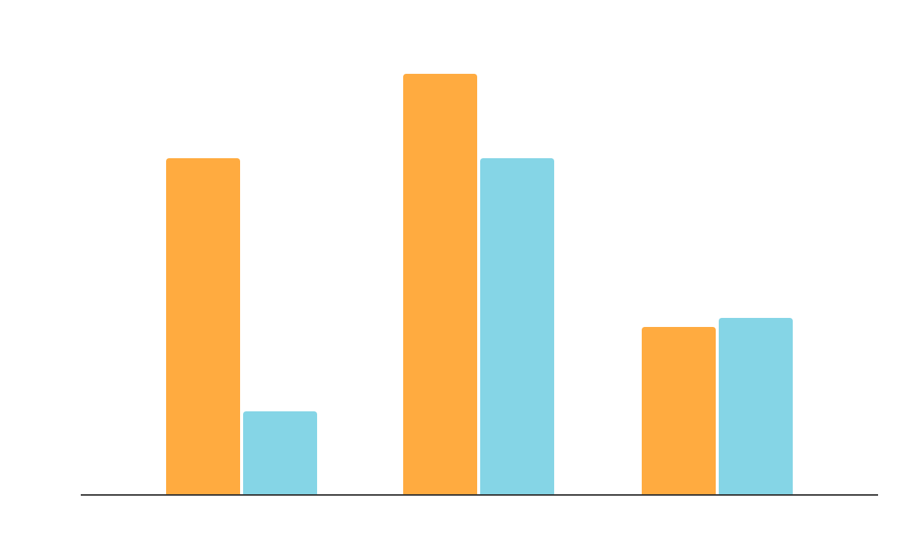
DO YOU PREFER THIS GRAPH?
To modify this graph, click on it, follow the link, change the data and replace it. Here you can describe the topic of the section Here you can describe the topic of the section can describe the topic of the section Here you can can describe the topic of the section Here you can can describe the topic of the section Here you can can describe the topic of the section Here you can can describe the topic of the section Here you can GDFGDF GFDG

Slide 5
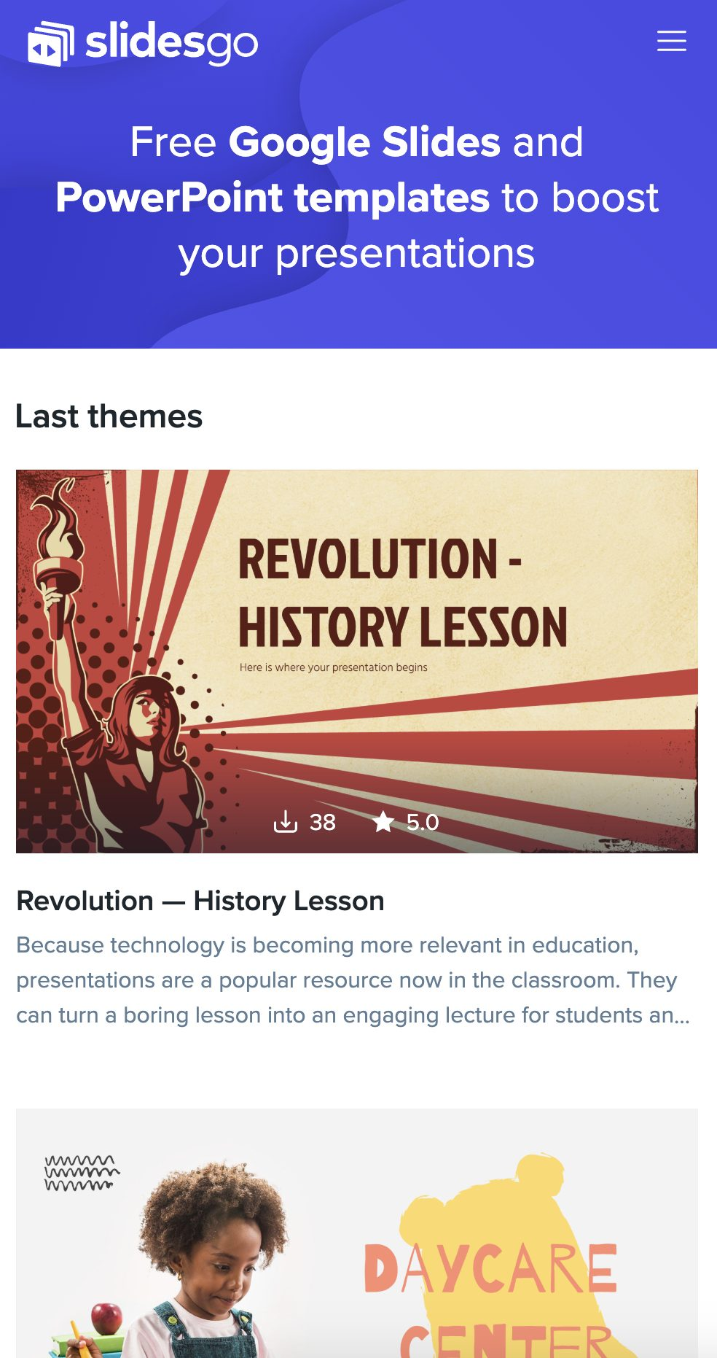
MOBILE WEB
You can replace the image on the screen with your own work. Just delete this one, add yours and center it properly

Slide 6
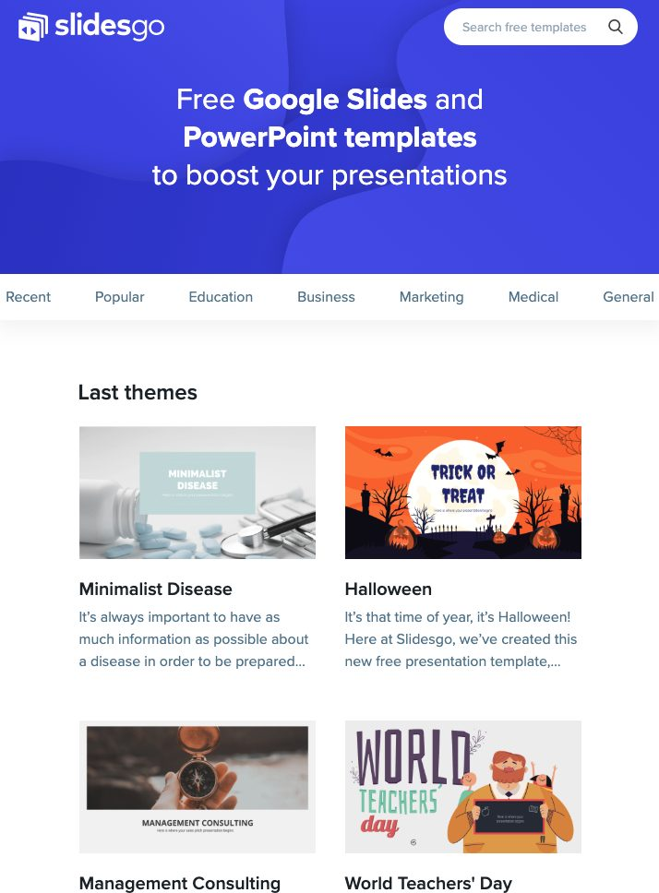
TABLET APP
You can replace the image on the screen with your own work. Just delete this one, add yours and center it properly

Slide 7

DESKTOP SOFTWARE
You can replace the image on the screen with your own work. Just delete this one, add yours and center it properly

Slide 8
E’TIBORINGIZ UCHUN RAHMAT!

