Slide 1
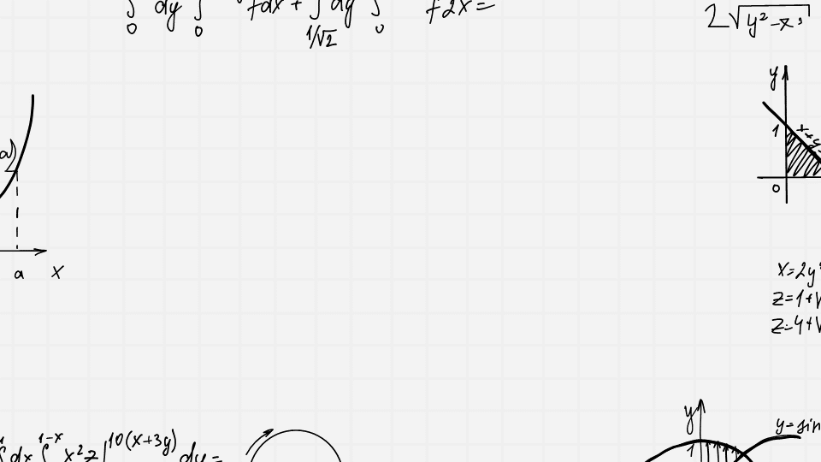
Discrete Mathematics
Here is where your presentation begins

Slide 2
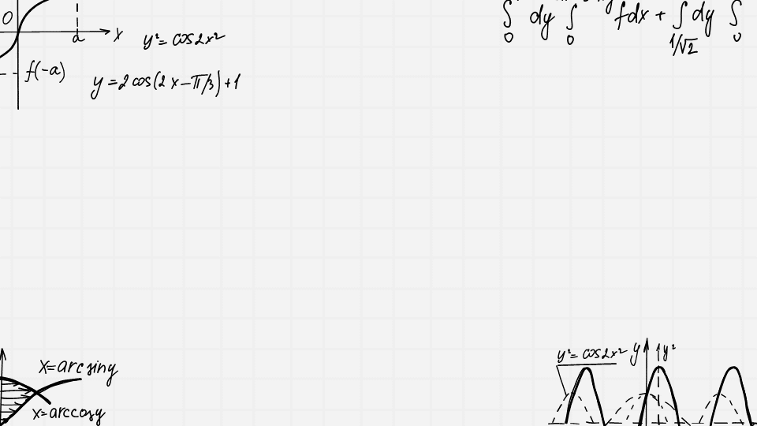
Reja
This can be the part of the presentation where you introduce yourself, write your email…
This can be the part of the presentation where you introduce yourself, write your email…
This can be the part of the presentation where you introduce yourself, write your email…

Slide 3
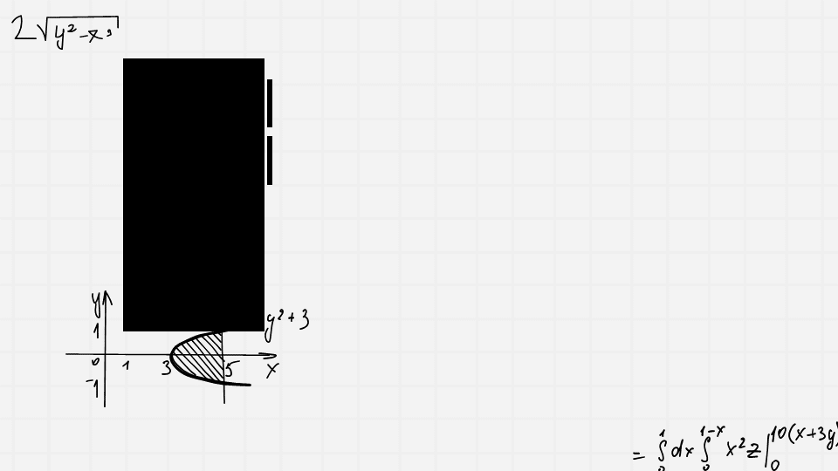
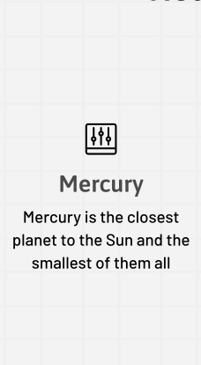
Phone mockup
You can replace the image on the screen with your own work. Just right-click on it and select “Replace image”

Slide 4
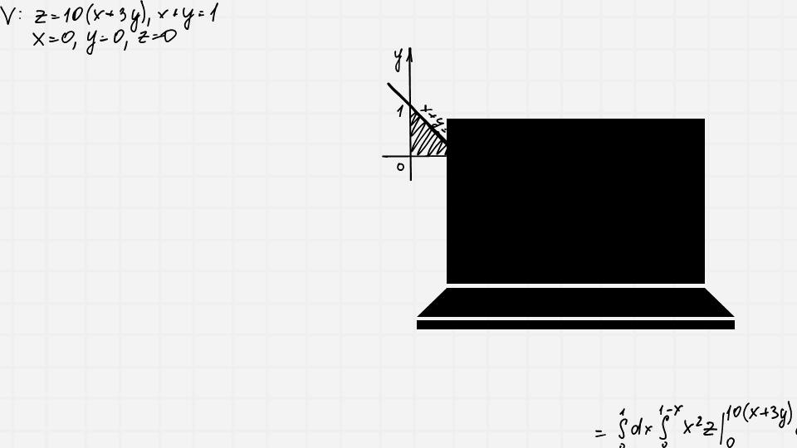
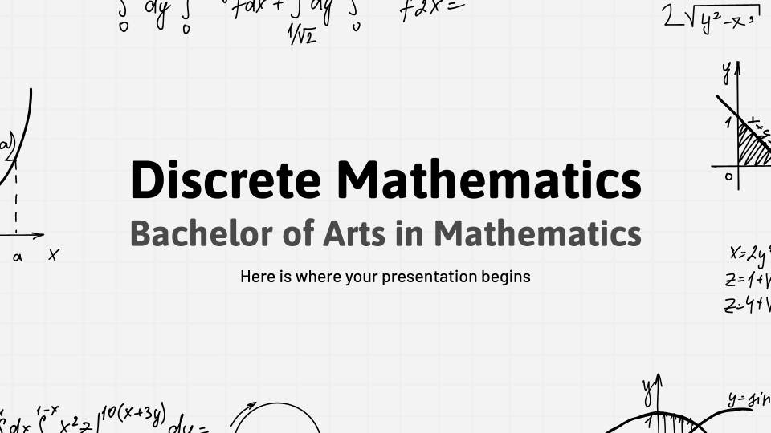
Computer mockup
You can replace the image on the screen with your own work. Just right-click on it and select “Replace image”

Slide 5
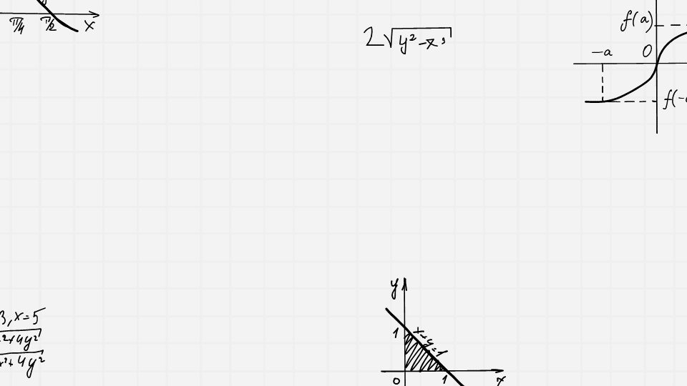
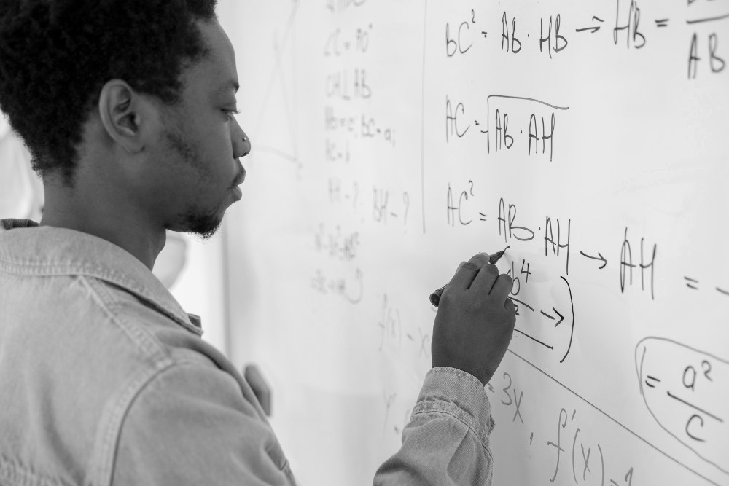
A picture always reinforces
the concept
Images reveal large amounts of data, so remember: use an image instead of a long text. Your audience will appreciate it

Slide 6
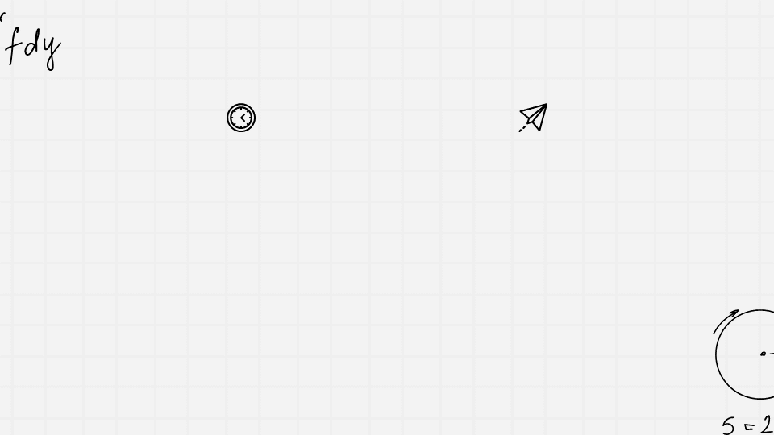
Overview of discrete mathematics
Mercury is the closest planet to the Sun and the smallest one in the entire Solar System. Contrary to popular belief, this planet's name has nothing to do with the liquid metal. Mercury was, instead, named after the famous Roman messenger god Mercurius
Mercury takes a little more than 58 days to complete its rotation, so try to imagine how long days must be there! Since the temperatures are so extreme, albeit not as extreme as on Venus, Mercury has been deemed to be non-habitable for humans

Slide 7
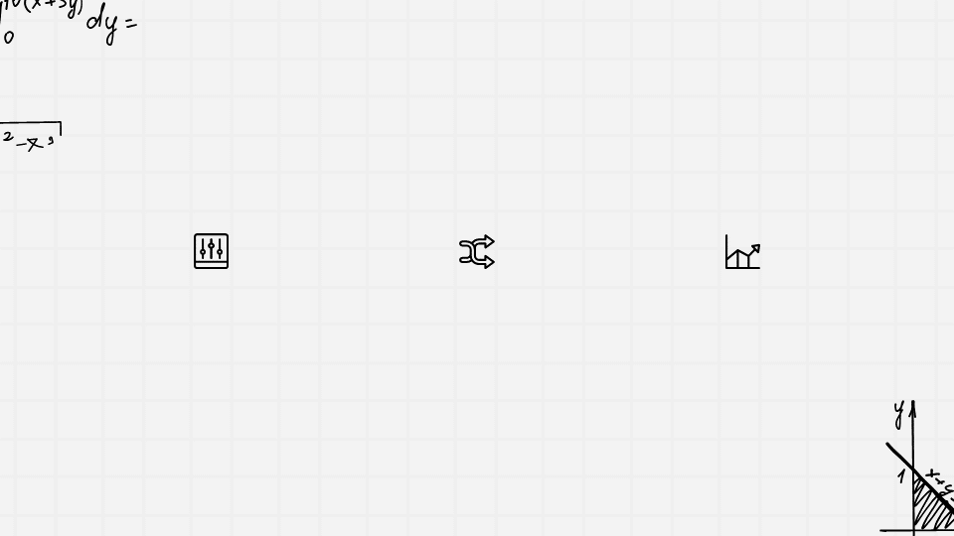
Relations and functions
Mercury is the closest planet to the Sun and the smallest of them all
Venus has a beautiful name and is the second planet from the Sun
Despite being red, Mars is actually a cold place. It’s full of iron oxide dust

Slide 8
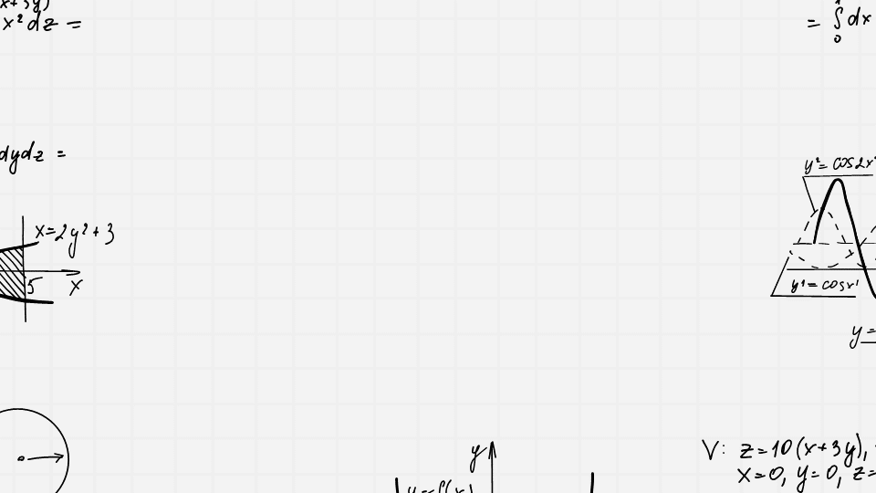
E’tiboringiz uchun rahmat!

