Slide 1
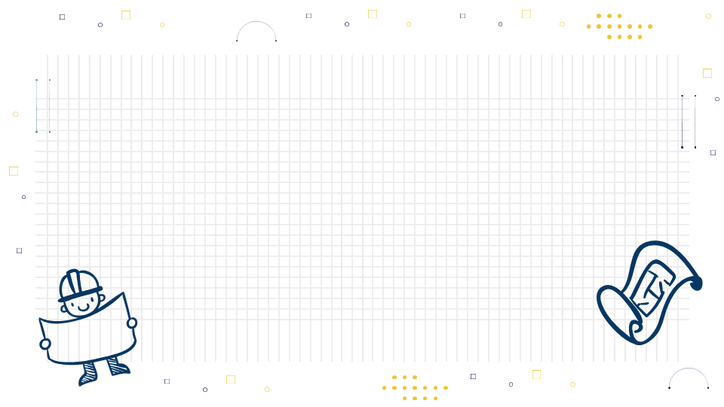
Architect Minitheme
Here is where your presentation begins

Slide 2
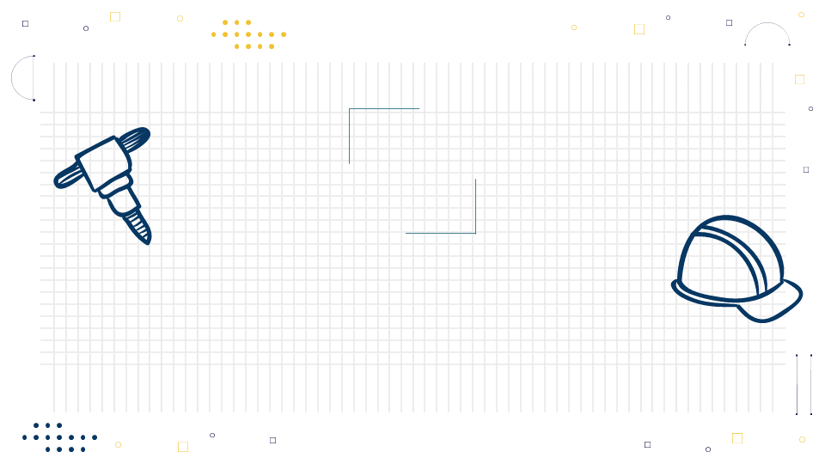
Reja
You can enter a subtitle here if you need
You can enter a subtitle here if you need
You can enter a subtitle here if you need

Slide 3
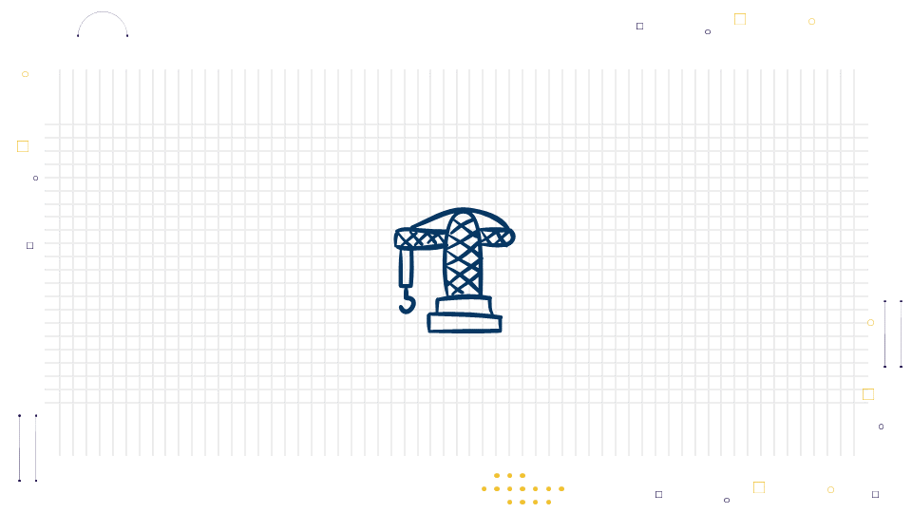
Three columns
It’s the closest planet to the Sun and the smallest one in the Solar System It’s the closest planet to the Sun and the smallest one in the Solar System It’s the closest planet to the Sun and the smallest one in the Solar System
It’s the closest planet to the Sun and the smallest one in the Solar System
It’s the closest planet to the Sun and the smallest one in the Solar System
It’s the closest planet to the Sun and the smallest one in the Solar System
It’s the closest planet to the Sun and the smallest one in the Solar System It’s the closest planet to the Sun and the smallest one in the Solar System It’s the closest planet to the Sun and the smallest one in the Solar System
It’s the closest planet to the Sun and the smallest one in the Solar System
It’s the closest planet to the Sun and the smallest one in the Solar System
It’s the closest planet to the Sun and the smallest one in the Solar System

Slide 4
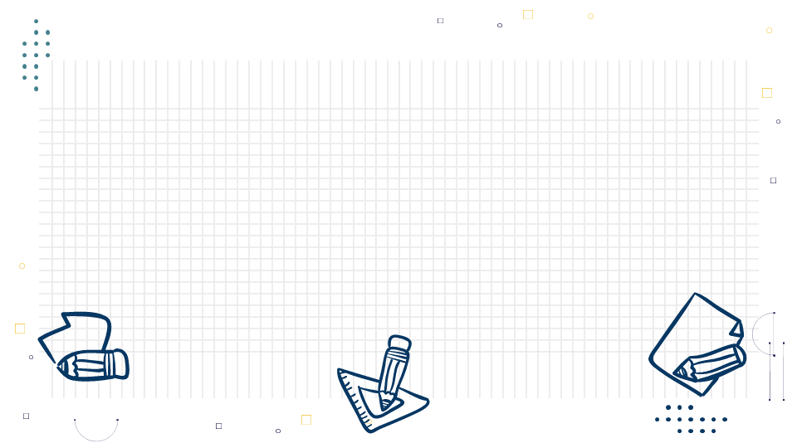
About Us
Mercury is the closest planet to the Sun and the smallest one in the entire Solar System. This planet's name has nothing to do with the liquid metal, since Mercury was named after the Roman messenger god. Despite being closer to the Sun than Venus, its temperatures aren't as terribly hot
Mercury takes a little more than 58 days to complete its rotation, so try to imagine how long days must be there! Since the temperatures are so extreme, albeit not as extreme as on Venus, and the solar radiation is so high, Mercury has been deemed to be non-habitable for humans

Slide 5
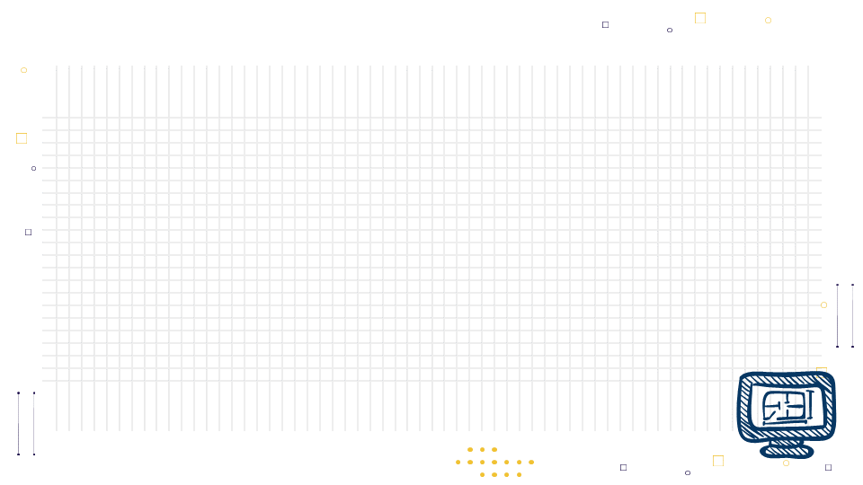

Desktop Software
Gf kjkjkhjgcjvhjjn
You can replace the image on the screen with your own work. Just right-click on it and select “Replace image”

Slide 6
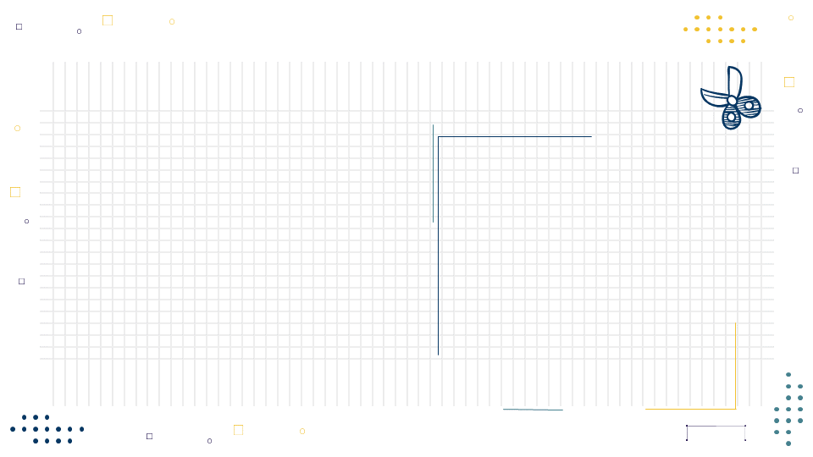
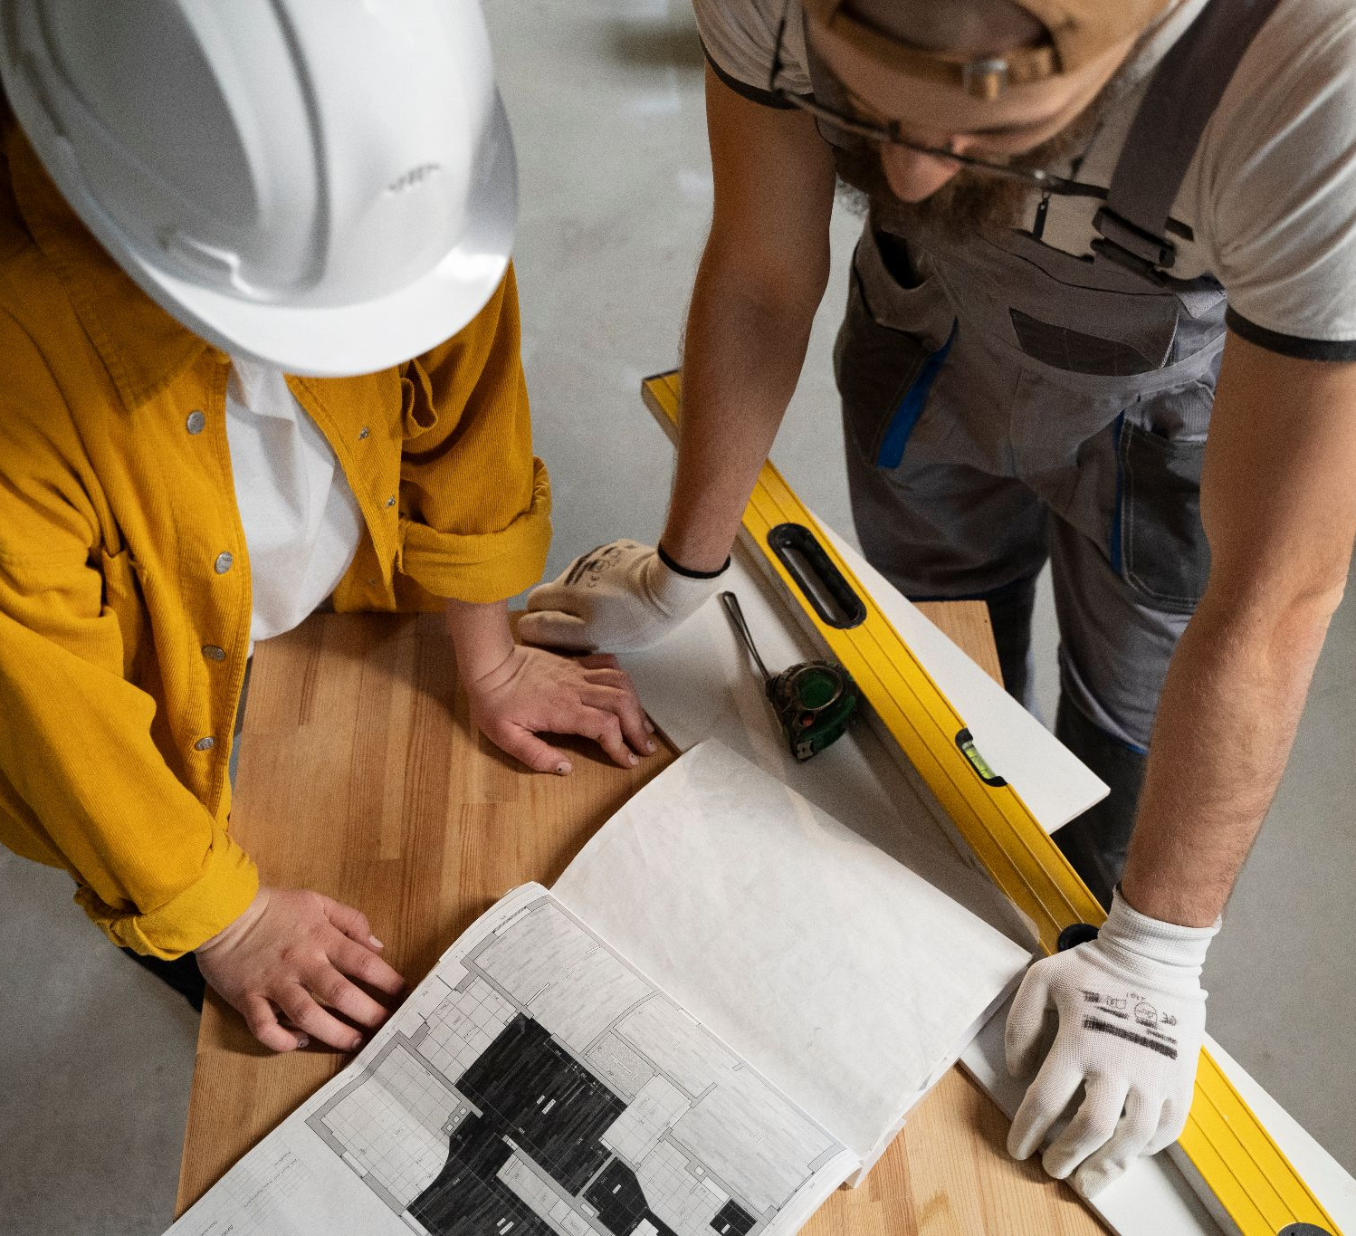
The slide title goes here!
Chghbn bjhghnkl,jnkjhvhjmn
Do you know what helps you make your point clear? Lists like this one:
They’re simple
You can organize your ideas clearly
You’ll never forget to buy milk!
You can replace the image. Just right-click on it and select “Replace image”

Slide 7
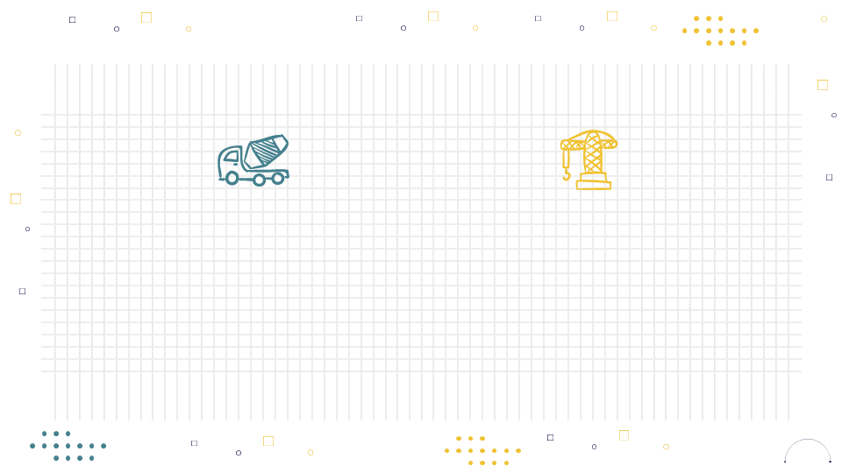
Maybe you need two columns
Mercury is the closest planet to the Sun and the smallest one in the Solar System. This planet’s name has nothing to do with the liquid metal
Venus has a beautiful name and is the second planet from the Sun. It’s hot and is the second-brightest natural object in the night sky

Slide 8
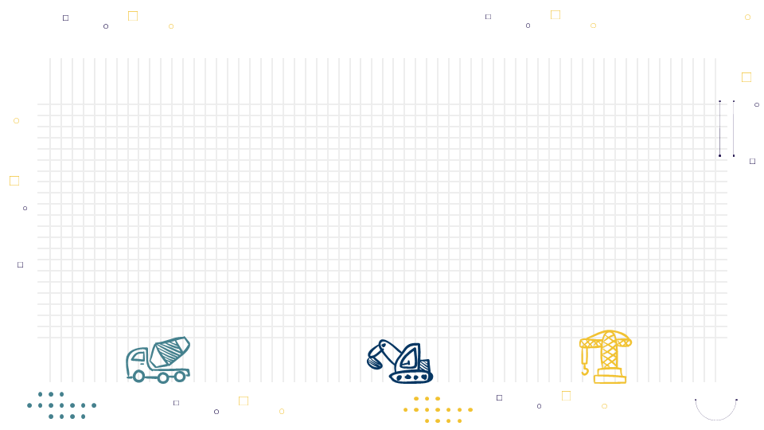
E’TIBORINGIZ UCHUN
RAHMAT!

