Slide 1

Nutrition Information System
SRS, Milestones and Presentation on understanding of Nutrition System
to
Fulfill requirement of Deliverable # 1
1
2
3
4
5
6
7

Slide 2
Contents
Deliverable details
Milestones Chart
Existing System Flow
Proposed new system and Components
Demo of proposed System (Short Version)
Suggestions, Comments and Locking of requirements for NIS Desktop based Short version
1
2
3
4
5
6
7

Slide 3
Presentation Objective
Task to be performed : Initial Study of existing System Website Architecture and general orientation about the site and existing system
Deliverable-1 : Complete Implementation proposal
including SRS document : will be handed over after 26th Sept, meeting
with scheduled milestones completion dates : coming in next slides
and presentation on understanding of Nutrition System : coming in next slides
1
2
3
4
5
6
7

Slide 4
Scheduled Milestones
Provision of Services to enhance existing Desktop based NIS Software and to design and develop web based NIS Portal for Nutrition Section of UNICEF Pakistan.
Main Activities | Sub Activities | Months
 |  | Aug |  | Sep |  | Oct |  | Nov |  | Dec |  | Jan |  | Feb |  | Mar |  | Apr |  | May |  | Jun |  | Jul
Project Inception | Project Signing
 | Initial Meeting on overall project
 | Meeting with UNICEF Team on Desktop based Application
 | Presentation of Prototype to UNICEF and Output Finalization
 | Inception Report (SRS, Milestones, Presentation on understanding of system)
Working on existing System and Upgradation and handing over | Locking of requirements with UNICEF
 | Development of Newly proposed Database of NIS
 | Development on Newly proposed short version of NIS
 | Demo – 1 to UNICEF Management
 | Demo – 2 to UNICEF Management
 | Final Demo of Desktop Based Application and Handover
New Database development, Implementation Diagrams, Use Cases etc. Basic Structure of Web Portal / Dashboard | Designing of new Database for Web based System along with presentation on Data flow diagrams of System and basic layout of Web Portal
Fully working Dashboard as per final discussion with NIS TWG along with related input screen and access of different levels of users | Fully Functional Dashboard, responding on User inputs, with User Logins and Web based reports and link with GIS Maps
Training for staff on use of the Web Management System along with Technical training on Server side Development for Master Users | Trainings and web portal documentation
Advising, testing and installation and configuration | Complete technical documentation along with source code |  | Ongoing Process through out the implementation phase
Ensure easy downloading of site pages by minimizing use of large graphics, optimizing all graphics and documents for smaller file size | Handover of all application – virtual or otherwise. All coding, all diagrams workflows and related things on DVD
1
2
3
4
5
6
7

Slide 5
Existing System Flow
Entry of Paper based forms
Paper based Admission Form, Exit Form, Screening, Sessions, Follow ups etc. filled at Field Level
Forms submitted to District IMO for Data Entry
All forms submitted to District IMO for Data Entry in NIS
Reports generated at Local level for Follow up cases and revert back to Field Offices
NIS XML submitted to PO & CO Level
NIS XML Files sent to PO (KP/FATA, Sindh, Punjab, AJK, Baluchistan) and shared with CO on monthly basis
CO Publish Monthly Report for all stakeholders (UN Agencies, I/NGOs)
Report generation at all levels for respective Geographical location
Different types of reports generated at all levels for respective geographical Locations
1
2
3
4
5
6
7

Slide 6
Proposed System COMPONENTS
IYCF Data Entry Information
CMAM Information (SC, OTP, TSFP)
4W Information Entry
MNP Consolidated Information
Vitamin A Consolidated Information
Supplies Information Data
Trainings and Session Information
Dashboard at all levels
1
2
3
4
5
6
7

Slide 7
NIS Short Version PROTOTYPE DEMO
1
2
3
4
5
6
7

Slide 8
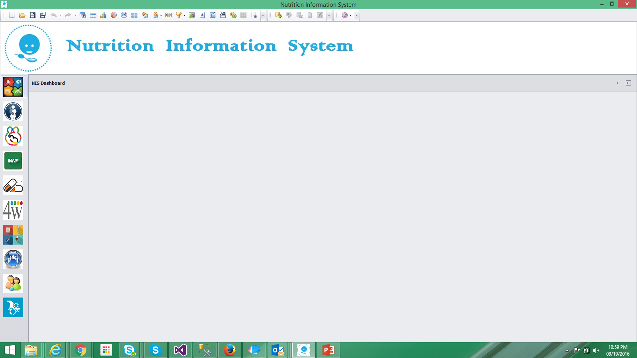
DASHBOARD
Total CMAM Sites
321
OTP | TSFP Sites
321| 1023
Total Screening
98766
OTP Admission
9734
TSFP Admission
19877
Total Exits
15987

Slide 9
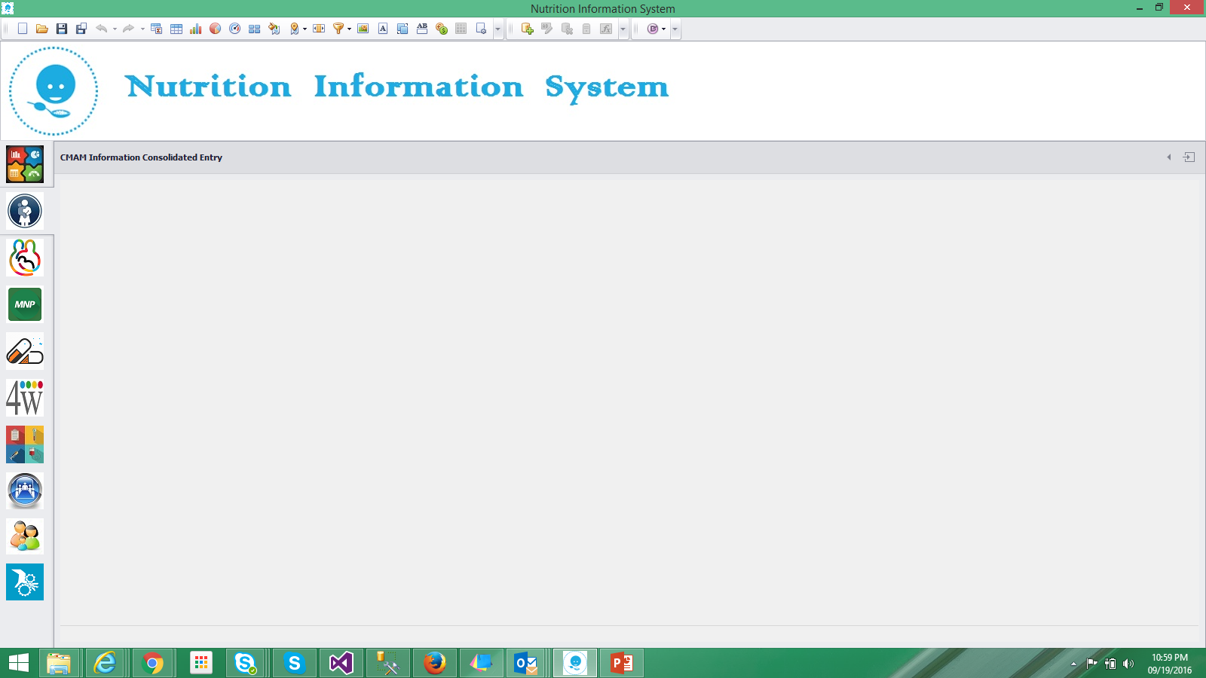
CMAM Consolidated Information entry
Country |  | Province |  | District
Tehsil |  | UC |  | Village
CMAM Site |  | Site Type | OTP/SFP | IP Type | Govt/Natl,Intl
IP Name |  | PD # |  | Project Title
Entered By |  | Entry Date & time
 | Screening | Muac < 11.5 | Muac 11.5 – 12.4 | MUAC > 12.4 | MUAC < 21 cm
Male Child
Female Child
Pregnant
Lactating

Slide 10

IYCF Consolidated Information entry
Country |  | Province |  | District
Tehsil |  | UC |  | Village
CMAM Site |  | Site Type | OTP/SFP | IP Type | Govt/Natl/Intl
IP Name |  | PD # |  | Project Title
Entered By |  | Entry Date & time
Community based IYCF Counselling [ ] Yes [ ] No
Indicators | Targets | Actuals
# of pregnant women counselled for early initiation & exclusive breast feeding.
# of targeted mother's with child < 6 months counselled for exclusive breast feeding.
# of mother's with child 6-23 months counselled for age appropriate feeding.
Health Facility Level Data Reporting Section [ ] Yes [ ] No
Indicators | Targets | Actuals
# of pregnant women attending ANC who received IFA's / MM supplementation & counselled on maternal nutritious diet.
# of mother's / caregivers of children < 2 years who received IYCF counselling.
# of HF based staff assigned for IYCF counselling.
# of Mothers of children < 24 months who are part of Mother to Mother Support Groups.

Slide 11

MNP Consolidated Information entry
Country |  | Province |  | District
Tehsil |  | UC |  | Village
CMAM Site |  | Site Type | OTP/SFP | IP Type | Govt/Natl,Intl
IP Name |  | PD # |  | Project Title
Entered By |  | Entry Date & time
Indicators | Targets | Actual
Number of children (6-23 months) received MNP
Number of children (6-23 months), who received complete treatment dosage of MNP
Number of children in each age group received vitamin A capsule through campaign-style in semester 1
Number of children in each age group received vitamin A capsule through campaign-style in semester 2
Annual coverage of Vitamin A (semester 1 & 2)

Slide 12

Vitaman A Consolidated Information entry
Country |  | Province |  | District
Tehsil |  | UC |  | Village
CMAM Site |  | Site Type | OTP/SFP | IP Type | Govt/Natl,Intl
IP Name |  | PD # |  | Project Title
Entered By |  | Entry Date & time
TBD ?

Slide 13

4W Consolidated Information entry
Country |  | Province |  | District
Tehsil |  | UC |  | Village
CMAM Site |  | Site Type | OTP/SFP | IP Type | Govt/Natl,Intl
IP Name |  | PD # |  | Project Title
Entered By |  | Entry Date & time
Donor / Funding Organization |  | Project Owner |  | Project Owner Org. Type
Activity |  | Activity Description |  | Activity Start Date |  | Activity End Date
Target (Number) |  | Achieved (Number) |  | Acivity Unit
Targets Beneficiaries | Families | Women | Men | Girls | Boys | Other Beneficiaries
Actual Benefiairies | Families | Women | Men | Girls | Boys | Other Beneficiaries

Slide 14

Supplies Consolidated Information entry
Country |  | Province |  | District
Tehsil |  | UC |  | Village
CMAM Site |  | Site Type | OTP/SFP | IP Type | Govt/Natl,Intl
IP Name |  | PD # |  | Project Title
Entered By |  | Entry Date & time
S. No | Items Description | Units | Opening Stock (Closing of previous month) | Quantity Received (Received in reporting month) | Quantity Used (Used in reporting month) | Quantity in hand | Item Expiry date | Project End date | Remarks / Notes
Supply Sheet

Slide 15

Training & Session Consolidated Information entry
Country |  | Province |  | District
Tehsil |  | UC |  | Village
CMAM Site |  | Site Type | OTP/SFP | IP Type | Govt/Natl,Intl
IP Name |  | PD # |  | Project Title
Entered By |  | Entry Date & time
# of Health facilities with assigned HR for IYCF counselling
total number of health facilities in a targeted district.
No. of Sessions conducted
No. of trainings conducted

Slide 16
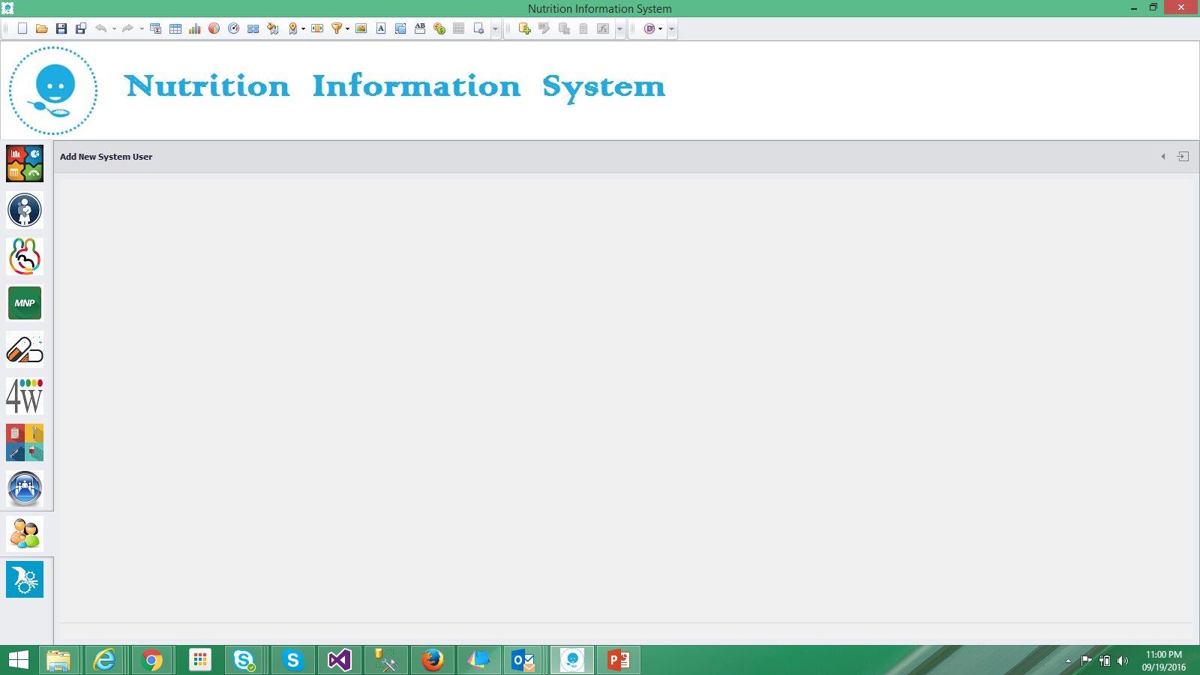
User / Rights Management / Geographical Location Setup
Country |  | Province |  | District
Tehsil |  | UC |  | Village
CMAM Site |  | Site Type | OTP/SFP | IP Type | Govt/Natl,Intl
IP Name |  | PD # |  | Project Title

Slide 17

Setup Information
Adding all Basic Settings
Country,
Province,
District,
Tehsil
UC
Village
Project Information
IP names
Donor Information

Slide 18
Suggestions & Comments
For
Locking Requirements

Slide 19
Supply Sheet
S. No | Items Description | Units | Opening Stock (Closing of previous month) | Quantity Received (Received in reporting month) | Quantity Used (Used in reporting month) | Quantity in hand | Item Expiry date | Project End date | Remarks / Notes
UNICEF Food Supplies
1 | Therapeutic spread, sachet 92g/CAR-150 | CAR | 142 |  | 25 | 117 | 31-Aug-16 | 30-Jun-15
UNICEF Medicines Supplies
2 | Fe (as fum) +folic 60+0.4mg tab/PAC-1000 | PAC | 0 |  | 0 | 0
3 | Folic acid 5mg tabs/PAC-1000 | PAC | 0 |  | 0 | 0
4 | Micronutrient,film-coated tabs/PAC-1000 | PAC | 26 |  | 4 | 22 | 31-Aug-16
5 | Multiple micronutrient pdr,sach./PAC-30 | PAC | 0 |  | 0 | 0
6 | Amoxici.pdr/oral sus 125mg/5ml/BOT-100ml | BOT
7 | Paracetamol 125mg/5ml or.sol/BTL-60ml | BOT
8 | Mebendazole 500mg chewable tabs/PAC-100 | PAC
9 | Metronidazol pdr/o.s.200mg/5ml/BOT-100ml | PAC
10 | Ferrous sulp.oral sol.drops 125mg/ml/BOT-30ml | BOT
11 | Chloroquine syrup 50mg/5ml/BOT-60ml | BOT
12 | Benzyl benzoate 25% lotion /BOT-1000ml | BOT
13 | Zinc 20mg tablets/PAC-100 | PAC
Anthropometry Supplies
14 | Baby/child L-hgt mea.system/SET-2 | EA
15 | Scale,electronic,mother/child,150kgx100g | EA
16 | MUAC,Adult,without colour code/PAC-50 | EA
17 | MUAC,Child 11.5 Red/PAC-50 | EA
UNWFP Food Supplies
1 | Fortified Blended Food ( FBF) PKT of 2.5kg | KG | 2,231 | 3,040 | 5,271 | 0 | 30-Sep-15 | 31-Jul-15
2 | Acha Mum ( RUSF) Sachet of 100 gms | KG | 81 | 50,250 | 50,331 | 0 | 10-Jan-16 | 31-Jul-15
3 | Veg. Oil Can of 1 kg | KG | 512 | 1,687 | 2,199 | 0 | 31-Dec-16 | 31-Jul-15

