Slide 1


Turnover Prediction for MilliÖN Payment Terminals
Data-Driven Approach

Slide 2

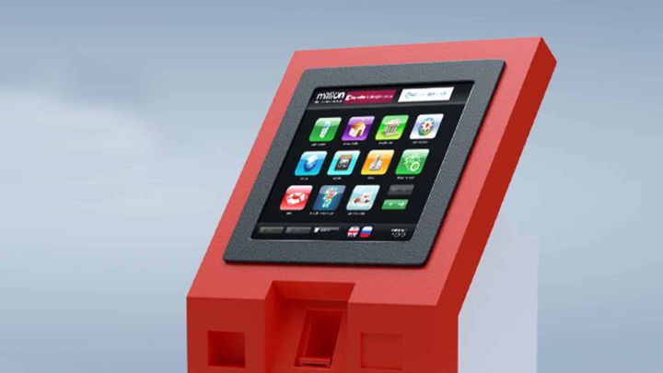

Introduction
“PashaPay” Limited Liability (“PashaPay” or “PashaPay” LLC) was established as a FinTech company on April 29, 2022.
Products
MilliÖN
M10

Slide 3
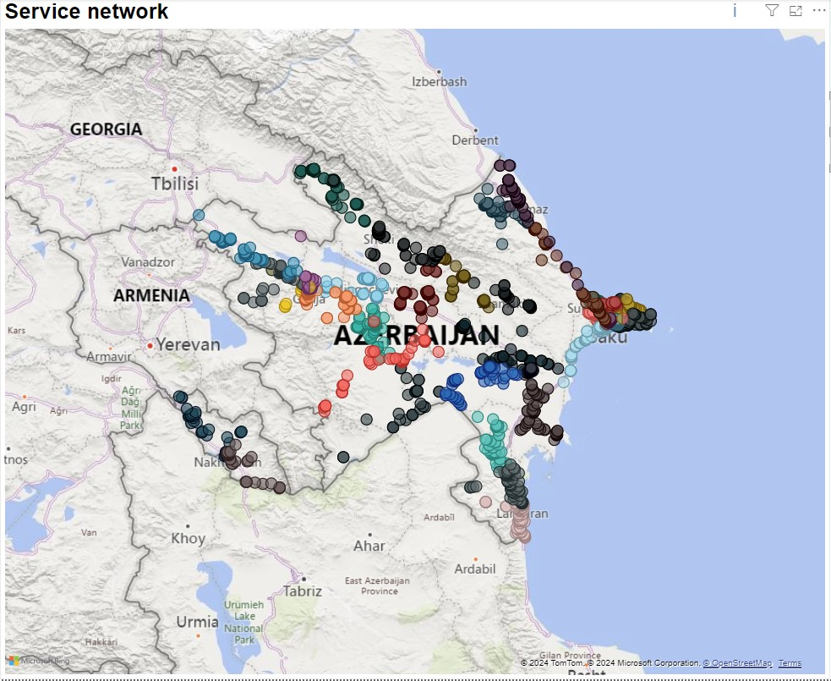
Problem
Optimal Placement Strategy
Where Should the Terminal Go?
Current Method: Trial and Error
Proposed Approach: Data-Driven Methodology
Importance
Utilizing resources in the most efficient and
effective manner

Slide 4
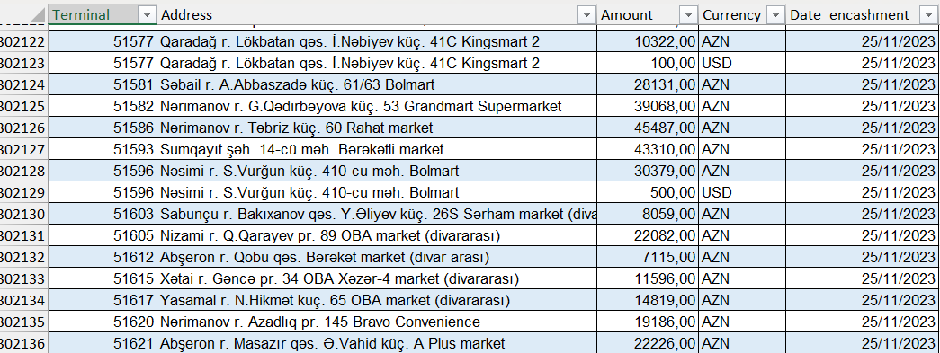
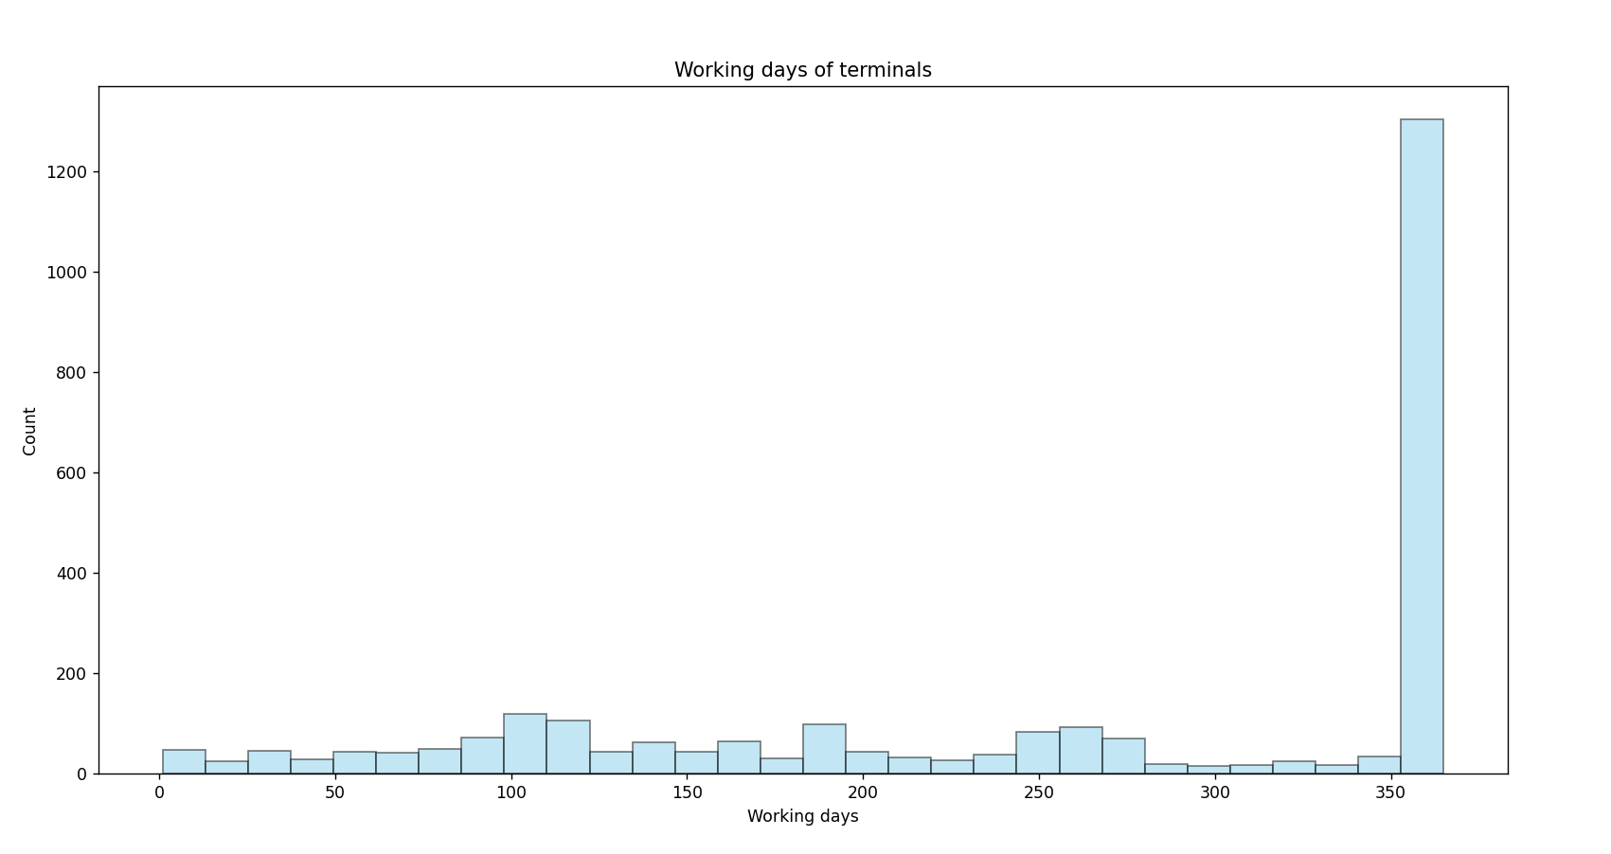
Dataset
To overcome some seasonal problems, I used the yearly report
Target – Monthly Turnover
Outliers

Slide 5
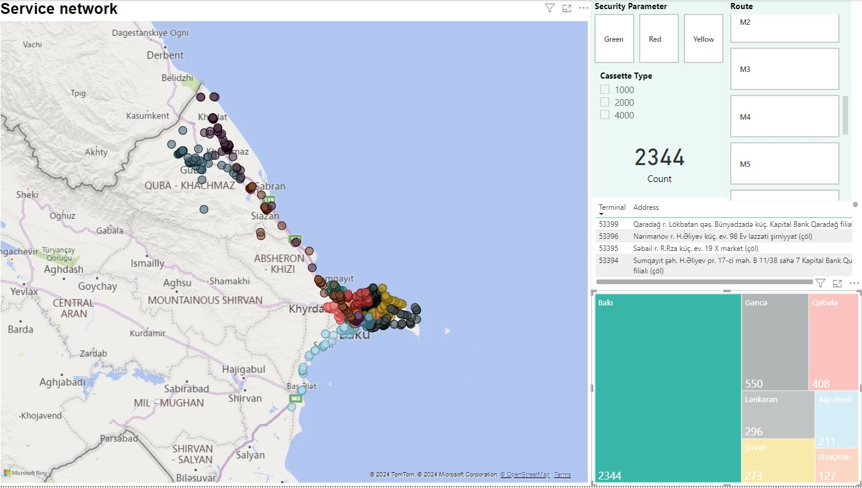
Features
Terminal count by address
Locations (city, district, street etc.)
Markets (OBA and AL market)
Market types
Banks
Working hours of terminals
stat.gov.az (Pirallahı)
Kapital Bank

Slide 6
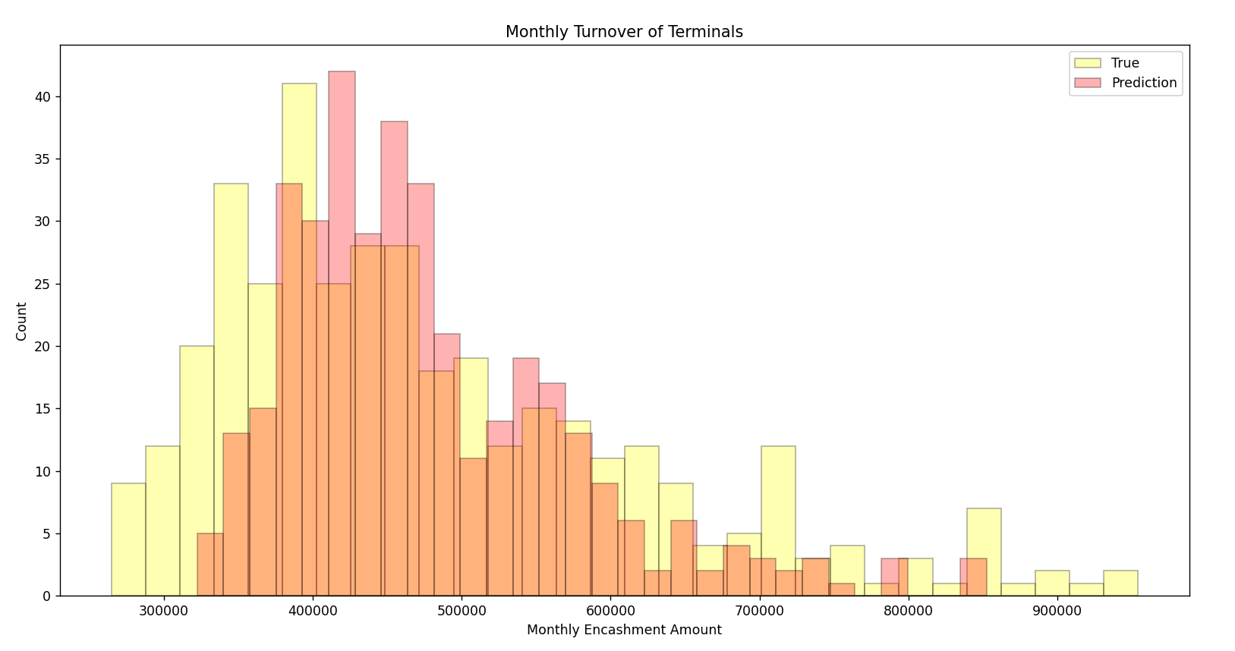
Results
Threshold – 28%
SmallError / Test = 70+ %

Slide 7
Thank you!
Ulvi Hasanov
ulvi.hasanov@pashapay.az

