Slide 1

Turnover Prediction
for MilliÖN Payment
Terminals
Data-Driven Approach
MilliÖN

Slide 2
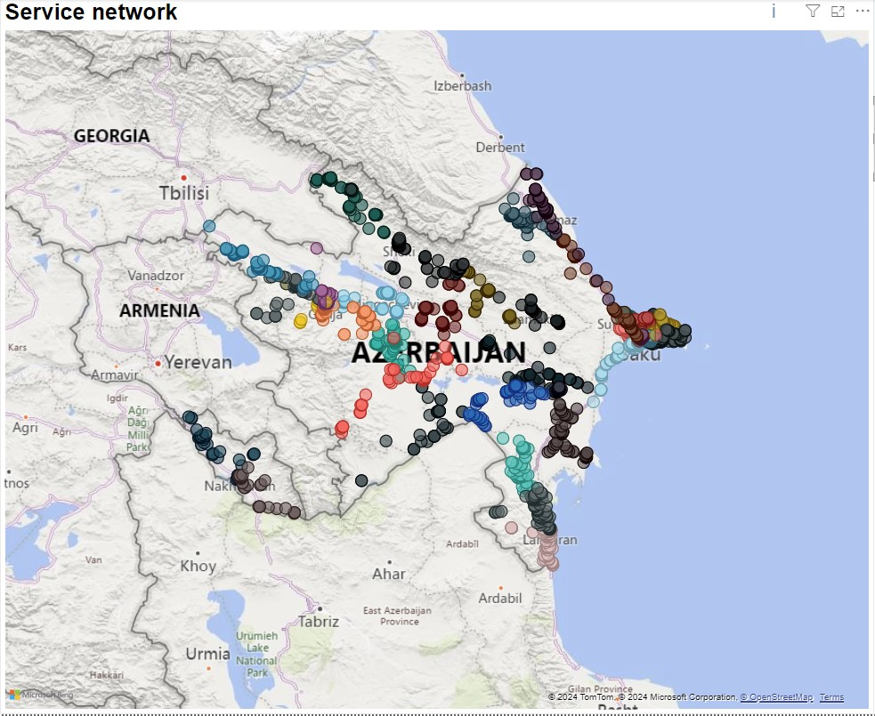
Problem
Optimal Placement Strategy
Where Should the Terminal Go?
Current Method: Trial and Error
Proposed Approach: Data-Driven Methodology
Importance
Utilizing resources in the most efficient and effective manner

Slide 3
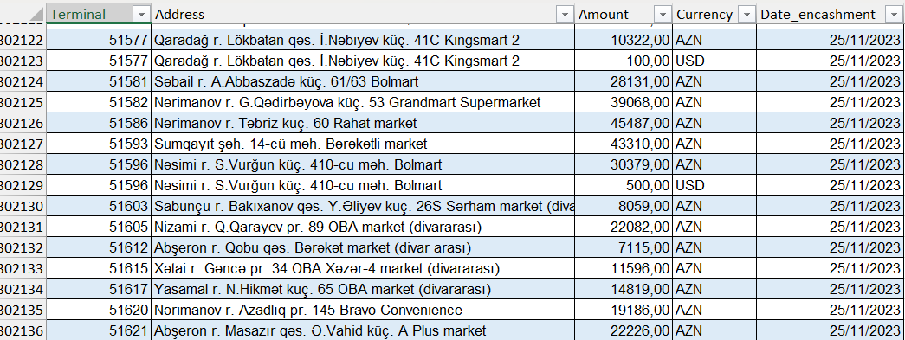
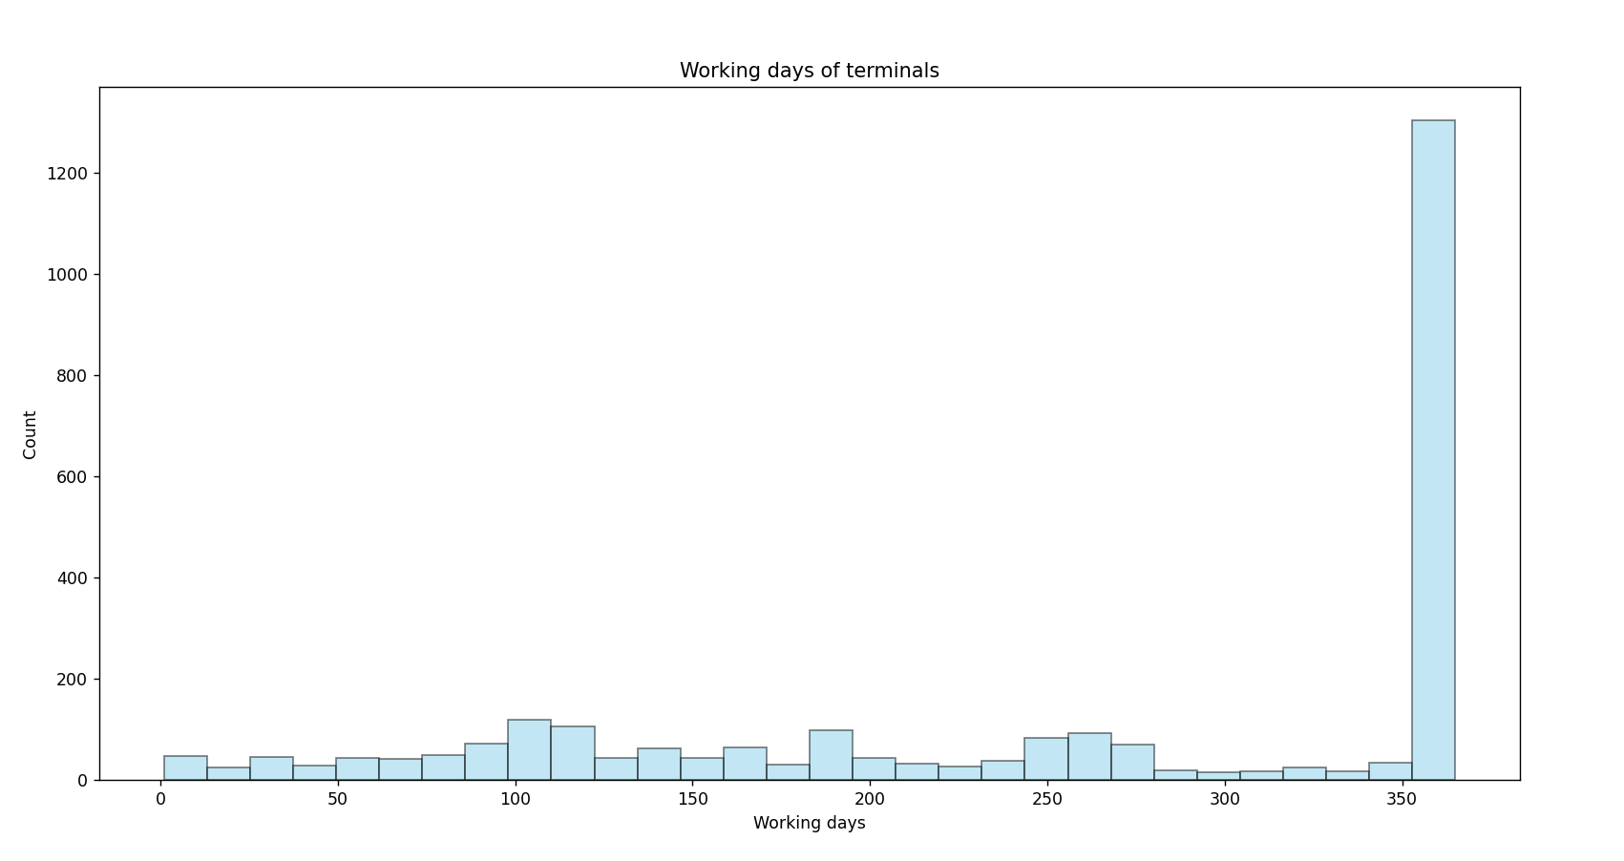
Dataset
To overcome some seasonal problems, I used the yearly report
Target – Monthly Turnover
Outliers

Slide 4
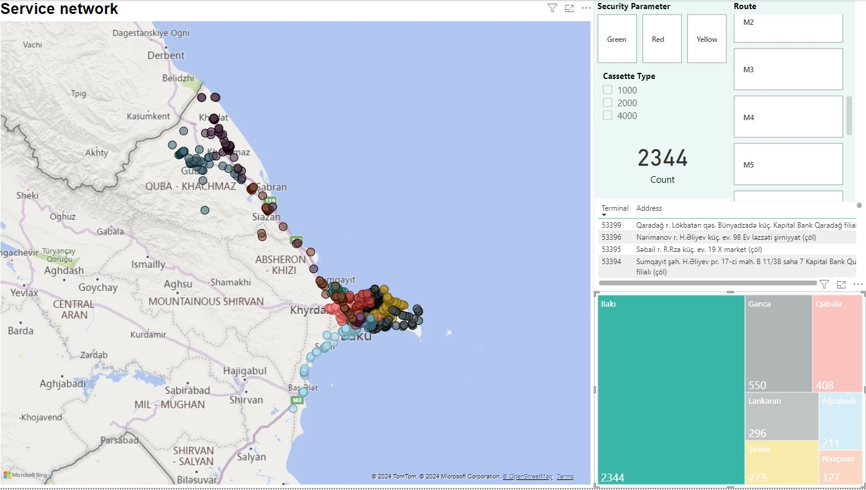
Features
Terminal count by address
Locations (city, district, street etc.)
Markets (OBA and AL market)
Market types
Banks
Working hours of terminals
stat.gov.az (Pirallahı)
Kapital Bank

Slide 5
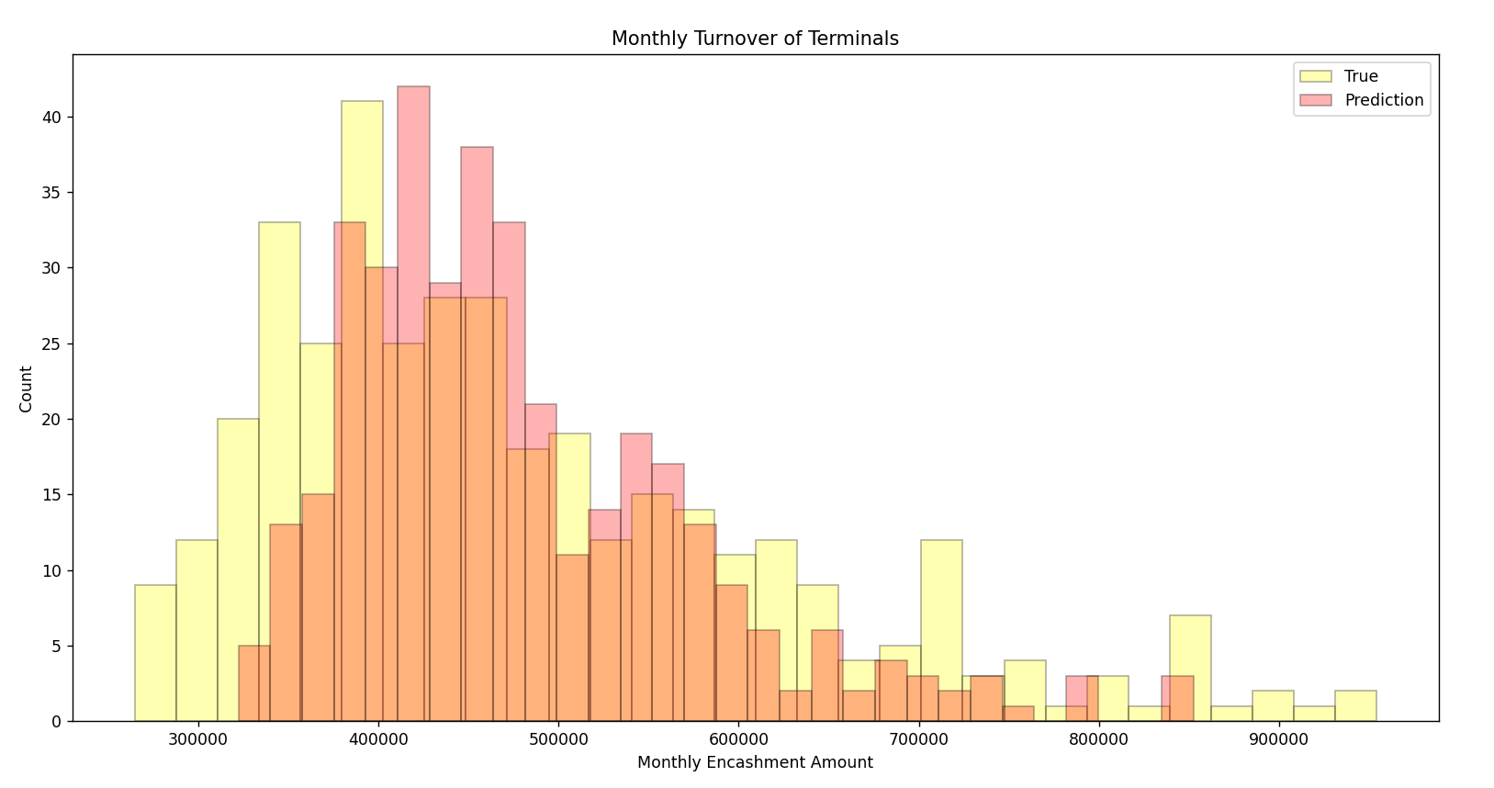
Results
Algorithm: XGBoost
Threshold – 28%
SmallError / Test = 70 %

Slide 6
Recommendation: Address Standardization
Address | Abbreviation
İçərişəhər m/s | Icherisheher Metro
İçərişəhər Metro Stansiyası | Icherisheher Metro
Xacmaz r, N,Narimanov kuc, | Xachmaz r, N.Narimanov kuch.
Xaçmaz r. S.Qurbanov küç. | Xachmaz r, S.Qurbanov kuch.
1. Structured Addresses: City, Street, Market, Bank, etc.
2. Data Encoding: Utilizing Zip Codes and Abbreviations
ex. Replacing of [küçə, massivi, prospekti, yolu] with [str]
Advantages
1. More Accurate Calculation, Optimization and Cost saving
2. Effective Segmentation for Targeted Marketing
3. Improved Business Understanding

Slide 7
Thank You!
Ulvi Hasanov
ulvi.hasanov@pashapay.az

