Slide 1
ADVANCE THEORY AND DESIGN OF ALGORITHM
Lecture 2a: Boolean Algebra
Instructor: Aqib Perwaiz
ABASYN UNIVERSITY

Slide 2
Boolean Algebra
Equations involving two values and three primary operators:
  OR : symbol + , X = A + B ➔ X is true if at least one of
  A or B is true
  AND : symbol . , X = A . B ➔ X is true if both A and B
  are true
  NOT : symbol , X = A ➔ X is the inverted value of A

Slide 3
Boolean Algebra Rules
Identity law : A + 0 = A ; A . 1 = A
Zero and One laws : A + 1 = 1 ; A . 0 = 0
Inverse laws : A . A = 0 ; A + A = 1
Commutative laws : A + B = B + A ; A . B = B . A
Associative laws : A + (B + C) = (A + B) + C
A . (B . C) = (A . B) . C
Distributive laws : A . (B + C) = (A . B) + (A . C)
A + (B . C) = (A + B) . (A + C)

Slide 4
DeMorgan’s Laws
A + B = A . B
A . B = A + B

Slide 5


Pictorial Representations
AND OR NOT
Source: H&P textbook
What logic function is this?
Source: H&P textbook

Slide 6
Boolean Equation
Consider the logic block that has an output E that is true
only if exactly two of the three inputs A, B, C are true

Slide 7
Boolean Equation
Consider the logic block that has an output E that is true
only if exactly two of the three inputs A, B, C are true
Multiple correct equations:
Two must be true, but all three cannot be true:
E = ((A . B) + (B . C) + (A . C)) . (A . B . C)
Identify the three cases where it is true:
E = (A . B . C) + (A . C . B) + (C . B . A)

Slide 8
Sum of Products
Can represent any logic block with the AND, OR, NOT operators
  Draw the truth table
  For each true output, represent the corresponding inputs
  as a product
  The final equation is a sum of these products
A B C E
0 0 0 0
0 0 1 0
0 1 0 0
0 1 1 1
1 0 0 0
1 0 1 1
1 1 0 1
1 1 1 0
(A . B . C) + (A . C . B) + (C . B . A)
Can also use “product of sums”
Any equation can be implemented
with an array of ANDs, followed by
an array of ORs

Slide 9
NAND and NOR
NAND : NOT of AND : A nand B = A . B
NOR : NOT of OR : A nor B = A + B
NAND and NOR are universal gates, i.e., they can be
used to construct any complex logical function

Slide 10
Common Logic Blocks – Decoder
Takes in N inputs and activates one of 2^{N} outputs
I₀ I₁ I₂ O₀ O₁ O₂ O₃ O₄ O₅ O₆ O₇
0 0 0 1 0 0 0 0 0 0 0
0 0 1 0 1 0 0 0 0 0 0
0 1 0 0 0 1 0 0 0 0 0
0 1 1 0 0 0 1 0 0 0 0
1 0 0 0 0 0 0 1 0 0 0
1 0 1 0 0 0 0 0 1 0 0
1 1 0 0 0 0 0 0 0 1 0
1 1 1 0 0 0 0 0 0 0 1
3-to-8
Decoder
I₀₋₂
O₀₋₇

Slide 11
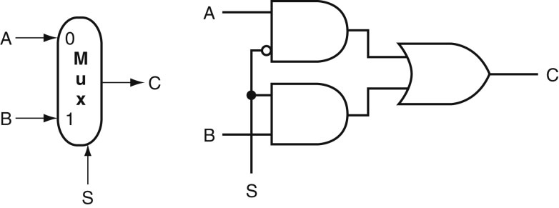
Common Logic Blocks – Multiplexor
Multiplexor or selector: one of N inputs is reflected on the
output depending on the value of the log₂N selector bits
2-input mux
Source: H&P textbook

Slide 12
Adder Algorithm
1 0 0 1
0 1 0 1
Sum 1 1 1 0
Carry 0 0 0 1
Truth Table for the above operations:
A B Cin Sum Cout
0 0 0
0 0 1
0 1 0
0 1 1
1 0 0
1 0 1
1 1 0
1 1 1

Slide 13
Adder Algorithm
1 0 0 1
0 1 0 1
Sum 1 1 1 0
Carry 0 0 0 1
Equations:
Sum = Cin . A . B +
B . Cin . A +
A . Cin . B +
A . B . Cin
Cout = A . B . Cin +
A . B . Cin +
A . Cin . B +
B . Cin . A
= A . B + A . Cin . B +
B . Cin . A
Truth Table for the above operations:
A B Cin Sum Cout
0 0 0 0 0
0 0 1 1 0
0 1 0 1 0
0 1 1 0 1
1 0 0 1 0
1 0 1 0 1
1 1 0 0 1
1 1 1 1 1

Slide 14
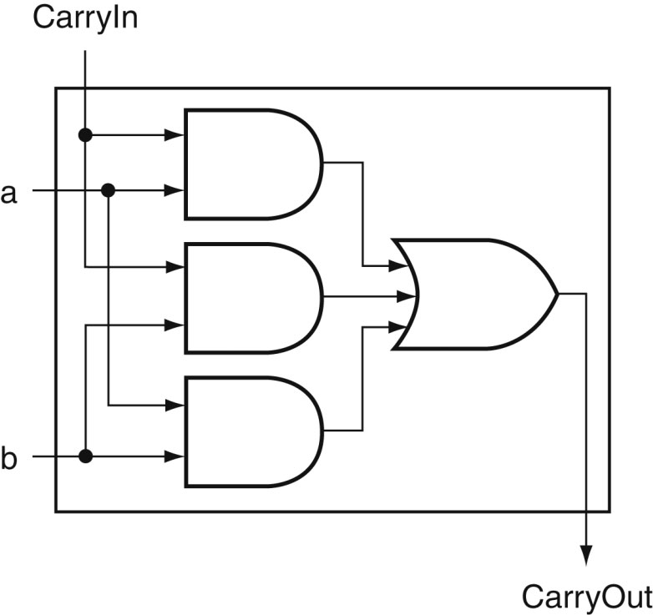
Carry Out Logic
Equations:
Sum = Cin . A . B +
B . Cin . A +
A . Cin . B +
A . B . Cin
Cout = A . B . Cin +
A . B . Cin +
A . Cin . B +
B . Cin . A
= A . B + A . Cin . B + B . Cin . A
Source: H&P textbook

Slide 15
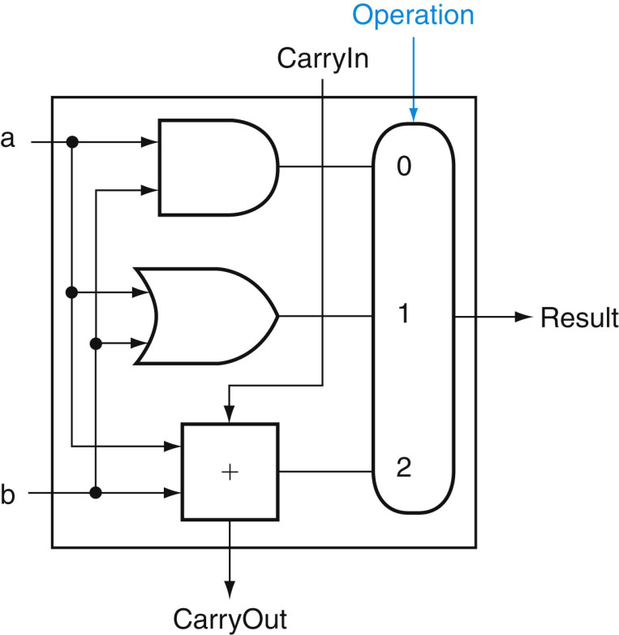
1-Bit ALU with Add, Or, And
Multiplexor selects between Add, Or, And operations
Source: H&P textbook

Slide 16
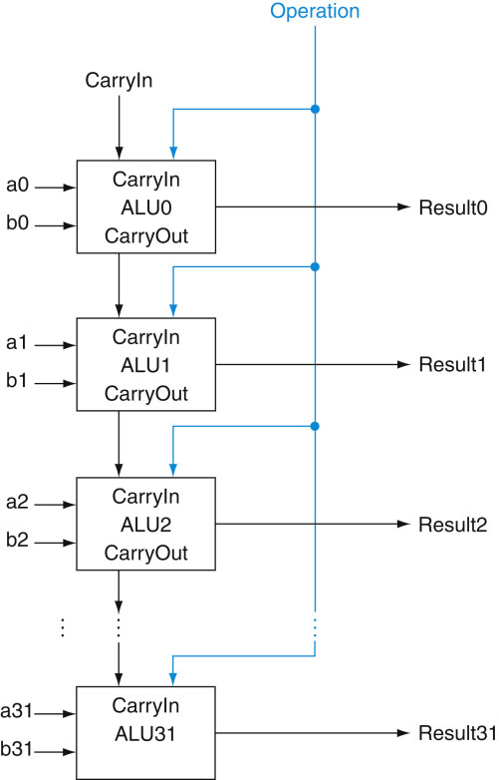
32-bit Ripple Carry Adder
1-bit ALUs are connected
“in series” with the
carry-out of 1 box
going into the carry-in
of the next box
Source: H&P textbook

Slide 17
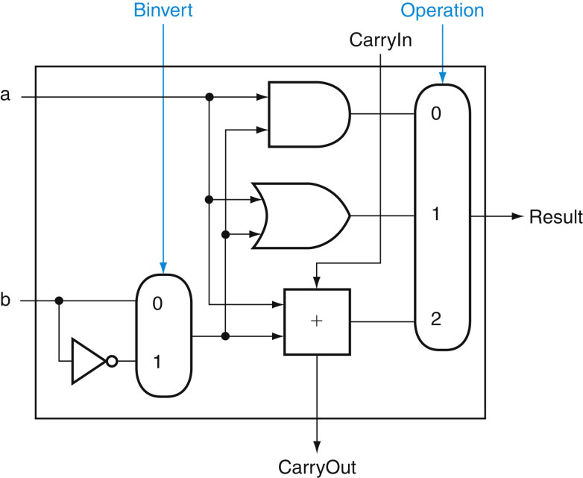
Incorporating Subtraction
Must invert bits of B and add a 1
  Include an inverter
  CarryIn for the first bit is 1
  The CarryIn signal (for the
  first bit) can be the same
  as the Binvert signal
Source: H&P textbook

Slide 18
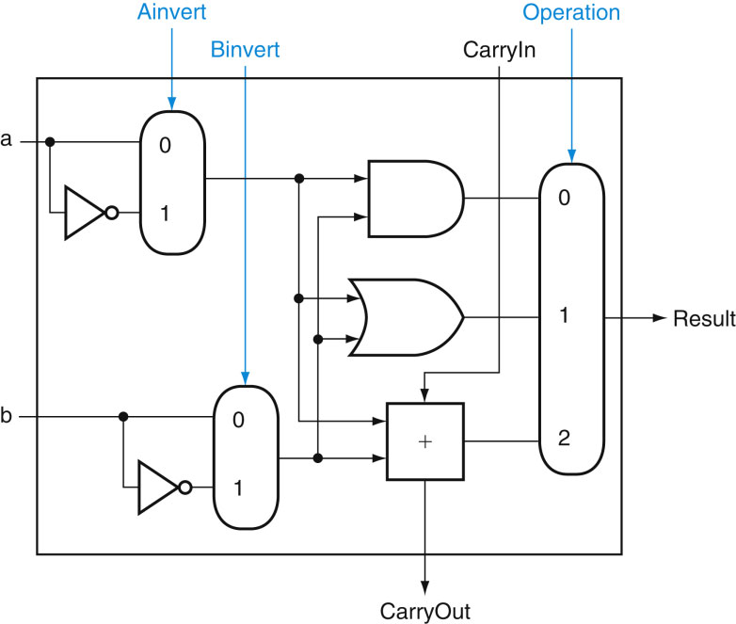
Incorporating NOR and NAND
Source: H&P textbook

Slide 19
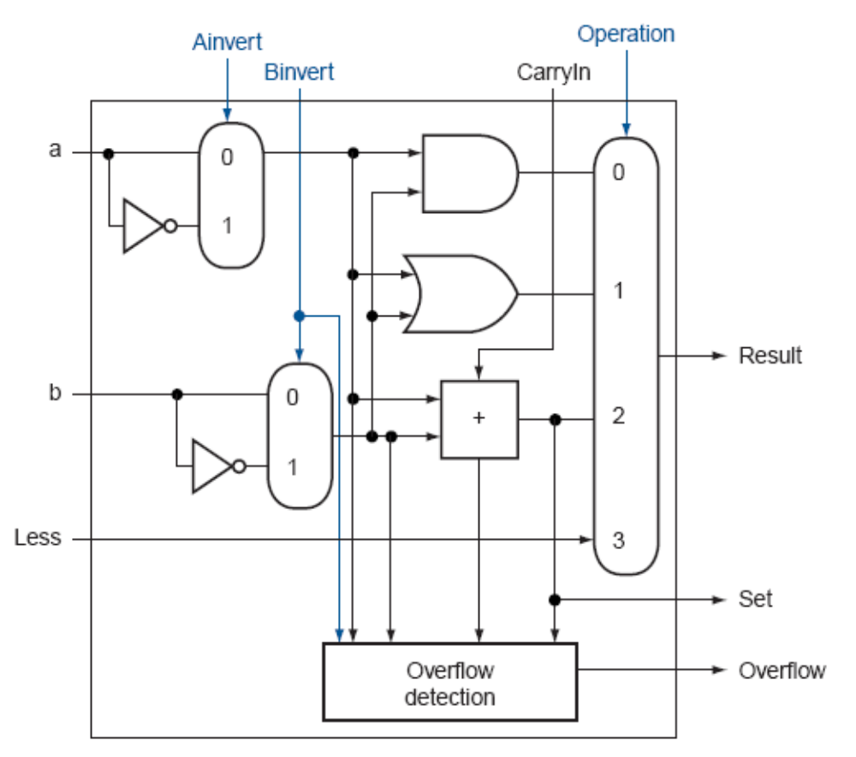
Incorporating slt
Perform a – b and check
the sign
New signal (Less) that
is zero for ALU boxes
1-31
The 31st box has a unit
to detect overflow and
sign – the sign bit
serves as the Less
signal for the 0th box
Source: H&P textbook

Slide 20
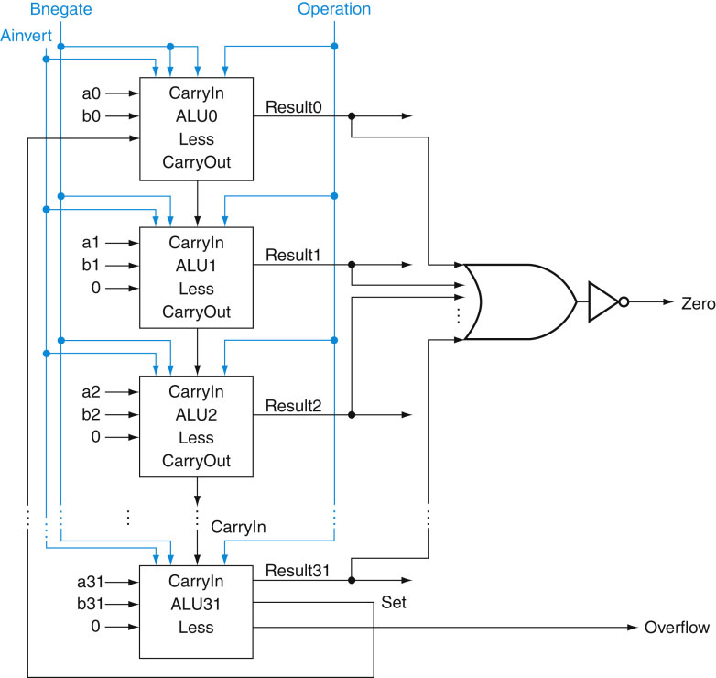
Incorporating beq
Perform a – b and
confirm that the
result is all zero’s
Source: H&P textbook

Slide 21
Control Lines
What are the values
of the control lines
and what operations
do they correspond to?
Source: H&P textbook

Slide 22
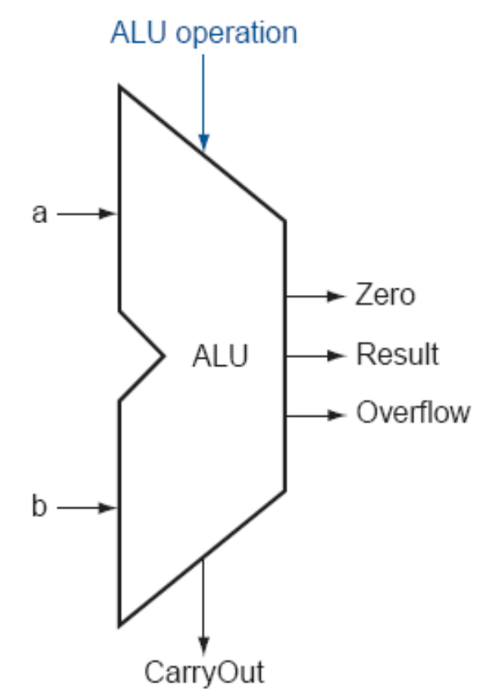
Control Lines
What are the values
of the control lines
and what operations
do they correspond to?
Ai Bn Op
AND 0 0 00
OR 0 0 01
Add 0 0 10
Sub 0 1 10
SLT 0 1 11
NOR 1 1 00
Source: H&P textbook

Slide 23
Title
Bullet

