Slide 1

Prepared by Qasim Batrawi & Taleed Hamadneh
Low-Power GDI Master-Slave D Flip-Flop Design and Performance Comparison with CMOS in 22nm Technology
June 15, 2025

Slide 2
Introduction
Our project proposes a new optimized GDI-based DFF
design that addresses these issues. The design is analyzed andcompared with conventional CMOS DFFs using simulation in a 22nm CMOS process.

Slide 3
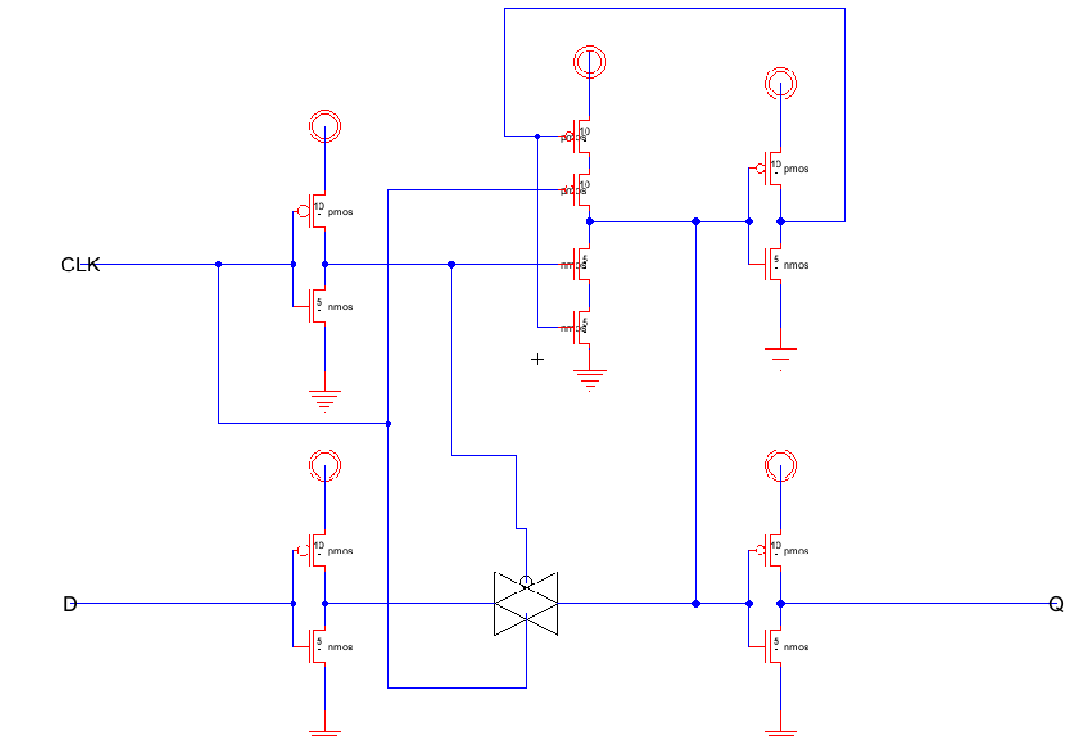
CMOS N-Latch

Slide 4
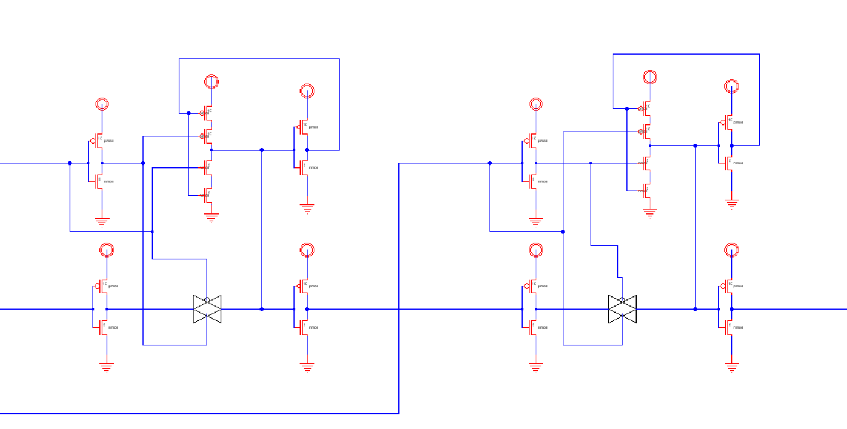
CMOS DFF Schematic

Slide 5
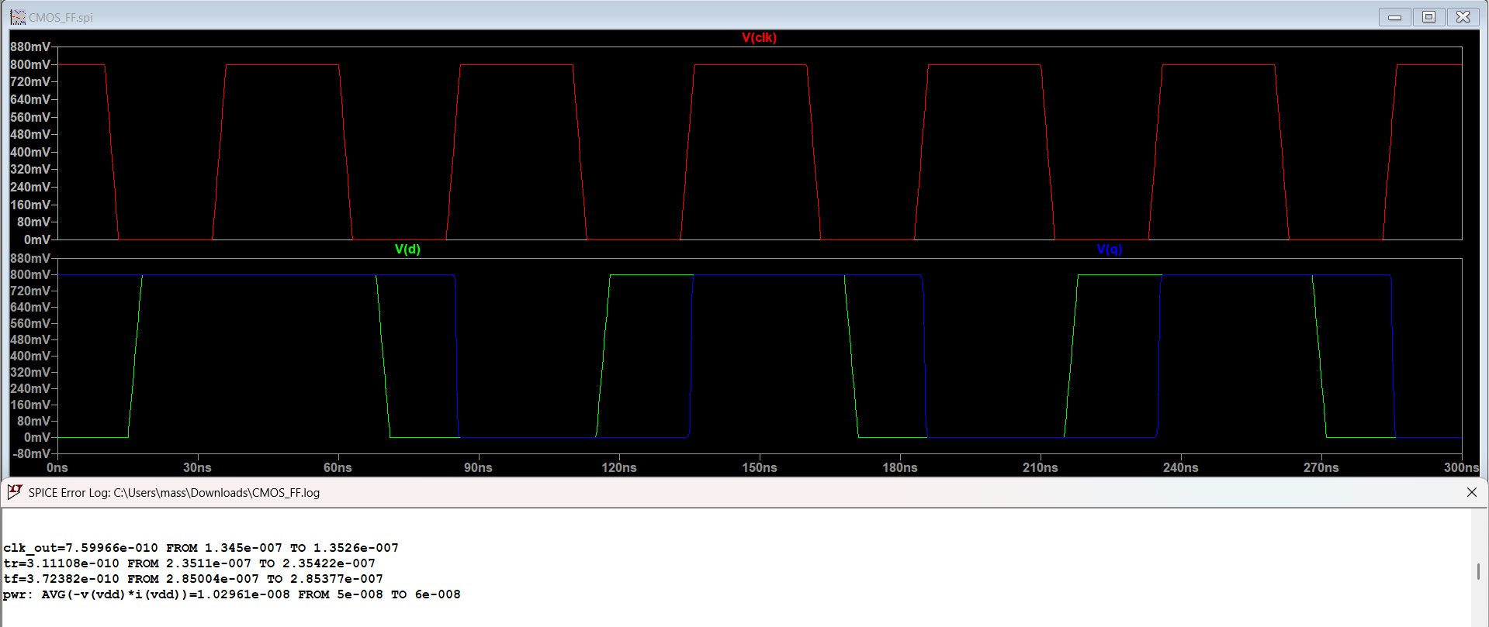
CMOS DFF Schematic Simulation

Slide 6
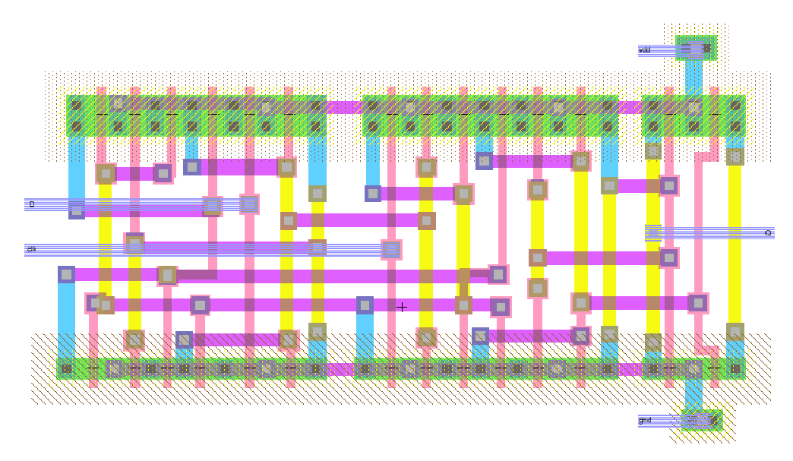
CMOS DFF Layout

Slide 7
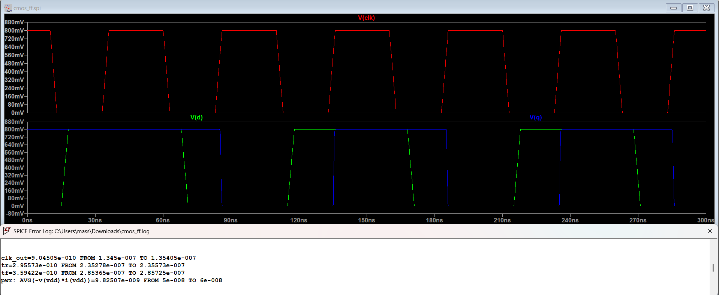
CMOS DFF Layout Simulation

Slide 8
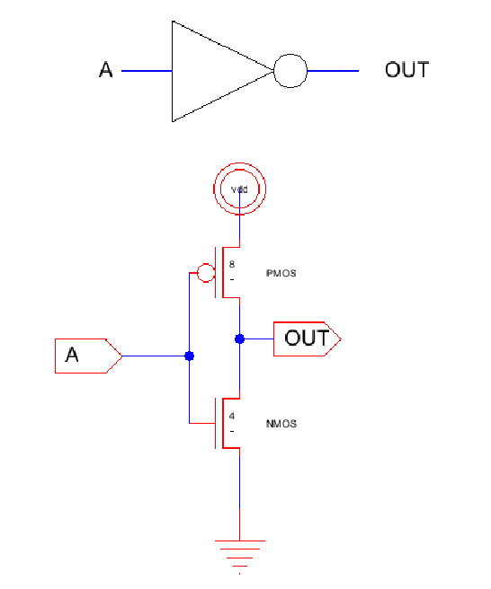
Inverter Schematic

Slide 9
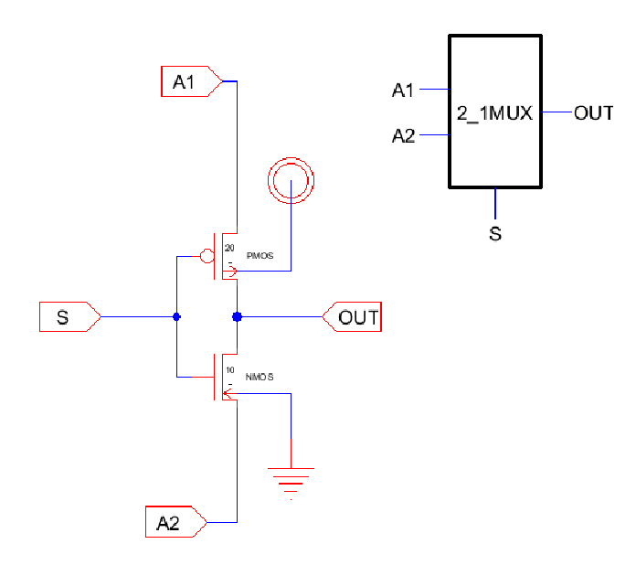
GDI 2-1 MUX Schematic

Slide 10
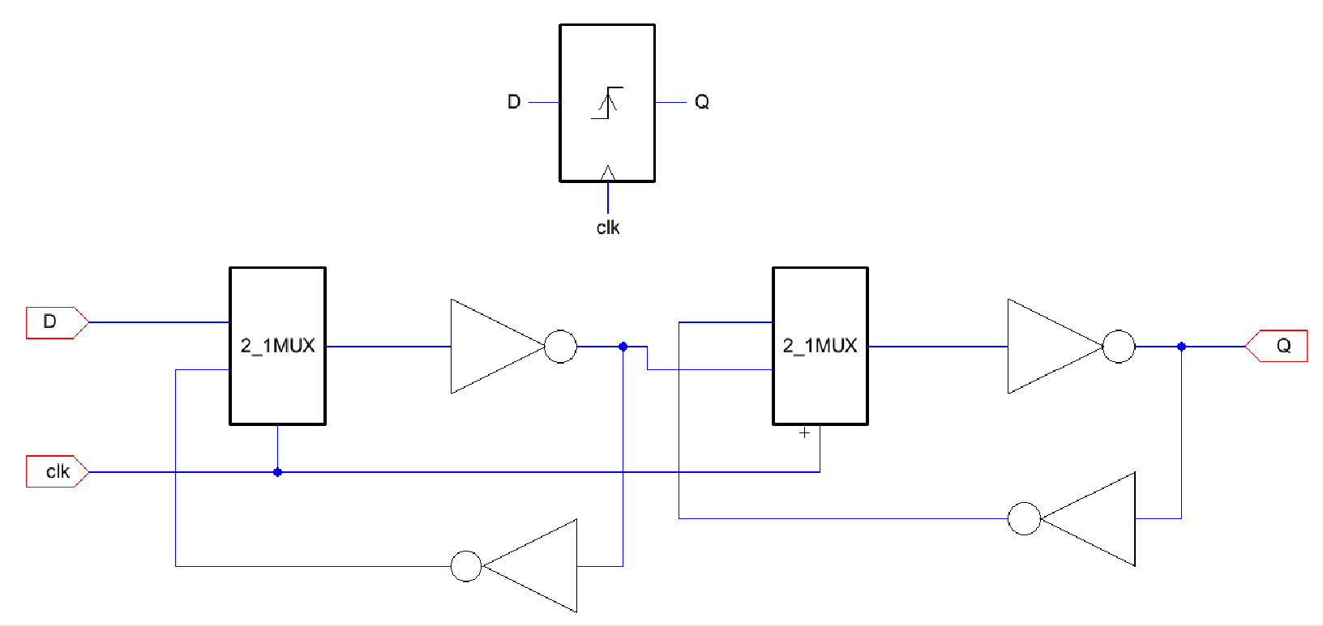
GDI DFF Schematic

Slide 11
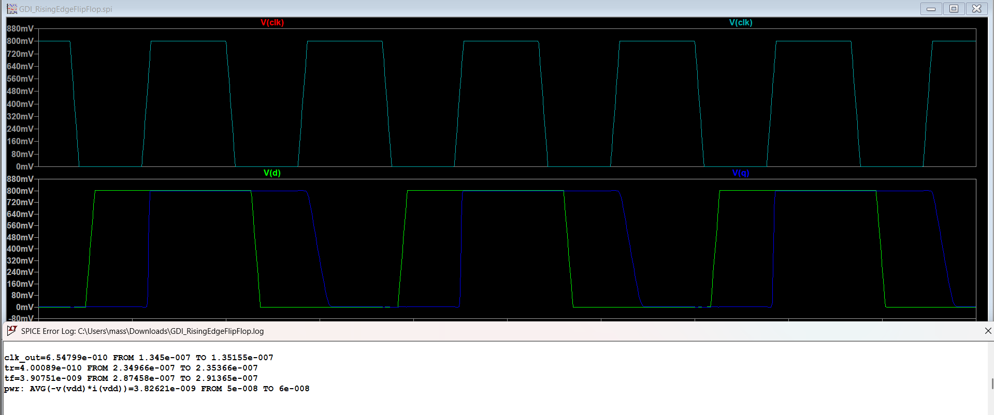
GDI DFF Schematic Simulation

Slide 12
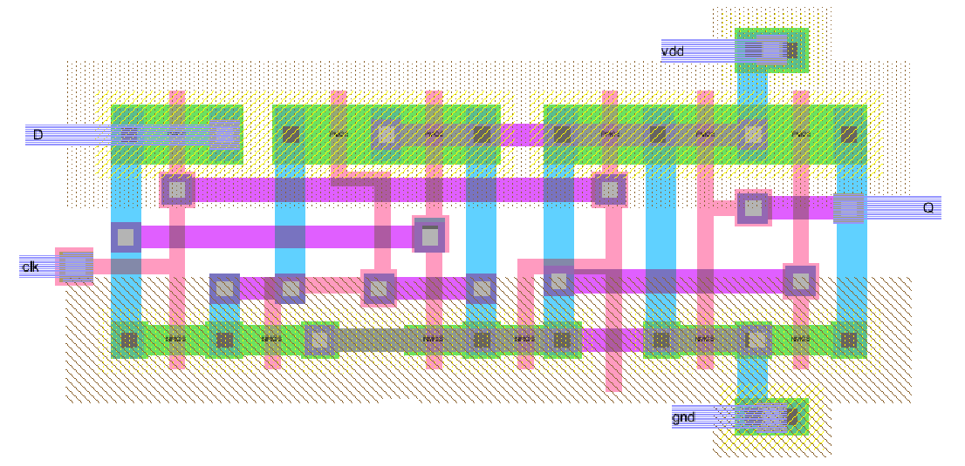
GDI DFF Layout

Slide 13
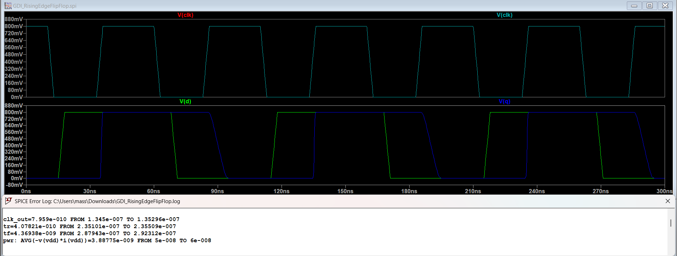
GDI DFF Layout Simulation

Slide 14
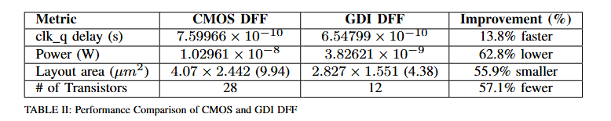
Performance Comparasion

Slide 15
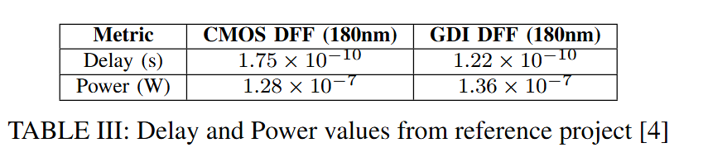
Performance Comparasion
http://jcse.kiise.org/files/V17N4-02.pdf

Slide 16
Innovation
This work presents a hybrid GDI-based D Flip-Flop (DFF) that significantly reduces transistor count and chip area. Unlike typical GDI DFFs that use 20–28 transistors, the proposed design uses only 12 transistors by combining two GDI multiplexers with CMOS inverters. This results in a 55.9% reduction in layout area, from 9.94 µm² to 4.38 µm², without compromising functionality.
The design operates with a single clock input, eliminating the need for a complementary clock signal (CLKB) and its supporting circuitry, which reduces both power consumption and clock load. Transistor sizing and CMOS inverter design are carefully optimized to ensure full-swing signals and avoid voltage degradation often seen in GDI logic.
Simulation results show that this DFF is 13.8% faster and consumes 62.8% less power than the standard CMOS DFF, making it highly suitable for low-power, high-density applications.

Slide 17
Future Improvements
For future improvements, we plan to focus on physical design methods to make the chip even better. This includes adjusting wire widths (tapering), adding repeaters to reduce signal delay, and using an H-tree structure for balanced clock distribution. We will also explore adaptive clocking and biasing techniques to save more power and improve performance under different conditions. These steps will help fully use the advantages of the GDI DFF in large chip designs.

Slide 18
Conclusion
We proposed a new structured GDI D Flip-Flop (DFF) cell consisting of two GDI multiplexers (MUXs) and CMOS inverters, achieving the same functionality using only 12 transistors. This cell was compared with a standard CMOS DFF. The GDI DFF operates equivalently to the conventional CMOS DFF because the internal GDI signals pass through CMOS inverter gates. However, to reduce power consumption caused by intermediate voltages, careful transistor sizing was performed to effectively balance power and speed. The layout area of the conventional 28-transistor CMOS DFF measures 9.94 square micrometers, whereas the optimized 12-transistor GDI DFF occupies only 4.38 square micrometers, achieving a 55.9% area reduction. Average power consumption decreased by 62.8%, and clock-to-output delay was reduced by 13.8%. Future work will involve full-chip analysis to evaluate the broader impact on power consumption when deploying the GDI DFF.

Slide 19
Thank you

