Slide 1

Digital Marketing
Engineer your Career as Digital Marketer
Signature Training by Qasim Nadeem

Slide 2

What is Course About?
Problem identification requires critical thinking,
But solving a Problem just requires creative thinking_
Digital Marketing is like breath to the businesses today, so its understanding gives you the highest place in the business world. Training is carefully designed to meet all the requirements of the Digital Marketer job role in the current marketplace.
The course also addresses the ECommerce trends so the digital marketer can help businesses to sell their products over the Internet. And the addition of WordPress let you fly solo in the freelancing market
Notes:
Notes to presenter:
What is your purpose for sharing this reflection?
Is it at the end of a unit or project?
Are you sharing this reflection, at the attainment of a learning goal you set for yourself?
Is it at the end of a course?
State your purpose for the reflection or even the purpose of the learning experience or learning goal. Be clear and be specific in stating your purpose.

Slide 3





Meet the Instructor
Microsoft Certified Professional in Web and Cloud Technologies
Started Professional Life in 1989-90 and spent 7 years in Low Level Software Engineering
A Decade in Networks i.e. MCSE CCNA CCNP
Last Decade in Web & Software Engineering i.e. MEAN & MERN Stack (Node.js, ExpressJS, ReactJS, NextJS, Angular, MongoDB), PHP - Laravel, ASP.Net, C#, Java, Android, SQL Server, HTML, CSS, Javascript etc.
Digital Marketing (SMO, SMM, SEO, Affiliate Marketing, Blogging)
Running a Software House that delivers various products i.e. Ecommerce Portals, Job Portals, LMS, Corporate Websites etc.
Consultant to Ecommerce & Web Industry
Working in capacity of Principal Technologist & eCommerce Expert
Notes:
Notes to presenter:
Description of what you learned in your own words on one side.
Include information about the topic
Details about the topic will also be helpful here.
Tell the story of your learning experience. Just like a story there should always be a beginning, middle and an end.
On the other side, you can add a graphic that provides evidence of what you learned.
Feel free to use more than one slide to reflect upon your process. It also helps to add some video of your process.

Slide 4
In-demand Skills for the Role of Digital Marketer
Understanding of Marketing Concepts
Digital Marketing [Social Media, Emails, etc]
Graphics Designing
Videos & Video Editing
Web Design / WordPress
Social Media Marketing
Email Marketing
Notes:
Notes to presenter:
Description of what you learned in your own words on one side.
Include information about the topic
Details about the topic will also be helpful here.
Tell the story of your learning experience. Just like a story there should always be a beginning, middle and an end.
On the other side, you can add a graphic that provides evidence of what you learned.
Feel free to use more than one slide to reflect upon your process. It also helps to add some video of your process.

Slide 5
Course Content
Notes:
Notes to presenter:
What is your purpose for sharing this reflection?
Is it at the end of a unit or project?
Are you sharing this reflection, at the attainment of a learning goal you set for yourself?
Is it at the end of a course?
State your purpose for the reflection or even the purpose of the learning experience or learning goal. Be clear and be specific in stating your purpose.

Slide 6
Let’s Start with Marketing
Notes:
Notes to presenter:
What is your purpose for sharing this reflection?
Is it at the end of a unit or project?
Are you sharing this reflection, at the attainment of a learning goal you set for yourself?
Is it at the end of a course?
State your purpose for the reflection or even the purpose of the learning experience or learning goal. Be clear and be specific in stating your purpose.

Slide 7
The Marketing
“The art of telling stories so enthralling that people lose track of their wallets". The New York Times ‘2017
Marketing refers to activities a company undertakes to promote the buying or selling of a product, or service.
Notes:
Notes to presenter:
Description of what you learned in your own words on one side.
Include information about the topic
Details about the topic will also be helpful here.
Tell the story of your learning experience. Just like a story there should always be a beginning, middle and an end.
On the other side, you can add a graphic that provides evidence of what you learned.
Feel free to use more than one slide to reflect upon your process. It also helps to add some video of your process.

Slide 8
Marketing Process
Offering: Product or Service
Value Creation: Process through which company knows what customer needs and making product or delivering service accordingly
Communication: Effectively passing your message to customer
Deliverability: Delivering the product or service to customer
Value Exchange: Customer is getting product or service and we are getting financial resources.
Marketing
Notes:
Notes to presenter:
Description of what you learned in your own words on one side.
Include information about the topic
Details about the topic will also be helpful here.
Tell the story of your learning experience. Just like a story there should always be a beginning, middle and an end.
On the other side, you can add a graphic that provides evidence of what you learned.
Feel free to use more than one slide to reflect upon your process. It also helps to add some video of your process.

Slide 9
Types of Marketing – Question?
Question: How many types of Marketing do you know?
Notes:
Notes to presenter:
Description of what you learned in your own words on one side.
Include information about the topic
Details about the topic will also be helpful here.
Tell the story of your learning experience. Just like a story there should always be a beginning, middle and an end.
On the other side, you can add a graphic that provides evidence of what you learned.
Feel free to use more than one slide to reflect upon your process. It also helps to add some video of your process.

Slide 10

Traditional
Digital
Most Effective?
Print Media
Newspaper
Flyers
Magazines
Hoarding/Insignia
Event Marketing
Radio & TV Ads
Email Marketing
SMS Marketing
Social Media M.
Search Engine M.
Content Marketing
Influencer Marketing
Call to Action – CTA
Tele Marketing
Affiliate Marketing
Notes:
Notes to presenter:
What was important about this learning experience?
How is it relevant to your course, yourself, or your society or community?
Why is this significant?
This SmartArt allows you add images and text to help outline your process. If a picture is worth a thousand words, then pictures and words should help you communicate this reflection on learning perfectly! You can always click on Insert>SmartArt to change this graphic or select the graphic and click on the Design contextual menu to change the colors.

Slide 11
Facts about Digital Marketing?
Vast Reachability
Insights/Tracking
Personalization
Greater Influence on Purchasing Decision
Re-targeting
Feedback
Notes:
Notes to presenter:
Description of what you learned in your own words on one side.
Include information about the topic
Details about the topic will also be helpful here.
Tell the story of your learning experience. Just like a story there should always be a beginning, middle and an end.
On the other side, you can add a graphic that provides evidence of what you learned.
Feel free to use more than one slide to reflect upon your process. It also helps to add some video of your process.

Slide 12
Inbound & Outbound Marketing
Inbound Marketing is a business methodology that attracts customers by creating valuable content and experiences tailored to them.
Ways: Social Posts & Articles, Blogs, Infographics, eBook, Whitepaper, Podcast, Video Series, and Most in-demand SEO.
Outbound Marketing also referred as “interruption” or “push” marketing, uses tactics that get a message to a large number of people in an effort to make a sale.
Ways: Print/TV/Radio Advertising, Cold Calling, Direct Mail, Mass Emails, Outdoor Signage, Radio Spots, Social Media Ads etc.
Notes:
Notes to presenter:
Description of what you learned in your own words on one side.
Include information about the topic
Details about the topic will also be helpful here.
Tell the story of your learning experience. Just like a story there should always be a beginning, middle and an end.
On the other side, you can add a graphic that provides evidence of what you learned.
Feel free to use more than one slide to reflect upon your process. It also helps to add some video of your process.

Slide 13
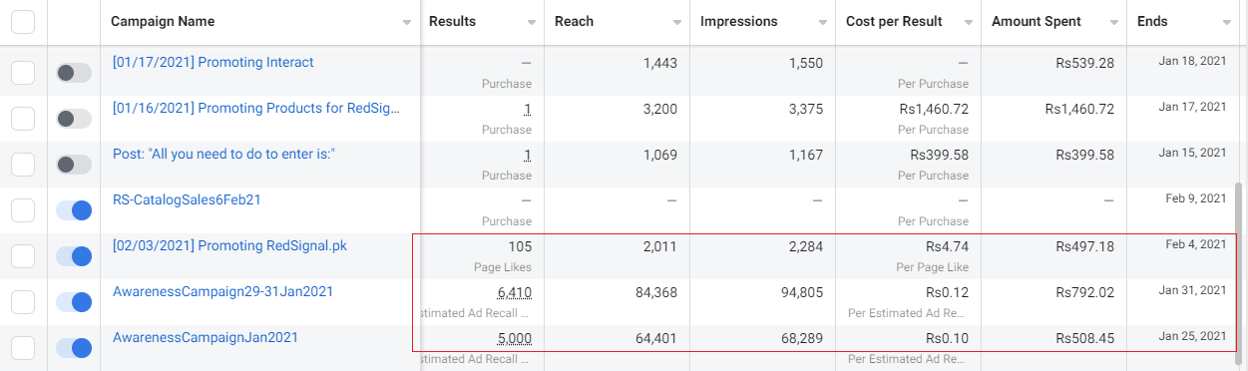
Why Choose Digital Marketing? Prove!
Notes:
Notes to presenter:
Description of what you learned in your own words on one side.
Include information about the topic
Details about the topic will also be helpful here.
Tell the story of your learning experience. Just like a story there should always be a beginning, middle and an end.
On the other side, you can add a graphic that provides evidence of what you learned.
Feel free to use more than one slide to reflect upon your process. It also helps to add some video of your process.

Slide 14
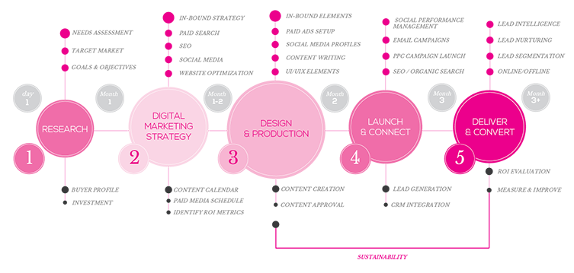
Marketing Campaign Process
Notes:
Notes to presenter:
Description of what you learned in your own words on one side.
Include information about the topic
Details about the topic will also be helpful here.
Tell the story of your learning experience. Just like a story there should always be a beginning, middle and an end.
On the other side, you can add a graphic that provides evidence of what you learned.
Feel free to use more than one slide to reflect upon your process. It also helps to add some video of your process.

Slide 15
Jazak’Allah
Notes:
Notes to presenter:
What is your purpose for sharing this reflection?
Is it at the end of a unit or project?
Are you sharing this reflection, at the attainment of a learning goal you set for yourself?
Is it at the end of a course?
State your purpose for the reflection or even the purpose of the learning experience or learning goal. Be clear and be specific in stating your purpose.

