Slide 1

Digital Marketing
Engineer your Career as Digital Marketer
Signature Training by Qasim Nadeem

Slide 2

What is Course About?
Problem identification requires critical thinking,
But solving a Problem just requires creative thinking_
Digital Marketing is like breath to the businesses today, so its understanding gives you the highest place in the business world. Training is carefully designed to meet all the requirements of the Digital Marketer job role in the current marketplace.
The course also addresses the ECommerce trends so the digital marketer can help businesses to sell their products over the Internet. And the addition of WordPress let you fly solo in the freelancing market
Notes:
Notes to presenter:
What is your purpose for sharing this reflection?
Is it at the end of a unit or project?
Are you sharing this reflection, at the attainment of a learning goal you set for yourself?
Is it at the end of a course?
State your purpose for the reflection or even the purpose of the learning experience or learning goal. Be clear and be specific in stating your purpose.

Slide 3





Meet the Instructor
Microsoft Certified Professional in Web and Cloud Technologies
Started Professional Life in 1989-90 and spent 7 years in Low Level Software Engineering
A Decade in Networks i.e. MCSE CCNA CCNP
Last Decade in Web & Software Engineering i.e. MEAN & MERN Stack (Node.js, ExpressJS, ReactJS, NextJS, Angular, MongoDB), PHP - Laravel, ASP.Net, C#, Java, Android, SQL Server, HTML, CSS, Javascript etc.
Digital Marketing (SMO, SMM, SEO, Affiliate Marketing, Blogging)
Running a Software House that delivers various products i.e. Ecommerce Portals, Job Portals, LMS, Corporate Websites etc.
Consultant to Ecommerce & Web Industry
Working in capacity of Principal Technologist & eCommerce Expert
Notes:
Notes to presenter:
Description of what you learned in your own words on one side.
Include information about the topic
Details about the topic will also be helpful here.
Tell the story of your learning experience. Just like a story there should always be a beginning, middle and an end.
On the other side, you can add a graphic that provides evidence of what you learned.
Feel free to use more than one slide to reflect upon your process. It also helps to add some video of your process.

Slide 4
Sales or Leads
Notes:
Notes to presenter:
What is your purpose for sharing this reflection?
Is it at the end of a unit or project?
Are you sharing this reflection, at the attainment of a learning goal you set for yourself?
Is it at the end of a course?
State your purpose for the reflection or even the purpose of the learning experience or learning goal. Be clear and be specific in stating your purpose.

Slide 5
Sales Terms
Sales Funnel: The sales funnel is each step that someone has to take in order to become your customer
Conversion: A conversion in marketing is when a visitor to your website completes a desired goal.
Retention: marketing strategy that markets to the existing customers.
Notes:
Notes to presenter:
Description of what you learned in your own words on one side.
Include information about the topic
Details about the topic will also be helpful here.
Tell the story of your learning experience. Just like a story there should always be a beginning, middle and an end.
On the other side, you can add a graphic that provides evidence of what you learned.
Feel free to use more than one slide to reflect upon your process. It also helps to add some video of your process.

Slide 6
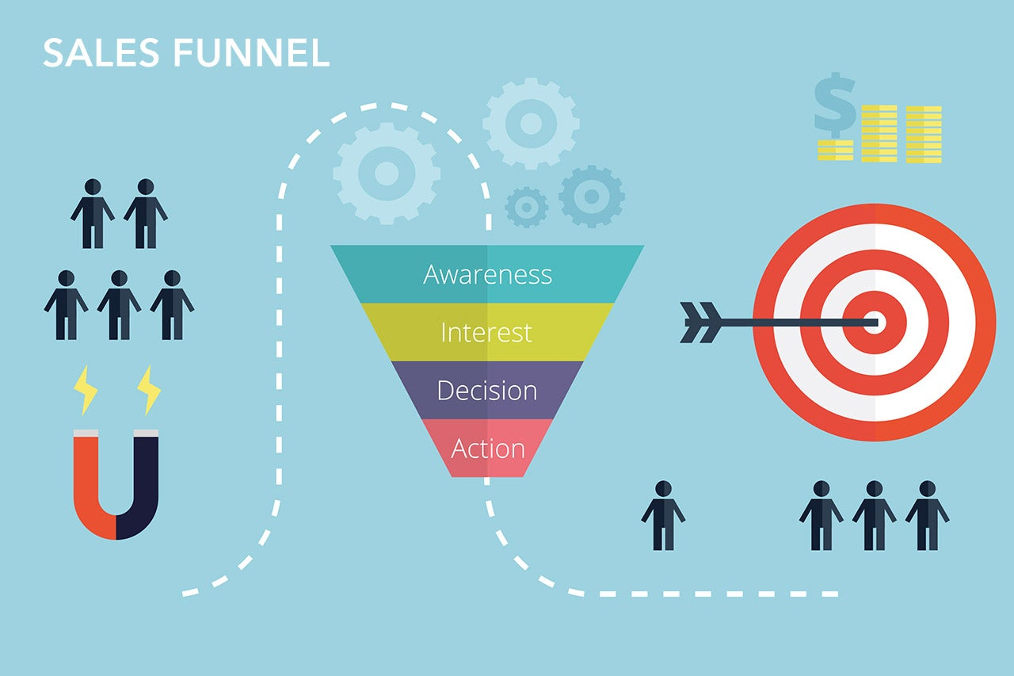
Sales Funnel
The sales funnel is each step that someone has to take in order to become your customer.
Notes:
Notes to presenter:
Description of what you learned in your own words on one side.
Include information about the topic
Details about the topic will also be helpful here.
Tell the story of your learning experience. Just like a story there should always be a beginning, middle and an end.
On the other side, you can add a graphic that provides evidence of what you learned.
Feel free to use more than one slide to reflect upon your process. It also helps to add some video of your process.

Slide 7
Conversion
A conversion in marketing is when a visitor to your website completes a desired goal.
In this way, they convert from visitors to leads or, if they purchase something, to customers.
A conversion occurs when someone changes from a passive visitor to an active, interested visitor or customer.
Notes:
Notes to presenter:
Description of what you learned in your own words on one side.
Include information about the topic
Details about the topic will also be helpful here.
Tell the story of your learning experience. Just like a story there should always be a beginning, middle and an end.
On the other side, you can add a graphic that provides evidence of what you learned.
Feel free to use more than one slide to reflect upon your process. It also helps to add some video of your process.

Slide 8
Converting traffic into leads/sales – 1/3
Refine your Unique Selling Proposition (USP). What makes your product different, special, better or more desirable? That’s the USP. Now get the answer to that question down to one or two concise sentences.
When writing for sales you need to sound friendly, not slick. Sales copy has to sound like you are simply excited to tell one of your friends about a great buy that you've come across. The last thing that you want to do is sound like a high-pressure infomercial.
Engage your viewers by asking for assistance. When you give viewers a reason to interact with you such as their opinion on a survey or requesting a product rating; you will not only get useful information but you will keep your prospects thinking about your product longer.
Don't overwhelm your viewers. If you there are three different products that you are trying to sell then take the time to create three websites. When you make the mistake of offering too much at once you can confuse your readers into buying nothing at all. The exception to this rule are major retailers, but they already have a brand and a following.
Notes:
Notes to presenter:
Description of what you learned in your own words on one side.
Include information about the topic
Details about the topic will also be helpful here.
Tell the story of your learning experience. Just like a story there should always be a beginning, middle and an end.
On the other side, you can add a graphic that provides evidence of what you learned.
Feel free to use more than one slide to reflect upon your process. It also helps to add some video of your process.

Slide 9
Converting traffic into leads/sales – 2/3
White space is your friend. If you leave wide on your sales page it makes it easier to read. Your potential clients will be able to focus on your your copy without distraction and in turn, you will increase your conversions.
Get people excited about your offering. When your product has a great rating or multiple endorsements from satisfied customers, share it with the world and let them brag about the product for you.
Leave plenty of hooks. When you are designing your sales letter or squeeze page make sure, the more hooks that you leave, the more chance you have of converting. It's better to have too many offers than to leave money on the table when you lose a potential buyer who was just one step away from taking action.
Find problems that your product can solve. Even after your sales page is complete, keep thinking about other problems that your product can solve. You might get a hint of new ways to promote your product by asking buyers how they use the product.
Notes:
Notes to presenter:
Description of what you learned in your own words on one side.
Include information about the topic
Details about the topic will also be helpful here.
Tell the story of your learning experience. Just like a story there should always be a beginning, middle and an end.
On the other side, you can add a graphic that provides evidence of what you learned.
Feel free to use more than one slide to reflect upon your process. It also helps to add some video of your process.

Slide 10
Converting traffic into leads/sales – 3/3
Direct your viewers attention. In addition to white space there will be times when you want to use moderate highlighting. This will bring focus to the most important parts of your copy. Be warned: Too many highlights or excessive colors frustrate online readers.
People love value, so give it to them. After presenting your USP, you can always sweeten the offer by adding more free information, more tools or more services to create a package deal. To increase the effectiveness of this method set a time Refine your Unique Selling Proposition (USP). What makes your product different, special, better or more desirable? That’s the USP. Now get the answer to that question down to one or two concise sentences.
Ask for the sale. If you are offering your customers value as we've already discussed then you shouldn't feel guilty about asking for the sale. Even somebody who is highly interested in your product may need to be asked up to three times to become a buyer. You can’t ask too many times.
And last but not least, always say “Thank you.” Have a gracious, personal sounding, “Thank you” email with the order confirmation you send out. It doesn't cost a penny to have good manners and show your buyer appreciation!
Notes:
Notes to presenter:
Description of what you learned in your own words on one side.
Include information about the topic
Details about the topic will also be helpful here.
Tell the story of your learning experience. Just like a story there should always be a beginning, middle and an end.
On the other side, you can add a graphic that provides evidence of what you learned.
Feel free to use more than one slide to reflect upon your process. It also helps to add some video of your process.

Slide 11
Retention & Its Importance
Customer retention might be even more important than customer acquisition.
Retention marketing is a strategy that markets to existing customers. It focuses on bringing back customers who have already done business with a brand and keeping customers who are already connected to a brand.
Increasing customer retention rates by only 5% can increase profits by as much as 95%.
Notes:
Notes to presenter:
Description of what you learned in your own words on one side.
Include information about the topic
Details about the topic will also be helpful here.
Tell the story of your learning experience. Just like a story there should always be a beginning, middle and an end.
On the other side, you can add a graphic that provides evidence of what you learned.
Feel free to use more than one slide to reflect upon your process. It also helps to add some video of your process.

Slide 12
Retention Importance
Keeping existing customers increases profits. It pays to keep customers around. Increasing customer retention rates by only 5% can increase profits by 25 to 95%.
Selling to existing customers is easier than selling to new customers. Brands have a 60% to 70% chance of selling to an existing customer versus only a 5% to 20% chance of selling to a new customer.
Every time a customer buys from you, the odds that they return go up. After one purchase, the odds are 60-70% they will buy when they visit you again. If they make a second or third purchase, that number increases to a 54% chance of making another purchase.
It costs less to attract existing customers than to attract new customers. It can cost up to 5x more to acquire a new customer than to keep an existing one.
Existing customers are likely to spend more. People who have already bought from your brand are more likely to return and spend more money when they do. In fact, they spend three times more per visit, according to the Adobe Digital Index.
Happy, existing customers help you acquire new customers. When you have happy brand fans, they turn into brand advocates.
Notes:
Notes to presenter:
Description of what you learned in your own words on one side.
Include information about the topic
Details about the topic will also be helpful here.
Tell the story of your learning experience. Just like a story there should always be a beginning, middle and an end.
On the other side, you can add a graphic that provides evidence of what you learned.
Feel free to use more than one slide to reflect upon your process. It also helps to add some video of your process.

Slide 13
Retention Strategy Types
Advocacy: set up an advocacy program for cutting down on pollution or any other concept. Your customers feel good when they can contribute to a good cause.
Daily Deals and Coupons
Exclusivity
Loyalty Programs
Email Marketing
Customer Panels or feedback/suggestion forms: where they can drop feedback and guides you abt what they want to see in the product.
Free Tools
Referral Bonuses etc
Notes:
Notes to presenter:
Description of what you learned in your own words on one side.
Include information about the topic
Details about the topic will also be helpful here.
Tell the story of your learning experience. Just like a story there should always be a beginning, middle and an end.
On the other side, you can add a graphic that provides evidence of what you learned.
Feel free to use more than one slide to reflect upon your process. It also helps to add some video of your process.

Slide 14
Evaluation Performance via Tools
Evaluation is the method(s) which could help marketers to evaluate their digital marketing campaign.
Facebook Pixel
Google Analytics
Google Search Console
Hubspot
Hootsuite etc
Notes:
Notes to presenter:
Description of what you learned in your own words on one side.
Include information about the topic
Details about the topic will also be helpful here.
Tell the story of your learning experience. Just like a story there should always be a beginning, middle and an end.
On the other side, you can add a graphic that provides evidence of what you learned.
Feel free to use more than one slide to reflect upon your process. It also helps to add some video of your process.

Slide 15
Jazak’Allah
Notes:
Notes to presenter:
What is your purpose for sharing this reflection?
Is it at the end of a unit or project?
Are you sharing this reflection, at the attainment of a learning goal you set for yourself?
Is it at the end of a course?
State your purpose for the reflection or even the purpose of the learning experience or learning goal. Be clear and be specific in stating your purpose.

