Slide 1

Digital Marketing
Engineer your Career as Digital Marketer
Signature Training by Qasim Nadeem

Slide 2

What is SEO?
Search engine optimization is the process of improving the quality and quantity of traffic to a website from search engines. SEO targets unpaid traffic rather than direct traffic or paid traffic.
Notes:
Notes to presenter:
What is your purpose for sharing this reflection?
Is it at the end of a unit or project?
Are you sharing this reflection, at the attainment of a learning goal you set for yourself?
Is it at the end of a course?
State your purpose for the reflection or even the purpose of the learning experience or learning goal. Be clear and be specific in stating your purpose.

Slide 3







Meet the Instructor – Qasim Nadeem
Microsoft Certified Professional in Web and Cloud Technologies
Started Professional Life in 1989-90 and spent 7 years in Low Level Software Engineering
A Decade in Networks i.e. MCSE CCNA CCNP
Last Decade in Web & Software Engineering i.e. HTML5, PHP, Java, Android, ASP.Net, C#, SQL Server, SharePoint, MongoDB ExpressJS Angular Node.js known as Mean Stack
Running a Software House that delivers various products i.e. Ecommerce Portals, Job Portals, LMS, Corporate Websites etc.
Consultant to Ecommerce & Web Industry
Working in capacity of Principal Technologist & eCommerce Expert
Notes:
Notes to presenter:
Description of what you learned in your own words on one side.
Include information about the topic
Details about the topic will also be helpful here.
Tell the story of your learning experience. Just like a story there should always be a beginning, middle and an end.
On the other side, you can add a graphic that provides evidence of what you learned.
Feel free to use more than one slide to reflect upon your process. It also helps to add some video of your process.

Slide 4
Course Content
Notes:
Notes to presenter:
What is your purpose for sharing this reflection?
Is it at the end of a unit or project?
Are you sharing this reflection, at the attainment of a learning goal you set for yourself?
Is it at the end of a course?
State your purpose for the reflection or even the purpose of the learning experience or learning goal. Be clear and be specific in stating your purpose.

Slide 5
SEO
The SEO?
SEO Benefits
SEO Process
Search Engines
Onpage & Offpage SEO
Keyword Research
KR Tools
Backlinks
Content and its Importance
Notes:
Notes to presenter:
Description of what you learned in your own words on one side.
Include information about the topic
Details about the topic will also be helpful here.
Tell the story of your learning experience. Just like a story there should always be a beginning, middle and an end.
On the other side, you can add a graphic that provides evidence of what you learned.
Feel free to use more than one slide to reflect upon your process. It also helps to add some video of your process.

Slide 6
Let’s Start with SEO
Notes:
Notes to presenter:
What is your purpose for sharing this reflection?
Is it at the end of a unit or project?
Are you sharing this reflection, at the attainment of a learning goal you set for yourself?
Is it at the end of a course?
State your purpose for the reflection or even the purpose of the learning experience or learning goal. Be clear and be specific in stating your purpose.

Slide 7
The SEO
Search engine optimization is the process of improving the quality and quantity of traffic to a website or a web page from search engines. SEO targets organic traffic rather than direct traffic or paid traffic.
Or
SEO is the process of improving website and increasing its visibility in the search engines listing to attract organic traffic from search engines
Notes:
Notes to presenter:
Description of what you learned in your own words on one side.
Include information about the topic
Details about the topic will also be helpful here.
Tell the story of your learning experience. Just like a story there should always be a beginning, middle and an end.
On the other side, you can add a graphic that provides evidence of what you learned.
Feel free to use more than one slide to reflect upon your process. It also helps to add some video of your process.

Slide 8
SEO Benefits
SEO targets quality traffic.
Biggest advantages of SEO is that it's an inbound marketing strategy.
You don't need to pay for ads in SEO.
SEO gets more clicks than PPC.
SEO enforce you to keep your website updated [content etc].
Notes:
Notes to presenter:
Description of what you learned in your own words on one side.
Include information about the topic
Details about the topic will also be helpful here.
Tell the story of your learning experience. Just like a story there should always be a beginning, middle and an end.
On the other side, you can add a graphic that provides evidence of what you learned.
Feel free to use more than one slide to reflect upon your process. It also helps to add some video of your process.

Slide 9

SEO Process
Keyword Research: Finding right keywords for your website.
Onpage Optimization: Optimize your content, page title, headings, alt, sitemaps, interlinking etc.
01
04
02
03
Offpage Optimization: Do local listings, back-linking, social signaling etc
Analysis: Measure your success
Notes:
Notes to presenter:
What did you think at first?
What obstacles did you encounter along the way?
How did you overcome those obstacles?
What images can you add to support your process?
This SmartArt allows you add images and text to help outline your process. If a picture is worth a thousand words, then pictures and words should help you communicate this reflection on learning perfectly! You can always click on Insert>SmartArt to change this graphic or select the graphic and click on the Design contextual menu to change the colors.
Feel free to use more than one slide to reflect upon your process. It also helps to add some video of your process.

Slide 10
Search Engines
Search engines work by taking a list of known URLs, which then go to the scheduler. The scheduler decides when to crawl each URL. Crawled pages then go to the parser where vital information is extracted and indexed. Parsed links go to the scheduler, which prioritizes their crawling and re-crawling.
Top Search Engines
Google
Yahoo
Bing
Notes:
Notes to presenter:
Description of what you learned in your own words on one side.
Include information about the topic
Details about the topic will also be helpful here.
Tell the story of your learning experience. Just like a story there should always be a beginning, middle and an end.
On the other side, you can add a graphic that provides evidence of what you learned.
Feel free to use more than one slide to reflect upon your process. It also helps to add some video of your process.

Slide 11
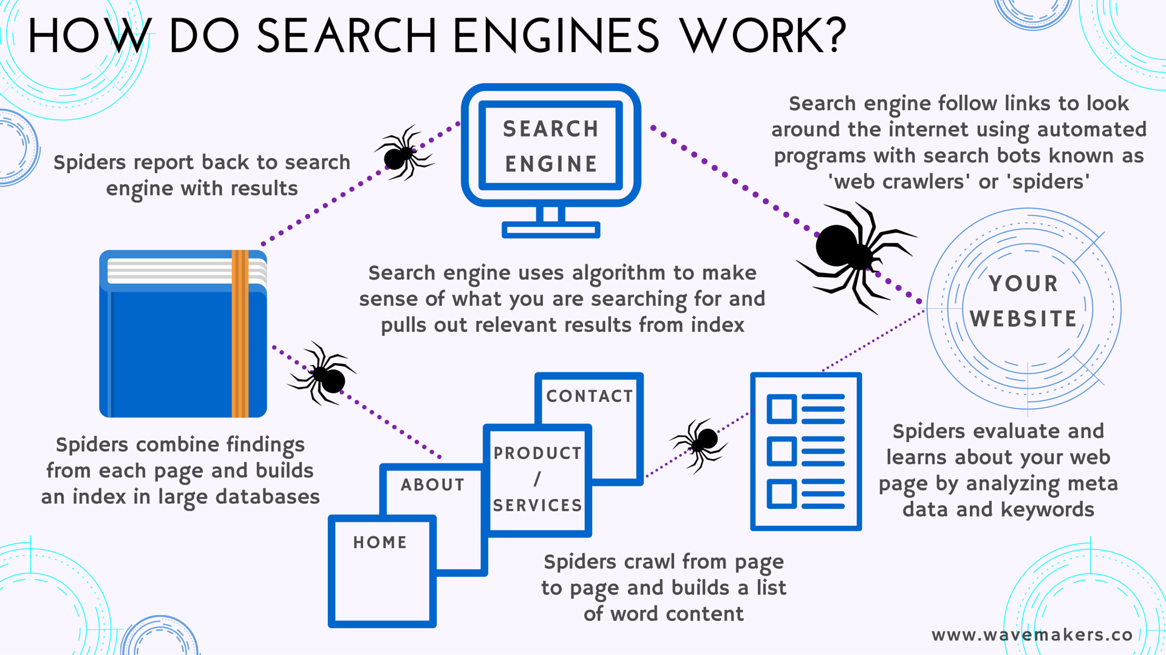
Search Engines
Notes:
Notes to presenter:
Description of what you learned in your own words on one side.
Include information about the topic
Details about the topic will also be helpful here.
Tell the story of your learning experience. Just like a story there should always be a beginning, middle and an end.
On the other side, you can add a graphic that provides evidence of what you learned.
Feel free to use more than one slide to reflect upon your process. It also helps to add some video of your process.

Slide 12
Onpage SEO Factors
On-page SEO is the practice of optimizing web page content for search engines and users, in order to rank higher and earn more relevant traffic in search engines.
Crawlable website
Site Architecture
Quality outbound links
Website speed
Mobile friendliness
Use of HTTPS
User friendly URLs
Well targeted content
Keyword optimization
Image optimization
Readability and UX
Click-through rate (CTR)
Notes:
Notes to presenter:
Description of what you learned in your own words on one side.
Include information about the topic
Details about the topic will also be helpful here.
Tell the story of your learning experience. Just like a story there should always be a beginning, middle and an end.
On the other side, you can add a graphic that provides evidence of what you learned.
Feel free to use more than one slide to reflect upon your process. It also helps to add some video of your process.

Slide 13
Onpage SEO Factors
On-page SEO is the practice of optimizing web page content for search engines and users, in order to rank higher and earn more relevant traffic in search engines.
Crawlable website
Site Architecture
Quality outbound links
Website speed
Mobile friendliness
Use of HTTPS
User friendly URLs
Well targeted content
Keyword optimization
Image optimization
Readability and UX
Click-through rate (CTR)
Notes:
Notes to presenter:
Description of what you learned in your own words on one side.
Include information about the topic
Details about the topic will also be helpful here.
Tell the story of your learning experience. Just like a story there should always be a beginning, middle and an end.
On the other side, you can add a graphic that provides evidence of what you learned.
Feel free to use more than one slide to reflect upon your process. It also helps to add some video of your process.

Slide 14
Offpage SEO Factors
Off-page SEO refers to actions taken outside of your own website to impact your rankings within search engine results pages
Local directory submission
SEO directory submission
Article submission
Social bookmarking
Blog submission
Forum submission
Linkwheel submission
Audio submission
Video submission
Document sharing
Classified ad posting
Infographic submission
Setup and optimize google business
Notes:
Notes to presenter:
Description of what you learned in your own words on one side.
Include information about the topic
Details about the topic will also be helpful here.
Tell the story of your learning experience. Just like a story there should always be a beginning, middle and an end.
On the other side, you can add a graphic that provides evidence of what you learned.
Feel free to use more than one slide to reflect upon your process. It also helps to add some video of your process.

Slide 15
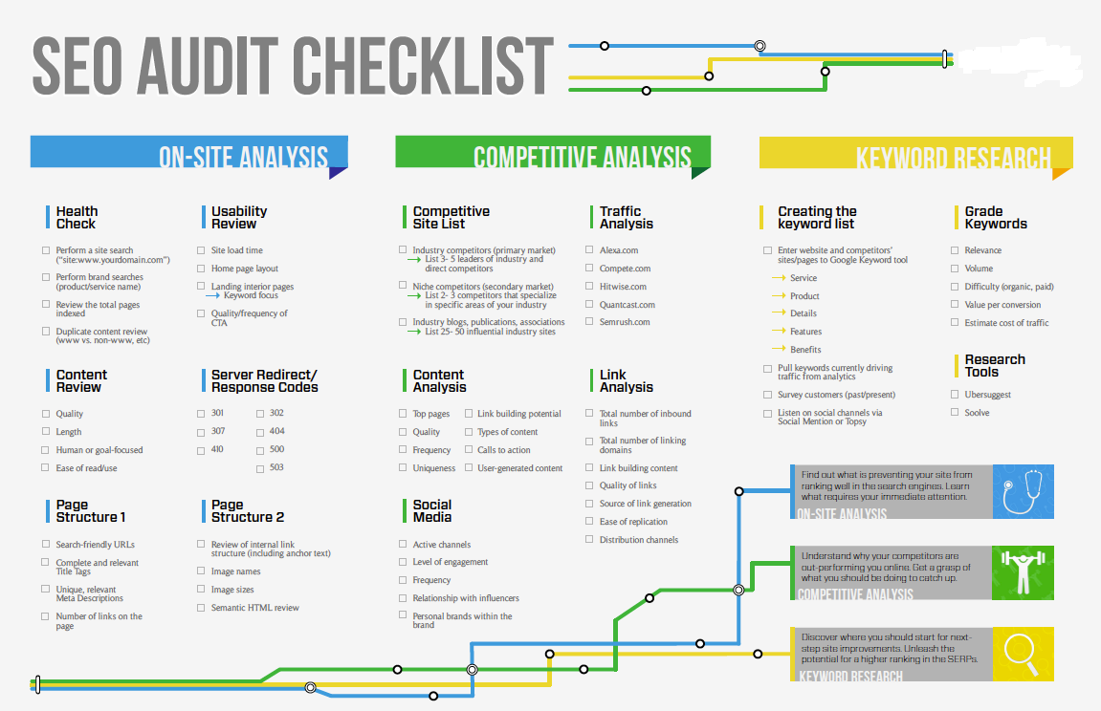

Slide 16
Keyword Research
Identify your customers
Conduct a keyword gap analysis [Instant SEO competitive analysis between you and your top competitors · See the unique keywords your competitor is ranking for that you are not]
Find your main “money” keywords
Find long-tail keyword variations
Find question keywords
Analyze the intent of pages that rank [e.g. London Olympics, customer (selling rugs) wants to rank his site on keyword London Olympics [and event going to held], complete mismatch of intent. ]
Create a keyword map
Prioritize by search volume and keyword density
Notes:
Notes to presenter:
Description of what you learned in your own words on one side.
Include information about the topic
Details about the topic will also be helpful here.
Tell the story of your learning experience. Just like a story there should always be a beginning, middle and an end.
On the other side, you can add a graphic that provides evidence of what you learned.
Feel free to use more than one slide to reflect upon your process. It also helps to add some video of your process.

Slide 17
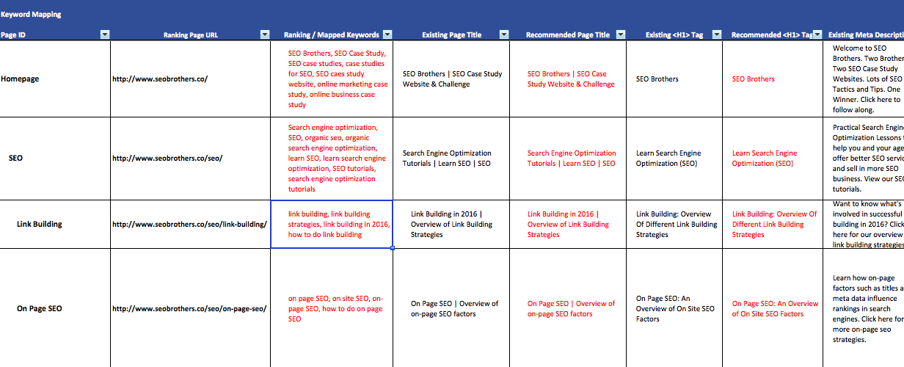
Keyword Research
Notes:
Notes to presenter:
Description of what you learned in your own words on one side.
Include information about the topic
Details about the topic will also be helpful here.
Tell the story of your learning experience. Just like a story there should always be a beginning, middle and an end.
On the other side, you can add a graphic that provides evidence of what you learned.
Feel free to use more than one slide to reflect upon your process. It also helps to add some video of your process.

Slide 18
Keyword Research Tools
Google Ads
Semrush
Ahref
Alsoasked
Answerthepublic
Notes:
Notes to presenter:
Description of what you learned in your own words on one side.
Include information about the topic
Details about the topic will also be helpful here.
Tell the story of your learning experience. Just like a story there should always be a beginning, middle and an end.
On the other side, you can add a graphic that provides evidence of what you learned.
Feel free to use more than one slide to reflect upon your process. It also helps to add some video of your process.

Slide 19
Backlinks
A backlink for a given web resource is a link from some other website to that web resource. A web resource may be a website, web page, or web directory. A backlink is a reference comparable to a citation.
Or
Backlinks (also known as “inbound links”, “incoming links” or “one way links”) are links from one website to a page on another website. Google and other major search engines consider backlinks “votes” for a specific page. Pages with a high number of backlinks tend to have high organic search engine rankings.
Notes:
Notes to presenter:
Description of what you learned in your own words on one side.
Include information about the topic
Details about the topic will also be helpful here.
Tell the story of your learning experience. Just like a story there should always be a beginning, middle and an end.
On the other side, you can add a graphic that provides evidence of what you learned.
Feel free to use more than one slide to reflect upon your process. It also helps to add some video of your process.

Slide 20
Content & Its Importance
“SEO” refers to search engine optimization, or the process of optimizing a website so that people can easily find it via search engines like Google.
By “content,” we mean any information that lives on the web and can be consumed on the web
So, putting these two concepts together: SEO content is any content created with the goal of attracting search engine traffic.
Google, the king of search engines, processes over 6.7 billion searches per day. Larry Page and Sergey Brin co-founded Google in 1998 with a mission: “Organize the world’s information and make it universally accessible and useful”
The reason optimized content is important is simple… you won’t rank in search engines without it.
Notes:
Notes to presenter:
Description of what you learned in your own words on one side.
Include information about the topic
Details about the topic will also be helpful here.
Tell the story of your learning experience. Just like a story there should always be a beginning, middle and an end.
On the other side, you can add a graphic that provides evidence of what you learned.
Feel free to use more than one slide to reflect upon your process. It also helps to add some video of your process.

Slide 21
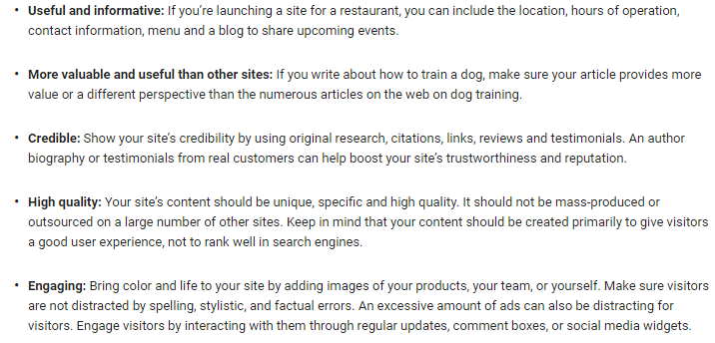
Google Recommendation for Content
Notes:
Notes to presenter:
Description of what you learned in your own words on one side.
Include information about the topic
Details about the topic will also be helpful here.
Tell the story of your learning experience. Just like a story there should always be a beginning, middle and an end.
On the other side, you can add a graphic that provides evidence of what you learned.
Feel free to use more than one slide to reflect upon your process. It also helps to add some video of your process.

Slide 22
How to Develop Content & Promote
Keyword Research: If you want to generate traffic through search, it’s best to do keyword research before you start writing. This way, you can focus on keywords for which a certain amount of search volume already exists – in other words, write toward topics (or find keyword niches!) that people are already searching for information about.
Keyword Optimization: Know where and how to use keywords in your content for maximum searchability.
Content Organization: The content on your site should be organized in a logical way. This is not only good for SEO, it also helps visitors on your site find other related content easily. The longer they stay on your site, the better.
Content Promotion: Increase visibility to new content you create by sharing it on social networks and building links to your content (both internally and from external sites)
Notes:
Notes to presenter:
Description of what you learned in your own words on one side.
Include information about the topic
Details about the topic will also be helpful here.
Tell the story of your learning experience. Just like a story there should always be a beginning, middle and an end.
On the other side, you can add a graphic that provides evidence of what you learned.
Feel free to use more than one slide to reflect upon your process. It also helps to add some video of your process.

Slide 23

How you take steps?
Analysis and Measuring Success
4
Offpage SEO
3
2
Onpage SEO
1
Keyword Research
Notes:
Notes to presenter:
What steps will you be taking as a result of this learning experience?
Did you learn from any failed experiences? How will you do things differently?
What advice will you give to others so they can learn from your experiences?
How can you share what you learned with a real-world audience?
Some examples of next steps might be:
After delivering my first persuasive presentation, I am thinking about joining the debate team.
After making my first film, I’m considering entering it in our school film festival or local film festival.
After connecting with this career expert, I’d like to do some research on that career field because it sounds interesting to me.
This SmartArt allows you add images and text to help outline your process. If a picture is worth a thousand words, then pictures and words should help you communicate this reflection on learning perfectly! You can always click on Insert>SmartArt to change this graphic or select the graphic and click on the Design contextual menu to change the colors.
Feel free to use more than one slide to share your next steps. It also helps to add some video content to explain your message.

Slide 24
Jazak’Allah
Notes:
Notes to presenter:
What is your purpose for sharing this reflection?
Is it at the end of a unit or project?
Are you sharing this reflection, at the attainment of a learning goal you set for yourself?
Is it at the end of a course?
State your purpose for the reflection or even the purpose of the learning experience or learning goal. Be clear and be specific in stating your purpose.

