Slide 1

Digital Marketing
Engineer your Career as Digital Marketer
Signature Training by Qasim Nadeem

Slide 2







Meet the Instructor – Qasim Nadeem
Microsoft Certified Professional in Web and Cloud Technologies
Started Professional Life in 1989-90 and spent 7 years in Low Level Software Engineering
A Decade in Networks i.e. MCSE CCNA CCNP
Last Decade in Web & Software Engineering i.e. HTML5, PHP, Java, Android, ASP.Net, C#, SQL Server, SharePoint, MongoDB ExpressJS Angular Node.js known as Mean Stack
Running a Software House that delivers various products i.e. Ecommerce Portals, Job Portals, LMS, Corporate Websites etc.
Consultant to Ecommerce & Web Industry
Working in capacity of Principal Technologist & eCommerce Expert
Notes:
Notes to presenter:
Description of what you learned in your own words on one side.
Include information about the topic
Details about the topic will also be helpful here.
Tell the story of your learning experience. Just like a story there should always be a beginning, middle and an end.
On the other side, you can add a graphic that provides evidence of what you learned.
Feel free to use more than one slide to reflect upon your process. It also helps to add some video of your process.

Slide 3

Target Audience?
Target Audience is the group of people you want to reach with your marketing message
Notes:
Notes to presenter:
What is your purpose for sharing this reflection?
Is it at the end of a unit or project?
Are you sharing this reflection, at the attainment of a learning goal you set for yourself?
Is it at the end of a course?
State your purpose for the reflection or even the purpose of the learning experience or learning goal. Be clear and be specific in stating your purpose.

Slide 4
Target Audience
What is a target audience?
A target audience is the group of people you want to reach with your marketing message, because they may be likely to take action as a result of seeing it.
People in your target audience will have certain characteristics in common. These characteristics fall into three broad categories: Demographics, Interests, Behaviours.
Why define a target audience?
It's important to reach the people most likely to become customers. Defining business’s target audience will help us do just that.
Notes:
Notes to presenter:
Description of what you learned in your own words on one side.
Include information about the topic
Details about the topic will also be helpful here.
Tell the story of your learning experience. Just like a story there should always be a beginning, middle and an end.
On the other side, you can add a graphic that provides evidence of what you learned.
Feel free to use more than one slide to reflect upon your process. It also helps to add some video of your process.

Slide 5
Audience Common Characteristics
Demographics [audience may have same]:
Age
Gender
Household income
Occupation
Education
Location
Interests:
They may share interests in certain products, topics or activities.
Behaviours:
They may read the same publications, visit the same online destinations, have certain hobbies or play the same sports.
Notes:
Notes to presenter:
Description of what you learned in your own words on one side.
Include information about the topic
Details about the topic will also be helpful here.
Tell the story of your learning experience. Just like a story there should always be a beginning, middle and an end.
On the other side, you can add a graphic that provides evidence of what you learned.
Feel free to use more than one slide to reflect upon your process. It also helps to add some video of your process.

Slide 6
Target Audience – Types of Audiences
Types of audiences
It's possible for a company to have more than one target audience.
Primary target audience
Your primary target audience will typically get most of your attention, as you expect them to become your most valuable group of customers.
Secondary target audience
Your secondary target audiences are other groups of people with common characteristics who may be interested in your products or services but are unlikely to become your most valuable customers. Secondary target audiences can help you structure your marketing efforts. Especially if you sell more than one product or service, or if you feel your products or services may appeal to distinctly different groups of people.
Notes:
Notes to presenter:
Description of what you learned in your own words on one side.
Include information about the topic
Details about the topic will also be helpful here.
Tell the story of your learning experience. Just like a story there should always be a beginning, middle and an end.
On the other side, you can add a graphic that provides evidence of what you learned.
Feel free to use more than one slide to reflect upon your process. It also helps to add some video of your process.

Slide 7
Target Audience – Case Study
Define Lucky Shrub's target audience
Using the definitions of the different audiences, let's try to define Lucky Shrub's audiences.
Primary audience
People interested in planting and maintaining their garden.
Karen knows that a lot of people are planning or planting home gardens this time of year. Lucky Shrub's online selection of plants and gardening tools could be attractive to them.
Secondary audience 1
People who may be interested in design and maintenance services.
Karen knows that these larger garden projects bring in a great deal of revenue, and Lucky Shrub's maintenance services help keep customers long term. So Karen would also like to attract these customers.
Secondary audience 2
People who want to spruce up their apartments with houseplants.
Karen has noticed an increased interest in houseplants among millennials. So she decided that Lucky Shrub should offer a selection of houseplants in its nursery and on its website.
Notes:
Notes to presenter:
Description of what you learned in your own words on one side.
Include information about the topic
Details about the topic will also be helpful here.
Tell the story of your learning experience. Just like a story there should always be a beginning, middle and an end.
On the other side, you can add a graphic that provides evidence of what you learned.
Feel free to use more than one slide to reflect upon your process. It also helps to add some video of your process.

Slide 8
Key Takeaways
Key takeaways
A target audience will help you to focus your marketing efforts on the people most likely to be interested in your business.
A target audience is the group of people you want to reach with your marketing message. Decide on your primary and secondary target audiences, as necessary.
Notes:
Notes to presenter:
Description of what you learned in your own words on one side.
Include information about the topic
Details about the topic will also be helpful here.
Tell the story of your learning experience. Just like a story there should always be a beginning, middle and an end.
On the other side, you can add a graphic that provides evidence of what you learned.
Feel free to use more than one slide to reflect upon your process. It also helps to add some video of your process.

Slide 9
Define your Target Audience
Create a target audience for your business
Build your target audience template
A target audience can help you focus your marketing efforts on the people most likely to be interested in what your business has to offer.
How do you determine your target audience?
Ideally, you would use customer research. For example, focus groups, online questionnaires, individual interviews with people who use certain products or in-home studies.
If you don't have the resources to conduct this kind of research, follow these tips:
Start with your current customers – specifically those that buy the products or services your marketing efforts are most focused on. Think about the characteristics they have in common, and brainstorm with your team to describe them.
Monitor your competition. Get a sense of how they communicate and the groups of people they're trying to reach. You can also monitor the accounts of important brands in your space on social media.
Talk to friends – or even strangers – you think may have an interest in your product.
Notes:
Notes to presenter:
Description of what you learned in your own words on one side.
Include information about the topic
Details about the topic will also be helpful here.
Tell the story of your learning experience. Just like a story there should always be a beginning, middle and an end.
On the other side, you can add a graphic that provides evidence of what you learned.
Feel free to use more than one slide to reflect upon your process. It also helps to add some video of your process.

Slide 10
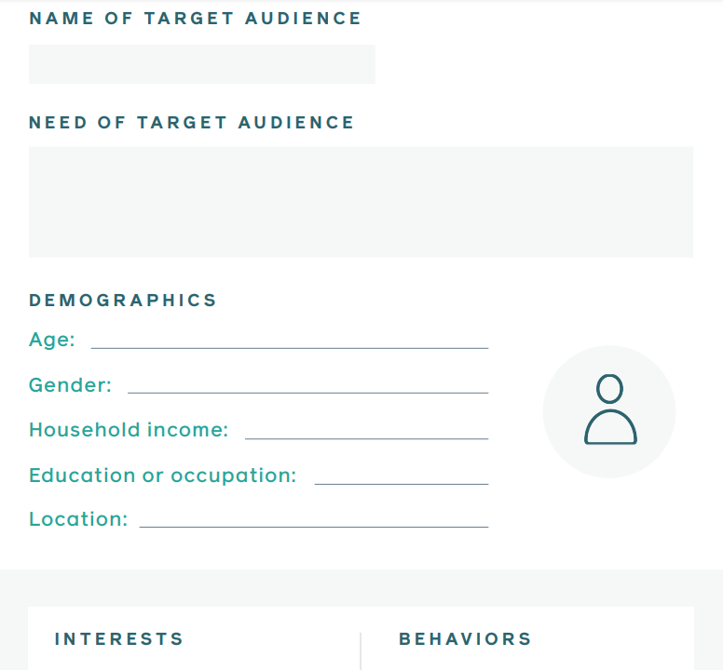
Template
Notes:
Notes to presenter:
Description of what you learned in your own words on one side.
Include information about the topic
Details about the topic will also be helpful here.
Tell the story of your learning experience. Just like a story there should always be a beginning, middle and an end.
On the other side, you can add a graphic that provides evidence of what you learned.
Feel free to use more than one slide to reflect upon your process. It also helps to add some video of your process.

Slide 11
Template Explained
Here's a template that you can use to create a target audience for your business.
NAME AND IMAGE
Give your target audience a name and even an image, if you choose. Marketers will often do this to remind them of what their target customer might look like.
NEED
What does your target audience need that your product or service provides?
DEMOGRAPHICS
Describe your target audience by age, gender, household income, education or occupation, and location.
INTERESTS
Describe what your prospective customers are typically interested in.
BEHAVIOURS
Describe common behaviours among your target audience.
Notes:
Notes to presenter:
Description of what you learned in your own words on one side.
Include information about the topic
Details about the topic will also be helpful here.
Tell the story of your learning experience. Just like a story there should always be a beginning, middle and an end.
On the other side, you can add a graphic that provides evidence of what you learned.
Feel free to use more than one slide to reflect upon your process. It also helps to add some video of your process.

Slide 12
Template Filled for Lucky Shrub 1/2
Build a target audience for Lucky Shrub
Lucky Shrub doesn't have the time or the money to do major research now. But Karen, the owner, uses her understanding of her customers to fill in the target audience template:
NAME AND IMAGE
Karen decides to name her target audience Garden Designers, and she chooses a picture to remind her of the type of person in her target audience. Note that pictures are just a way to make a target audience more personable, and are optional.
NEED
People who need to plan or plant their garden.
DEMOGRAPHICS
People aged 35-54 of any gender. Karen estimates that her customers are university-educated professionals with a household income of USD 175,000 or more.
Notes:
Notes to presenter:
Description of what you learned in your own words on one side.
Include information about the topic
Details about the topic will also be helpful here.
Tell the story of your learning experience. Just like a story there should always be a beginning, middle and an end.
On the other side, you can add a graphic that provides evidence of what you learned.
Feel free to use more than one slide to reflect upon your process. It also helps to add some video of your process.

Slide 13
Template Filled for Lucky Shrub 2/2
INTERESTS
Karen is trying to attract people interested in native plants, modern design and gardening.
BEHAVIOURS
Many of the people in this target audience have recently bought a house. Karen guesses that they enjoy home improvement shows, read architecture and design magazines, like to pin or save design pictures online, and like to browse design-related websites to get ideas for their house and garden.
Notes:
Notes to presenter:
Description of what you learned in your own words on one side.
Include information about the topic
Details about the topic will also be helpful here.
Tell the story of your learning experience. Just like a story there should always be a beginning, middle and an end.
On the other side, you can add a graphic that provides evidence of what you learned.
Feel free to use more than one slide to reflect upon your process. It also helps to add some video of your process.

Slide 14
Case Study: Build a target audience for Hair Day
Notes:
Notes to presenter:
What is your purpose for sharing this reflection?
Is it at the end of a unit or project?
Are you sharing this reflection, at the attainment of a learning goal you set for yourself?
Is it at the end of a course?
State your purpose for the reflection or even the purpose of the learning experience or learning goal. Be clear and be specific in stating your purpose.

Slide 15
Pria’s Hair Day
Hair Day is a salon that specialises in haircuts and colour.
The owner of Hair Day, Pria, is looking to increase product sales through the salon's website, and has created a series of home hair-dye kits, with several bright options for her more adventurous clients.
Hair Day would benefit from a good definition of its target audience, so it can focus its marketing efforts on the people who are most likely to be interested in the new kits.
Pria did research and talked to some of her friends from the hairdressing academy as well as some of her clients – particularly people with bold hair colour. This research helped her get a better idea of what kind of people would be interested in these kits.
Based on these insights, Pria wrote out her target audience and shared it with the woman who helps her with social media outreach.
Notes:
Notes to presenter:
Description of what you learned in your own words on one side.
Include information about the topic
Details about the topic will also be helpful here.
Tell the story of your learning experience. Just like a story there should always be a beginning, middle and an end.
On the other side, you can add a graphic that provides evidence of what you learned.
Feel free to use more than one slide to reflect upon your process. It also helps to add some video of your process.

Slide 16
Pria’s Hair Day 1/2
NAME AND IMAGE
Pria refers to her target audience as Edgy Young Professionals and uses a picture of a friend to represent them.
Pria plans to use the description of Edgy Young Professional to help her plan out the Instagram posts for the next few months. She will brainstorm ideas for what may appeal to this audience and how she can attract more of them to her website. She also intends to spend a little money on advertising, and knows that this description will help her select the audience for her ads.
NEED
A fun, non-traditional or bold hair colour.
DEMOGRAPHICS
Women aged 23-35 with an income of over USD 40,000. They are often young professionals with some higher education.
Notes:
Notes to presenter:
Description of what you learned in your own words on one side.
Include information about the topic
Details about the topic will also be helpful here.
Tell the story of your learning experience. Just like a story there should always be a beginning, middle and an end.
On the other side, you can add a graphic that provides evidence of what you learned.
Feel free to use more than one slide to reflect upon your process. It also helps to add some video of your process.

Slide 17
Pria’s Hair Day 2/2
INTERESTS
Pria knows her audience is interested in fashion, hair and nail trends, and style tips and advice from celebrities.
BEHAVIOURS
Pria's audience reads fashion magazines, follows fashion-related Instagram accounts from stylists and designers, and prefers to shop at small boutiques over big department stores.
Key takeaways
A target audience will help you to focus your marketing efforts on the people most likely to be interested in your product.
Describe your target audience in a simple template that outlines their needs, demographics, interests and behaviours.
Notes:
Notes to presenter:
Description of what you learned in your own words on one side.
Include information about the topic
Details about the topic will also be helpful here.
Tell the story of your learning experience. Just like a story there should always be a beginning, middle and an end.
On the other side, you can add a graphic that provides evidence of what you learned.
Feel free to use more than one slide to reflect upon your process. It also helps to add some video of your process.

Slide 18
Jazak’Allah
Notes:
Notes to presenter:
What is your purpose for sharing this reflection?
Is it at the end of a unit or project?
Are you sharing this reflection, at the attainment of a learning goal you set for yourself?
Is it at the end of a course?
State your purpose for the reflection or even the purpose of the learning experience or learning goal. Be clear and be specific in stating your purpose.

