Slide 1

Digital Marketing
Engineer your Career as Digital Marketer
Signature Training by Qasim Nadeem

Slide 2







Meet the Instructor – Qasim Nadeem
Microsoft Certified Professional in Web and Cloud Technologies
Started Professional Life in 1989-90 and spent 7 years in Low Level Software Engineering
A Decade in Networks i.e. MCSE CCNA CCNP
Last Decade in Web & Software Engineering i.e. HTML5, PHP, Java, Android, ASP.Net, C#, SQL Server, SharePoint, MongoDB ExpressJS Angular Node.js known as Mean Stack
Running a Software House that delivers various products i.e. Ecommerce Portals, Job Portals, LMS, Corporate Websites etc.
Consultant to Ecommerce & Web Industry
Working in capacity of Principal Technologist & eCommerce Expert
Notes:
Notes to presenter:
Description of what you learned in your own words on one side.
Include information about the topic
Details about the topic will also be helpful here.
Tell the story of your learning experience. Just like a story there should always be a beginning, middle and an end.
On the other side, you can add a graphic that provides evidence of what you learned.
Feel free to use more than one slide to reflect upon your process. It also helps to add some video of your process.

Slide 3

Customer Journey?
The customer journey (sometimes called the buyer's journey) refers to the experiences that people have before deciding to purchase a product or service.
Notes:
Notes to presenter:
What is your purpose for sharing this reflection?
Is it at the end of a unit or project?
Are you sharing this reflection, at the attainment of a learning goal you set for yourself?
Is it at the end of a course?
State your purpose for the reflection or even the purpose of the learning experience or learning goal. Be clear and be specific in stating your purpose.

Slide 4
Customer Journey
What is customer journey?
The customer journey (sometimes called the buyer's journey) refers to the experiences that people have before deciding to purchase a product or service.
Understand the customer journey:
Define a customer journey.
Describe how the customer journey relates to your marketing efforts.
Create a map for your customers' journey.
Why map the customer journey:
If you understands the different stages of her customers' journey, you'll know when to begin your business marketing efforts for the upcoming engagement season and how to approach your customers with marketing messages.
Notes:
Notes to presenter:
Description of what you learned in your own words on one side.
Include information about the topic
Details about the topic will also be helpful here.
Tell the story of your learning experience. Just like a story there should always be a beginning, middle and an end.
On the other side, you can add a graphic that provides evidence of what you learned.
Feel free to use more than one slide to reflect upon your process. It also helps to add some video of your process.

Slide 5
3 Stages of Customer Journey
The customer journey roughly divided into three stages:
Awareness: When the customer first learns about a business or product.
Consideration: When the customer becomes interested in a business or product.
Conversion: When the customer decides to buy a product or service.
Your marketing efforts are meant to help move your target audience along this journey. Marketers often refer to this process as a funnel.
The term "funnel" is used because the number of prospective customers gets smaller as they move from awareness to conversion.
This is completely normal. Even if you selected your target audience well, not everyone will become your customer. Not everyone who's aware of your product will consider buying it, and not everyone who considers buying it will. Maybe they already chose to do business with a competitor, or maybe the time just isn't right.
Notes:
Notes to presenter:
Description of what you learned in your own words on one side.
Include information about the topic
Details about the topic will also be helpful here.
Tell the story of your learning experience. Just like a story there should always be a beginning, middle and an end.
On the other side, you can add a graphic that provides evidence of what you learned.
Feel free to use more than one slide to reflect upon your process. It also helps to add some video of your process.

Slide 6
Marketing Messages by the Stages of Customer Journey
Marketing messages by stage of the customer journey Different types of marketing messages will be more effective at different stages of the customer journey.
Awareness: At the awareness stage of the customer journey, you want to reach as many people in your target audience as possible. Focus on imagery of your products and services that will prompt people to pause and learn more. You can also include general information about your business, and basic descriptions of your products or services.
Consideration: Once people are aware of your business, you want to focus more on the specific benefits of your products and services. This is a good moment to talk about how your products and services differ from those of competitors, since customers may be comparing brands.
Conversion: Finally, at the conversion stage, you want messages that remove the final hurdle to purchase. For example, promotions and special offers that prompt your customers to act now.
Notes:
Notes to presenter:
Description of what you learned in your own words on one side.
Include information about the topic
Details about the topic will also be helpful here.
Tell the story of your learning experience. Just like a story there should always be a beginning, middle and an end.
On the other side, you can add a graphic that provides evidence of what you learned.
Feel free to use more than one slide to reflect upon your process. It also helps to add some video of your process.

Slide 7



Case Study: Mangata & Gallo’s Marketing Effort
Let's take a closer look at how Mariana might use this information to plan Mangata & Gallo's marketing efforts.
Awareness Mariana might create posts with images of Mangata & Gallo rings. | Consideration Mariana might post testimonials of couples explaining why they decided to get engaged with rings from Mangata & Gallo, or pictures of different diamond cuts and settings that only Mangata & Gallo offers. | Conversion Mangata & Gallo might promote a Valentine's Day sale, or free delivery for February purchases.
Notes:
Notes to presenter:
Description of what you learned in your own words on one side.
Include information about the topic
Details about the topic will also be helpful here.
Tell the story of your learning experience. Just like a story there should always be a beginning, middle and an end.
On the other side, you can add a graphic that provides evidence of what you learned.
Feel free to use more than one slide to reflect upon your process. It also helps to add some video of your process.

Slide 8
Key Takeaways
The customer journey refers to the experiences that people have before deciding to purchase a product or service.
There are three stages of the customer journey: awareness, consideration and conversion.
When you understand your customers' journey, it can help you create a marketing strategy for your business.
Notes:
Notes to presenter:
Description of what you learned in your own words on one side.
Include information about the topic
Details about the topic will also be helpful here.
Tell the story of your learning experience. Just like a story there should always be a beginning, middle and an end.
On the other side, you can add a graphic that provides evidence of what you learned.
Feel free to use more than one slide to reflect upon your process. It also helps to add some video of your process.

Slide 9
Map your Customers' Journey
Awareness
When will my customer be most receptive to becoming aware of products like mine?
How could my customer become aware of my company and its products?
Consideration
When will my customers be ready to learn more about my products?
How will my customers find information about my products once they are ready?
Conversion
When will my customer be ready to make a purchase?
How can I convince my customer to buy my product?
Notes:
Notes to presenter:
Description of what you learned in your own words on one side.
Include information about the topic
Details about the topic will also be helpful here.
Tell the story of your learning experience. Just like a story there should always be a beginning, middle and an end.
On the other side, you can add a graphic that provides evidence of what you learned.
Feel free to use more than one slide to reflect upon your process. It also helps to add some video of your process.

Slide 10
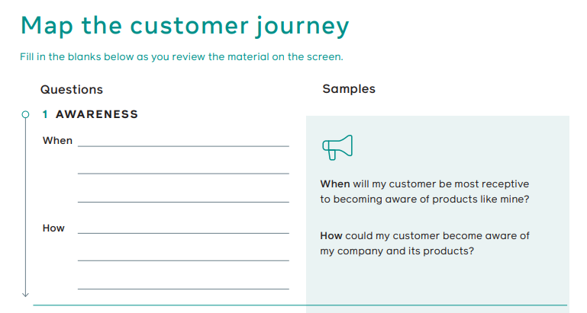
Map your Customers' Journey – Template 1/2
Notes:
Notes to presenter:
Description of what you learned in your own words on one side.
Include information about the topic
Details about the topic will also be helpful here.
Tell the story of your learning experience. Just like a story there should always be a beginning, middle and an end.
On the other side, you can add a graphic that provides evidence of what you learned.
Feel free to use more than one slide to reflect upon your process. It also helps to add some video of your process.

Slide 11
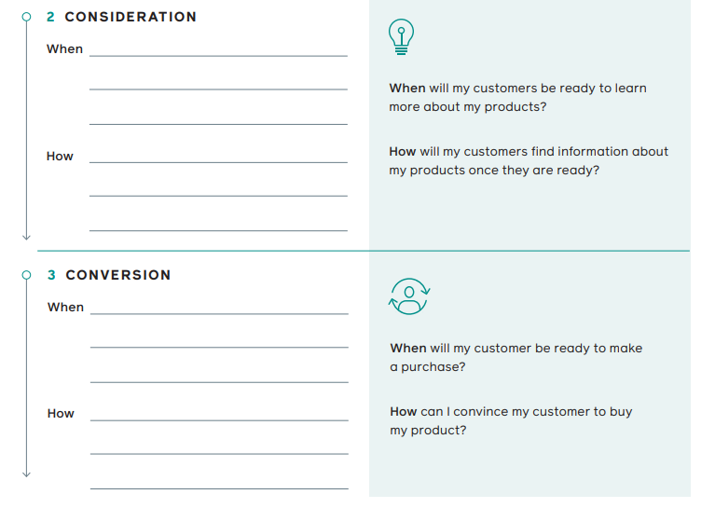
Map your Customers' Journey – Template 2/2
Notes:
Notes to presenter:
Description of what you learned in your own words on one side.
Include information about the topic
Details about the topic will also be helpful here.
Tell the story of your learning experience. Just like a story there should always be a beginning, middle and an end.
On the other side, you can add a graphic that provides evidence of what you learned.
Feel free to use more than one slide to reflect upon your process. It also helps to add some video of your process.

Slide 12
Sample Template 1 - Mangata & Gallo
Mangata & Gallo, a shop that sells special occasion jewellery and engagement rings, is planning its Valentine's Day promotion on Instagram.
If Mariana, the owner, understands the different stages of a customer's journey to purchase an engagement ring, it will help her plan when to begin her marketing efforts for Valentine's Day and the next engagement season.
Mariana knows that it can take up to 30 days for a typical customer to make a purchase, so her template may look like this:
Awareness
When: Beginning of January
How: Pictures and videos on Instagram of Mangata & Gallo rings with a Valentine's Day theme
Consideration
When: Mid-January
How: Testimonials from customers and different engagement ring styles with a Valentine's Day theme
Conversion
When: End of January (to allow time for sizing the rings and delivery)
How: Special offer of 10% off with free delivery for all engagement rings
Notes:
Notes to presenter:
Description of what you learned in your own words on one side.
Include information about the topic
Details about the topic will also be helpful here.
Tell the story of your learning experience. Just like a story there should always be a beginning, middle and an end.
On the other side, you can add a graphic that provides evidence of what you learned.
Feel free to use more than one slide to reflect upon your process. It also helps to add some video of your process.

Slide 13
Sample Template 2 – Little Lemon 1/2
Little Lemon is a restaurant that serves traditional Mediterranean food with a modern twist. Its typical customers are busy families who need healthy, kid-friendly lunch and dinner options.
Little Lemon has just started accepting online orders and offering delivery for customers within a 10-mile radius. Mario and Adriano are the two brothers from Italy who founded Little Lemon using family recipes.
Mario is the chef of the restaurant, and Adriano handles marketing and business.
Many of Little Lemon's customers are on Facebook, and it has a nice following on its Facebook business Page.
Since Little Lemon just started doing online ordering, Adriano wants to get the word out by posting on its Page. This is what Little Lemon's customer journey template looks like:
Notes:
Notes to presenter:
Description of what you learned in your own words on one side.
Include information about the topic
Details about the topic will also be helpful here.
Tell the story of your learning experience. Just like a story there should always be a beginning, middle and an end.
On the other side, you can add a graphic that provides evidence of what you learned.
Feel free to use more than one slide to reflect upon your process. It also helps to add some video of your process.

Slide 14
Sample Template 2 – Little Lemon 2/2
Awareness
When: As soon as possible
How: Post with information about online ordering and delivery, with pictures of delivery orders
Consideration
When: Three to five days later to stay top of mind
How: Post with menu options and instructions for how to place an order on the website
Conversion
When: After an additional three to five days
How: Post a flash sale with free delivery on all orders placed within the next 48 hours
Notes:
Notes to presenter:
Description of what you learned in your own words on one side.
Include information about the topic
Details about the topic will also be helpful here.
Tell the story of your learning experience. Just like a story there should always be a beginning, middle and an end.
On the other side, you can add a graphic that provides evidence of what you learned.
Feel free to use more than one slide to reflect upon your process. It also helps to add some video of your process.

Slide 15
Jazak’Allah
Notes:
Notes to presenter:
What is your purpose for sharing this reflection?
Is it at the end of a unit or project?
Are you sharing this reflection, at the attainment of a learning goal you set for yourself?
Is it at the end of a course?
State your purpose for the reflection or even the purpose of the learning experience or learning goal. Be clear and be specific in stating your purpose.

