Slide 1

Digital Marketing
Engineer your Career as Digital Marketer
Signature Training by Qasim Nadeem

Slide 2

What is Instagram?
Instagram is a photo and video sharing social networking platform owned by American company Meta. 2 billion active users, Instagram ranks 4th among the biggest social media networks globally as of 2022.
Notes:
Notes to presenter:
What is your purpose for sharing this reflection?
Is it at the end of a unit or project?
Are you sharing this reflection, at the attainment of a learning goal you set for yourself?
Is it at the end of a course?
State your purpose for the reflection or even the purpose of the learning experience or learning goal. Be clear and be specific in stating your purpose.

Slide 3







Meet the Instructor – Qasim Nadeem
Microsoft Certified Professional in Web and Cloud Technologies
Started Professional Life in 1989-90 and spent 7 years in Low Level Software Engineering
A Decade in Networks i.e. MCSE CCNA CCNP
Last Decade in Web & Software Engineering i.e. HTML5, PHP, Java, Android, ASP.Net, C#, SQL Server, SharePoint, MongoDB ExpressJS Angular Node.js known as Mean Stack
Running a Software House that delivers various products i.e. Ecommerce Portals, Job Portals, LMS, Corporate Websites etc.
Consultant to Ecommerce & Web Industry
Working in capacity of Principal Technologist & eCommerce Expert
Notes:
Notes to presenter:
Description of what you learned in your own words on one side.
Include information about the topic
Details about the topic will also be helpful here.
Tell the story of your learning experience. Just like a story there should always be a beginning, middle and an end.
On the other side, you can add a graphic that provides evidence of what you learned.
Feel free to use more than one slide to reflect upon your process. It also helps to add some video of your process.

Slide 4
Course Content
Notes:
Notes to presenter:
What is your purpose for sharing this reflection?
Is it at the end of a unit or project?
Are you sharing this reflection, at the attainment of a learning goal you set for yourself?
Is it at the end of a course?
State your purpose for the reflection or even the purpose of the learning experience or learning goal. Be clear and be specific in stating your purpose.

Slide 5
The Facebook Marketing Contents
Instagram & Its Benefits
How to Setup a Instagram Account
Types of Instagram posts
How to get Instagram Likes & Traffic
#Tag strategy and increase follower-ship
Staying top9
Tips of trending content
How to grow page
Instagram Advertisement
Notes:
Notes to presenter:
Description of what you learned in your own words on one side.
Include information about the topic
Details about the topic will also be helpful here.
Tell the story of your learning experience. Just like a story there should always be a beginning, middle and an end.
On the other side, you can add a graphic that provides evidence of what you learned.
Feel free to use more than one slide to reflect upon your process. It also helps to add some video of your process.

Slide 6
Let’s Start with Instagram Marketing
Notes:
Notes to presenter:
What is your purpose for sharing this reflection?
Is it at the end of a unit or project?
Are you sharing this reflection, at the attainment of a learning goal you set for yourself?
Is it at the end of a course?
State your purpose for the reflection or even the purpose of the learning experience or learning goal. Be clear and be specific in stating your purpose.

Slide 7
Instagram & Its Benefits
2 billion active users, Instagram ranks 4th among the biggest social media networks globally as of 2022.
Instagram is free. [When something is free you are the product]
Instagram has a vast reach.
Businesses can share their information i.e. products, events, pictures, videos etc.
Raise brand awareness and promote positive word-of-mouth.
Instagram can steer traffic to your website.
Instagram is a low-cost marketing strategy.
Targeted advertising.
Notes:
Notes to presenter:
Description of what you learned in your own words on one side.
Include information about the topic
Details about the topic will also be helpful here.
Tell the story of your learning experience. Just like a story there should always be a beginning, middle and an end.
On the other side, you can add a graphic that provides evidence of what you learned.
Feel free to use more than one slide to reflect upon your process. It also helps to add some video of your process.

Slide 8

Instagram Process
Identifying Audience & Page Creation: Identify your audience & create and live your Instagram account
Strategy: Design and Implement Instagram strategy, publish engaging posts as per strategy
01
04
02
03
Marketing Campaign: Reach maximum potential customers by running paid campaigns
Analysis: Measure your success with Instagram detailed analytics
Notes:
Notes to presenter:
What did you think at first?
What obstacles did you encounter along the way?
How did you overcome those obstacles?
What images can you add to support your process?
This SmartArt allows you add images and text to help outline your process. If a picture is worth a thousand words, then pictures and words should help you communicate this reflection on learning perfectly! You can always click on Insert>SmartArt to change this graphic or select the graphic and click on the Design contextual menu to change the colors.
Feel free to use more than one slide to reflect upon your process. It also helps to add some video of your process.

Slide 9
Why it is Important to Identify your Audience?
It's important to reach the people most likely to become customers. Defining business’s target audience will help us do just that.
What is a target audience?
A target audience is the group of people you want to reach with your marketing message, because they may be likely to take action as a result of seeing it.
People in your target audience will have certain characteristics in common. These characteristics fall into three broad categories:
Demographics (Age, gender, Income, Occupation, Education, Location), Interests, Behaviors.
Document & Template
Notes:
Notes to presenter:
Description of what you learned in your own words on one side.
Include information about the topic
Details about the topic will also be helpful here.
Tell the story of your learning experience. Just like a story there should always be a beginning, middle and an end.
On the other side, you can add a graphic that provides evidence of what you learned.
Feel free to use more than one slide to reflect upon your process. It also helps to add some video of your process.

Slide 10
Using Instagram to Identify Your Audience
Demographics are the most basic facts about your customers.
Where do they live? How old are they? What do they do for a living?
There’s a ready-made solution that will give you all of this information. It only takes about five minutes.
Everything you need is already inside Instagram!
Log in and head over to your account Insights.
Notes:
Notes to presenter:
Description of what you learned in your own words on one side.
Include information about the topic
Details about the topic will also be helpful here.
Tell the story of your learning experience. Just like a story there should always be a beginning, middle and an end.
On the other side, you can add a graphic that provides evidence of what you learned.
Feel free to use more than one slide to reflect upon your process. It also helps to add some video of your process.

Slide 11
Creating Instagram Account
Create a Instagram account
Add photos/videos
Add a short description
Create a username for your Page
Customize account
Verify your account
Notes:
Notes to presenter:
Description of what you learned in your own words on one side.
Include information about the topic
Details about the topic will also be helpful here.
Tell the story of your learning experience. Just like a story there should always be a beginning, middle and an end.
On the other side, you can add a graphic that provides evidence of what you learned.
Feel free to use more than one slide to reflect upon your process. It also helps to add some video of your process.

Slide 12
Instagram Post Types
There are no of types of posts, which we can use to pass our message to our audience.
Few of the types are:
Reels,
Images Carousel,
Memes, etc.
Notes:
Notes to presenter:
Description of what you learned in your own words on one side.
Include information about the topic
Details about the topic will also be helpful here.
Tell the story of your learning experience. Just like a story there should always be a beginning, middle and an end.
On the other side, you can add a graphic that provides evidence of what you learned.
Feel free to use more than one slide to reflect upon your process. It also helps to add some video of your process.

Slide 13
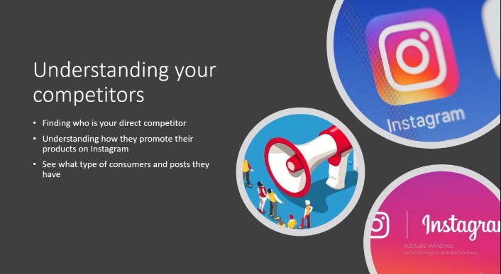
Finding Competition and Competitors
Notes:
Notes to presenter:
Description of what you learned in your own words on one side.
Include information about the topic
Details about the topic will also be helpful here.
Tell the story of your learning experience. Just like a story there should always be a beginning, middle and an end.
On the other side, you can add a graphic that provides evidence of what you learned.
Feel free to use more than one slide to reflect upon your process. It also helps to add some video of your process.

Slide 14
How to get Instagram Page Likes & Traffic
Sharing on following venues:
Hashtags listing
Response on posts
Regular & enagaging posting on page
Notes:
Notes to presenter:
Description of what you learned in your own words on one side.
Include information about the topic
Details about the topic will also be helpful here.
Tell the story of your learning experience. Just like a story there should always be a beginning, middle and an end.
On the other side, you can add a graphic that provides evidence of what you learned.
Feel free to use more than one slide to reflect upon your process. It also helps to add some video of your process.

Slide 15
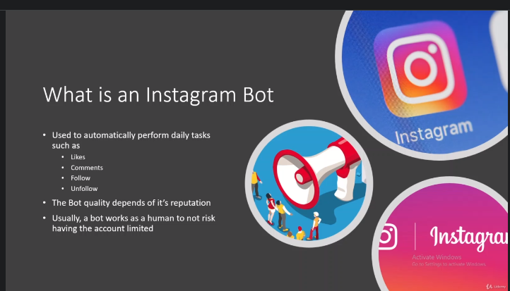
How to get Instagram Page Likes & Traffic
Do following things:
Everliker standalone chrome extension
You can grow IG page by liking other’s pictures
Notes:
Notes to presenter:
Description of what you learned in your own words on one side.
Include information about the topic
Details about the topic will also be helpful here.
Tell the story of your learning experience. Just like a story there should always be a beginning, middle and an end.
On the other side, you can add a graphic that provides evidence of what you learned.
Feel free to use more than one slide to reflect upon your process. It also helps to add some video of your process.

Slide 16
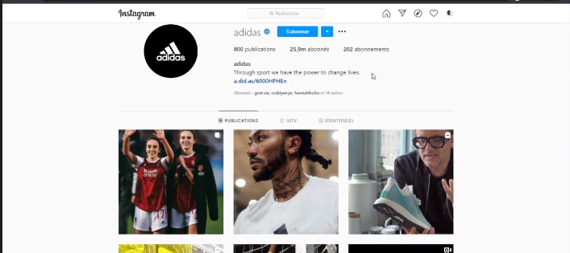
How follower becomes consumer
Complete Bio
Give website link
Must have contact info and button on profile
Personalize your profile:
Have your own style donot copy anyone
Personalized picture taking style
Personalized picture description
Personalized posts
Create posts and ads specifically for your audience that you have
When writing description to your post adapt it to your specific audience
Notes:
Notes to presenter:
Description of what you learned in your own words on one side.
Include information about the topic
Details about the topic will also be helpful here.
Tell the story of your learning experience. Just like a story there should always be a beginning, middle and an end.
On the other side, you can add a graphic that provides evidence of what you learned.
Feel free to use more than one slide to reflect upon your process. It also helps to add some video of your process.

Slide 17
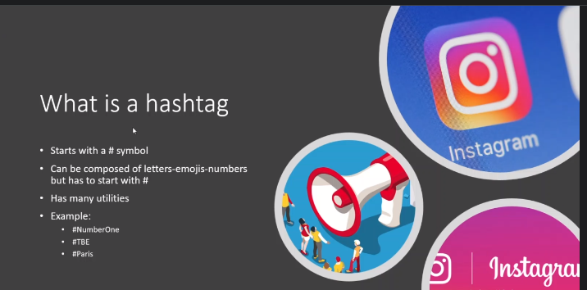
What is #Hashtags?
Notes:
Notes to presenter:
Description of what you learned in your own words on one side.
Include information about the topic
Details about the topic will also be helpful here.
Tell the story of your learning experience. Just like a story there should always be a beginning, middle and an end.
On the other side, you can add a graphic that provides evidence of what you learned.
Feel free to use more than one slide to reflect upon your process. It also helps to add some video of your process.

Slide 18
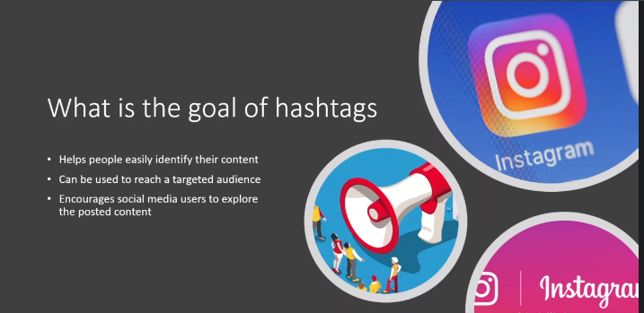
Goals of #Hashtags
Notes:
Notes to presenter:
Description of what you learned in your own words on one side.
Include information about the topic
Details about the topic will also be helpful here.
Tell the story of your learning experience. Just like a story there should always be a beginning, middle and an end.
On the other side, you can add a graphic that provides evidence of what you learned.
Feel free to use more than one slide to reflect upon your process. It also helps to add some video of your process.

Slide 19
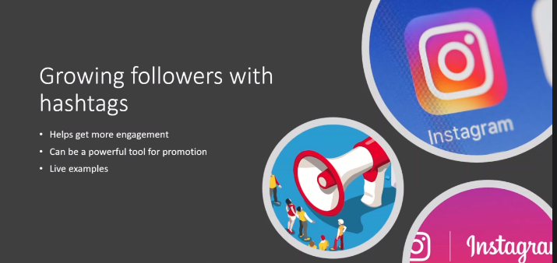
Followers with #Hashtags
Notes:
Notes to presenter:
Description of what you learned in your own words on one side.
Include information about the topic
Details about the topic will also be helpful here.
Tell the story of your learning experience. Just like a story there should always be a beginning, middle and an end.
On the other side, you can add a graphic that provides evidence of what you learned.
Feel free to use more than one slide to reflect upon your process. It also helps to add some video of your process.

Slide 20
Key for Getting Followers
Just take an example:
If you are focusing petcare publish post after every hour with hashtag #petcare
Stay in top9 popular posts against relevant hashtag.
Use bot to get likes and comments on your post
Notes:
Notes to presenter:
Description of what you learned in your own words on one side.
Include information about the topic
Details about the topic will also be helpful here.
Tell the story of your learning experience. Just like a story there should always be a beginning, middle and an end.
On the other side, you can add a graphic that provides evidence of what you learned.
Feel free to use more than one slide to reflect upon your process. It also helps to add some video of your process.

Slide 21
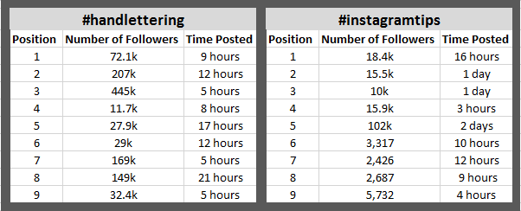
Stay in Top9 against Specific Hashtag
In the above image, I’m showing two examples. One for the hashtag #handlettering (which has quite a few results, 3+ million), and one using the hashtag #instagramtips (almost 50k results).
I’m going to get to the “how to get here” in a moment. Before that, I wanted to break down the top post results for both of these hashtags for context. Here is how things break down:
Top Post Examples Breakdown in a table:
Notes:
Notes to presenter:
Description of what you learned in your own words on one side.
Include information about the topic
Details about the topic will also be helpful here.
Tell the story of your learning experience. Just like a story there should always be a beginning, middle and an end.
On the other side, you can add a graphic that provides evidence of what you learned.
Feel free to use more than one slide to reflect upon your process. It also helps to add some video of your process.

Slide 22
Stay in Top9 against Specific Hashtag
Remember that #handlettering has over 3 million results showing for that hashtag, and #instagramtips has around 50k.
A few observations here:
The trending posts are not always from the biggest accounts. On #handlettering, the top result is from an account with 72,000 followers. An account with almost a half a million followers is in the four-spot.
A “smaller” account with just 27,900 followers is trending at the six-spot.
While you don’t have to have the biggest account to win the top spot, for hashtags with a higher number of results (like #handlettering), you are more likely to win a trending spot if your account is larger.
While I have seen some really small accounts trend for a giant hashtag, it doesn’t happen all that often. If you are sitting there with 600 followers, I wouldn’t become obsessed with trying to trend for #handlettering. I would look for something else in that hashtag family with fewer results to try and trend for.
Notes:
Notes to presenter:
Description of what you learned in your own words on one side.
Include information about the topic
Details about the topic will also be helpful here.
Tell the story of your learning experience. Just like a story there should always be a beginning, middle and an end.
On the other side, you can add a graphic that provides evidence of what you learned.
Feel free to use more than one slide to reflect upon your process. It also helps to add some video of your process.

Slide 23
Stay in Top9 against Specific Hashtag
The larger the hashtag, the more quickly the trending posts are refreshed. For a large hashtag like our #handlettering example, it’s unlikely that you would stay in a trending spot for more than 24-hours.
But for smaller hashtags, like #instagramtips, you may be able to remain trending for a day or two (or more)!
These observations are not just based on these two examples. They are based on my ALL observations from the time that Instagram Top Posts were rolled out, but I’ve chosen these two examples to illustrate my thoughts.
Notes:
Notes to presenter:
Description of what you learned in your own words on one side.
Include information about the topic
Details about the topic will also be helpful here.
Tell the story of your learning experience. Just like a story there should always be a beginning, middle and an end.
On the other side, you can add a graphic that provides evidence of what you learned.
Feel free to use more than one slide to reflect upon your process. It also helps to add some video of your process.

Slide 24
Tips for Trending Content
So now that we understand a little bit about who is sitting in these top spots, I’ll share my tips for getting there:
First, you don’t see spammy, crappy content up here. The one thing that all of this trending content has in common is that it is high-quality and adds value to the person consuming it. Learn more about developing high quality social media content here.
Tip: Bring your A-game every day and post beautiful images with valuable captions.
Because you see a mix of larger and smaller accounts (even on the #handlettering example, a 27k follower account is WAY different in size than the 445k follower account), I believe that engagement is a huge success-factor.
Likewise, whenever I post something that gets a lot of likes and comments, it trends 99% of the time. Tip: ASK for engagement, post things that inspire comments and likes, and post at your best time.
Notes:
Notes to presenter:
Description of what you learned in your own words on one side.
Include information about the topic
Details about the topic will also be helpful here.
Tell the story of your learning experience. Just like a story there should always be a beginning, middle and an end.
On the other side, you can add a graphic that provides evidence of what you learned.
Feel free to use more than one slide to reflect upon your process. It also helps to add some video of your process.

Slide 25
Tips for Trending Content
Engagement is great, but quick engagement is even better.
Trending posts generally take their position within the first 24 hours of posting, so you need it to happen fast.
Tip: (Again) Post at your best time, but also use the right mix of hashtags to get some quick engagement (even if it isn’t the most genuine).
Help your #Instagram content to trend in the top posts area by posting at your optimal time.
Notes:
Notes to presenter:
Description of what you learned in your own words on one side.
Include information about the topic
Details about the topic will also be helpful here.
Tell the story of your learning experience. Just like a story there should always be a beginning, middle and an end.
On the other side, you can add a graphic that provides evidence of what you learned.
Feel free to use more than one slide to reflect upon your process. It also helps to add some video of your process.

Slide 26
Growing Your Instagram account 1000 to 5000
Step 1: Post Efficiency
Prepare all your posts in advance and schedule them for a week.
Have a posting schedule for every week
Increase the number of posts from one to 2 per day
Increase the number of stories by at least +1 per day. if it's 3-4 then make it 5. And if 5 you wanna make it 6 or 7 or 8.
Do Planning for at least per week of posting.
Step 2: Being Part of different engagement groups:
Will increase the engagement on your page.
Will allow you to worry less about engagement on your posts
More engagement means more visibility and more followers
Step 3: Creating Engagement:
Unfollow at least half of the people followed.
Follow back and like one post of other influencers and people who follow you.
The conversion rate should increase since the number of followers will also have increased
Start getting more active in the comments of different posts
Notes:
Notes to presenter:
Description of what you learned in your own words on one side.
Include information about the topic
Details about the topic will also be helpful here.
Tell the story of your learning experience. Just like a story there should always be a beginning, middle and an end.
On the other side, you can add a graphic that provides evidence of what you learned.
Feel free to use more than one slide to reflect upon your process. It also helps to add some video of your process.

Slide 27
Growing Your Instagram account from 5000 to 10000 (5000+) – 1/5
Step 1: Post Efficiency
Increase the number of your posts (Try to post 3 days per day)
Posting videos and reels
Upgrade the quality of posts
Be more active in stories
Keep the schedule up to date with new changes.
Do Planning for at least 2 weeks of posting.
Notes:
Notes to presenter:
Description of what you learned in your own words on one side.
Include information about the topic
Details about the topic will also be helpful here.
Tell the story of your learning experience. Just like a story there should always be a beginning, middle and an end.
On the other side, you can add a graphic that provides evidence of what you learned.
Feel free to use more than one slide to reflect upon your process. It also helps to add some video of your process.

Slide 28
Growing Your Instagram account from 5000 to 10000 (5000+) – 2/5
Step 2: Different Types of Promotion:
Paid Ads on Instagram
Partnership with other accounts and influencers.
(*Idea: You can partner up with other small influencers. So let's say you were at five, six thousand followers and you know someone whose followers are also at five, six thousand people.
So basically you guys do cross-promotion so you can promote his account, he can promote your account. And usually, those accounts are pretty much in the same field.
For example, you're selling shoes, he's selling hats. Well, you can promote your product, and that person can promote your product. So basically, you promote his hats.
You say, oh, well, good hats, check out his account and he will promote your account.
This promotion works pretty well, especially for new businesses.)
Notes:
Notes to presenter:
Description of what you learned in your own words on one side.
Include information about the topic
Details about the topic will also be helpful here.
Tell the story of your learning experience. Just like a story there should always be a beginning, middle and an end.
On the other side, you can add a graphic that provides evidence of what you learned.
Feel free to use more than one slide to reflect upon your process. It also helps to add some video of your process.

Slide 29
Growing Your Instagram account from 5000 to 10000 (5000+) – 3/5
Contest Creation
(*Idea: So basically what you can do, is really offering, for example, well, let's say you have a business, you want to offer cards.
So basically not discounts, but really gift cards, let's say you have a product on your business that doesn't cost you that much to produce and you don't really mind offering it as a price for your contest. So it's going to cost you a little bit.
Once again, the return on investment is amazing because what's going to happen is once people start sharing your product or your account, what will happen is that people will start to get in and everybody will start sharing your account.
The only thing you need is really that little push when people start reposting your product or posting their story, your post. And the moment that this starts, you'll see there is a lot of people who will join your lessoning other platform promotions.
Notes:
Notes to presenter:
Description of what you learned in your own words on one side.
Include information about the topic
Details about the topic will also be helpful here.
Tell the story of your learning experience. Just like a story there should always be a beginning, middle and an end.
On the other side, you can add a graphic that provides evidence of what you learned.
Feel free to use more than one slide to reflect upon your process. It also helps to add some video of your process.

Slide 30
Growing Your Instagram account from 5000 to 10000 (5000+) – 4/5
Other Platform Promotion:
So usually if you guys are starting out the business account on Instagram, maybe it's because you guys are active on other platforms such as Facebook or you have your own website.
So in this case, what you can do is pretty simple. You can send basically it's going to come in, you can put your Instagram account in your website or your Facebook account, for example, or any other social media you can.
If you have an email list, you can email your best consumers to check out your Instagram account. Usually, this helps a lot and you can gain a really good amount of people on your Instagram in a pretty short amount of time.
Notes:
Notes to presenter:
Description of what you learned in your own words on one side.
Include information about the topic
Details about the topic will also be helpful here.
Tell the story of your learning experience. Just like a story there should always be a beginning, middle and an end.
On the other side, you can add a graphic that provides evidence of what you learned.
Feel free to use more than one slide to reflect upon your process. It also helps to add some video of your process.

Slide 31
Growing Your Instagram account from 5000 to 10000 (5000+) – 5/5
Step 3: Creating Engagement:
Unfollow 90%-95% of followed accounts.
Double the number of likes daily.
The conversion rate will decrease but will still remain important since the account has many followers.
Increase activity in comments.
It will take almost 3 to 4 months in order to go organically reach real people from zero to 5000. Thought if you work on this strategy on a daily basis. However, you can easily achieve 5000 within 5 to 6 months. But you have to work hard as it will require time.
Notes:
Notes to presenter:
Description of what you learned in your own words on one side.
Include information about the topic
Details about the topic will also be helpful here.
Tell the story of your learning experience. Just like a story there should always be a beginning, middle and an end.
On the other side, you can add a graphic that provides evidence of what you learned.
Feel free to use more than one slide to reflect upon your process. It also helps to add some video of your process.

Slide 32
Customer Journey
The customer journey (buyer's journey) refers to the experiences that people have before deciding to purchase a product or service. It can be roughly divided into three stages:
Awareness: When the customer first learns about a business or product.
Consideration: When the customer becomes interested in a business or product.
Conversion: When the customer decides to buy a product or service.
Your marketing efforts are meant to help move your target audience along this journey. Marketers often refer to this process as a funnel.
The term "funnel" is used because the number of prospective customers gets smaller as they move from awareness to conversion.
Document & Template
Notes:
Notes to presenter:
Description of what you learned in your own words on one side.
Include information about the topic
Details about the topic will also be helpful here.
Tell the story of your learning experience. Just like a story there should always be a beginning, middle and an end.
On the other side, you can add a graphic that provides evidence of what you learned.
Feel free to use more than one slide to reflect upon your process. It also helps to add some video of your process.

Slide 33
Setup Marketing Goal
Why is it important to set goals?
Goals can help you stay focused on what you hope to accomplish with your marketing efforts. For instance, Adriano wants to get the word out about Little Lemon's new service, but has limited resources Specific goals will keep his team aligned and focused.
What is a SMART goal?
As you think about your own marketing goals, it helps to make them SMART. Let's take a closer look at each element of the SMART acronym.
S= Specific, M=Measureable, A=Achieveable, R=Relevant, T=Timebound
Document & Template
Notes:
Notes to presenter:
Description of what you learned in your own words on one side.
Include information about the topic
Details about the topic will also be helpful here.
Tell the story of your learning experience. Just like a story there should always be a beginning, middle and an end.
On the other side, you can add a graphic that provides evidence of what you learned.
Feel free to use more than one slide to reflect upon your process. It also helps to add some video of your process.

Slide 34
Instagram Advertisement
Advertisement strategy is about running ads on Instagram, this will give the instant reach to your prospects.
Outbound is costly but gives you access to your target market.
Types of Campaigns:
Awareness
Consideration
Conversion
Notes:
Notes to presenter:
Description of what you learned in your own words on one side.
Include information about the topic
Details about the topic will also be helpful here.
Tell the story of your learning experience. Just like a story there should always be a beginning, middle and an end.
On the other side, you can add a graphic that provides evidence of what you learned.
Feel free to use more than one slide to reflect upon your process. It also helps to add some video of your process.

Slide 35
Jazak’Allah
Notes:
Notes to presenter:
What is your purpose for sharing this reflection?
Is it at the end of a unit or project?
Are you sharing this reflection, at the attainment of a learning goal you set for yourself?
Is it at the end of a course?
State your purpose for the reflection or even the purpose of the learning experience or learning goal. Be clear and be specific in stating your purpose.

