Slide 1
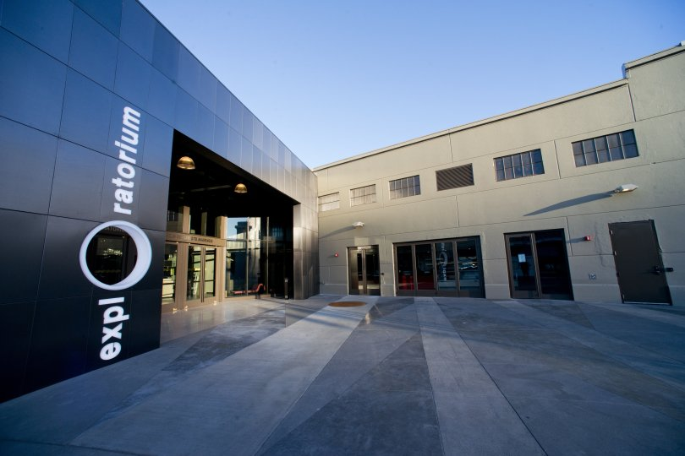
SAN FRANCISCO EXPLORATORIUM MUSEUM

Slide 2
SOME INFORMATION YOU DON’T NEED
Starts: Pier 15 San Francisco, CA 94111
Hours of Operation: 10:00 am - 5:00 pm, closed on Monday
Ticket Price: $29.95
Included: Entrance fee to Exploratorium
Not Included: Souvenirs, food, beverages
Know before you go: Complimentary museum maps are available in English, Spanish, Traditional Chinese, Simplified Chinese, Japanese, Korean, French, German, and Portuguese. - The Exploratorium is fully wheelchair accessible and can also lend a limited number of wheelchairs to visitors who need them. Tactile maps for blind and visually impaired visitors are available upon request at the Information Desk after you enter the museum.

Slide 3
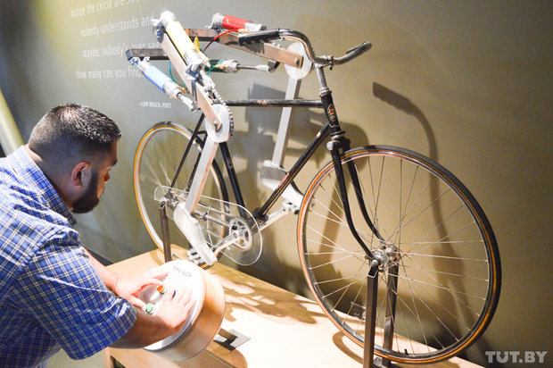
AUTOMATISM OF OUR BODY DEMONSTATION

Slide 4
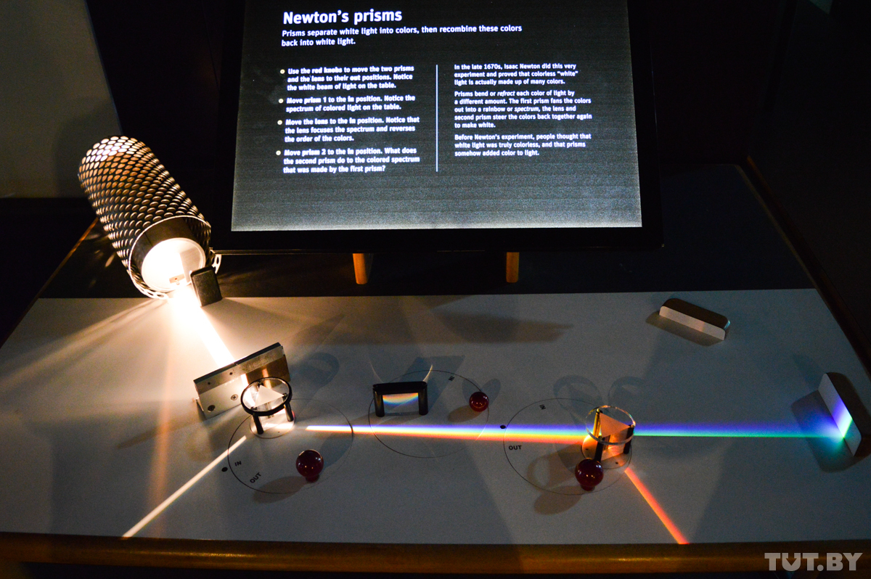
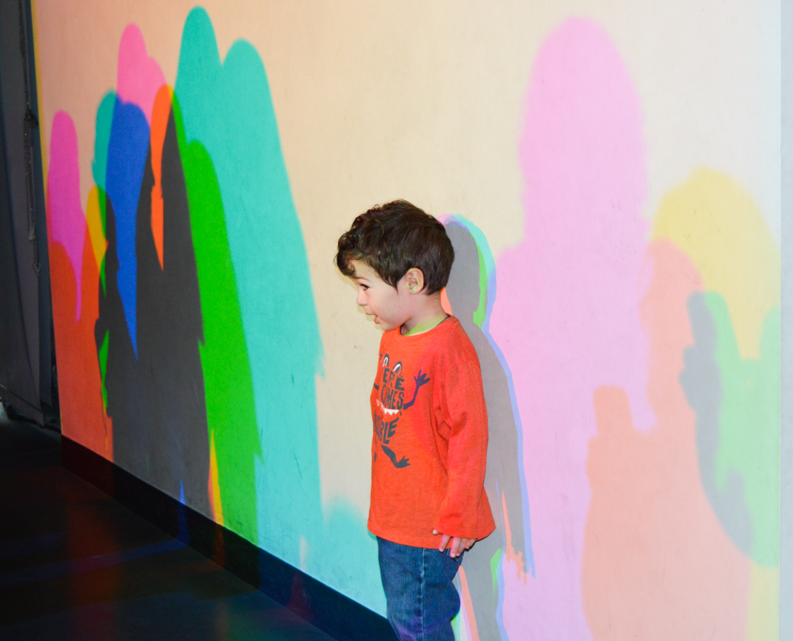
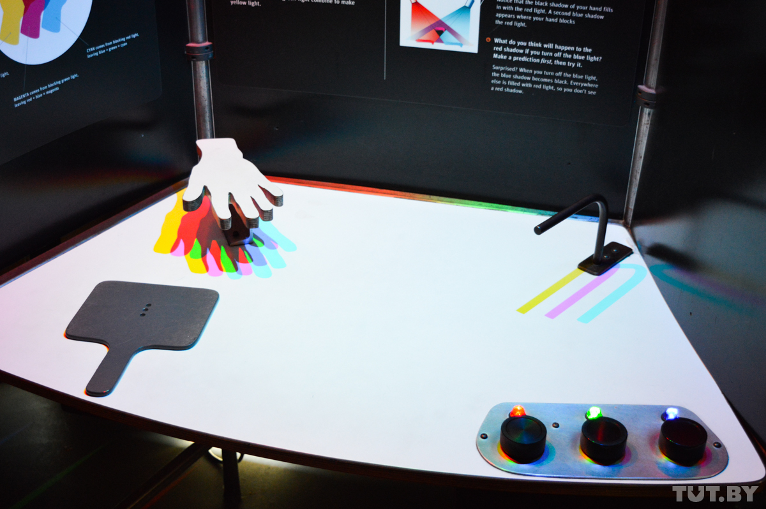
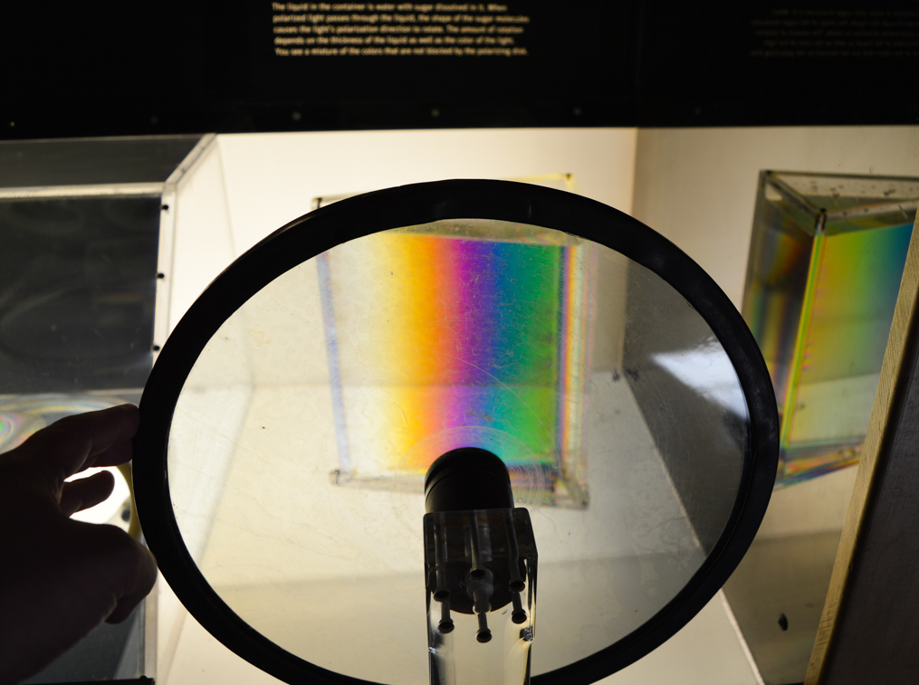
COLOR DISPERSION DEMONSTRATION

Slide 5
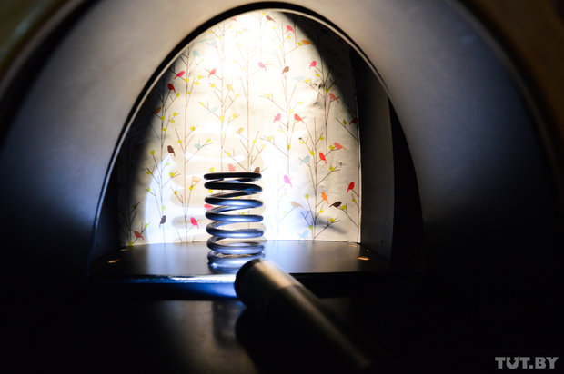
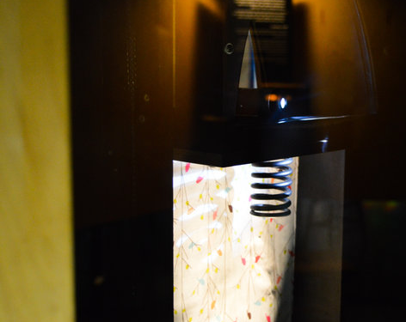
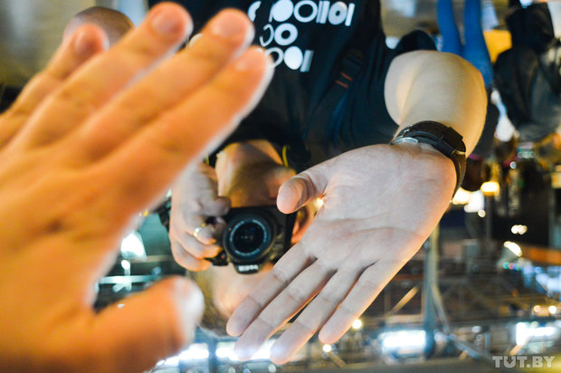
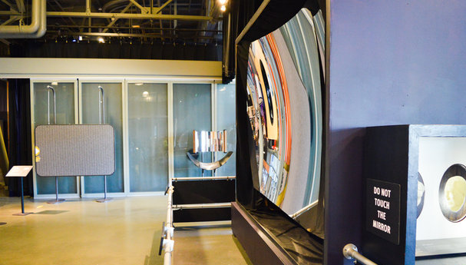
OPTICAL ILLUSIONS

Slide 6
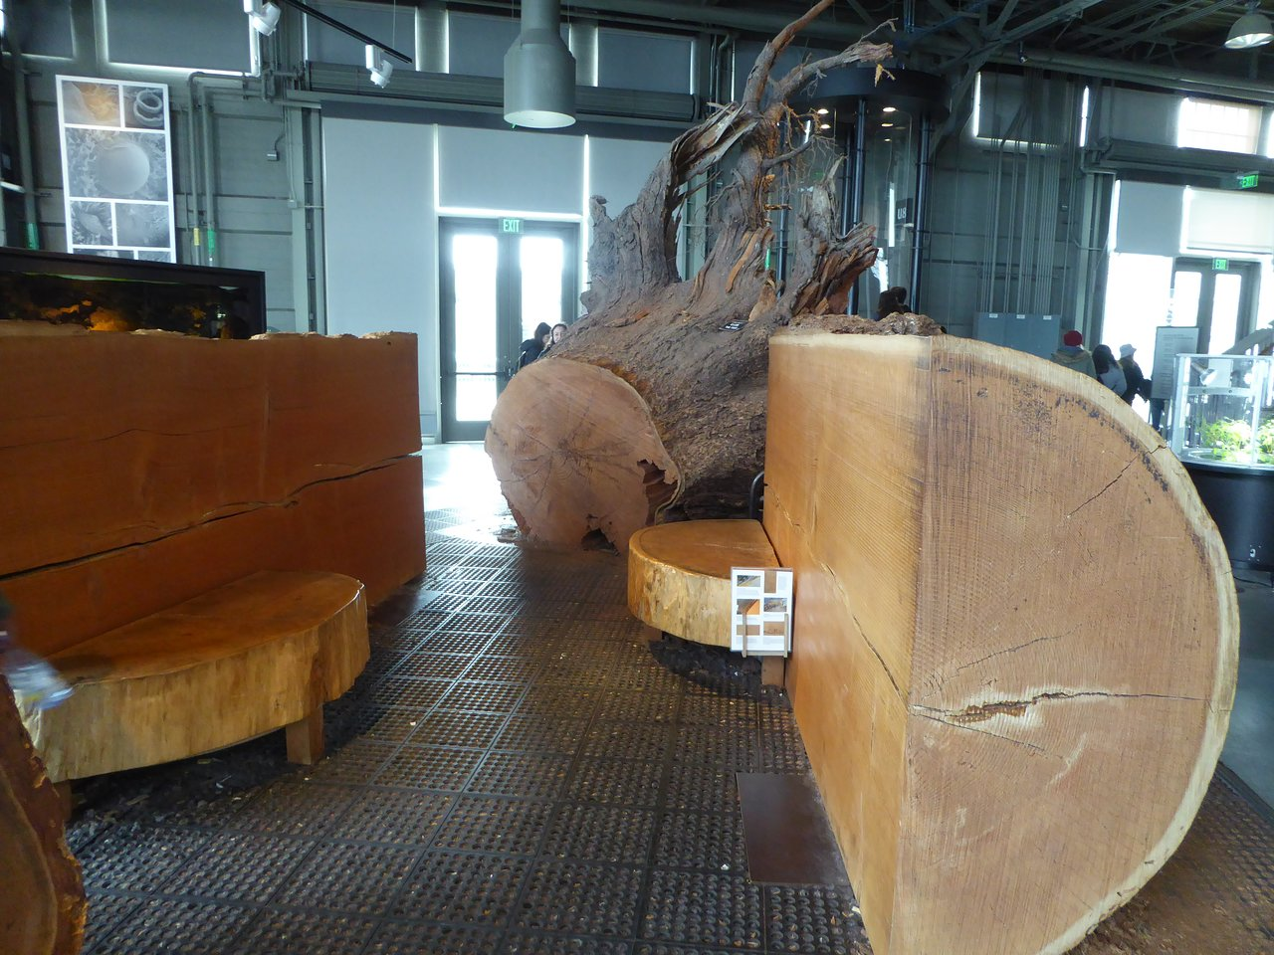
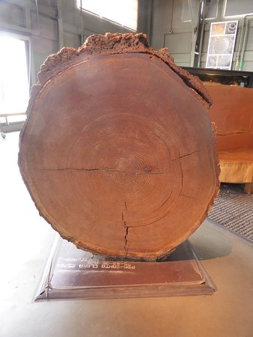
HOW DO TREES WORK

Slide 7
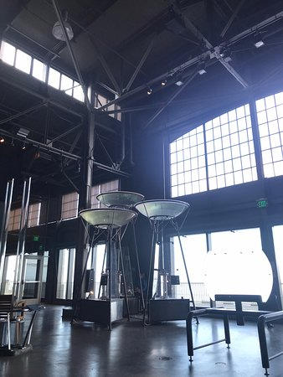
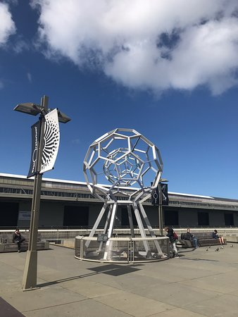
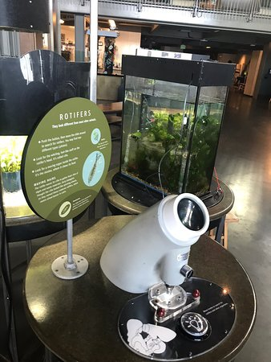
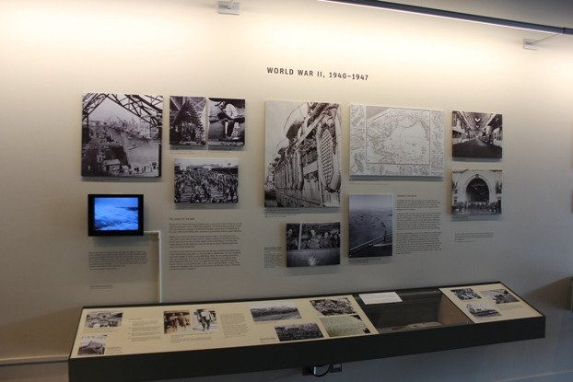
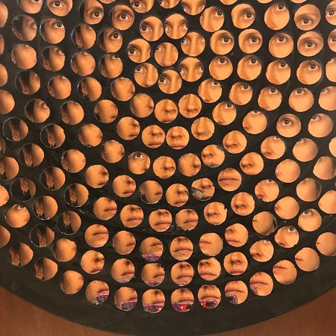
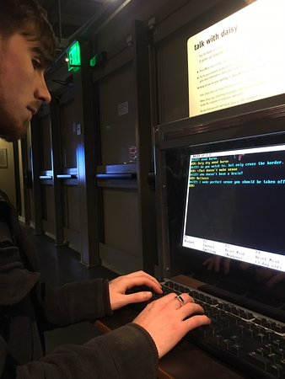
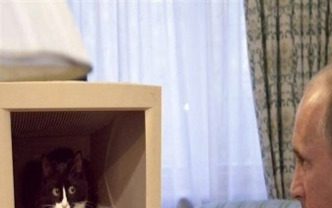
SOME OTHER THINGS TO HAVE A LOOK AT

Slide 8
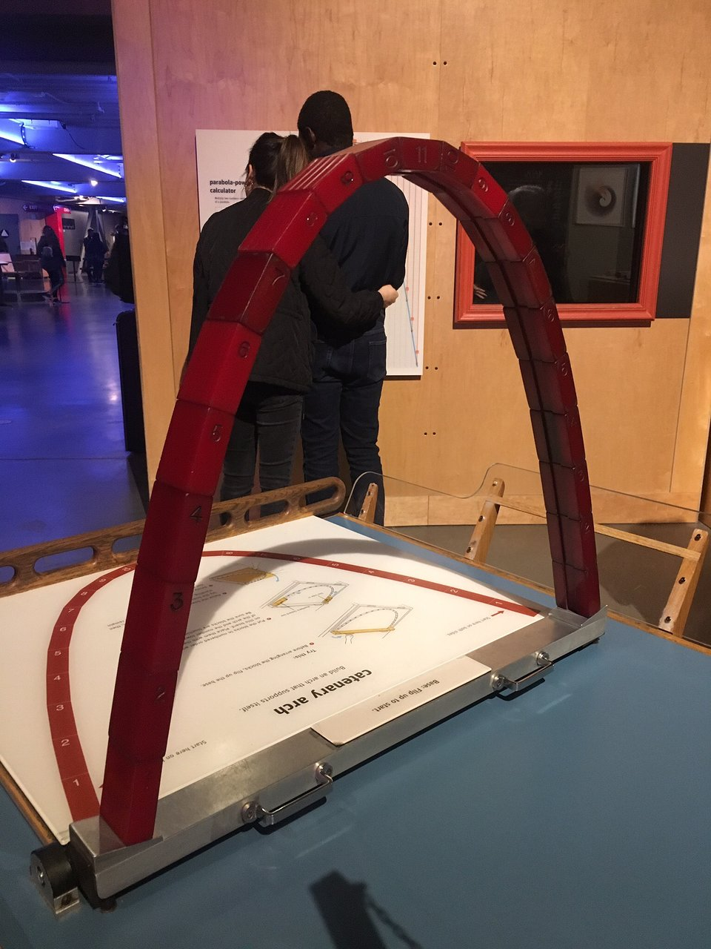
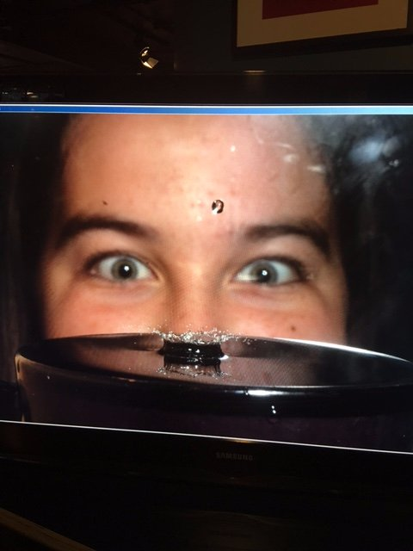
You will like itYou will like it
You will like it
You will like it
You will like it
You will like it
You will like it
You will like it
You will like it
You will like it
You will like it
You will like it
You will like it
You will like it
You will like it
You will like it
You will like it
You will like it
You will like it
You will like it
You will like it
You will like it
You will like it
You will like it
You will like it
You will like it
You will like it
You will like it
You will like it
You will like it
COME AND SEE IT BY YOURSELF
You will like it
You will like it
You will like it
You will like it

