Slide 1
Image Processing
Lab (1) Notes
Autumn 2024-25

Slide 2
Digital Images
A digital image is composed of a finite number of elements, each of which has a particular location and value, called Pixels.

Slide 3
Digital Image Formation
Acquisition
Sampling
Quantization

Slide 4
Hands On: Import and Show Images
Use the following python packages:
Package | Usage
skimage | Image processing and analysis
matplotlib | Plotting and visualization
Import the following modules
Module | Usage
data | Provides a collection of built-in example images for quick testing and experimentation with image processing algorithms.
matplotlib.pyplot | pyplot is a versatile and user-friendly plotting library that simplifies the process of creating visualizations in Python.
Goal: Getting familiar with python packages used in image processing.

Slide 5
Hands On: Import and Show Images
from skimage import data
import matplotlib.pyplot as plt
# Load a built-in image from skimage
image = data.astronaut()
# Display the image using matplotlib
plt.imshow(image)
plt.title('Astronaut Image')
plt.show()

Slide 6
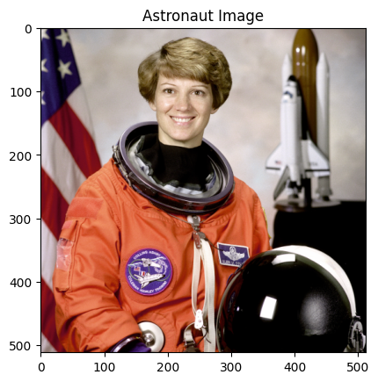

Slide 7
Hands On: Convert RGB to Grayscale
Use the following python packages:
Package | Usage
skimage | Image processing and analysis
matplotlib | Plotting and visualization
Import the following modules
Module | Usage
color | Offers tools for color space conversion, color quantization, and color filtering.
matplotlib.pyplot | pyplot is a versatile and user-friendly plotting library that simplifies the process of creating visualizations in Python.
Goal: Understanding how images are interpreted in python’s venv.

Slide 8
Hands On: Convert RGB to Grayscale
from skimage import color
image = data.astronaut()
# Convert the image to grayscale
gray_image = color.rgb2gray(image)
# Display the original and grayscale images
fig, axes = plt.subplots(1, 2, figsize=(10, 5))

Slide 9
Hands On: Convert RGB to Grayscale
# Display the original RGB image
axes[0].imshow(image)
axes[0].set_title("Original Image")
# Display the grayscale image
axes[1].imshow(gray_image, cmap='gray')
axes[1].set_title("Grayscale Image")
plt.show()

Slide 10
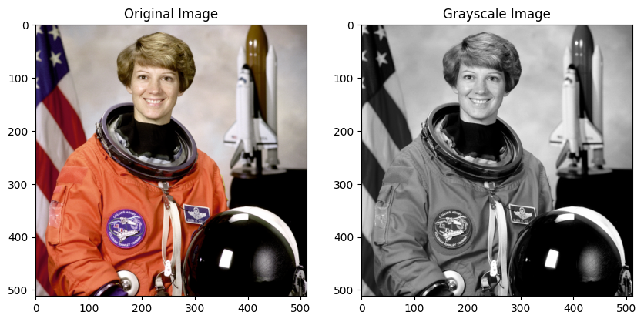

Slide 11
Hands On: Image shape and datatype
Use the following python functions:
function | Usage
shape | Returns a tuple representing the dimensions of the image array.
dtype | Returns the data type of the image array elements.
uint8: 8-bit unsigned integer (0-255)
uint16: 16-bit unsigned integer (0-65535)
float32: 32-bit floating-point number
float64: 64-bit floating-point number
Goal: Understanding the characteristics of an image and calculate the size of an uncompressed image.

Slide 12
Hands On: Image shape and datatype
# Show the shape and dtype of the grayscale image
print(f"Gray image shape: {gray_image.shape}")
print(f"Gray image Data type: {gray_image.dtype}")
# Show the shape and dtype of the grayscale image
print(f"Original image shape: {image.shape}")
print(f"Original image Data type: {image.dtype}")
Try: Calculate the size of both image in bytes, given that they are uncompressed.

Slide 13
Hands On: Split RGB into 3 Channels
Use the following python packages:
Package | Usage
skimage | Image processing and analysis
matplotlib | Plotting and visualization
numpy | Working with arrays and matrices
Goal: Understanding the concept of channels.

Slide 14
Hands On: Split RGB into 3 Channels
import numpy as np
image = data.astronaut()
# Split the image into R, G, B channels
red_channel = image[:, :, 0]
green_channel = image[:, :, 1]
blue_channel = image[:, :, 2]
allBlack = np.zeros_like(red_channel)

Slide 15
Hands On: Split RGB into 3 Channels
just_red = np.stack((red_channel, allBlack, allBlack), axis=2)
just_green = np.stack((allBlack, green_channel, allBlack), axis=2)
just_blue = np.stack((allBlack, allBlack, blue_channel), axis=2)
# Create a plot to display the original and the channels
fig, axes = plt.subplots(1, 4, figsize=(15, 5))

Slide 16
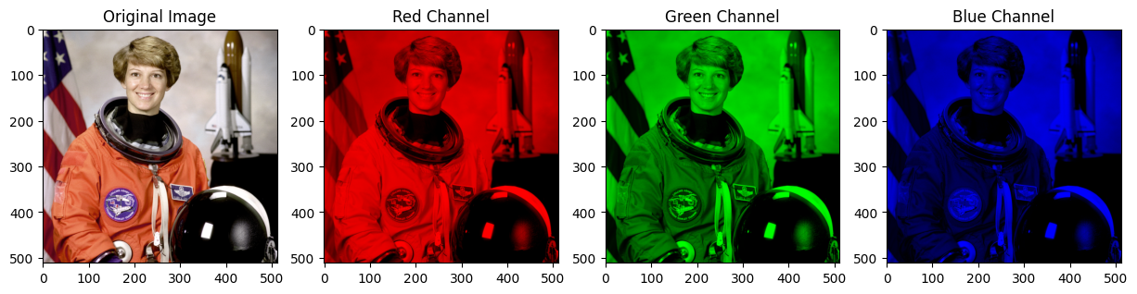

Slide 17
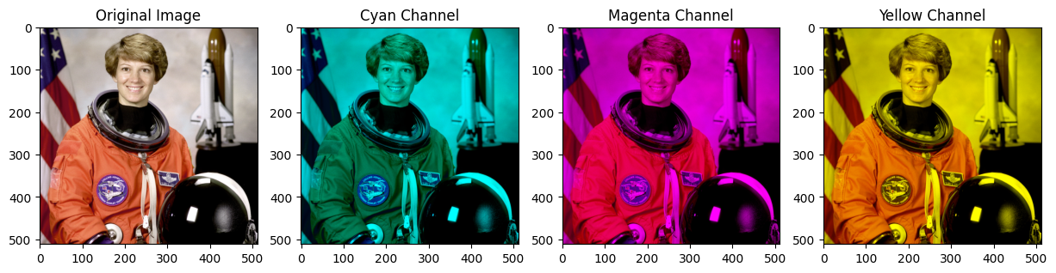
Exercise: CMY colors
Use the same concept to get the following output, given that:
Cyan = RGB – R, Magenta = RGB – G, and Yellow = RGB - B
Goal: Understanding the concept of channels.

Slide 18
Thank You
https://github.com/qassasahmed/ip/tree/main/LABS2425/1

