Slide 1
Image Processing
Lab (2) Notes
Autumn 2024-25

Slide 2
Review
Sampling affects spatial resolution.
Quantization affects intensity resolution.

Slide 3
Aliasing
Aliasing occurs when sampling rate is too low to capture the image details leading to distortions.
Aliasing can be avoided by sampling at a rate that is at least twice the highest frequency component of the signal (Nyquist-Shannon sampling theorem).

Slide 4
Quantization Error
Quantization error refers to the difference between the original continuous intensity and the quantized (rounded) value.

Slide 5
Image Processing in Spatial Domain
The term spatial domain refers to the image plane itself.
Image processing methods in this category are based on direct manipulation of pixels in an image.
Examples include Contrast Stretching and Histogram Equalization.

Slide 6
Histogram
A histogram is a type of bar chart that represents the distribution of a dataset.
It divides data into intervals, called "bins," and shows the frequency of data points in each bin.
Each bar's height corresponds to the number of data points within that range, making it easy to visualize the shape, spread, and central tendency of the data distribution.

Slide 7
Hands On: Contrast Stretching
Import the following modules
Module | Usage
exposure | Provides functions for adjusting the dynamic range and contrast of images.
Goal: applying contrast stretching and interpreting histograms.

Slide 8
Hands On: Contrast Stretching
from skimage import exposure, data
import numpy as np
# Load an example image
image = data.moon()
# Apply contrast stretching
p2, p98 = np.percentile(image, (2, 98))
stretched_image = exposure.rescale_intensity(image, in_range=(p2, p98))

Slide 9
Hands On: Contrast Stretching
fig, ax = plt.subplots(1, 2)
ax[0].imshow(image, cmap='gray')
ax[0].set_title('Original Image')
ax[1].imshow(stretched_image, cmap='gray')
ax[1].set_title('Contrast-Stretched Image')
fig.tight_layout()
plt.show()

Slide 10
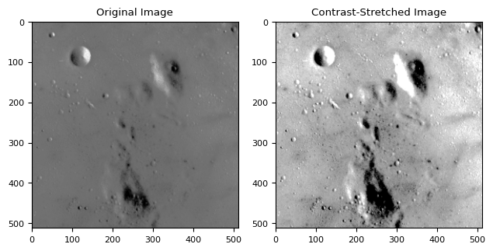

Slide 11
Hands On: calculating Root Mean Square RMS contrast
$C= \sqrt{\frac{1}{N}\sum_{i=1}^{N}{{\left(I_{i}−\overline{I}\right)}^{2}}}$
# Calculate the RMS contrast for gray_image
mean_intensity_1 = np.mean(image)
rms_contrast_1 = np.sqrt(np.mean((image - mean_intensity_1) ** 2))
print(f'First image RMS contrast = {rms_contrast_1}')
# Calculate the RMS contrast for gray_image_low_contrast
mean_intensity_2 = np.mean(stretched_image)
rms_contrast_2 = np.sqrt(np.mean((stretched_image- mean_intensity_2) ** 2))
print(f'Second image RMS contrast = {rms_contrast_2}')
First image RMS contrast = 13.330291211858185
Second image RMS contrast = 42.27173519126207

Slide 12
Hands On: Creating Histograms
# Plotting
figure, ax = plt.subplots(2, 2)
# Plot first Image
ax[0, 0].imshow(image, cmap='gray')
ax[0, 0].set_title('Original image')
# Plot second Image
ax[0, 1].imshow(stretched_image, cmap='gray', )
ax[0, 1].set_title('Contrast-Stretched Imaget')

Slide 13
Hands On: Creating Histograms
# Plot first histogram
ax[1, 0].hist(image.ravel(), bins= 256, color='black')
ax[1, 0].set_title('Histogram')
ax[1, 0].set_xlabel('Pixel Intensity')
ax[1, 0].set_ylabel('Frequency')
# Plot second histogram
ax[1, 1].hist(stretched_image.ravel(), bins= 256, color='k')
ax[1, 1].set_title('Histogram')
ax[1, 1].set_xlabel('Pixel Intensity')
ax[1, 1].set_ylabel('Frequency')

Slide 14
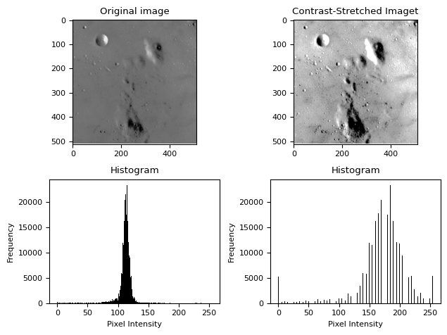

Slide 15
Interpreting Histogram
Dark Image: Histogram peaks at lower intensity values.
Bright Image: Histogram peaks at higher intensity values.
Low Contrast: Histogram is narrow and concentrated.
High Contrast: Histogram spans a wide range of intensity values

Slide 16
Hands On: Histogram Equalization
from skimage import exposure
# Apply histogram equalization
img_eq = exposure.equalize_hist(image)
img_eq = img_as_ubyte(img_eq)
# Plotting
fig, ax = plt.subplots(1, 2, figsize=(15, 5))
…

Slide 17
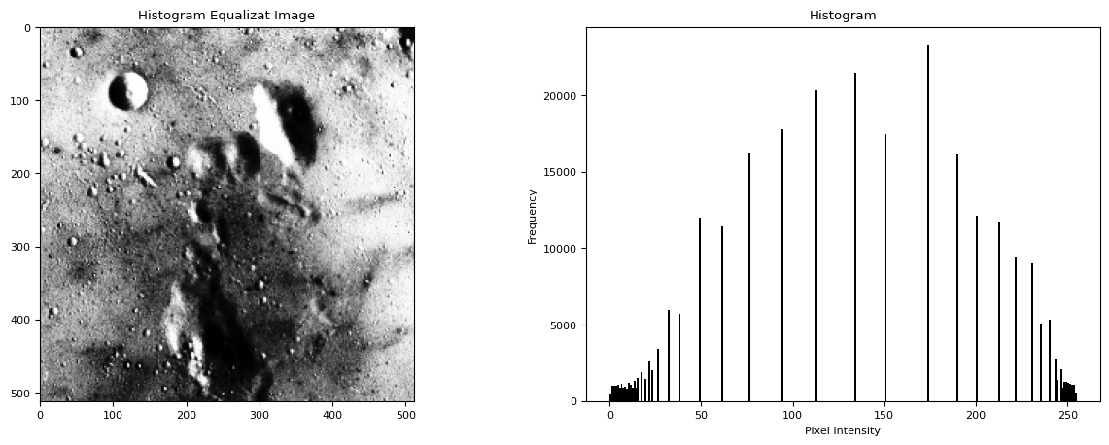

Slide 18
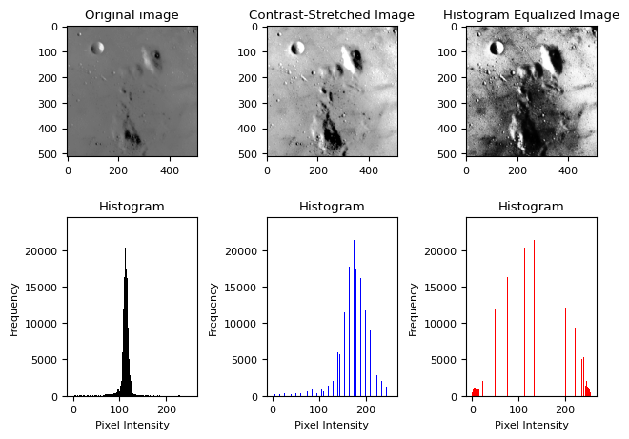

Slide 19
Thank You
https://github.com/qassasahmed/ip/tree/main/LABS2425/2

