Slide 1
Image Processing
Lab (3) Notes
Autumn 2024-25
All code here is for presentation purposes only, check GitHub repository for full source code.

Slide 2
Review
Aliasing, Quantization Error
Image processing in spatial domain
Histogram, RMS Contrast
Contrast Stretching
Histogram Equalization
https://scikit-image.org/docs/stable/user_guide/data_types.html

Slide 3
Hands On: Image Negative
from skimage import data
import matplotlib.pyplot as plt
im = data.astronaut()
print('data type: {im.dtype}') # unit8
# Calculate the negative intensities
negim = 255 - im
The negative of an image with $L$ intensity levels can be obtained using the formula $s=L −1 −r$ given that $s=T\left(r\right).$

Slide 4
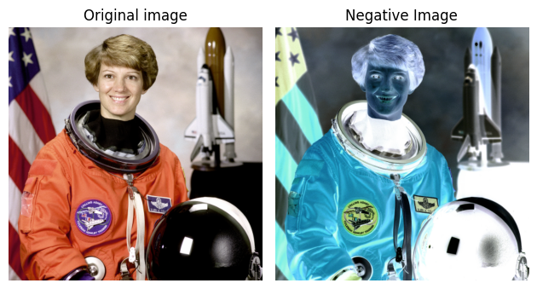
Use ax[0].axis('off') to hide the axis.

Slide 5
Histogram Specification
There are applications in which histogram equalization is not suitable.
It is useful sometimes to be able to specify the shape of the histogram that we wish the processed image to have.
The method used to generate images that have a specified histogram is called histogram matching or histogram specification.

Slide 6
Hands On: Histogram Specification
from skimage import data
from skimage import exposure, color
reference = color.rgb2gray(data.astronaut())
image = color.rgb2gray(data.coffee())
matched = exposure.match_histograms(image, reference)
hist, hist_bins = exposure.histogram(image)
plt.plot(hist_bins, hist, color='b', label='Histogram')
plt.show()

Slide 7
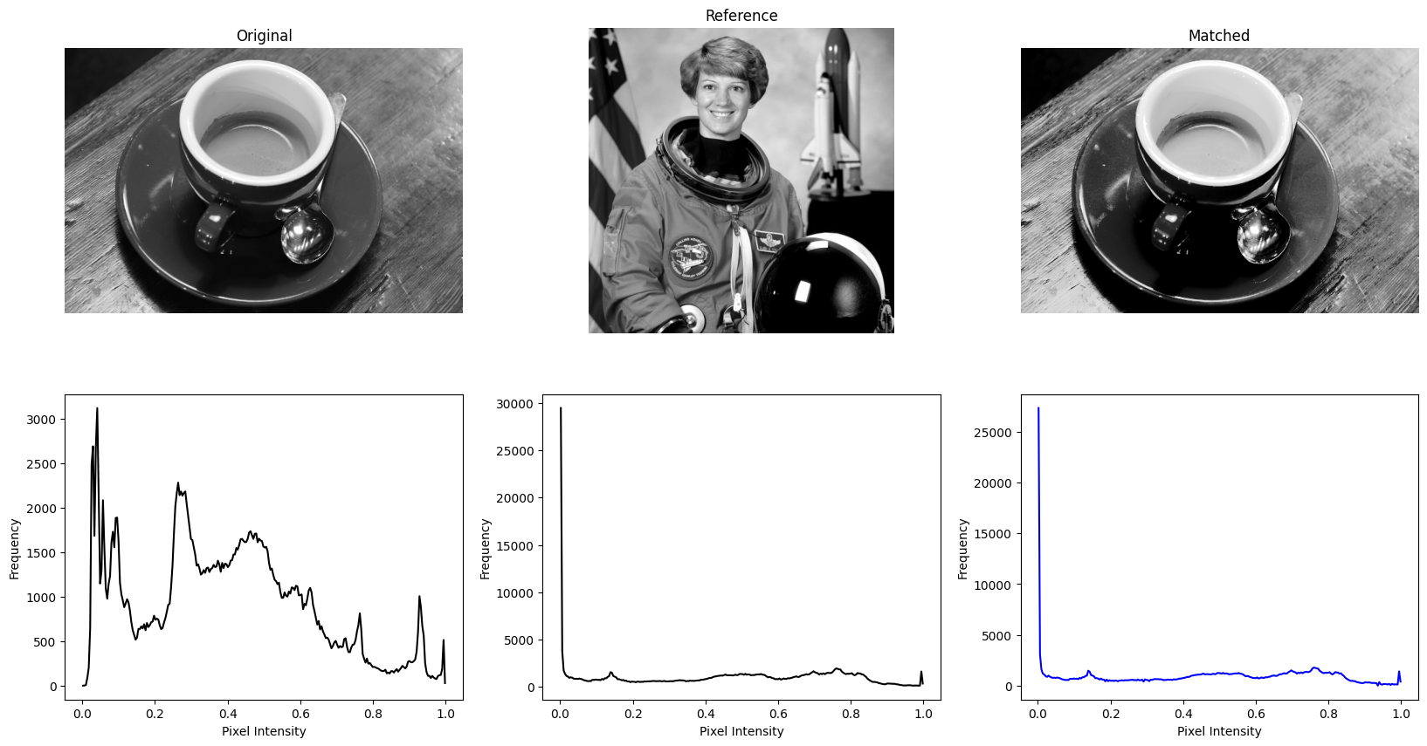

Slide 8
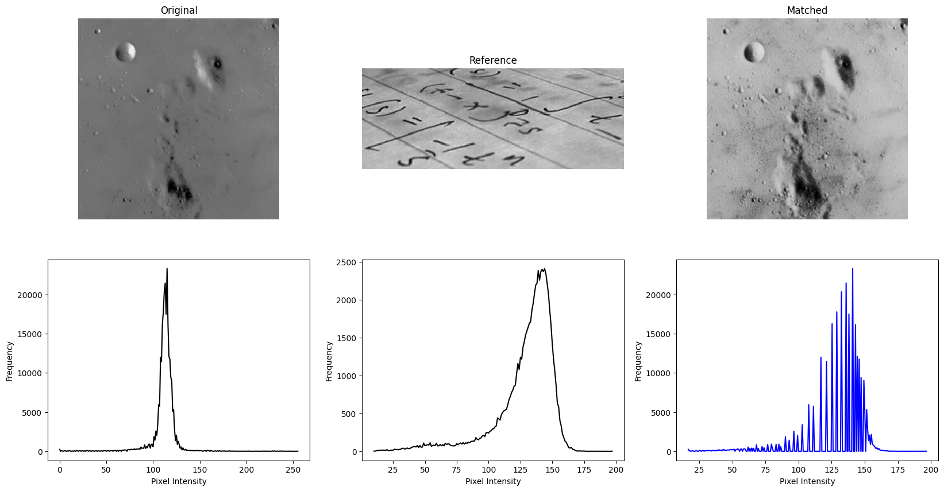

Slide 9
Hands On: Transformation
from skimage import data
from skimage.transform import rescale, resize
image = data.astronaut()
image_rescaled = rescale(image, 0.25, anti_aliasing=False)
image_resized = resize(image, (128, 128), anti_aliasing=True)
rescale uses factors while resize uses sizes

Slide 10
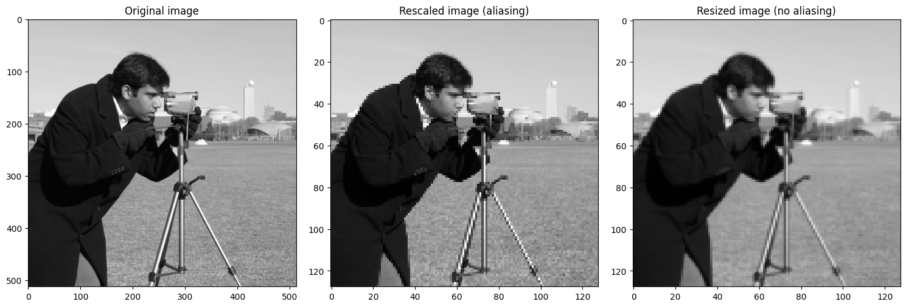

Slide 11
Image Interpolation
In image processing, image interpolation is a technique used to estimate new pixel values when resizing or transforming images.
https://www.youtube.com/watch?v=AqscP7rc8_M

Slide 12
Image Interpolation
In skimage, the order parameter controls the interpolation method used when rescaling or resizing an image.
It specifies the degree of the polynomial for interpolation, affecting how pixel values are calculated during the transformation.

Slide 13
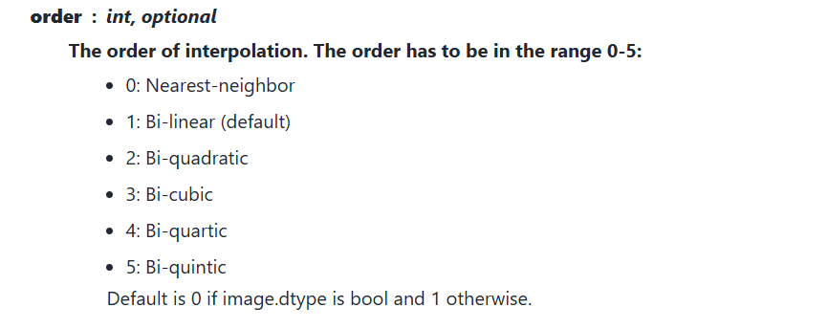
https://scikit-image.org/docs/stable/api/skimage.transform.html#skimage.transform.warp

Slide 14
Hands On: Interpolation
from skimage import data, io
image = io.imread('lena.png', as_gray=True)
image = rescale(image, 0.5)
orders = [1, 2, 3]
interpolation = ['bilinear', 'biquadratic', 'bicubic']
images = [rescale(image, 2, order=order) for order in orders] # Use 2x scale

Slide 15
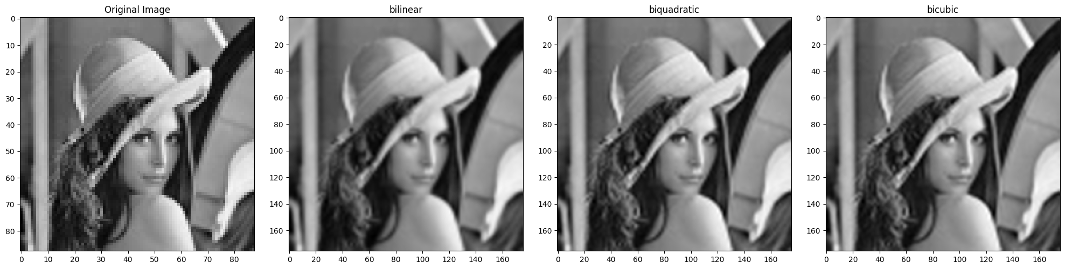
Original: (256, 256)
[[161 159 157 ... 118 135 145]
[157 157 155 ... 123 97 69]
[155 155 155 ... 98 56 54]
...
[ 59 74 112 ... 68 62 57]
[ 54 62 108 ... 62 58 69]
[ 54 59 104 ... 57 74 94]]
Bilinear (512, 512)
[[159 159 159 ... 125 126 126]
[159 159 159 ... 125 126 126]
[158 158 157 ... 102 92 92]
...
[ 56 56 59 ... 65 72 72]
[ 55 55 58 ... 74 83 83]
[ 55 55 58 ... 74 83 83]]
Biquadratic (512, 512)
[[160 160 159 ... 134 137 137]
[160 160 159 ... 134 137 137]
[158 158 158 ... 103 90 90]
...
[ 54 54 56 ... 65 74 74]
[ 54 54 55 ... 78 90 90]
[ 54 54 55 ... 78 90 90]]
Bicubic (512, 512)
[[160 160 159 ... 134 136 136]
[160 160 159 ... 134 136 136]
[158 158 158 ... 104 92 92]
...
[ 54 54 57 ... 66 75 75]
[ 54 54 56 ... 78 89 89]
[ 54 54 56 ... 78 89 89]]

Slide 16
Thank You

