Slide 1
Image Processing
Lab 5
Autumn 2024-25
https://github.com/qassasahmed/ip/tree/main/LABS2425/5

Slide 2
Digital Image Basics
GitHub Link: https://github.com/qassasahmed/ip/tree/main/LABS2425/1
Key Concepts
Digital image structure: pixels, acquisition, sampling, and quantization.
Image manipulation using Python libraries such as `skimage` and `matplotlib`.
Tasks:
Displaying an image.
Converting RGB to grayscale.
Exploring image properties like shape and data type.
Splitting RGB into individual color channels.

Slide 3
Displaying an Image
from skimage import data
import matplotlib.pyplot as plt
# Load and display an image
image = data.astronaut() # Built-in example image
plt.imshow(image)
plt.title("Astronaut Image")
plt.axis('off')
plt.show()

Slide 4
Converting RGB to Grayscale
from skimage.color import rgb2gray
# Convert to grayscale
gray_image = rgb2gray(image)
plt.imshow(gray_image, cmap='gray')
plt.title("Grayscale Image")
plt.axis('off')
plt.show()

Slide 5
Spatial Image Processing
GitHub Link: https://github.com/qassasahmed/ip/tree/main/LABS2425/2
Key Concepts
Sampling, quantization, and aliasing.
Histogram analysis and its interpretation.
Techniques:
Contrast stretching.
Histogram equalization.
RMS contrast calculation.

Slide 6
Contrast Stretching
from skimage import exposure
import numpy as np
# Apply contrast stretching
p2, p98 = np.percentile(image, (2, 98))
stretched_image = exposure.rescale_intensity(image, in_range=(p2, p98))
plt.imshow(stretched_image)
plt.title("Contrast-Stretched Image")
plt.axis('off')
plt.show()

Slide 7
Histogram Equalization
from skimage.exposure import equalize_hist
from skimage import img_as_ubyte
# Apply histogram equalization
equalized_image = img_as_ubyte(equalize_hist(gray_image))
plt.imshow(equalized_image, cmap='gray')
plt.title("Histogram Equalized Image")
plt.axis('off')
plt.show()

Slide 8
Transformations
GitHub Link: https://github.com/qassasahmed/ip/tree/main/LABS2425/3
Key Concepts
Histogram specification for customizing image intensity distributions.
Image transformations: rescaling, resizing, and interpolation.

Slide 9
Histogram Specification
image = data.moon()
reference = data.text()
matched = exposure.match_histograms(image, reference)
hist, hist_bins = exposure.histogram(matched)
h, b = exposure.histogram(image)
plt.plot(hist_bins, hist, color='b', label='Matched')
plt.plot(b, h, color='r', label='Original')
plt.title("Histogram")
plt.legend()
plt.show()
Full code: https://github.com/qassasahmed/ip/blob/main/LABS2425/5/Lab_5_Summary.ipynb

Slide 10
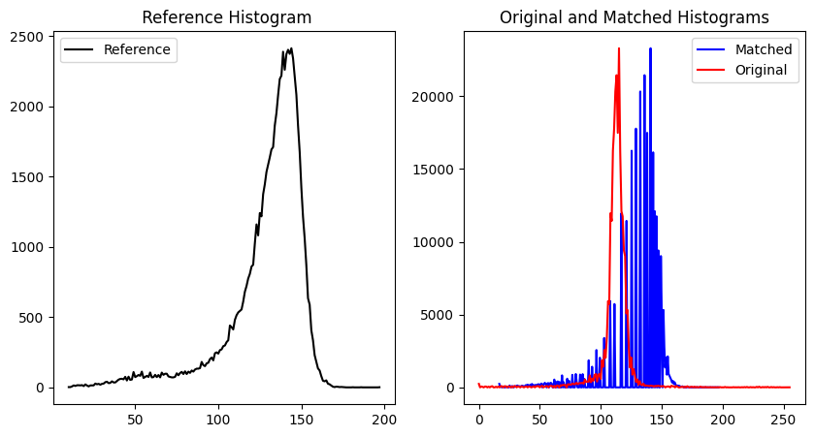

Slide 11
Rescaling and Resizing
from skimage.transform import rescale, resize
# Rescale (scale down by 50%)
rescaled_image = rescale(image, 0.5, anti_aliasing=True)
# Resize (to 128x128 pixels)
resized_image = resize(image, (128, 128), anti_aliasing=True)
plt.imshow(resized_image)
plt.axis('off')
plt.show()

Slide 12
Filters
GitHub Link: https://github.com/qassasahmed/ip/tree/main/LABS2425/4
Key Concepts
Smoothing filters: Median, Mean, Gaussian, Bilateral, Non-Local Means.
Edge detection filters: Sobel, Scharr, Prewitt, Roberts, and Canny.
Tasks:
Reducing noise with smoothing filters.
Highlighting edges using gradient-based filters.

Slide 13
Median Filter
from skimage.filters import median
from skimage import io
# Load a noisy image
noisy_image = io.imread('Noise_salt_and_pepper.png', as_gray=True)
smoothed_image = median(noisy_image)
plt.imshow(smoothed_image, cmap='gray')
plt.title("Median Filtered Image")
plt.axis('off')
plt.show()

Slide 14
Gaussian Filter
from skimage.filters import gaussian
# Apply Gaussian filter
smoothed_gaussian = gaussian(noisy_image, sigma=2)
plt.imshow(smoothed_gaussian, cmap='gray')
plt.title("Gaussian Smoothed Image")
plt.axis('off')
plt.show()

Slide 15
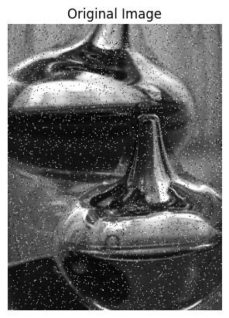
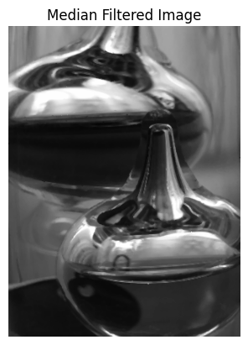
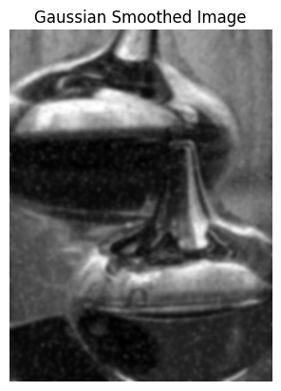
Best for salt-and-pepper noise

Slide 16
Edge detection filters
Gradient based
Gaussian based
Sobel
Prewitt
Robert
Canny
Laplacian

Slide 17
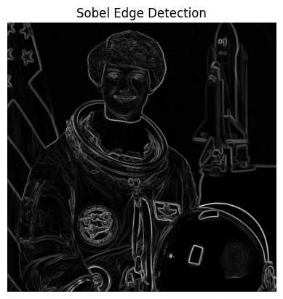
Sobel Filter
from skimage.filters import sobel
# Sobel edge detection
edges = sobel(gray_image)
plt.imshow(edges, cmap='gray')
plt.title("Sobel Edge Detection")
plt.axis('off')
plt.show()

Slide 18
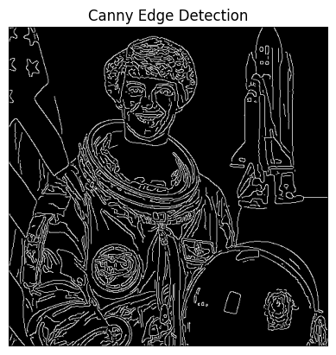
Canny Filter
from skimage.feature import canny
# Canny edge detection
canny_edges = canny(gray_image, sigma=1)
plt.imshow(canny_edges, cmap='gray')
plt.title("Canny Edge Detection")
plt.axis('off')
plt.show()

Slide 19
Thank You
This lab has reviewed:
1. Basics of digital images.
2. Spatial domain processing and histograms.
3. Image transformations.
4. Noise reduction, smoothing techniques, and Edge detection methods.

