Slide 1
Image Processing
Lab 6 Notes
Nov 2024

Slide 2
Image Segmentation
Image segmentation involves partitioning a digital image into multiple segments (regions or objects) to simplify and analyze an image by separating it into meaningful components.
This process makes image processing more efficient by focusing on specific regions of interest.

Slide 3
Simple Thresholding
Thresholding is a simple technique that converts grayscale images into binary images by applying a threshold value. 5 Types of Thresholding:
0: Binary
1: Binary Inverted
2: Threshold Truncated
3: Threshold to Zero
4: Threshold to Zero Inverted

Slide 4
Code Example
import cv2
thrshld = 127
# Load a grayscale image
img = cv2.imread('lena.png', 0) # 0: Grayscale image
_, thresh_binary = cv2.threshold(img, # Src image
thrshld, # Threshold value
255, # Max value
0) # Threshold type: Binary

Slide 5
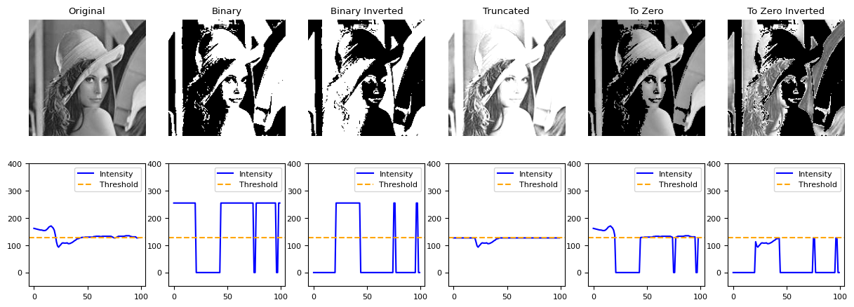

Slide 6
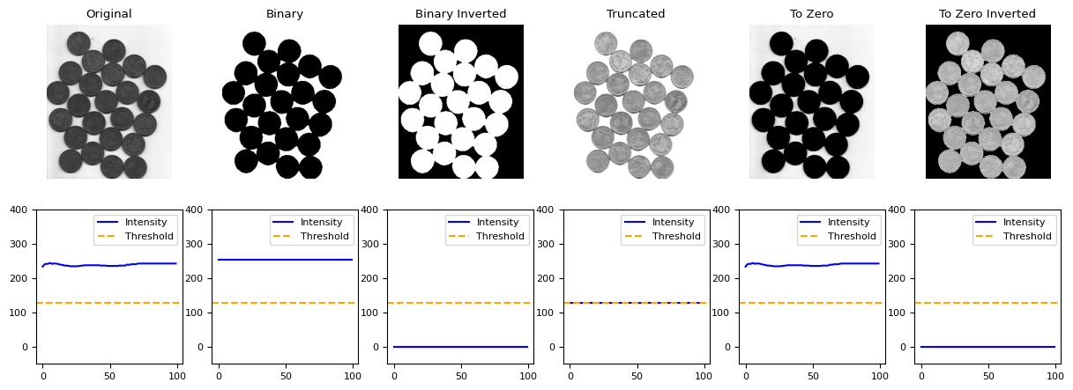
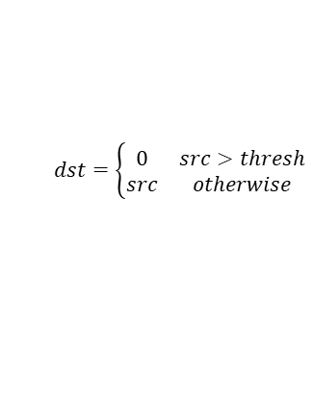
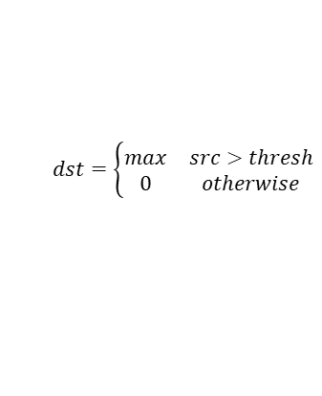
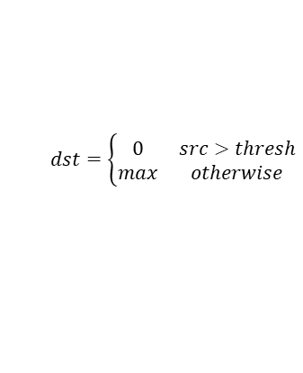
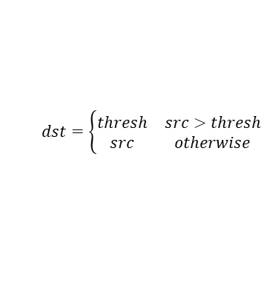
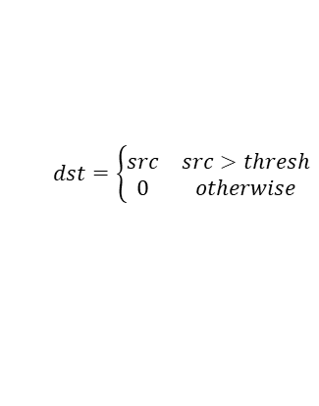
$$dst=\left\{\begin{matrix}max & src>thresh \\ 0 & otherwise\end{matrix}\right.$$
$$dst=\left\{\begin{matrix}0 & src>thresh \\ max & otherwise\end{matrix}\right.$$
$$dst=\left\{\begin{matrix}thresh & src>thresh \\ src & otherwise\end{matrix}\right.$$
$$dst=\left\{\begin{matrix}src & src>thresh \\ 0 & otherwise\end{matrix}\right.$$
$$dst=\left\{\begin{matrix}0 & src>thresh \\ src & otherwise\end{matrix}\right.$$

Slide 7
Use cases for segmentation with simple thresholding
Document Processing
Converts scanned documents into binary for OCR.
Barcodes and QR Code Detection
Simplifies patterns for easier decoding.
License Plate Recognition
Extracts text regions from plates under good lighting.
Signature and Logo Extraction
Isolates signatures or logos for verification.

Slide 8
Adaptive Thresholding
Adaptive thresholding calculates thresholds for smaller regions of the image, making it useful for images with varying lighting.

Slide 9
Adaptive Thresholding
import cv2
thresh_adaptive = cv2.adaptiveThreshold(img,
255,
cv2.ADAPTIVE_THRESH_MEAN_C,
cv2.THRESH_BINARY,
11,
2)

Slide 10
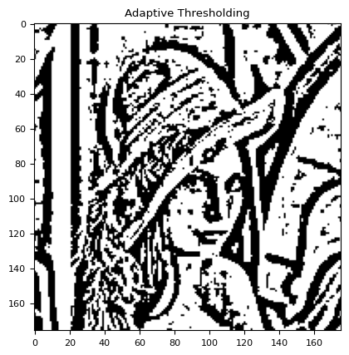
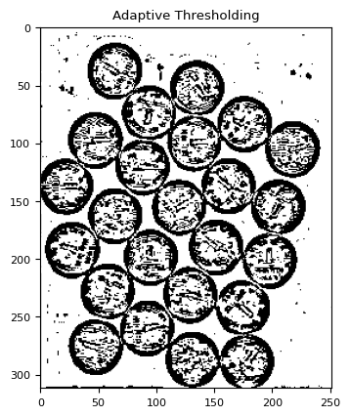

Slide 11
Otsu's Binarization
import cv2
_, thresh_otsu = cv2.threshold(img,
0,
255,
cv2.THRESH_BINARY + cv2.THRESH_OTSU)

Slide 12
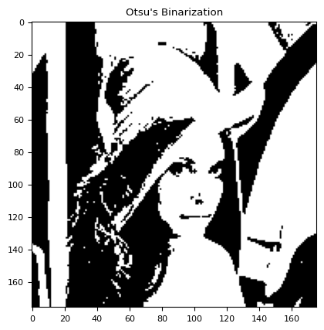
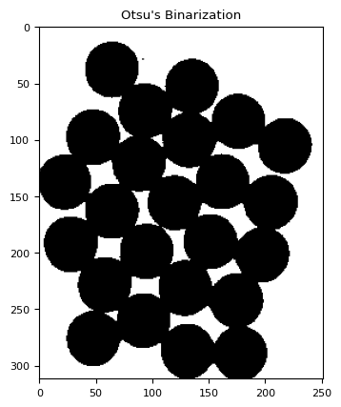

Slide 13
Canny Edge Detector
import cv2
edges = cv2.Canny(img, 100, 200)

Slide 14
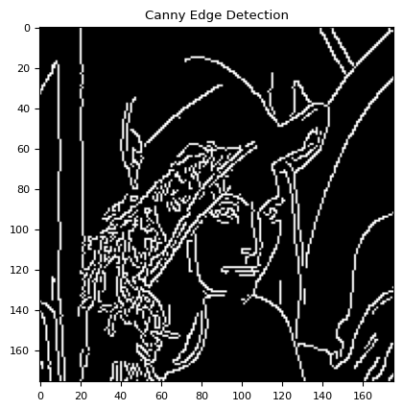
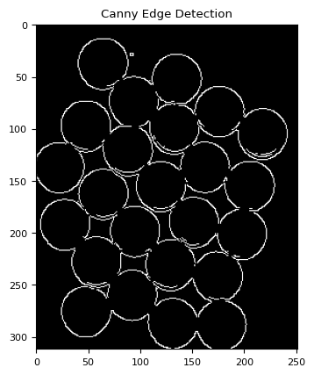

Slide 15
Thank You

