Slide 1
Parallel Computing
Lab 5 Notes
Autumn 2024-25

Slide 2
Review on Previous Labs
Introduction to goroutines
Channels and buffered channels
Sending data and closing channels
Waitgroups (+Slices and Structs)

Slide 3
Lab 1
Basics of Golang
Introduction to concurrency using go routines
Example
Running two functions sequentially and concurrently and calculating the execution time for both.

Slide 4
func printNumbers(num int){
for i:=1; i<=num; i++{
fmt.Printf("%d, i")
time.Sleep(1000 * time.Millisecond)
}
}
func printLetters(char rune){
for i:='A'; i<=char; i++ {
fmt.Printf("%c ", i)
time.Sleep(500 * time.Millisecond)
}
}

Slide 5
func main(){
now := time.Now()
defer func(){
fmt.Println("Execution time = ", time.Since(now))
}()
printNumbers(5)
printLetters('E')
}

Slide 6
Lab 2
Using channels to prevent application from closing before other goroutines are done.
Using buffered channels to prevent a deadlock.
Example
Calculating the factorial based on a user input meanwhile a copy simulation process is running

Slide 7
func main(){
ch_signal := make(chan bool)
go copy_simulation(20, ch_signal)
var input_num int
fmt.Printf("Enter Number: ")
fmt.Scan(&input_num) //Use error hanlding
answer := factorial(input_num)
fmt.Printf("%d! = %d\n", input_num, answer)
<-ch_signal
}

Slide 8
func copy_simulation(num int, done chan bool){
for i:=1; i<=num; i++{
fmt.Printf("-")
time.Sleep(1000 * time.Millisecond)
}
done<-true
}
func factorial(num int)int{
fact := 1
for i:=2;i<=num;i++ {
fact *= i
}
return fact
}

Slide 9
Lab 3
Sending data between goroutines
Running Concurrent loops
Closing channels
Bonus: Pseudo Random Generation
Example
Two loops running concurrently (withing different goroutines) based on an input from the user. The loop in main has no access to the number of iterations. Use range and close() so that the program run properly.

Slide 10
func getMoney(ch chan int) {
var trials int
fmt.Println("Number of trials: ")
if _, err := fmt.Scan(&trials); err != nil {
fmt.Println("Please Provide Intege number")
return
} rand.Seed(time.Now().UnixNano()) //Pseudu Random
for i := 1; i <= trials; i++ {
amount := rand.Intn(500)
ch <- amount
} // End sending
close(ch)
}

Slide 11
func main() {
channel := make(chan int)
go getMoney(channel)
for msg := range channel {
fmt.Printf("You've won: %d$\n", msg)
} }

Slide 12
Lab 4
Waitgroups
Channel vs Waitgroups
Bonus: Slices and Structs
Examples
Initiate goroutines within a loop. Use sync.WaitGroup for synchronization.

Slide 13
func printNumber(num int, wg *sync.WaitGroup) {
defer wg.Done()
fmt.Println(num)
}
func main() {
var wg sync.WaitGroup
for i := 1; i <= 5; i++ {
wg.Add(1)
go printNumber(i, &wg)
}
wg.Wait()

Slide 14
func main(){
number := [5]int{1, 2, 3, 4, 5}
fmt.Println(number)
//[1, 2, 3, 4, 5]
slice := number[2:4]
//len = 2, cap = 3
fmt.Print("Cap: ", cap(slice))
slice[0] = -10
fmt.Println("new Slice", slice)
//[-10, 4]
fmt.Println("new Array", number)
//[1, 2, -10, 4, 5]
}

Slide 15
func main(){
type Student struct {
courses [5]string
grades [5]float64
}
qassas := Student{
courses:[5]string{"DB", "IT", "AI", "ML", "CN"},
grades:[5]float64{85.0, 90.0, 92.0, 95.5, 100.0},
}
fmt.Println("course: ", qassas.courses)
}

Slide 16
Lab 5: Worker Pool
A worker pool is a concurrency pattern used to manage and distribute tasks among multiple worker goroutines efficiently.
It helps optimize resource usage by limiting the number of active workers while processing a potentially large number of tasks.

Slide 17
Example
Example: Basic Worker Pool
Imagine you have 10 boxes to pack. If only one person (your main program) is working, it will take forever. But if you hire 3 workers (goroutines), they can share the workload, and the job gets done much faster. At the same time, you don’t hire too many workers, so you don’t run out of resources (like memory or processing power).

Slide 18
func main() {
const numWorkers = 3
const numReq = 10
tasks := make(chan int, numReq) // Buffered Channel
var wg sync.WaitGroup
// Start workers
for i := 1; i <= numWorkers; i++ {
wg.Add(1)
go worker(i, tasks, &wg)
}

Slide 19
// Send tasks to the task queue
for i := 1; i <= numReq; i++ {
tasks <- i
}
close(tasks) // Close the task channel to signal no more tasks
// Wait for all workers to finish
wg.Wait()
fmt.Println("All tasks processed.")
}

Slide 20
func worker(id int, tasks chan int, wg *sync.WaitGroup) {
defer wg.Done()
for task := range tasks {
fmt.Printf("Worker %d processing task %d\n", id, task)
time.Sleep(time.Second) // Simulate task processing time
}
}

Slide 21
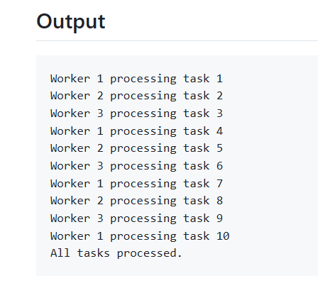

Slide 22
Thank You

