Slide 1
Parallel Computing
Lab (1) Notes
Autumn 2024-25

Slide 2

Sequential Execution
CPU Core 1
Task 1
Task 2
Time
One task after another on a single core.

Slide 3
Parallel Execution
CPU Core 1
Task 1
CPU Core 2
Task 2
Time
Multiple tasks executed simultaneously on multiple cores.

Slide 4
Concurrent Execution
waiting for user input
CPU Core 1
Thread 1.1
Thread 1.2
Thread 2.1
Thread 2.2
Time
Switching between threads of the tasks to minimize idle time and maximize CPU utilization.

Slide 5
Concurrent and Parallel Execution
Thread 1.1
Thread 2.1
Thread 1.2
CPU Core 1
Thread 3.1
Thread 3.2
Thread 2.2
Thread 4.1
Thread 4.2
Thread 3.3
CPU Core 2
Thread 3.4
Thread 3.5
Thread 4.3
Time
Apply both concurrency and parallelism.

Slide 6
Component
Role
Registers
Small, high-speed storage locations within the CPU that hold data being processed or instructions being executed.
Execution Units
The functional units of the CPU responsible for performing arithmetic, logical, and control operations on data.
Reg.
Exec. Units
L1 Cache
L1 Cache
A small, very fast cache memory located on the same chip as the CPU core. It stores frequently accessed data and instructions, providing faster access than main memory.
L2 Cache
L2 Cache
A larger cache memory that sits between the L1 cache and main memory. It stores less frequently accessed data and instructions than the L1 cache but still offers faster access than main memory.

Slide 7

$$P= \frac{Work}{Time} Flop/s$$
$$Flop is a Floating point operation (Add, Subtract, Multiply, Divide)$$
Up to 64 cores
Shared L3 Cache
This is called High Performance Computing.
https://youtu.be/sGJ8VJTt7Ig?si=gHxslz_2A4hxtjrQ

Slide 8
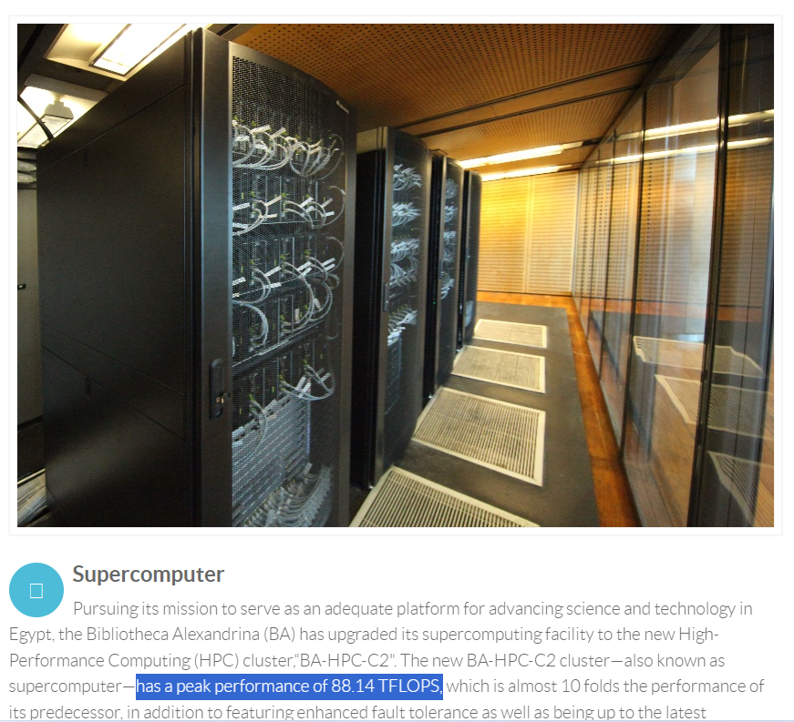
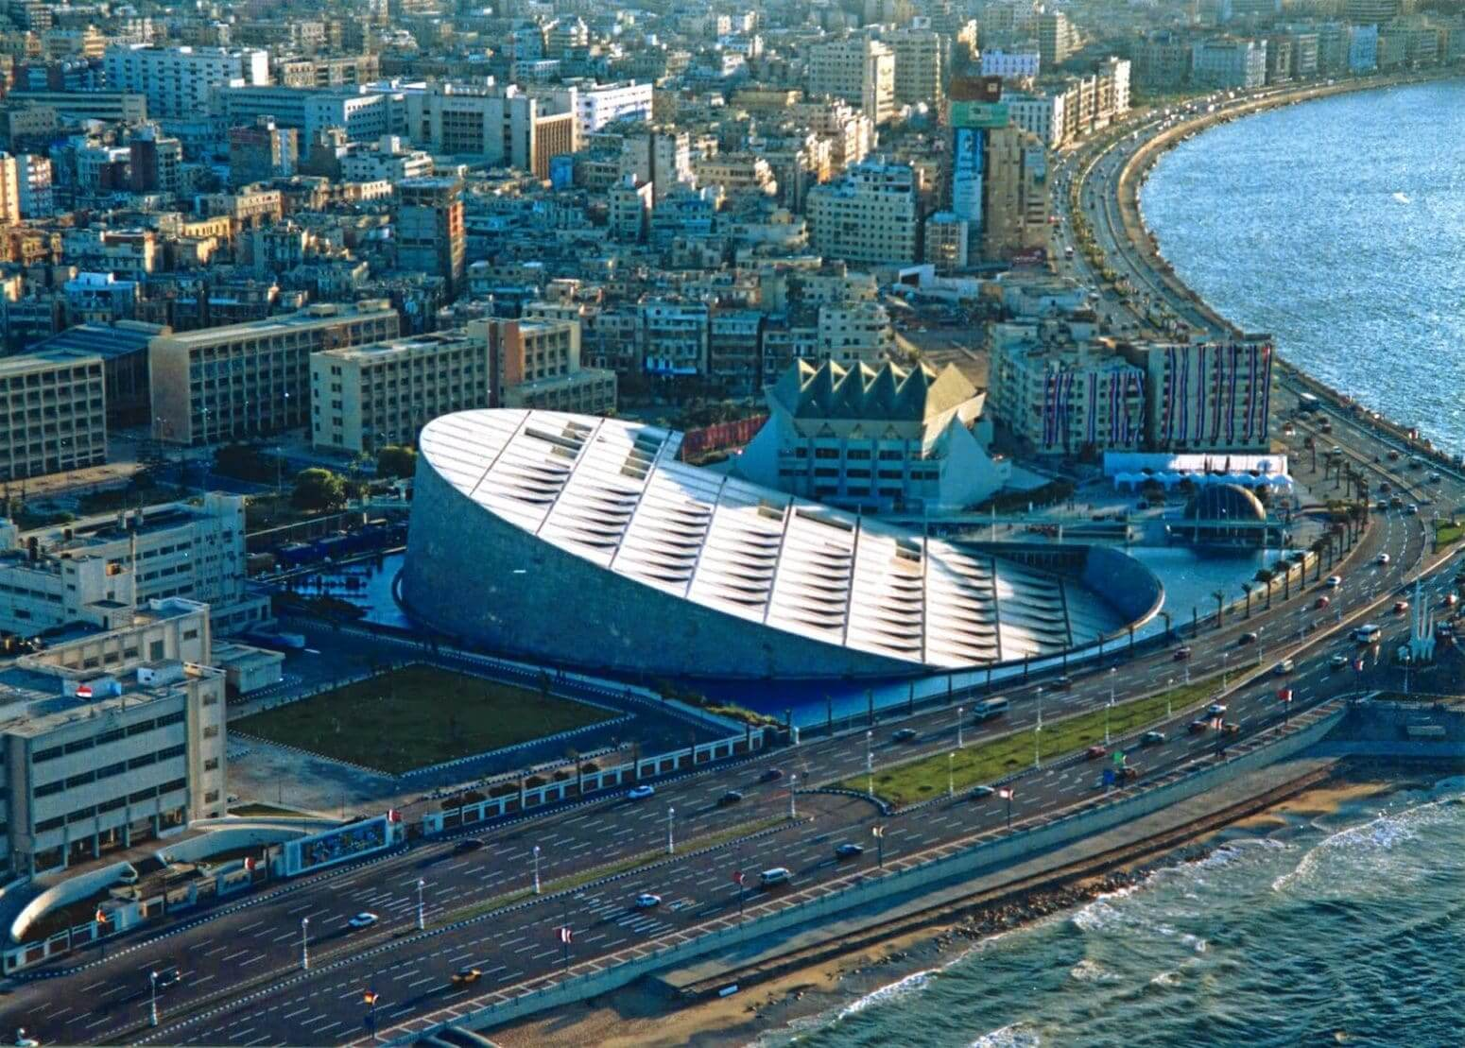
Bibliotheca Alexandria - Egypt
https://hpc.bibalex.org/
https://www.bibalex.org/en/project/details?documentid=281

Slide 9
Terminology
Concurrency manages multiple tasks simultaneously.
Parallelism executes multiple tasks simultaneously.
A thread is an independent execution units within a process.
https://youtu.be/RlM9AfWf1WU?si=xkpT9tD8Ifg6WS_t

Slide 10
Goroutines
Goroutines are lightweight threads of execution that are managed by the Go runtime.

Slide 11
Main()
func()
go func()
func()
go func()

Slide 12
Brief Introduction to Golang
Hello, World!
Variables
Functions
Loops
https://youtu.be/446E-r0rXHI?si=NtXj-SKbk6kIQx8T

Slide 13
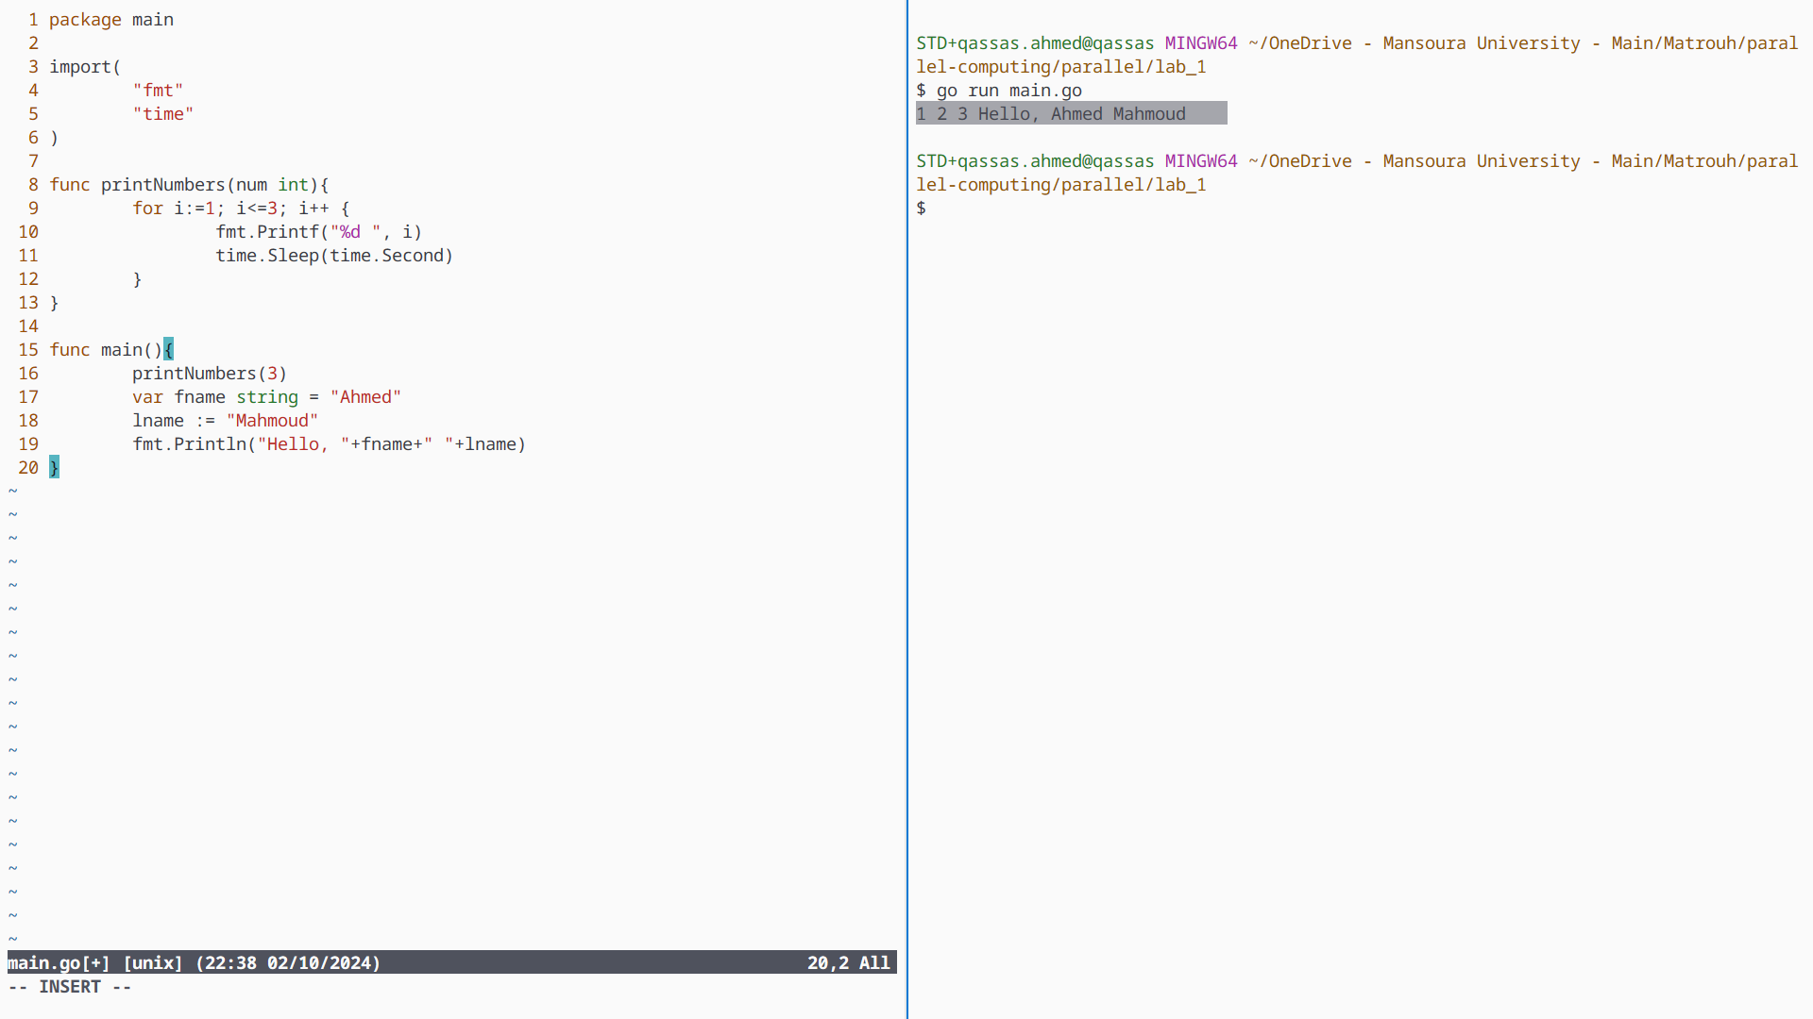

Slide 14
Create a Goroutine
Use time.Since() to calculate the execution time in both sequential and concurrent processing.
Use go keyword to run a normal function as a goroutine.
Once the main() finish execution, all running goroutines terminate by default.

Slide 15
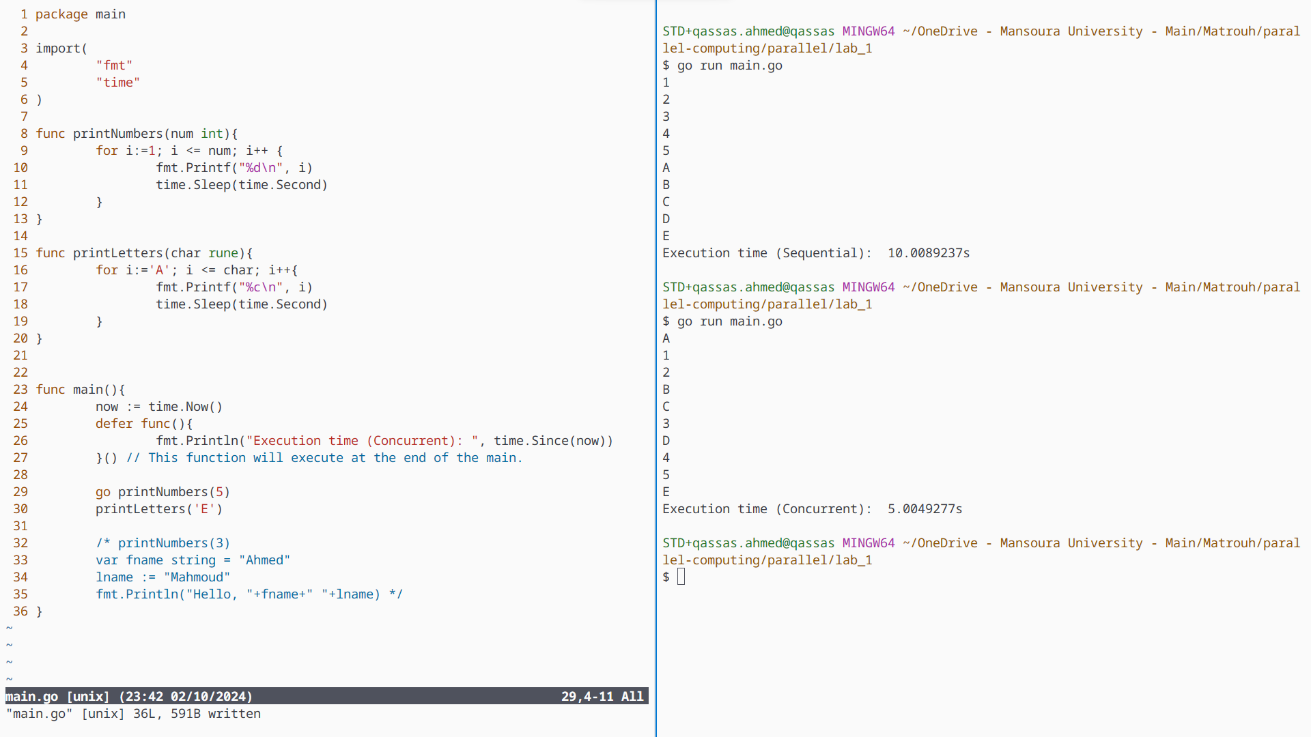

Slide 16
Main()
func()
go func()
func()
go func()
End
Synchronization is needed.

Slide 17
Channels
Goroutines can communicate with each other using channels.
Channels provide a safe and efficient way to synchronize and share data between concurrent tasks.

Slide 18
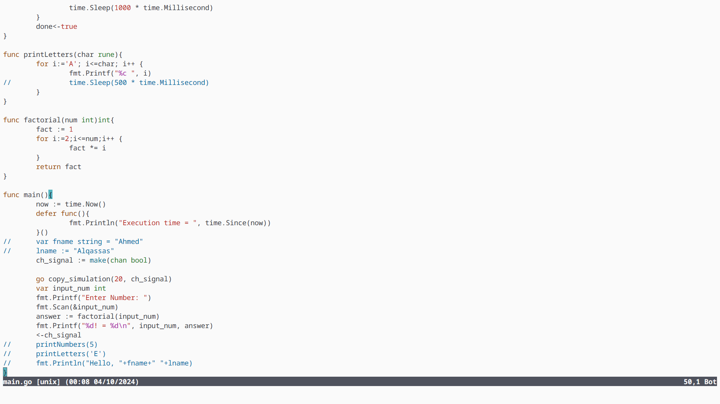

Slide 19
Thank You

