Slide 1
Parallel Computing
Lab (2) Notes
Autumn 2024-25

Slide 2
Review
Concurrency manages multiple tasks simultaneously.
Parallelism executes multiple tasks simultaneously.
A thread is an independent execution units within a process.

Slide 3
Goroutines
Goroutines are lightweight threads of execution that are managed by the Go runtime.
Use go keyword to run a normal function as a goroutine.

Slide 4
Main()
func()
go func()
func()
go func()
End
Synchronization is needed.

Slide 5
Channels
Goroutines can communicate with each other using channels.
Channels provide a safe and efficient way to synchronize and share data between concurrent tasks.

Slide 6
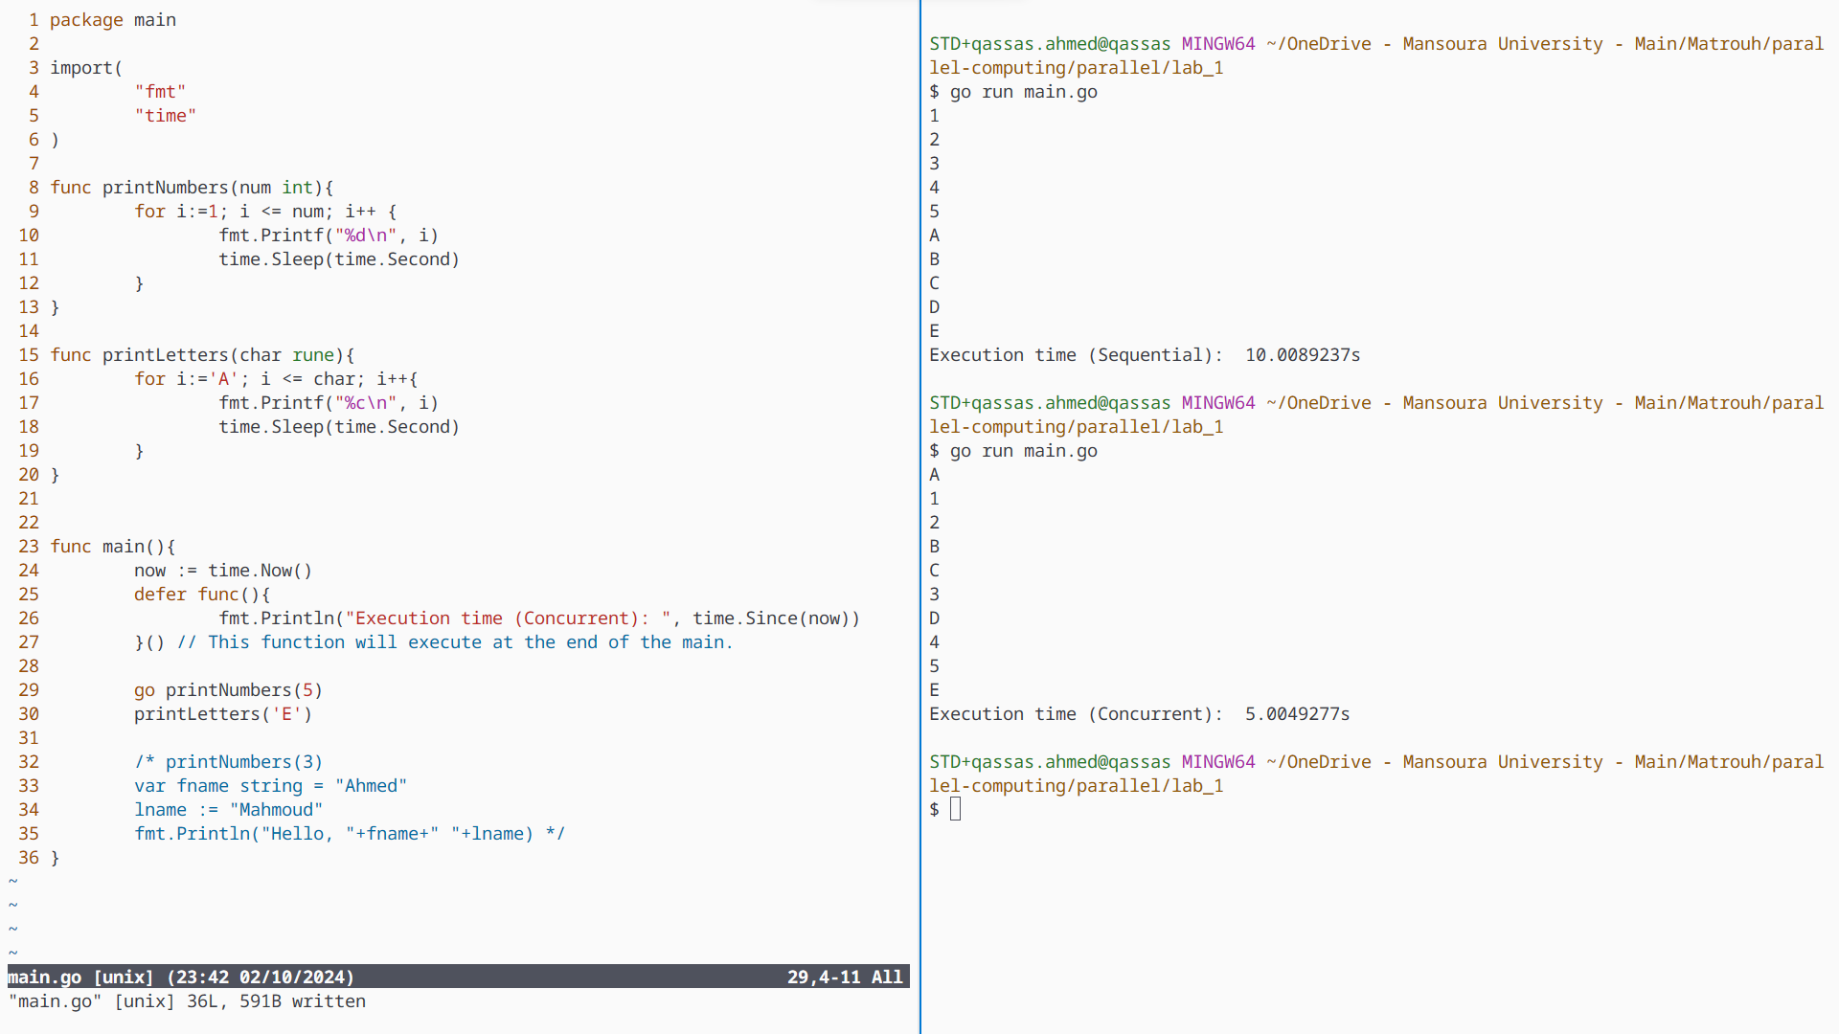

Slide 7
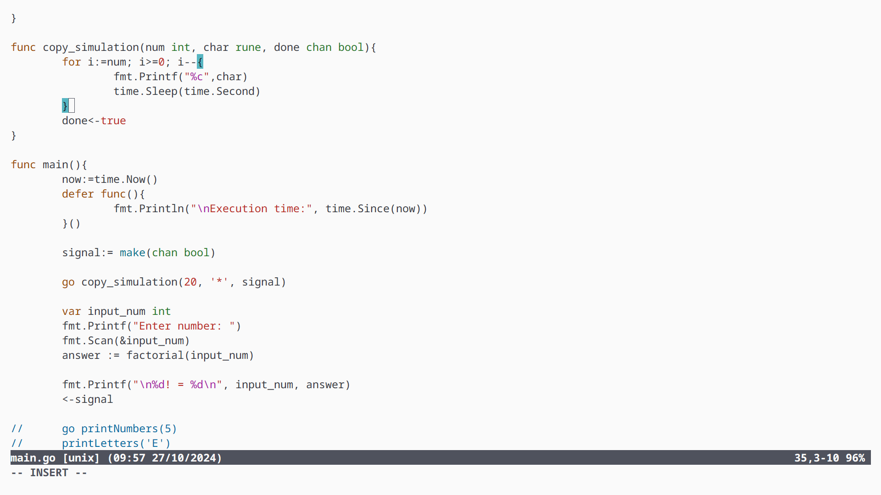

Slide 8
Buffered Channels
Buffered channels are commonly used in scenarios where production of data and its consumption are not always synchronized but still require a controlled flow.

Slide 9
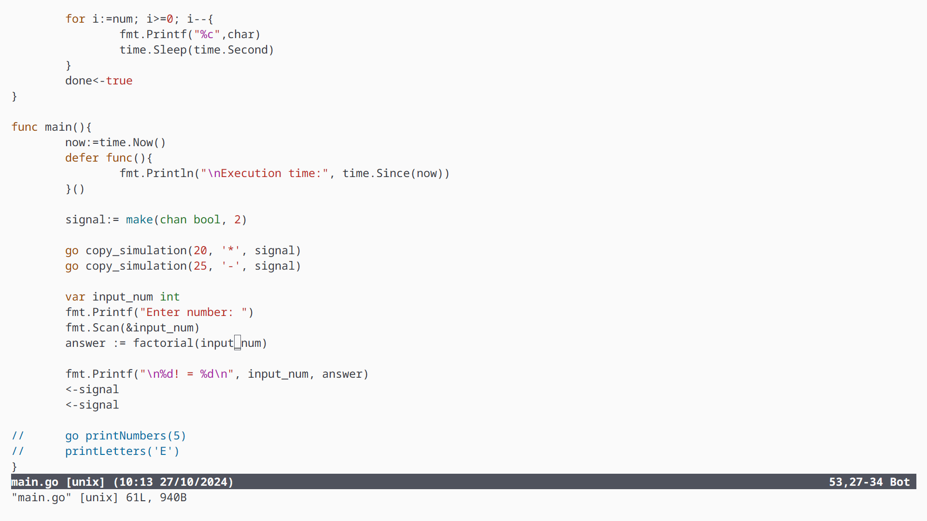

Slide 10
Thank You

