Slide 1
EV charging in Rebana: who can charge, who cannot, and is the grid ready?
Qashtalani Haramaini · PhD candidate, Monash University Indonesia (RACE for 2030)
2nd Powering Rebana Workshop · Cirebon, 5–6 November 2026
All layers are also available in ur-scape, the workshop's shared visualisation platform
Notes:
Purpose: show what the existing data says about EV charging in Rebana, and share the same layers in ur-scape so the workshop group can explore them together. Every number comes from the repo pathwaysevcharging and can be inspected cell by cell.

Slide 2
Rebana charges the cars passing through, not the cars of people who live there
73 %
29 %
1.04 M
−15 MVA
of Rebana's charging energy is sold at 19 toll-road rest areas
of residents live within a 10-minute drive of a charger (Jabodetabek 76 %)
residents (11 %) are more than 30 minutes from any charger
headroom at Sunyaragi substation, which supplies Kota Cirebon
Access is uneven and follows density, not need. The sparsest fifth of villages has 5 % of residents within 10 minutes; the densest fifth has 70 %.
Grid capacity exists, but in the wrong places. Haurgeulis, Cikedung and Arjawinangun Baru substations have 56–69 % headroom and almost no chargers.
Because Rebana is still being built, siting can be decided before demand forms. The village travel-time method becomes an ex-ante planning tool, not an audit.
Notes:
One sentence to remember: Rebana's chargers serve through-traffic on the Cipali–Palikanci toll road. Residents, especially outside the cities, are barely served, while the substations with spare capacity sit where there are no chargers.

Slide 3
Seven regencies, 9.2 million people, and a metropolitan area still under construction
Area | Population (M) | Industrial zones (KPI) | Investment 2025 (Rp T) | Chargers per 100k
Kab. Cirebon | 2.45 | 1 | 4.01 | 2.49
Kab. Indramayu | 1.95 | 6 | 3.35 | 1.06
Kab. Subang | 1.66 | 3 | 18.2 | 1.20
Kab. Majalengka | 1.36 | 3 | 3.36 | 1.74
Kab. Kuningan | 1.24 | 0 | – | 1.16
Kab. Sumedang | 1.17 | 0 | 5.63 | 1.30
Kota Cirebon | 0.36 | 0 | – | 1.96
Rp 36.7 T
investment in 2025 (BKPM via BP Rebana)
13 industrial zones
largest: Cipali Subang Barat 10,408 ha, Losarang 6,170 ha
1.78 M jobs targeted by 2030
plus Kertajati airport and Patimban port
Sources: Kontur 2023, BPS 2024, BKPM/BP Rebana; chargers: PLN Charge.IN
Notes:
Indramayu has six industrial zones and the most substation headroom, yet the fewest chargers per resident. Subang received half of 2025 investment.

Slide 4
Charging today follows the toll corridor, not the towns
13,691
charging sessions in March 2026, 13.6 % of West Java
60 %
of sessions at chargers of 100 kW or more
< 100
EVs registered by Rebana residents
Notes:
Five sites (KM 166 A, CSE UP3 Cirebon, KM 164 B, KM 229 B, KM 101 B) sell 42 % of Rebana's energy. Daily peak is 13:00–17:00, a travel pattern, not a commuting pattern. Majalengka and Subang look busy only because the Cipali rest areas fall inside their borders.

Slide 5
Fewer than three in ten residents can reach a charger in 10 minutes
How it is measured
Car travel time on the OSM road network (r5r village-to-village matrix, 60-minute cap, by Alyas Widita) from each of 1,981 Rebana villages to the nearest village with a public charger (1,556 sites, PLN Charge.IN June 2026), weighted by Kontur 2023 population.
Within 30 minutes: 88.8 %
Kuningan and Sumedang each have about 250,000 residents beyond 30 minutes.
Notes:
Kota Cirebon is well served at 78 %. The three north-coast regencies, Subang, Indramayu and Majalengka, sit at 19 %, where most industrial zones are planned.

Slide 6
The gap is rural versus urban, and the service ladder stops at the first rung
Concentration index of 15-minute access against density is 0.31; against spending per person only 0.08. Inequality here is rural–urban, not rich–poor, and can still be prevented. Sufficiency = E2SFCA charger kW within 10 minutes ≥ 0.03 kW per household.
Notes:
Quintile values from analysis/rebana_data.json (eq.rebana.quint), each fifth about 1.84 M residents. Rebana does not yet have a capacity problem, it has an existence problem.

Slide 7
Grid headroom exists where chargers do not
Risk 1 · saturated towns
Sunyaragi (Kota Cirebon) is at 86 % of peak, Subang at 89.5 %, Indramayu and Jatibarang above 80 %. Fast chargers there add midday peak to full substations.
Risk 2 · idle capacity
Haurgeulis (69 %), Cikedung (56 %) and Arjawinangun Baru (56 %) serve sub-districts with no charger. Pair new rural sites with these, and daytime solar tariffs in towns.
Notes:
Headroom = capacity minus reported peak load, PLN UID Jabar. N-1 and PLN reinforcement plans are not included.

Slide 8
Two siting models point to the same three places
Model A · siting priority score
0.5 × need (travel time, distance) + 0.25 × demand (log population) + 0.25 × readiness (substation headroom). Top: Pusakanagara 67.0, Cibingbin 65.9, Krangkeng 65.9, Losari 65.2, Gegesik 63.2.
Both models meet at Gegesik, Terisi and Pusakanagara–Pusakajaya
One 4-gun station in Gegesik adds 432,000 residents to the 10 km radius, more than all new chargers in 2026 combined. Twelve sites lift coverage from 67 % to about 90 %.
Notes:
Weights in model A are illustrative; use the ranking as a discussion order, not a decision. Model B is a greedy maximal-coverage pick at kecamatan level starting from 66.9 % coverage.

Slide 9
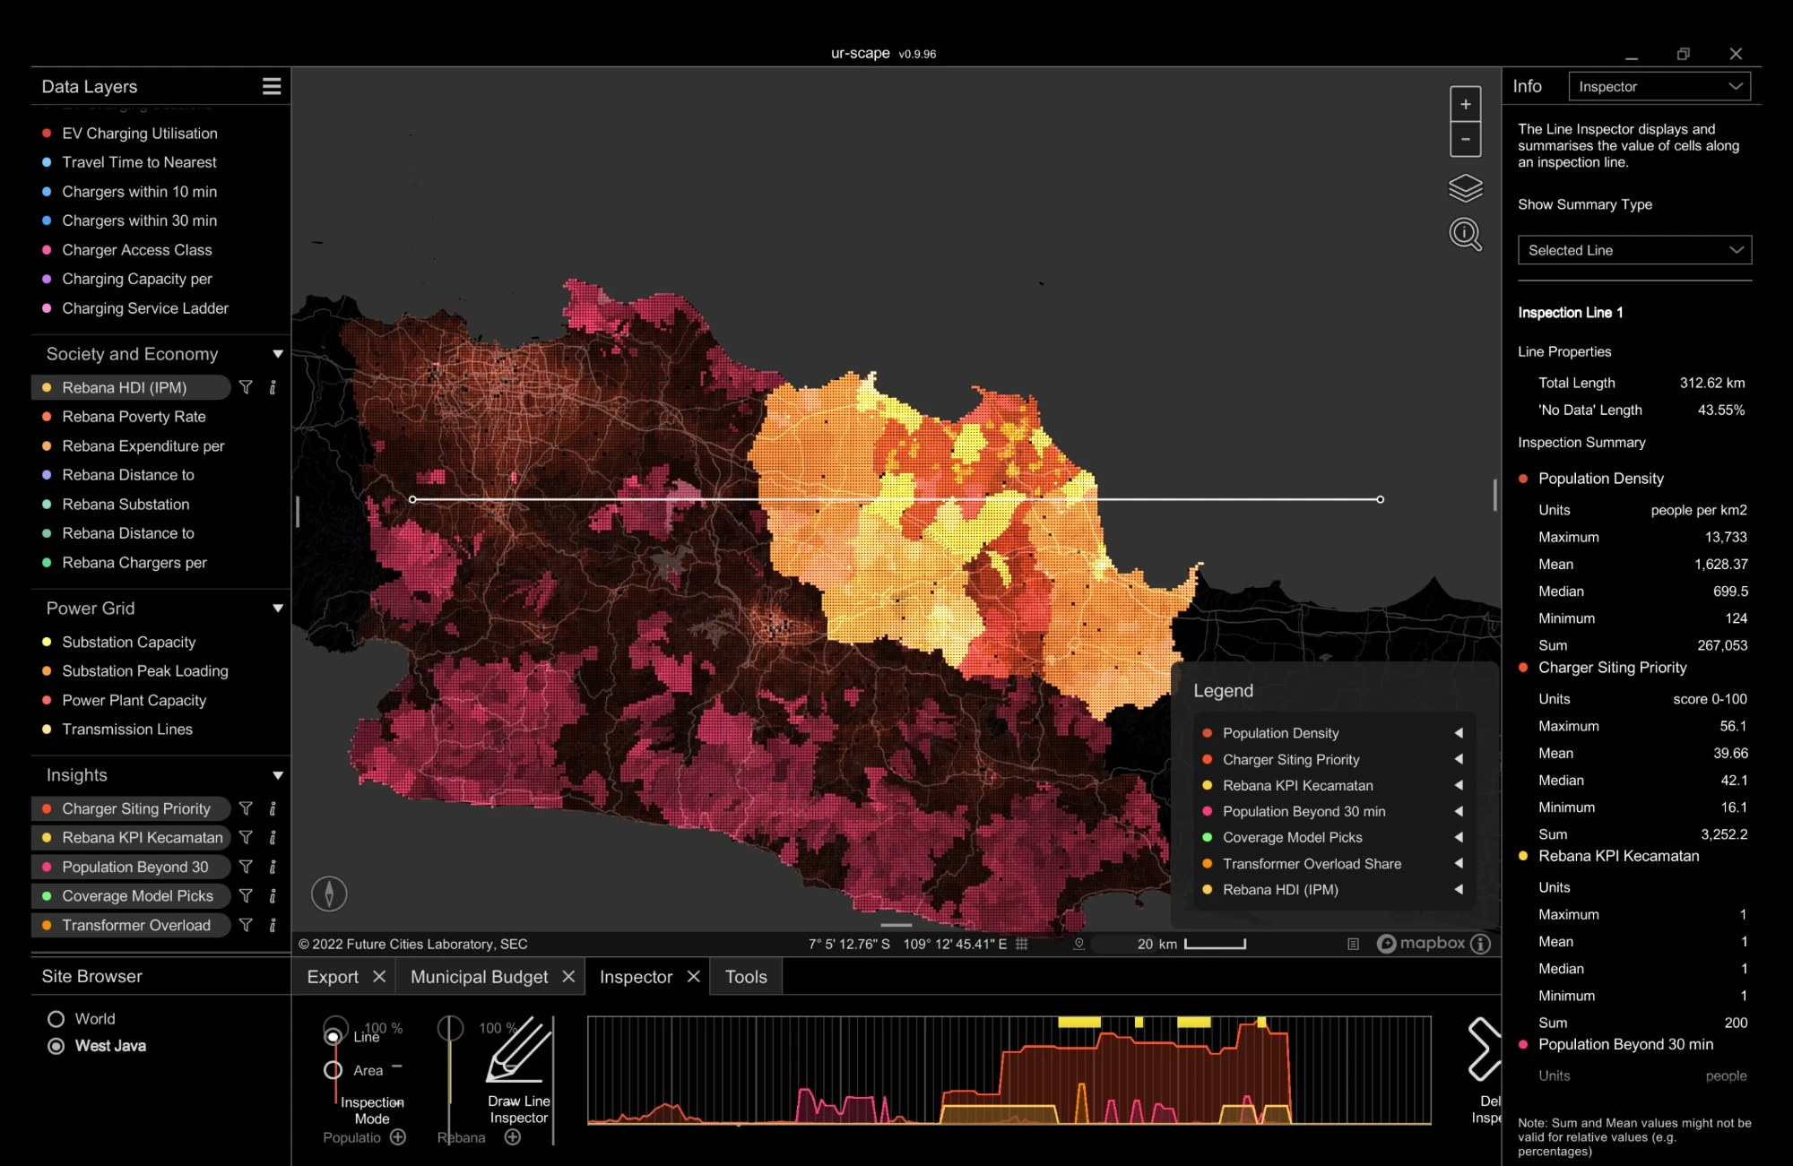
The same evidence in ur-scape, the workshop's shared platform
28 layers, one site
Site "West Java", 0.5 arc-minute cells (about 0.9 km), no QGIS needed.
EV Charging
stations, energy, utilisation, travel time, access class, service ladder
Society and Economy
density, Rebana HDI, poverty, expenditure, distances
Power Grid
substations, peak loading, power plants, transmission
Insights
siting priority, access gap, coverage picks, KPI kecamatan, transformer overload
Notes:
Install: unzip the package and run install.py with the path to ur-scape's Data folder, or copy Sites/West Java and append layers_add.csv and citations_add.csv. Download link on the last slide.

Slide 10
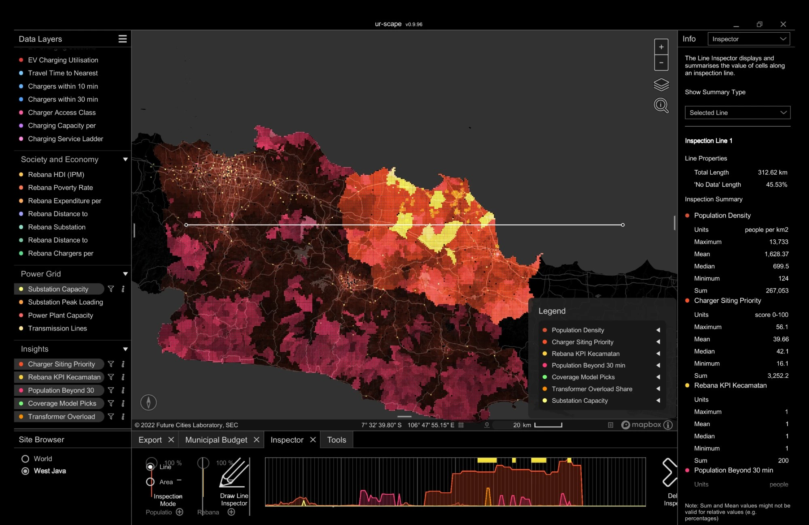
Reading one line across Rebana with the ur-scape Inspector
Layer along the 313 km line | Min | Median | Mean | Max
Population density (people/km²) | 124 | 700 | 1,628 | 13,733
Charger siting priority (0–100) | 16.1 | 42.1 | 39.7 | 56.1
What the line shows
Density along the line is skewed: median 700 but mean 1,628 people per km². A few town cells hold most residents.
Siting priority ranges from 16 to 56 (median 42). The profile graph under the map shows where along the line it rises.
The line crosses industrial-zone (KPI) sub-districts at 200 sample points.
42–53 % of the line has no data because Rebana-only layers stop at the Rebana border.
Notes:
Screenshots taken in ur-scape v0.9.96 with the West Java site. The inspector summary is for the selected line only; sums and means are not meaningful for percentage layers, as ur-scape itself notes.

Slide 11
What this means for the three workshop themes
1
2
3
Sustainable mobility & connectivity
Energy
Skills
Separate transit charging (toll, working) from resident charging (missing). Measure success as the share of residents within 10 minutes: from 29 % to at least 50 % needs about 12 sites.
Use substation headroom as a siting criterion. Haurgeulis, Cikedung, Arjawinangun Baru and Kadipaten can absorb 10–20 MW of chargers without reinforcement; towns need daytime time-of-use.
1.78 M jobs by 2030 and 10,000 ha of industrial land in west Subang will move demand to the north coast, where access is 19 %. Plan chargers, transformers and technician training by the KPI map.
Equity: spending-based concentration is close to zero, so a class gap has not formed yet. Kuningan and Sumedang, with no industrial zones, will be served last if siting follows the market.
Notes:
These map directly to ur-scape layers: Travel Time, Population Beyond 30 min, Coverage Model Picks (mobility); Substation Peak Loading, Rebana Substation Headroom (energy); Rebana KPI Kecamatan, Transformer Overload Share (skills).

Slide 12
Next steps and open data
Data that would sharpen the ex-ante analysis: monthly EV registrations by sub-district (Samsat), charger commissioning dates, and the 20 kV network plan for the industrial zones.
Report, slides and ur-scape package: jabar-ev.vercel.app/analysis/rebana_insights.html
Code and data: github.com/qastill/pathwaysevcharging
Notes:
Invite the group to add their own layers to the same ur-scape site so the workshop has one shared evidence base.

