Slide 1
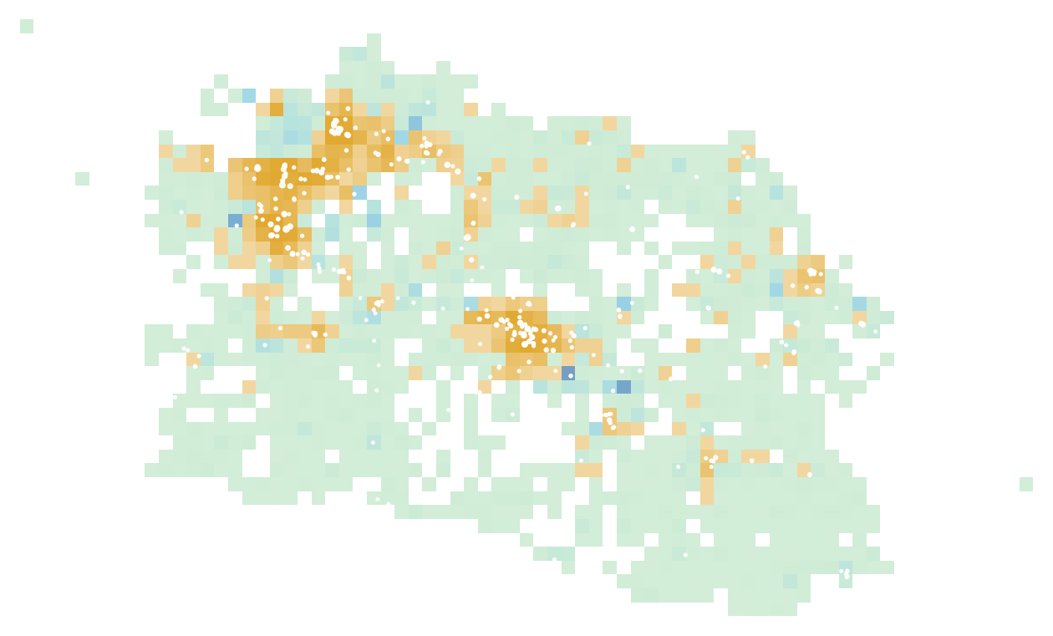



CIRED 2027 · WEST JAVA, INDONESIA
Capacity maps as an equity instrument
Publishing charging demand and network headroom as open data in a vertically integrated DSO
Qashtalani Haramaini
Alyas Widita · Liz Taylor
Monash University · PT PLN (Persero) UID Jawa Barat
network headroom
EV owners
public chargers
Notes:
One line: what a distribution operator chooses to publish on its capacity map decides where public chargers go and who gets served. The background map is the real data: amber cells are where registered EV owners live, green-blue cells are where the grid has spare capacity, white dots are public chargers.

Slide 2




The talk in four questions
01
02
03
04
Why does a map matter?
What did we find?
Is it robust?
What should a DSO publish?
A capacity map ranks places, and capital follows the ranking.
Chargers follow the strong grid, and the poorest regencies are left out.
Tested against chance, site size and four map resolutions.
Five requirements and a phased path to open data.
Source: PLN UID Jawa Barat internal data (transformer surveys 2020–24, GI register, March 2026 charging log, registered EV customers); BPS 2024. Reproduced by papers/capacity/prepare.py and v3/strengthen.py.
2
Notes:
Four parts. Each part opens with a dark divider slide.

Slide 3






Six findings at a glance
0.86 vs 0.46
11.6 % : 5.6 %
+18.0 vs +5.1
Grid size predicts where chargers are (AUC). Spare capacity is a coin toss.
Owners vs chargers in cells with high demand and low headroom.
Points of coverage for the poorest third of regencies: demand within headroom vs headroom-only.
+14–32 %
ρ = −0.02
79.6 %
More owners reached than headroom-only, at every map resolution.
Transformer and substation headroom are unrelated: publish both.
of load records name field staff. Clean before publishing.
Source: PLN UID Jawa Barat internal data (transformer surveys 2020–24, GI register, March 2026 charging log, registered EV customers); BPS 2024. Reproduced by papers/capacity/prepare.py and v3/strengthen.py.
3
Notes:
The whole talk on one slide. Each tile is backed by a later slide and a robustness test.

Slide 4
01
Why the map matters
If a DSO publishes only where the grid has room, where does the next charger go, and who does it serve?
4
Notes:
Part one sets up the argument and the data.

Slide 5




A capacity map is a ranking, and capital follows the ranking
DSO publishes
Developer searches
Grid connects
Owners served
headroom only, or headroom + demand
picks the top-ranked cells
where headroom allows
those near the new sites
Headroom-only map
Ranks the strong grid first: urban cores and industrial corridors, where chargers already are. It densifies.
Two-surface map
Shows where owners wait and whether the grid can host them. It fills gaps, and prices the connection.
Source: PLN UID Jawa Barat internal data (transformer surveys 2020–24, GI register, March 2026 charging log, registered EV customers); BPS 2024. Reproduced by papers/capacity/prepare.py and v3/strengthen.py.
5
Notes:
This is the causal chain the paper tests. Every arrow is a choice someone makes using what the DSO published.

Slide 6




PLN sees both surfaces that Europe keeps apart
European Union: unbundled
West Java: vertically integrated
PT PLN (Persero)
DSO
knows headroom
CPO
knows demand
grid · chargers · EV customers
One company sees both surfaces. Private CPOs do not: that asymmetry is what publication removes.
A wall between the two datasets: no single actor sees both.
Source: PLN UID Jawa Barat internal data (transformer surveys 2020–24, GI register, March 2026 charging log, registered EV customers); BPS 2024. Reproduced by papers/capacity/prepare.py and v3/strengthen.py.
6
Notes:
In the EU the DSO generally may not own charge points, partly because it would know where headroom is. In West Java PLN is both. That makes this study possible, and it creates an information asymmetry with private charge-point operators.

Slide 7





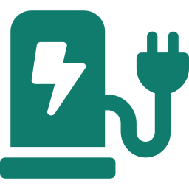
From 53,797 field records to 50 candidate sites
53,797
transformer load records (2020–24)
41,129
usable after plausibility checks
1,295
5 km cells with grid, chargers or owners
238
cells with registered EV owners
132
of them with no public charger (908 owners)
50
new sites placed by each rule
Source: PLN UID Jawa Barat internal data (transformer surveys 2020–24, GI register, March 2026 charging log, registered EV customers); BPS 2024. Reproduced by papers/capacity/prepare.py and v3/strengthen.py.
7
Notes:
The funnel shows how raw registers become a decision. Each step loses information for a reason: implausible records, aggregation to 5 km cells, and the restriction to cells that have owners but no charger.

Slide 8






Method: from spot readings to a ranking, then stress tests
Headroom
Age to 2026
5 km cells
Three rules
Stress tests
H = max(0, S·(0.8 − λ))
λ·(1+g)^(2026.2 − t)
g = 3.0 %/yr
+ 27 BPS regencies
+ per-capita expenditure
headroom · demand ·
demand within headroom
5,000 random draws,
site size, 4 resolutions
Each rule is scored on:
Owners reached
Stranded sites
Infeasible sites
Who gains (income)
Source: PLN UID Jawa Barat internal data (transformer surveys 2020–24, GI register, March 2026 charging log, registered EV customers); BPS 2024. Reproduced by papers/capacity/prepare.py and v3/strengthen.py.
8
Notes:
Headroom at the 80 percent planning limit; growth to March 2026 at 3 percent per year with sensitivities; aggregation to 5 km; three siting rules; then random portfolios and sweeps. Regencies come from BPS polygons, not the register's regency field.

Slide 9
02
What we found
Did chargers go where the grid has spare room, or where it is simply big? And who was left out?
9
Notes:
Part two: the findings.

Slide 10
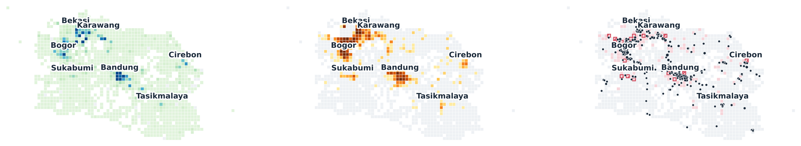
Headroom and demand are two different maps
Network headroom
what a DSO map shows today
EV owners
the demand layer that is missing
Where they meet
chargers, and the gaps
42.2 % of spare capacity sits in cells with no charger, and 24.6 % of owners live in such cells (5 km grid).
Source: PLN UID Jawa Barat internal data (transformer surveys 2020–24, GI register, March 2026 charging log, registered EV customers); BPS 2024. Reproduced by papers/capacity/prepare.py and v3/strengthen.py.
10
Notes:
Left: spare capacity, concentrated in the Bekasi–Karawang corridor and central Bandung. Middle: owners, concentrated in Bogor–Depok–Bekasi and Bandung. Right: overlay. 42.2 percent of headroom sits in cells without a charger and 24.6 percent of owners live in such cells (5 km figures).

Slide 11

Chargers follow the size of the grid, not its spare room
Pick one cell with a charger and one without. How often does each variable point to the right one?
86
of 100
76
of 100
46
of 100
coin toss = 50/100
spare capacity does no better
Installed grid capacity (kVA)
Registered EV owners
Spare capacity (% free)
17× more installed kVA in charger cells (median 11,395 vs 675 kVA), but the same free share (30.8 % vs 32.7 %). ρ with spare share = −0.06, 95 % CI −0.21 to +0.09.
Source: PLN UID Jawa Barat internal data (transformer surveys 2020–24, GI register, March 2026 charging log, registered EV customers); BPS 2024. Reproduced by papers/capacity/prepare.py and v3/strengthen.py.
11
Notes:
AUC: the probability that a randomly chosen charger cell scores higher than a randomly chosen cell without one. 0.50 is a coin toss. Installed kVA gets it right 86 times in 100; relative headroom 46 times, slightly worse than chance. Same story at every map resolution.

Slide 12
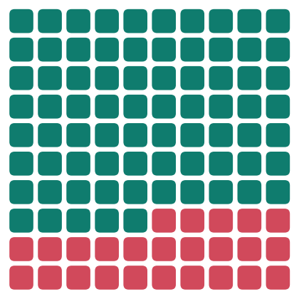

One in four EV owners has no public charger in their 5 km cell
75.3 %
live in a 5 km cell that already has a public charger
24.7 %
do not: 908 owners in 132 cells, the pool for new sites
Which of these owners a new site reaches depends on what the DSO publishes.
each square = 1 % of registered EV owners
Source: PLN UID Jawa Barat internal data (transformer surveys 2020–24, GI register, March 2026 charging log, registered EV customers); BPS 2024. Reproduced by papers/capacity/prepare.py and v3/strengthen.py.
12
Notes:
Of 3,687 registered owners, 75.3 percent live in a cell with a public charger. The rest, 24.7 percent, do not. This is the pool the next 50 sites could serve.

Slide 13
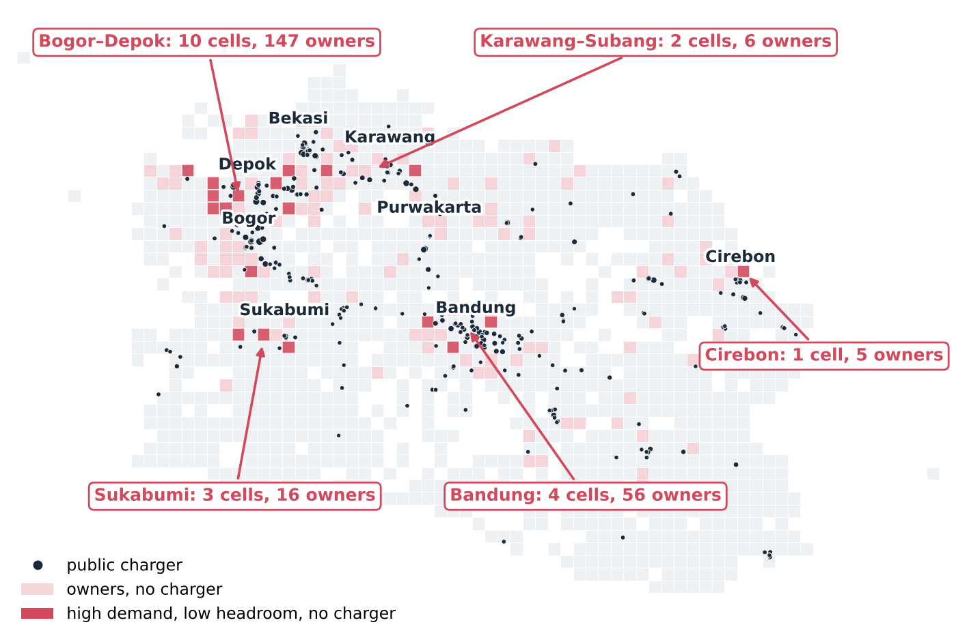
20 cells have many owners, little headroom and no charger
owners' share vs chargers' share in high-demand, low-headroom cells
Owners
11.6 %
Chargers
5.6 %
What each map does with them
Headroom-only: ranks them last.
Demand-only: ranks them first, silent on connection cost.
Two surfaces: shows both, so the cost can be priced.
Source: PLN UID Jawa Barat internal data (transformer surveys 2020–24, GI register, March 2026 charging log, registered EV customers); BPS 2024. Reproduced by papers/capacity/prepare.py and v3/strengthen.py.
13
Notes:
The red cells are the high-demand / low-headroom quadrant without a charger: 20 cells, 230 owners. Across that quadrant, owners' share is 11.6 percent and chargers' share 5.6 percent. A headroom-only map ranks these cells last; a demand-only map ranks them first without signalling the connection cost.

Slide 14
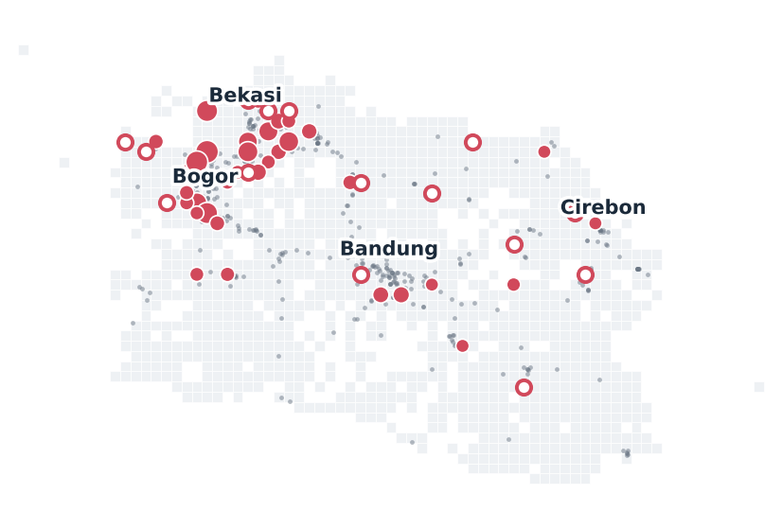
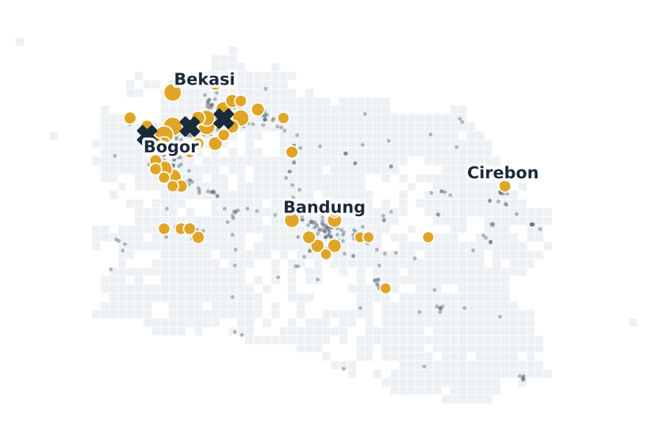
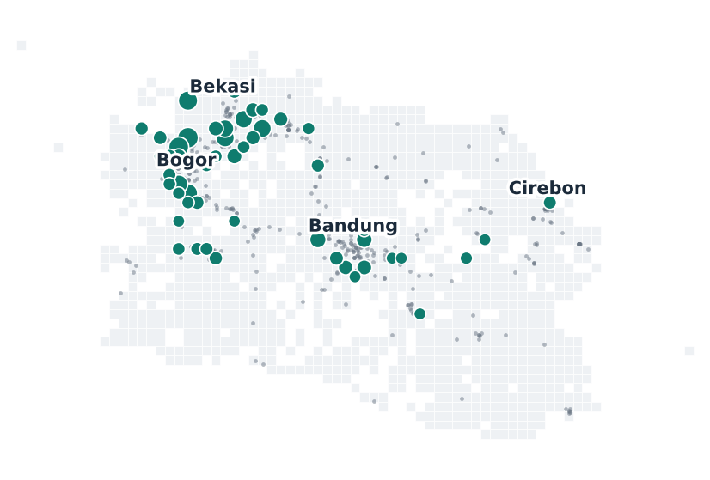
Three maps a DSO could publish, three ways to pick 50 sites
Headroom-only
Demand-only
Demand within headroom
Publish spare capacity.
Publish where owners are.
Publish both surfaces.
Rank cells by headroom (kVA).
Rank cells by registered owners.
Rank by owners among cells with ≥ 240 kVA (one 4 × 60 kW site).
Source: PLN UID Jawa Barat internal data (transformer surveys 2020–24, GI register, March 2026 charging log, registered EV customers); BPS 2024. Reproduced by papers/capacity/prepare.py and v3/strengthen.py.
14
Notes:
Each rule picks 50 of the 132 unserved cells that have owners. The rule is what the published layer implicitly tells developers.

Slide 15


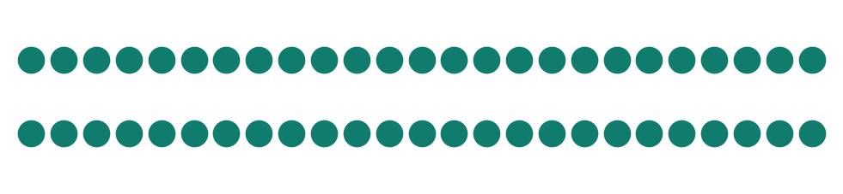
Fifty sites each: what happens to every one of them
Each dot is one new site. Filled = reaches owners; hollow = stranded in a low-demand cell; ✕ = grid cannot host it
Headroom-only
694 owners
15 stranded
Demand-only
809 owners
3 infeasible
Demand within headroom
789 owners
0 stranded · 0 infeasible
Source: PLN UID Jawa Barat internal data (transformer surveys 2020–24, GI register, March 2026 charging log, registered EV customers); BPS 2024. Reproduced by papers/capacity/prepare.py and v3/strengthen.py.
15
Notes:
Headroom-only: 15 of 50 sites stranded. Demand-only: 3 sites below the 240 kVA threshold. Demand within headroom: every site reaches demand and can be connected. Owners reached: 694, 809, 789.

Slide 16

Every rule beats chance, but the published layer still moves 115 owners
484
best 5 % of 5,000 random portfolios
809
789
694
115 owners
gap between best and worst informed rule
345
−20 owners
the price of making every site connectable
Random
Headroom-only
Demand-only
Demand within
headroom
Source: PLN UID Jawa Barat internal data (transformer surveys 2020–24, GI register, March 2026 charging log, registered EV customers); BPS 2024. Reproduced by papers/capacity/prepare.py and v3/strengthen.py.
16
Notes:
Random placement of 50 sites in the same pool reaches 345 owners on average. All rules are far above. Between the best and the worst informed rule: 115 owners for the same budget.

Slide 17

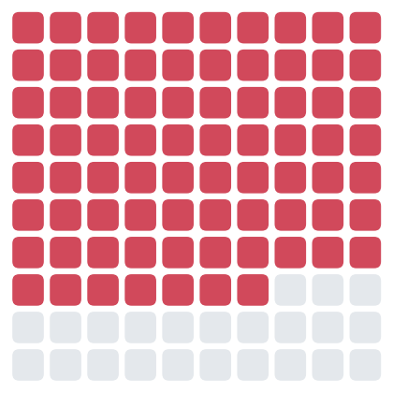
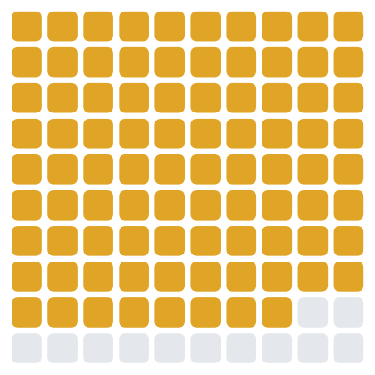
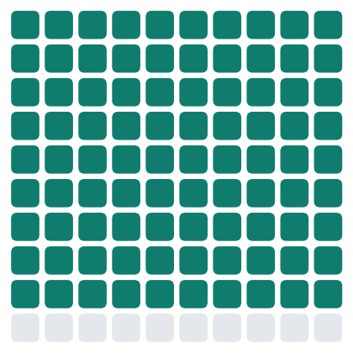
In the poorest third of regencies, the map decides who gets a charger
Of every 100 EV owners in the nine regencies with the lowest per-capita expenditure, how many live in a cell with a charger?
72
77
88
90
Today
Headroom-only
Demand-only
Demand within headroom
+5.1 points
+15.8 points
+18.0 points
Source: PLN UID Jawa Barat internal data (transformer surveys 2020–24, GI register, March 2026 charging log, registered EV customers); BPS 2024. Reproduced by papers/capacity/prepare.py and v3/strengthen.py.
17
Notes:
Regencies ranked by 2024 per-capita expenditure (BPS), nine per third. Today 71.7 percent; headroom-only 76.8; demand-only 87.5; demand within headroom 89.7. Only 272 owners live in this third, 181 in Kabupaten Bandung Barat, so treat magnitudes with care; the direction is clear.

Slide 18

Headroom-only widens the rich–poor gap fivefold; demand within headroom keeps it narrowest
Coverage gap, richest third minus poorest third (percentage points)
Income concentration index of coverage
Today
4.0 pts
Today
0.029
Headroom-only
20.6 pts
Headroom-only
0.026
Demand-only
11.5 pts
Demand-only
0.015
Demand within headroom
8.4 pts
Demand within headroom
0.012
Lower is fairer for both measures. Demand within headroom is lowest on the concentration index and narrowest of the three rules on the gap.
Source: PLN UID Jawa Barat internal data (transformer surveys 2020–24, GI register, March 2026 charging log, registered EV customers); BPS 2024. Reproduced by papers/capacity/prepare.py and v3/strengthen.py.
18
Notes:
Gap = coverage in the richest third minus coverage in the poorest third, in percentage points. Concentration index above zero means coverage leans toward richer regencies.

Slide 19

Spreading sites evenly is not the same as serving people
Random placement scores best on the between-regency Gini, and reaches the fewest owners
Owners reached
more is better
Regency Gini
lower = more even
Poorest third covered
more is better
Random
345
0.144
—
Insight
State equity targets as coverage of under-served groups, such as the poorest regencies, not as evenness across administrative units.
Headroom-only
694
0.171
76.8 %
Demand-only
809
0.191
87.5 %
Demand within headroom
789
0.174
89.7 %
Random wins on evenness and loses on reach and on the poorest third.
Source: PLN UID Jawa Barat internal data (transformer surveys 2020–24, GI register, March 2026 charging log, registered EV customers); BPS 2024. Reproduced by papers/capacity/prepare.py and v3/strengthen.py.
19
Notes:
Between-regency Gini of coverage: random 0.144, headroom-only 0.171, demand within headroom 0.174, demand-only 0.191. A Gini target alone rewards scattering sites. That is why the paper reports reach and poorest-third coverage alongside it.

Slide 20
03
Is it robust?
Could the result be luck, or an artefact of the 5 km grid or the site size we chose?
20
Notes:
Part three: robustness. We tried to break each finding.

Slide 21
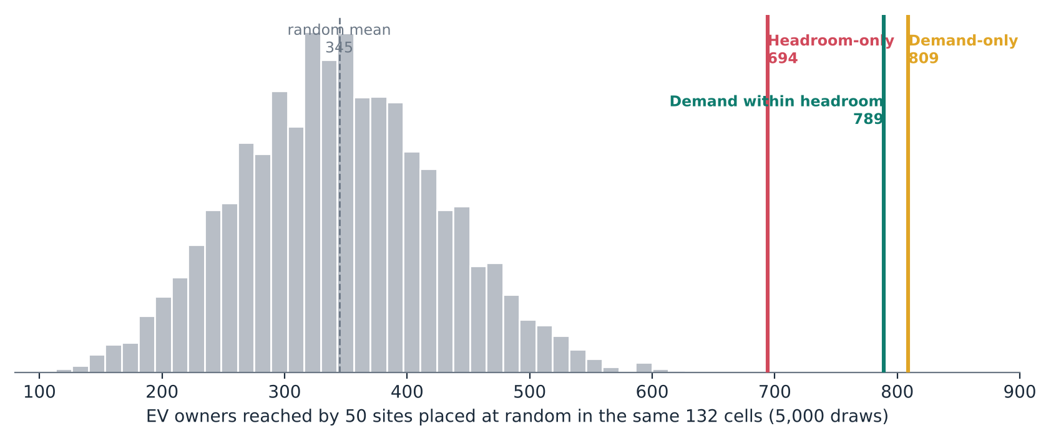

Not luck: all three rules sit beyond every one of 5,000 random portfolios
345
owners, average random portfolio
694+
owners, the weakest informed rule
24.6
stranded sites, random average
Using data at all doubles reach. The policy choice is which layers to publish, and that choice still moves hundreds of owners and the poorest regencies.
Source: PLN UID Jawa Barat internal data (transformer surveys 2020–24, GI register, March 2026 charging log, registered EV customers); BPS 2024. Reproduced by papers/capacity/prepare.py and v3/strengthen.py.
21
Notes:
Random 50-site portfolios from the same 132 cells: mean 345 owners, 95th percentile 484, maximum below every rule.

Slide 22

Bigger sites make demand-only riskier; demand within headroom always stays ahead of headroom-only
Demand-only sites the grid cannot host
120 kVA
2
240 kVA
3
480 kVA
6
960 kVA
12
Demand within headroom: 0 at every size
Source: PLN UID Jawa Barat internal data (transformer surveys 2020–24, GI register, March 2026 charging log, registered EV customers); BPS 2024. Reproduced by papers/capacity/prepare.py and v3/strengthen.py.
22
Notes:
Feasibility thresholds 120, 240, 480, 960 kVA. Demand-only infeasible sites: 2, 3, 6, 12. Demand within headroom owners: 807, 789, 754, 734. Headroom-only stays at 694.

Slide 23


Scorecard: what holds at 3, 5, 7 and 10 km
cell size →
3 km
5 km
7 km
10 km
Spare capacity fails to predict chargers (AUC < 0.5)
0.50
0.46
0.47
0.42
Owners outnumber chargers in high-demand, low-headroom cells
2.6×
2.1×
2.5×
1.4×
Demand within headroom reaches more owners than headroom-only
+20 %
+14 %
+32 %
+29 %
Demand-only places infeasible sites
10
3
2
0
Headroom-only strands sites
19
15
0
4
⚠ Stranded-site counts and "share of headroom in uncharged cells" depend on the grid: reported as 5 km figures, not headlines.
Source: PLN UID Jawa Barat internal data (transformer surveys 2020–24, GI register, March 2026 charging log, registered EV customers); BPS 2024. Reproduced by papers/capacity/prepare.py and v3/strengthen.py.
23
Notes:
Each column is the whole pipeline re-run at a different cell size, with the number of new sites held at 38 percent of the unserved pool. Two results are resolution-sensitive and are not used as headlines.

Slide 24
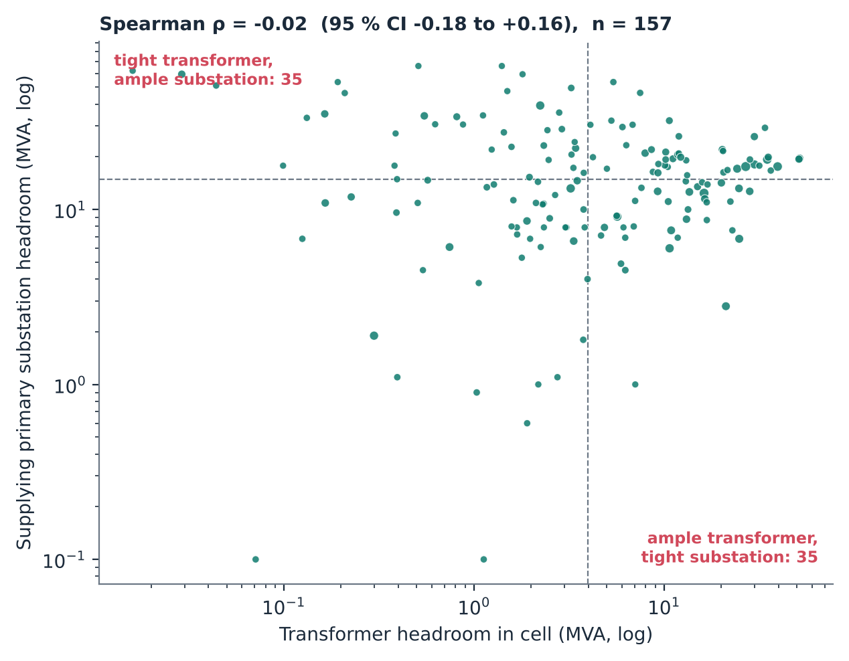

Transformer and substation headroom are independent, so publish both levels
Primary substation (GI)
150/20 kV
ρ = −0.02
95 % CI −0.18 to +0.16
157 served cells
Feeder
20 kV (next step: 2,574 feeders)
one level tells you nothing about the other
Distribution transformer
20 kV / LV
Charger
4 × 60 kW site
35 cells: transformer full, substation free → a low-voltage map wrongly says "avoid".
35 cells: transformer free, substation full → a low-voltage map hides the real constraint.
Source: PLN UID Jawa Barat internal data (transformer surveys 2020–24, GI register, March 2026 charging log, registered EV customers); BPS 2024. Reproduced by papers/capacity/prepare.py and v3/strengthen.py.
24
Notes:
Among 157 served cells linked to a primary substation: Spearman rho −0.02 (95 percent CI −0.18 to +0.16). 35 cells are tight at the transformer but ample at the substation, 35 the reverse. The earlier 51 percent discordance could not be reproduced; independence is the stronger, verified statement.

Slide 25




The register is not ready to publish, and ageing erodes headroom fast
Share of 53,797 transformer records failing each check
Headroom at 80 % limit (MVA)
Field-staff names recorded
79.6 %
No link to a substation
44.1 %
Coordinates > 1 km off
43.2 %
No load reading
23.0 %
No rated capacity
22.4 %
At 3 %/yr growth, 7,090 transformers (17 % of usable records) pass the 80 % limit; GI headroom falls 20 %.
Source: PLN UID Jawa Barat internal data (transformer surveys 2020–24, GI register, March 2026 charging log, registered EV customers); BPS 2024. Reproduced by papers/capacity/prepare.py and v3/strengthen.py.
25
Notes:
Shares of all 53,797 records. Growth correction at 3 percent per year pushes 7,090 transformers past the 80 percent limit. Field-staff names must be removed before any disclosure.

Slide 26
04
What a DSO should publish
What would a capacity map need to show to steer capital toward the gaps, and how do we get there safely?
26
Notes:
Part four: implications.

Slide 27

Claims ledger: what survived testing
Roll-out follows grid size, not spare capacity
AUC 0.86 vs 0.46; all resolutions
Holds
High-demand, low-headroom cells are under-served
owners 1.4–2.6× chargers' share
Holds
Headroom-only reaches fewest owners
+14 to +32 % for demand within headroom
Holds
Headroom-only does least for the poorest regencies
+5.1 vs +18.0 points (272 owners)
Holds
Transformer and GI levels are independent
ρ = −0.02 (was "51 % discordant")
Holds
Demand-only places infeasible sites
2 → 12 with site size; 0 at 10 km
Depends on grid
Headroom-only strands 30 % of sites
19 / 15 / 0 / 4 by resolution
Depends on grid
Demand within headroom minimises regency Gini
random and headroom-only are lower
Dropped
Source: PLN UID Jawa Barat internal data (transformer surveys 2020–24, GI register, March 2026 charging log, registered EV customers); BPS 2024. Reproduced by papers/capacity/prepare.py and v3/strengthen.py.
27
Notes:
Green survives every test. Amber: true at 5 km and in direction, magnitude depends on the grid. Red: dropped from the earlier draft.

Slide 28

Five requirements for a publishable capacity map
1
2
3
4
5
Two network levels
Growth-corrected
A demand layer
Aggregated
Versioned + scored
Transformer + substation; feeder where available.
A stated rate and survey date on every value.
Registered EV owners or predicted energy.
5 km cells or 2 km hexagons, never assets or people.
Quarterly versions with a data-quality score.
levels independent: ρ ≈ 0
GI headroom −20 % at 3 %/yr
+18 vs +5 pts for the poorest
79.6 % of records name staff
44 % lack a GI link
Source: PLN UID Jawa Barat internal data (transformer surveys 2020–24, GI register, March 2026 charging log, registered EV customers); BPS 2024. Reproduced by papers/capacity/prepare.py and v3/strengthen.py.
28
Notes:
Each requirement is tied to one of the findings: independence of levels, ageing, the income result, staff names, and register quality.

Slide 29



Publication does what unbundling does, without changing ownership
Information asymmetry
Open both surfaces
Capital follows gaps
Fairer coverage
PLN can site chargers using data private CPOs cannot see.
Headroom + demand, two levels, open to every applicant.
Public and private money aims at unserved owners.
Poorest regencies gain most under the two-surface rule.
EU DSOs are generally barred from owning charge points because of this advantage. Where the DSO is also the CPO, disclosure has to do the work that separation does in Europe.
Source: PLN UID Jawa Barat internal data (transformer surveys 2020–24, GI register, March 2026 charging log, registered EV customers); BPS 2024. Reproduced by papers/capacity/prepare.py and v3/strengthen.py.
29
Notes:
Europe separates the DSO from charging partly because the DSO would hold this information. Indonesia chose integration. Publishing both surfaces removes the asymmetry and steers private capital to the gaps.

Slide 30


A phased path to an open two-surface map (proposed)
Phase 0
Clean
Phase 1
Publish two surfaces
Phase 2
Deepen
Phase 3
Close the loop
Strip staff names (79.6 %)
Link records to GI (44 % missing)
Fix coordinates (43 % > 1 km)
5 km cells, transformer + GI
Growth-corrected and dated
Owner counts as demand layer
Add the feeder level
Quarterly versions
Published quality score
Link to connection requests
Track where sites go
Monitor poorest-third coverage
Success measure: coverage in the poorest third of regencies rises at least as fast as in the richest third.
Source: PLN UID Jawa Barat internal data (transformer surveys 2020–24, GI register, March 2026 charging log, registered EV customers); BPS 2024. Reproduced by papers/capacity/prepare.py and v3/strengthen.py.
30
Notes:
A proposal derived from the findings, for discussion with PLN UID Jawa Barat; not an agreed plan. Cleaning comes first, because publishing the raw register would misdirect capital and expose staff names.

Slide 31


What this evidence does not show
Two spot readings per transformer
a planning proxy, not a hosting-capacity calculation
Registered owners as demand
misses households without a home charger
272 owners in the poorest third
181 in one regency: direction, not precision
One growth rate for the province
unit-level rates would sharpen the ageing correction
No feeder level yet
2,574 feeders are the next layer
Regency expenditure is an area measure
it does not describe the owners themselves
Source: PLN UID Jawa Barat internal data (transformer surveys 2020–24, GI register, March 2026 charging log, registered EV customers); BPS 2024. Reproduced by papers/capacity/prepare.py and v3/strengthen.py.
31
Notes:
Be explicit about proxies and sample size. The equity result is a direction, not a precise estimate.

Slide 32
The capacity map is a planning decision disguised as a data product.
Headroom alone: 694 owners, +5.1 pts for the poorest third.
Headroom + demand: 789 owners, every site connectable, +18.0 pts for the poorest third.
Two levels, growth-corrected, quality-scored: from data every DSO already holds.
Qashtalani Haramaini · Alyas Widita · Liz Taylor | qashtalani.haramaini@monash.edu
32
Notes:
Close on the policy point: in a vertically integrated utility, publishing both surfaces is the functional substitute for unbundling. Then take questions; the claims ledger slide is the best backup.

