Slide 1
Capacity maps as an equity instrument
Publishing charging demand and network headroom as open data in a vertically integrated DSO
Qashtalani Haramaini
Alyas Widita · Liz Taylor
Monash University · PT PLN (Persero) UID Jawa Barat
CIRED 2027 · draft for discussion

Slide 2
A capacity map ranks locations, and a ranking that drives investment also distributes benefits
Distribution operators publish hosting-capacity maps to steer connection applicants toward spare grid.
In West Java, PT PLN is both the distribution operator (DSO) and the dominant public charge-point operator (CPO).
So the layer it publishes decides where chargers get built, and therefore who is served.
Research question
Does the existing charger roll-out follow spare capacity, grid density, or EV demand? And would publishing headroom alone change where the next 50 sites go?
Source: PLN UID Jawa Barat internal data (transformer load surveys 2020–24, GI register, March 2026 charging log, registered EV customers); all figures reproduced by papers/capacity/prepare.py.
2

Slide 3
PLN holds both surfaces that Europe keeps apart
EU model
DSO and CPO are separated. The DSO generally may not own charge points, because it would hold the headroom information.
West Java (Indonesia)
One organisation holds transformer load, substation data, the charging log and the EV customer register. That is the vertically integrated case.
53,797
182 GI
331
3,687
transformer records (41,129 usable after plausibility checks)
primary substations, 9,790 MVA of transformer capacity
public charging sites (SPKLU) with 2026 session data
geocoded registered EV customers (latent demand proxy)
Source: PLN UID Jawa Barat internal data (transformer load surveys 2020–24, GI register, March 2026 charging log, registered EV customers); all figures reproduced by papers/capacity/prepare.py.
3

Slide 4
Headroom is computed per transformer, corrected for growth, then aggregated to 5 km cells
1
2
3
Headroom at the 80 % limit
Growth correction to March 2026
Aggregate and classify
H = max(0, S · (0.8 − λ))
S = rated kVA, λ = measured loading (larger of day and night reading). Same for each GI.
λ(2026) = λ(t) · (1 + g)^(2026.2 − t)
Median survey age 2.3 yr (max 6.2). Base g = 3.0 %/yr; sensitivities 5.9 and 9.7 %/yr.
0.045° cells (≈5 km): 1,295 cells, 238 with registered owners, 174 with a public charger.
Demand (owners) × headroom, split at the medians.
Source: PLN UID Jawa Barat internal data (transformer load surveys 2020–24, GI register, March 2026 charging log, registered EV customers); all figures reproduced by papers/capacity/prepare.py.
4

Slide 5
The charger roll-out follows grid density, not spare capacity
Spearman rank correlation between charging energy and headroom, across the 174 cells with a charger
ρ = +0.42
ρ = −0.06
absolute headroom (MVA per cell). Large cells with many transformers attract chargers.
headroom as a share of installed capacity. Spare capacity, the thing a developer needs, has no link to where chargers went.
Implication: a map of absolute headroom reproduces the existing geography. It ranks dense urban cells first, whether or not they are loaded.
Source: PLN UID Jawa Barat internal data (transformer load surveys 2020–24, GI register, March 2026 charging log, registered EV customers); all figures reproduced by papers/capacity/prepare.py.
5

Slide 6
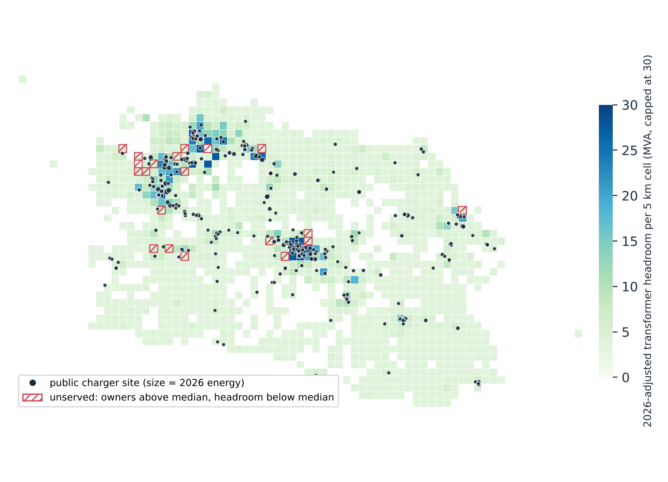
42 % of spare grid capacity sits in cells with no public charger
42.2 %
of 2026-adjusted headroom lies in cells with no charger
24.6 %
of registered EV owners live in those same cells
Red hatching: cells where owners are above the median but headroom is below it and there is no charger.
Source: PLN UID Jawa Barat internal data (transformer load surveys 2020–24, GI register, March 2026 charging log, registered EV customers); all figures reproduced by papers/capacity/prepare.py.
6

Slide 7
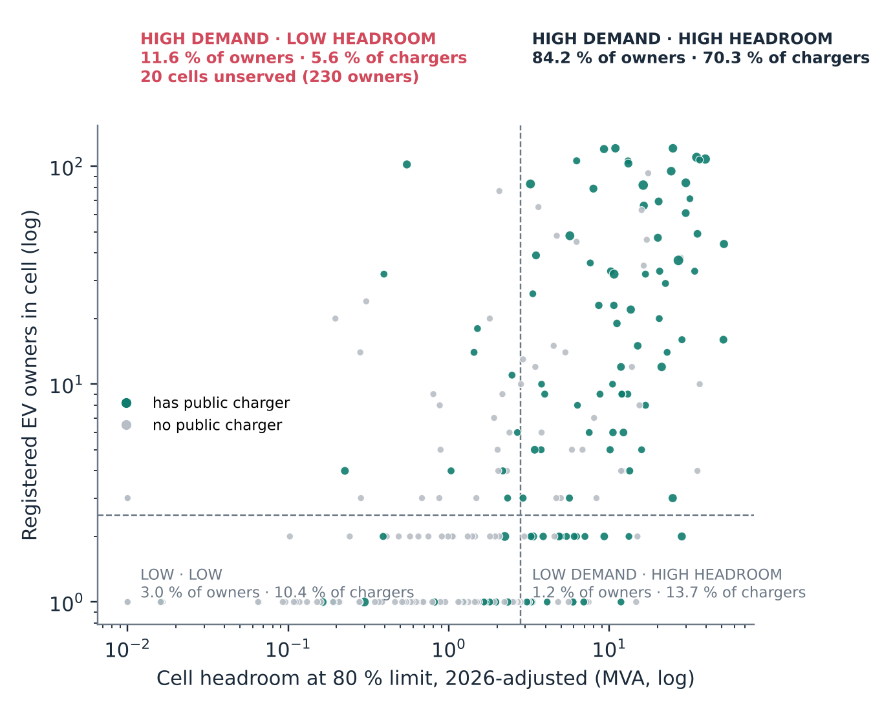
11.6 % of owners live where demand is high and headroom is low, with 5.6 % of chargers
Quadrants are split at the median cell: 2.5 owners and 2.8 MVA.
High demand, high headroom: 84.2 % of owners, 70.3 % of chargers. The roll-out is broadly rational here.
High demand, low headroom: 30 cells. In 20 of them there is no charger, holding 230 owners.
Source: PLN UID Jawa Barat internal data (transformer load surveys 2020–24, GI register, March 2026 charging log, registered EV customers); all figures reproduced by papers/capacity/prepare.py.
7

Slide 8
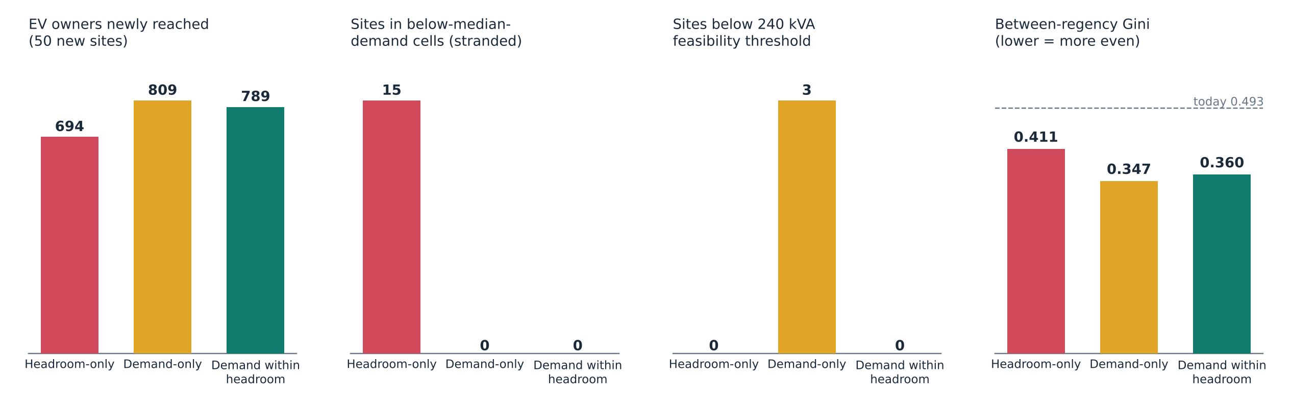
A headroom-only rule strands 15 of 50 sites; demand within headroom strands none
Three rules place 50 new sites in the 129 unserved cells that have registered EV owners
Feasibility threshold: 240 kVA of cell headroom, one 4 × 60 kW site. Today 75.4 % of owners live in a cell with a charger.
Source: PLN UID Jawa Barat internal data (transformer load surveys 2020–24, GI register, March 2026 charging log, registered EV customers); all figures reproduced by papers/capacity/prepare.py.
8

Slide 9
Demand-only reaches the most owners; headroom buys feasibility, not equity
Siting rule (50 new sites) | Owners reached | Stranded sites | Infeasible sites | Regencies | Coverage | Gini (regency)
Today (no new sites) | — | — | — | — | 75.4 % | 0.493
Headroom-only | 694 | 15 | 0 | 18 | 94.2 % | 0.411
Demand-only | 809 | 0 | 3 | 18 | 97.3 % | 0.347
Demand within headroom | 789 | 0 | 0 | 18 | 96.8 % | 0.360
Reading the table. Demand-only reaches 20 more owners than demand within headroom, but 3 of its sites sit below the feasibility threshold. Demand within headroom is the only rule with zero stranded and zero infeasible sites, and it reaches 14 % more owners than headroom-only.
Sensitivity: 789 / 789 / 788 owners at 3.0 / 5.9 / 9.7 %/yr load growth.
Source: PLN UID Jawa Barat internal data (transformer load surveys 2020–24, GI register, March 2026 charging log, registered EV customers); all figures reproduced by papers/capacity/prepare.py.
9

Slide 10
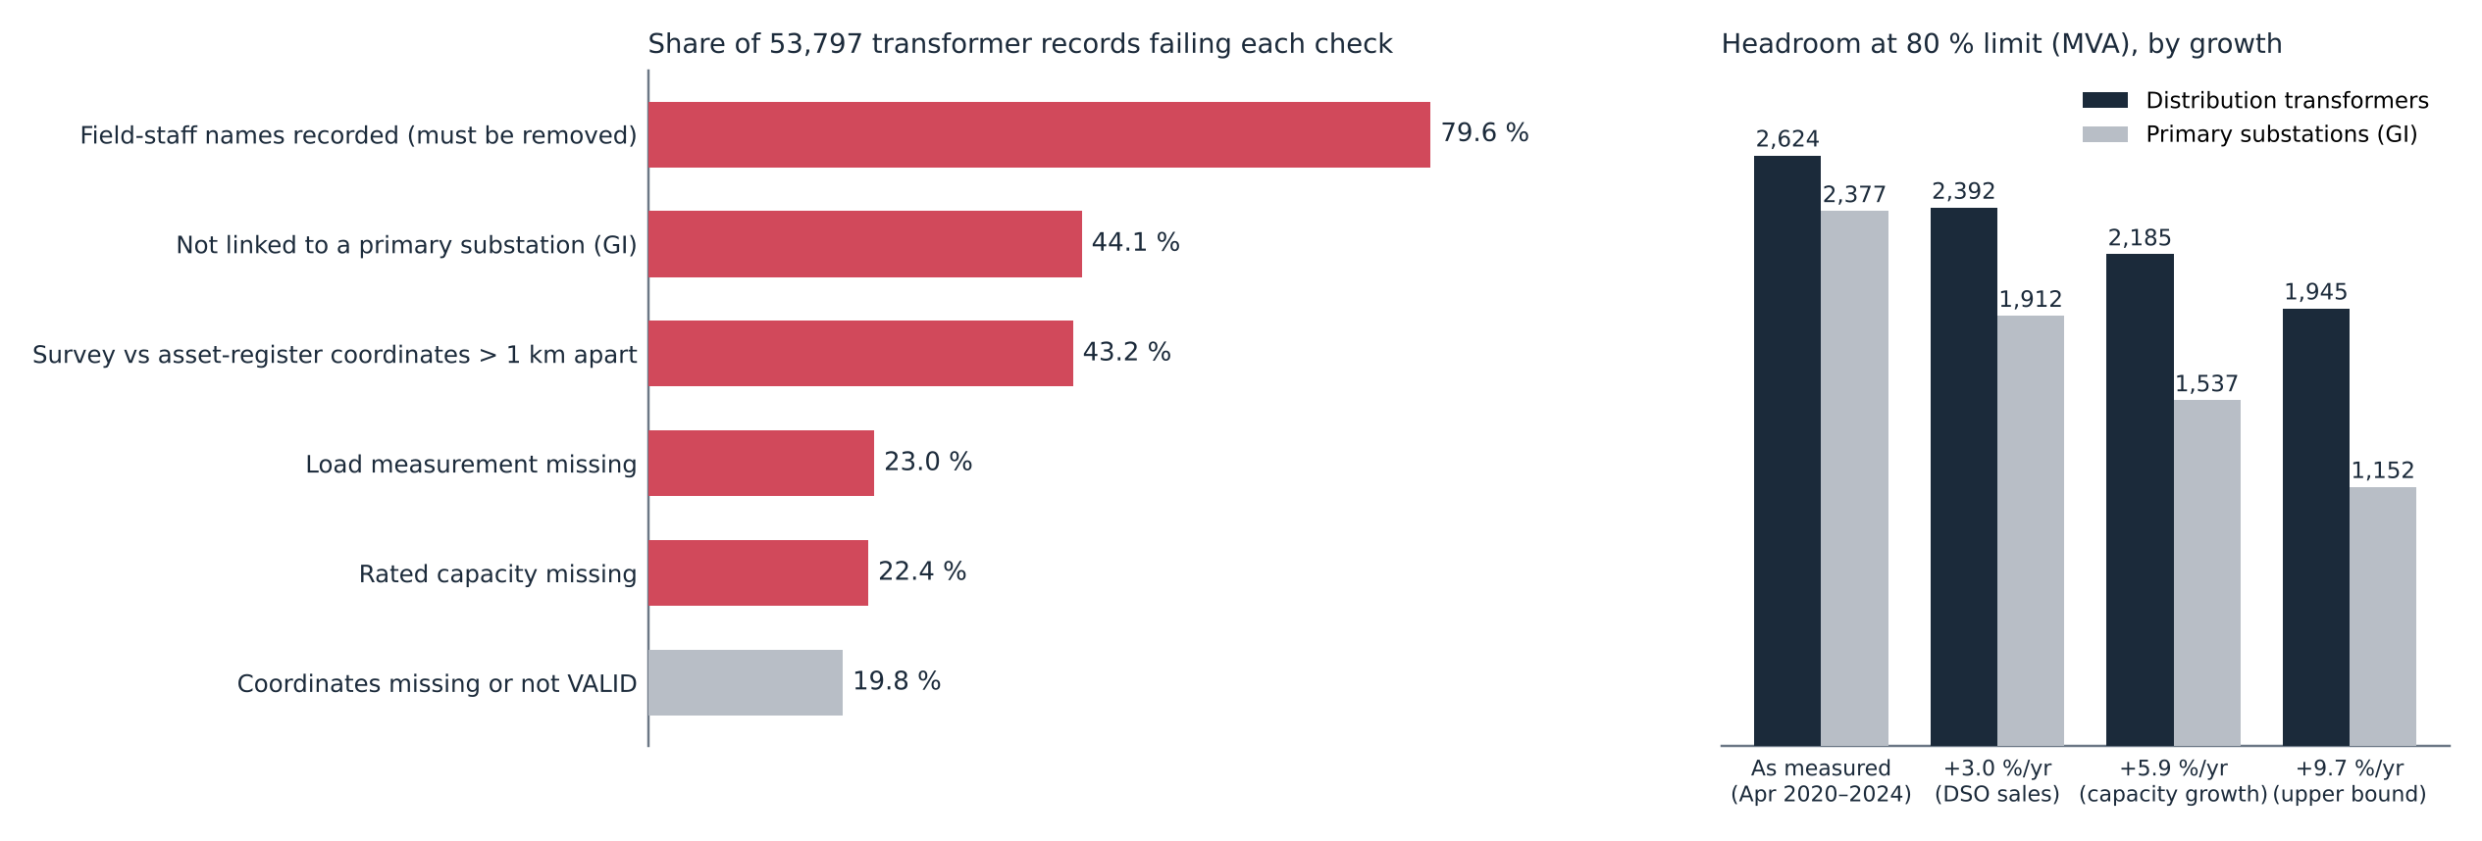
The load register is not publication-ready, and ageing cuts substation headroom by up to half
Left: share of records failing each readiness check. Right: headroom at the 80 % limit under four growth assumptions.
At 3.0 %/yr, 7,090 transformers (17 % of usable records) pass the 80 % limit. At 9.7 %/yr, GI headroom falls by 52 %.
Source: PLN UID Jawa Barat internal data (transformer load surveys 2020–24, GI register, March 2026 charging log, registered EV customers); all figures reproduced by papers/capacity/prepare.py.
10

Slide 11
Five requirements make a capacity map publishable
1
Two network levels
Transformer and primary substation at least; feeder where available.
2
Growth correction
A stated rate and survey date, because a static snapshot overstates headroom within two years.
3
A demand layer
Registered EV customers, predicted energy, or both, published next to headroom.
4
Spatial aggregation
5 km cells here. Protects customer and staff privacy and critical-infrastructure detail.
5
Versioning and a quality score
So a map that misdirects private capital can be corrected, not just trusted.
Source: PLN UID Jawa Barat internal data (transformer load surveys 2020–24, GI register, March 2026 charging log, registered EV customers); all figures reproduced by papers/capacity/prepare.py.
11

Slide 12
Publishing the two-surface map is a functional substitute for unbundling
Information asymmetry
Publish both surfaces
Capital steered to gaps
PLN can site its own chargers using knowledge of headroom and demand that third-party CPOs do not have.
Headroom and demand, at two network levels, open to every applicant. Ownership does not change.
Public and private investment is pointed at unserved high-demand cells instead of the densest grid.
EU distribution operators are generally barred from owning charge points because of this information advantage. Indonesia has the opposite structure, so disclosure has to do the work that separation does in Europe.
Source: PLN UID Jawa Barat internal data (transformer load surveys 2020–24, GI register, March 2026 charging log, registered EV customers); all figures reproduced by papers/capacity/prepare.py.
12

Slide 13
What this evidence does and does not show
Headroom comes from two spot readings per transformer, not continuous metering. It is a planning proxy, not a hosting-capacity calculation.
At 5 km, aggregate headroom is rarely binding. The binding constraint is local, at transformer and feeder level.
Registered EV owners are a proxy for latent demand and under-represent households without a home charger.
The growth rate is province-wide. Unit-level rates would sharpen the correction.
The counterfactual assumes 50 equal sites. A capacity-weighted portfolio may change the magnitudes, not necessarily the ordering.
Source: PLN UID Jawa Barat internal data (transformer load surveys 2020–24, GI register, March 2026 charging log, registered EV customers); all figures reproduced by papers/capacity/prepare.py.
13

Slide 14
Every number here comes from one script, and the remaining gaps are known
Next steps
Add the feeder level (2,574 feeders) to test whether the binding constraint sits there.
Re-derive the substation-versus-transformer disagreement, which was not recomputed in this revision.
Remove field-staff names (79.6 % of records) and customer-identifying labels before any disclosure.
Test a publication draft with PLN UID Jawa Barat and a CPO before the CIRED submission.
Reproducibility
papers/capacity/prepare.py rebuilds capacity.json from the raw PLN inputs. A fresh run is byte-identical to the committed file.
The dashboard, these slides and the paper all read the same output.
Source: PLN UID Jawa Barat internal data (transformer load surveys 2020–24, GI register, March 2026 charging log, registered EV customers); all figures reproduced by papers/capacity/prepare.py.
14

Slide 15
Headroom alone reproduces the existing geography.
Publishing headroom with demand, at two network levels, with growth correction and a data-quality score, moves the same 50 sites toward owners who are already waiting. Headroom alone strands 15 of 50 sites. Demand within headroom strands none.
Qashtalani Haramaini · Alyas Widita · Liz Taylor

