Slide 1
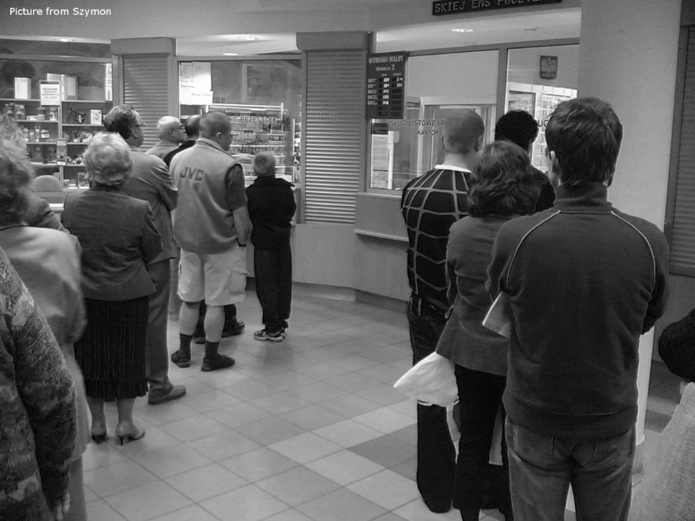
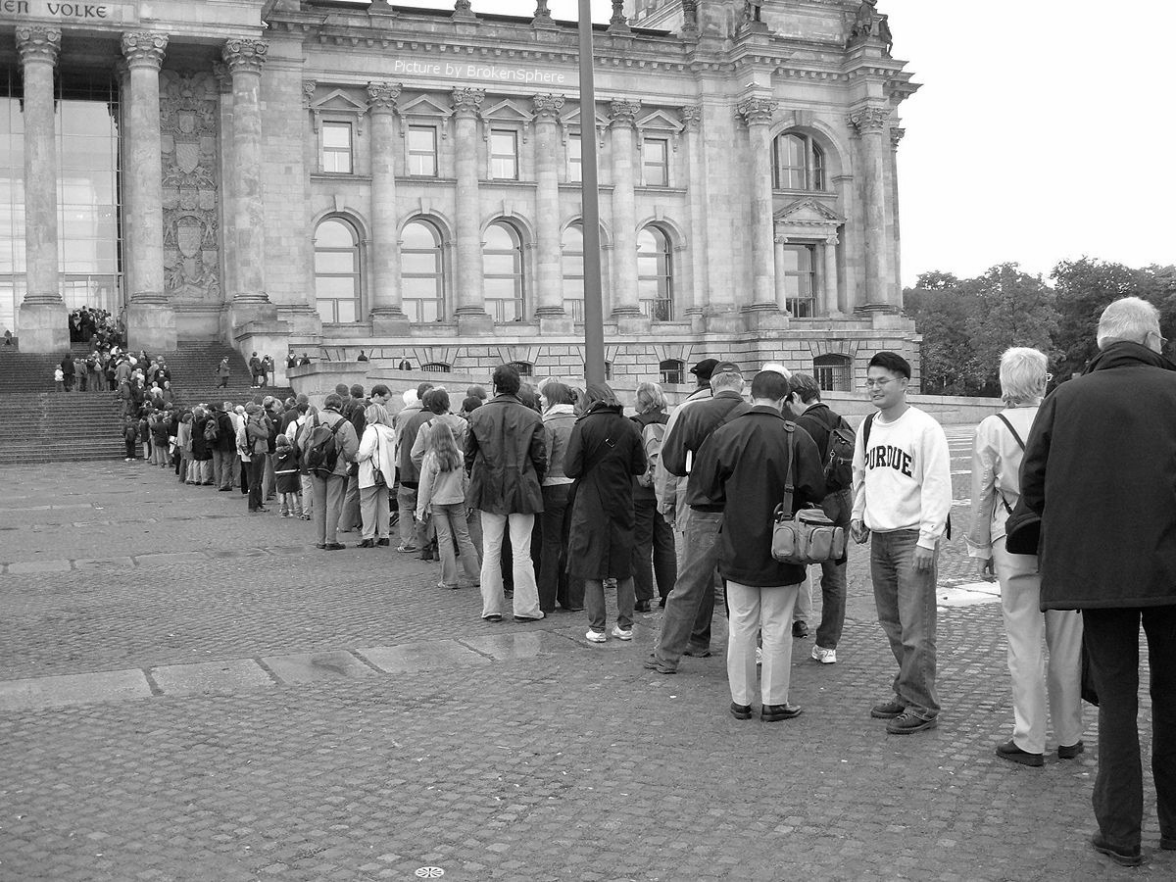
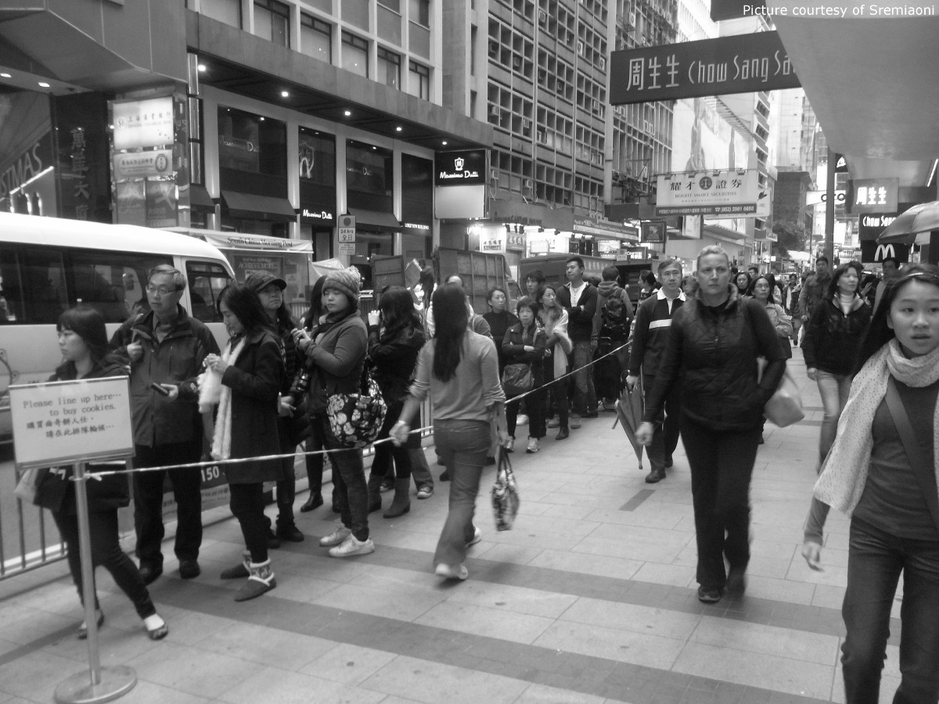
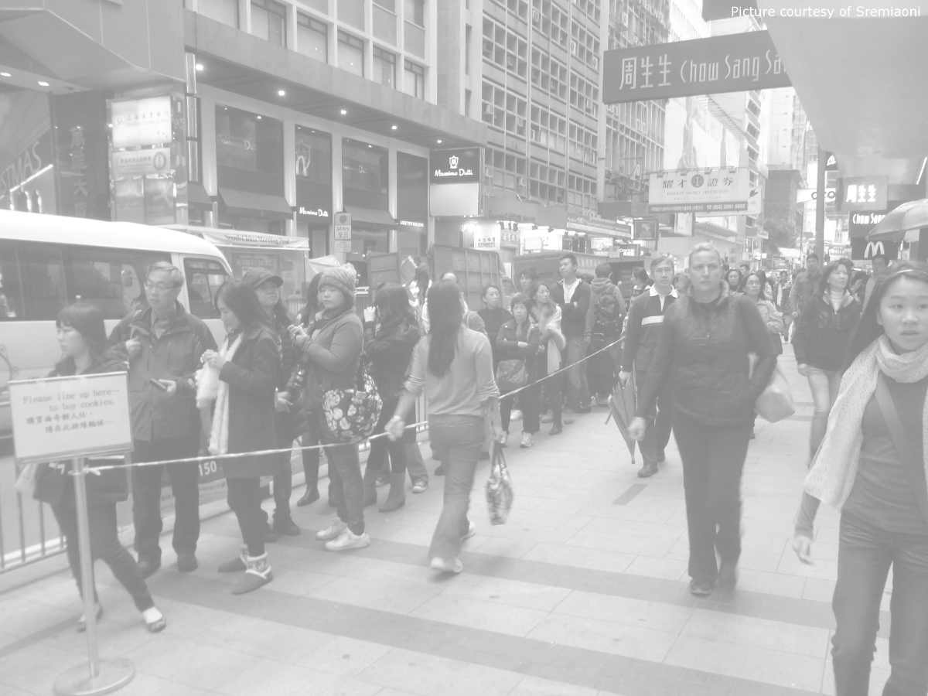
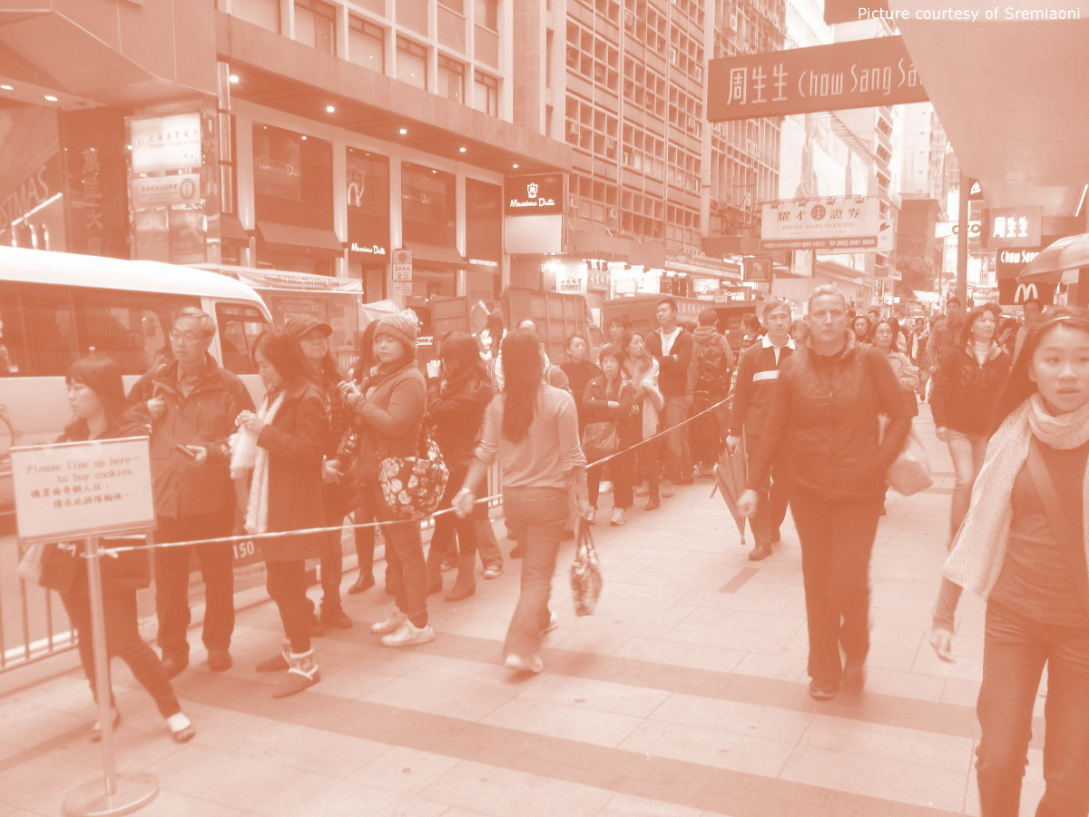
QatHome.com
The internet queue

Slide 2
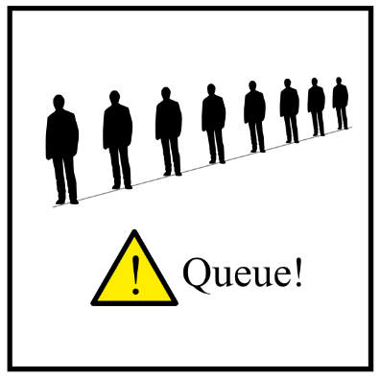
Problem
It is estimated that each person spends more than 100 hours per year waiting in line. This time is wasted and may be employed in more productive or pleasant activities.
Notes:
It is estimated that each person spends more than 100 hours per year waiting in line. This time is wasted and may be employed in more productive or pleasant activities.

Slide 3
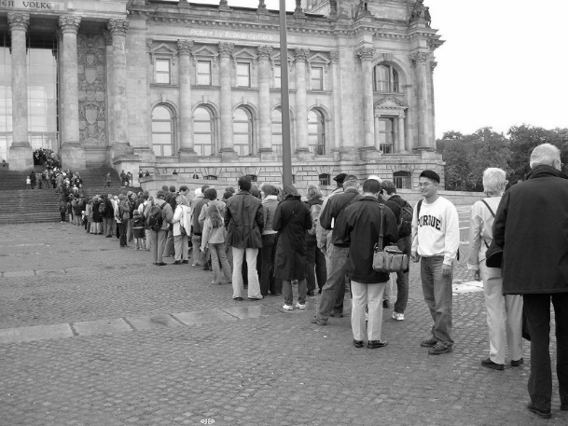
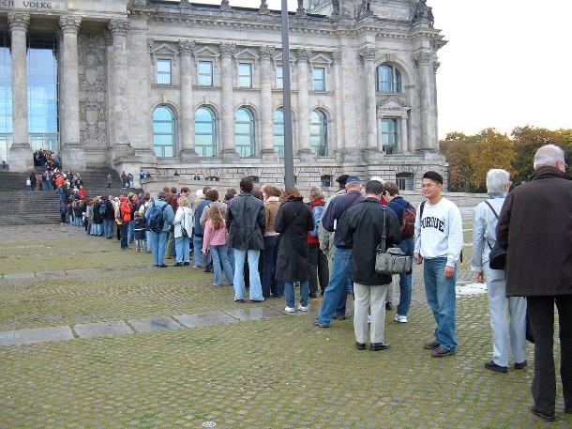
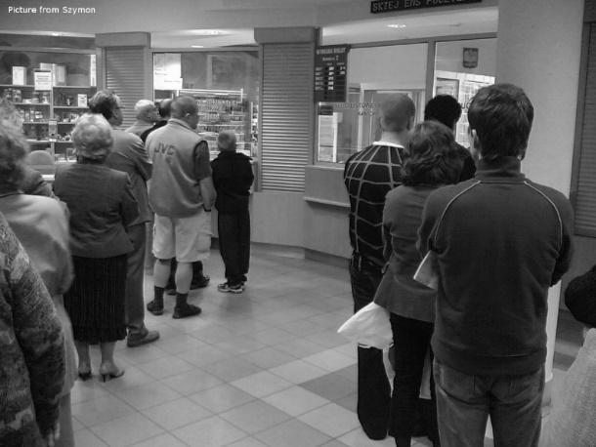
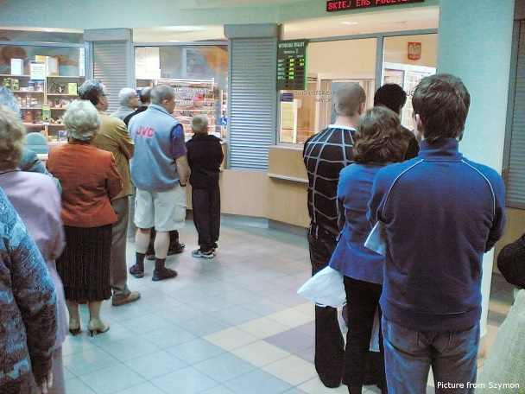
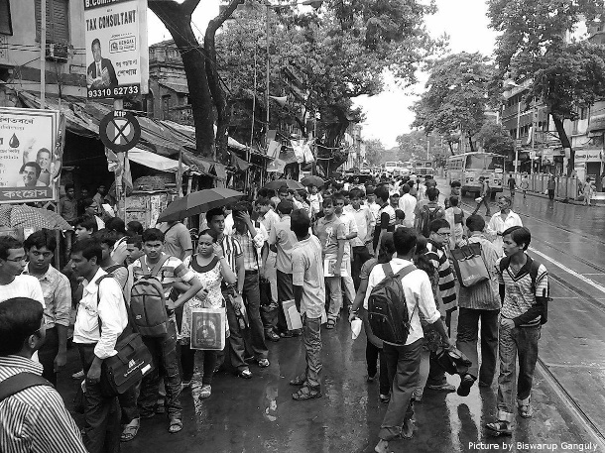
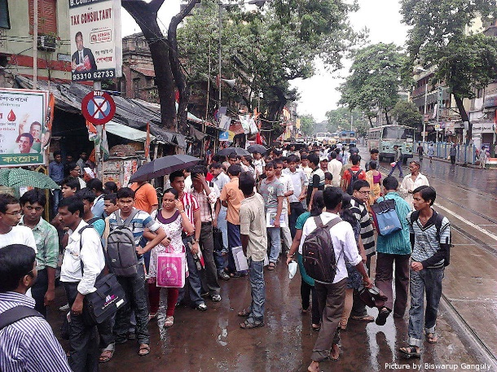
Problem
Queuing is a worldwide unsolved problem.
People waiting to get inside the Reichstag building in Berlin, Germany.
A typical queue in a post office, Poland.
College admission queue, India.

Slide 4
Solution
www.QatHome.eu
For users
For business
Get in line online in 3 clicks!
Make money out of your queue!
Notes:
FOR USERS
QatHome.eu is a website that allows people to stand in-line online finally allowing them to do whatever they like the most during their waiting time. People get their ticket online, are able to check the queue status, and the system automatically warns them when it is time to go.
FOR BUSINESSES
Thanks to QatHome.eu, not only you will save money, but you will make money out of your queue. Your customers can buy priority service to skip the queue without you having to do anything. We only get a small fraction of what your customers pay to you.

Slide 5
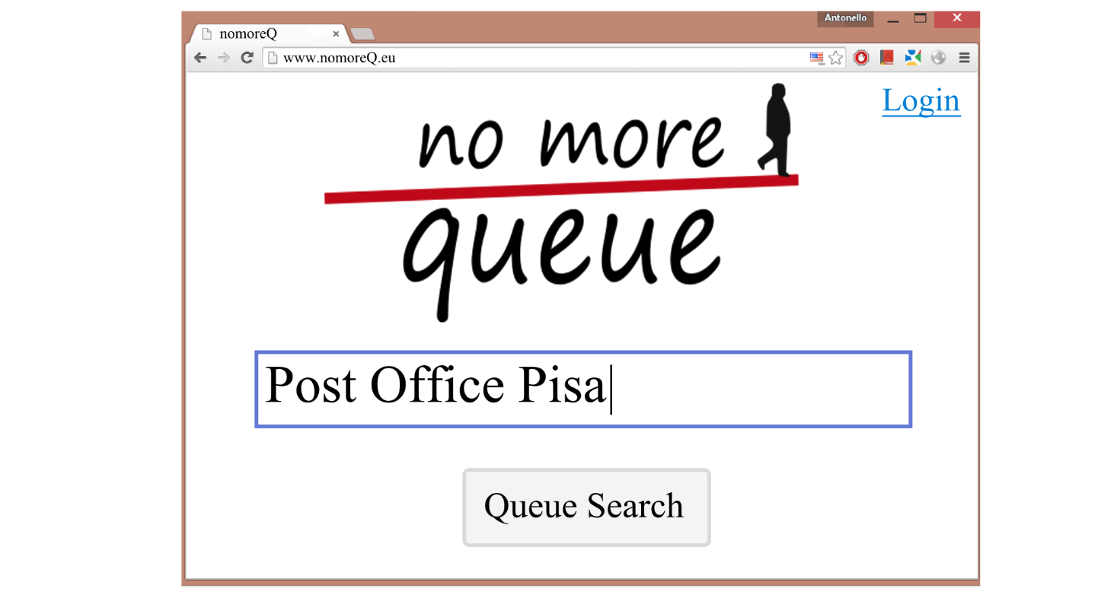
Solution (for users): Click 1
Open QatHome.eu

Slide 6
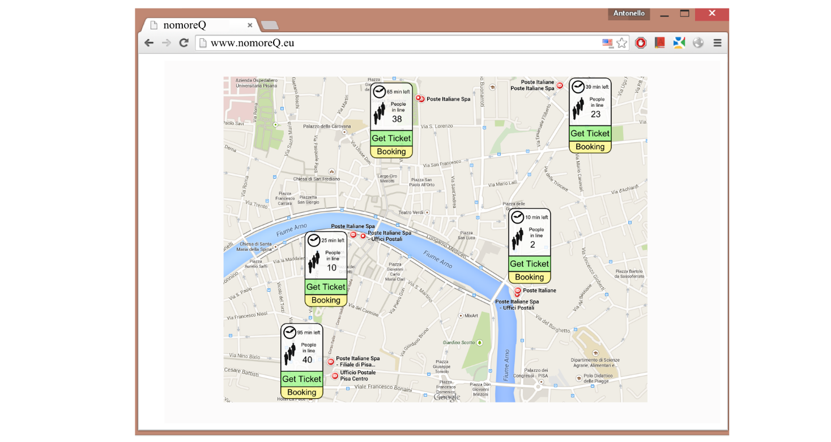
Solution (for users): Click 2
Find where you want to queue

Slide 7
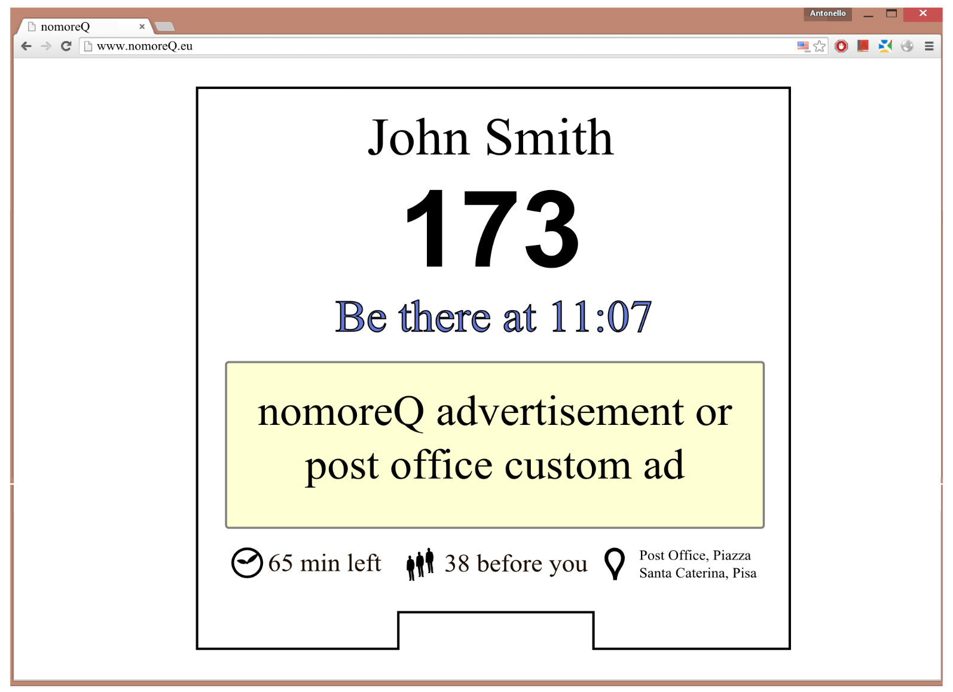
Solution (for users): Click 3
Get your ticket
‘be-there’ time
very reliable
statistically simulated
Updated in real time
Expected waiting time
later than “be-there” time

Slide 8
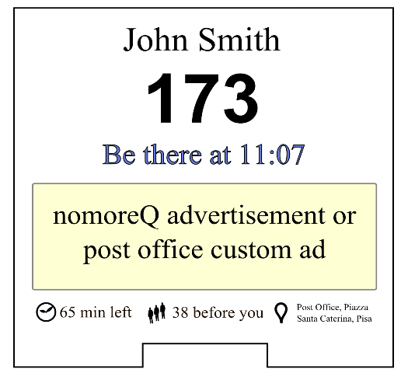

Special feature: in-advance booking
Today
Tomorrow
Seamless for businesses
Notes:
QatHome.eu can also start queuing instead of you. You only have to tell that you want to be at the post office at 11.00. The computer running our statistical model will issue the ticket at the right time instead of you, so that you can go there at 11.00 (and not before that time) and get your service in a few minutes. You will get a reminder 15 minutes before your turn just to be sure that you do not miss it.

Slide 9
Advantages
For users
For business
Save time
Queue at home, at work, or in the bus
Book for tomorrow
For free
Make money
Relaxed employees
Happy customers
Monitor performance
Free basic service
Notes:
FOR USERS
Save time - Queue at work, at home, or in the bus - Get your service whenever you want - Get a reminder before your turn
Get your service in a relaxed environment with only two or three people before you - QatHome is free of charge
FOR BUSINESSES
Make money - Save money - The basic service is totally free - Happy customers - Relaxed employees - Monitor the performance of your employees - In advance reservation makes your customers come whenever they want without you having to do anything - Now that your waiting room is free, use it for your business

Slide 10
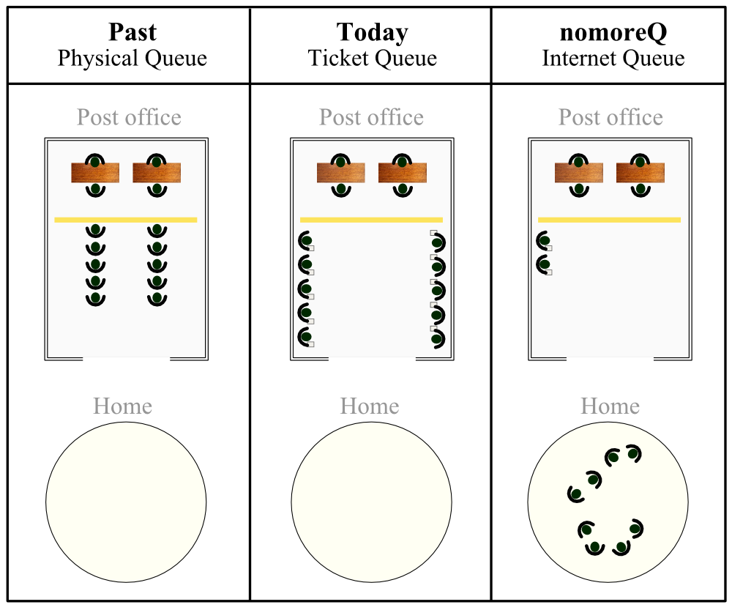
Vision: save time, save money, save room
Free space

Slide 11
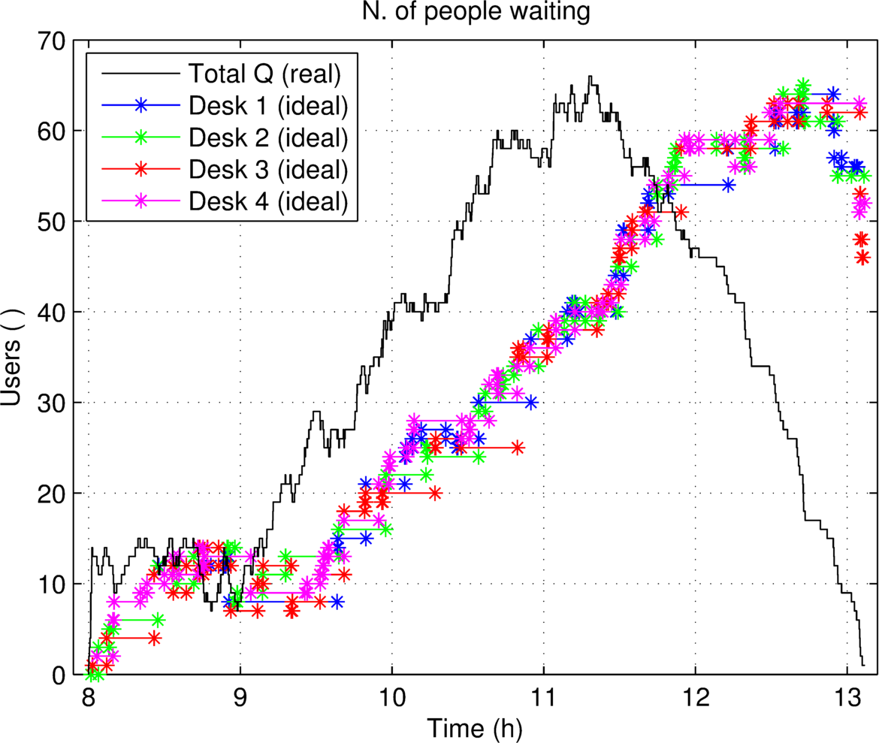
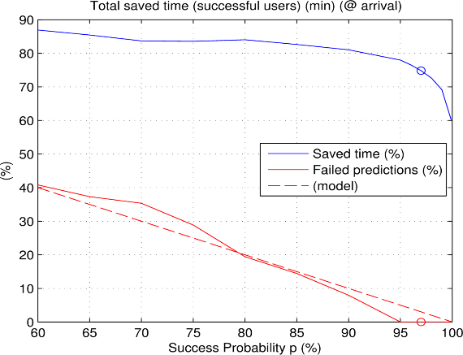
Proof of concept
Max queue length: 66 people
Max waiting time: 1h 26min
Customers save 74.8 % of time thanks to “be there time” only
Practically queue time will be reduced to around 10-15 minutes of real waiting time, regardless of the queue length.
Notes:
It is worth noticing that Pisa ranks 1st for health care in Italy and that, after all, Italy has one of the best health care systems in the world. Long queues will always be out there as long as demand exceeds supply.

Slide 12
Thank you
antonello.cherubini@gmail.com

