Slide 1
Module 1: Terraform Refresher
QATIP-Intermediate

Slide 2
Agenda
Introducing Terraform
Comparing Vendor tools to Terraform
Terraform Basics
Terraform Workflow Blocks
Lab 1 Creating a simple resource using Terraform

Slide 3
Introducing Terraform
Infrastructure as Code tool
Can manage on-premise and cloud resources
Is cloud agnostic
Supports both JSON and HashiCorp Configuration Language (HCL)

Slide 4
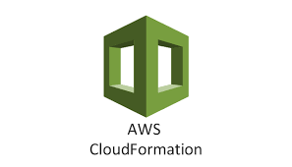


Comparing Vendor tools to Terraform
AWS
CloudFormation
Azure
ARM Templates
GCP
Deployment Manager

Slide 5
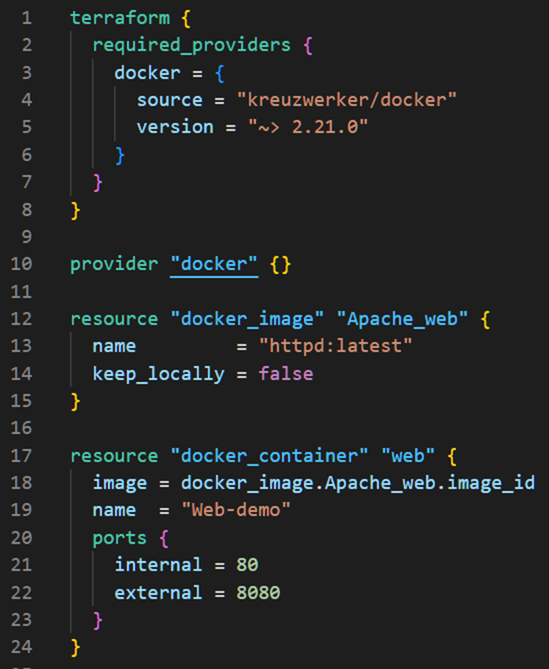

Terraform Basics
Scope - What are you trying to achieve?
Install - Install Terraform
Write - Author infrastructure as code
Plan - Preview changes before applying
Apply - Deploy reproducible infrastructure
Track - State file records deployment
Destroy - Remove deployed infrastructure

Slide 6
Terraform Workflow Blocks
terraform Identifies the version of terraform we use
provider Identify the infrastructure we want to terraform
resource Represents the resources we want to create
variable Allow parameter passing and customization
locals Allow easy access to frequently accessed values
data Loads or queries data from external sources
module Grouping of resources
output Allow configuration data to be output
provisioner Allow local or remote actions to be performed

Slide 7
Lab Group Discussion & Explore
Scoping
What Type of Resources are you going to create ?
What specific Properties do we need to consider for these resources ?
Workflow
Are there any Implicit or Explicit dependencies ?
What TF Provider, Resource, and Modules are required ?
Research
Identify the TF documentation that will assist in developing the solution

Slide 8

Lab 1
In this lab you will deploy a Docker image and container as local resources on a Windows or Linux computer.
A sample Terraform deployment

Slide 9

Any questions…

Slide 10

Quiz Time
* Logo designed by Freepik

Slide 11
Question 1
What is the primary advantage of Infrastructure as Code (IaC)?
A) Manual server setup
B) Consistent and repeatable infrastructure management
C) Increased hardware costs
D) Reduced need for cloud resources

Slide 12
Question 1
What is the primary advantage of Infrastructure as Code (IaC)?
A) Manual server setup
B) Consistent and repeatable infrastructure management
C) Increased hardware costs
D) Reduced need for cloud resources

Slide 13
Question 2
What is Terraform primarily known for?
A) Being vendor-specific
B) Being vendor-independent
C) Supporting only JSON configuration
D) Limited scalability

Slide 14
Question 2
What is Terraform primarily known for?
A) Being vendor-specific
B) Being vendor-independent
C) Supporting only JSON configuration
D) Limited scalability

Slide 15
Question 3
Which format is most used with Terraform?
A) XML
B) YAML
C) HashiCorp Configuration Language (HCL)
D) INI

Slide 16
Question 3
Which format is most used with Terraform?
A) XML
B) YAML
C) HashiCorp Configuration Language (HCL)
D) INI

