Slide 1
Module 2: Introduction & JSON Syntax Primer
QATIP-Intermediate

Slide 2

Introduction to JSON
JavaScript Object Notation (JSON) - lightweight data format
Used as an alternative syntax to HCL in Terraform
Machine-readable and easy to automate
Notes:
JSON (JavaScript Object Notation) is a lightweight, text-based data format widely used for configuration files and data exchange. In Terraform, JSON serves as an alternative syntax to HCL (HashiCorp Configuration Language), offering a structured format that is machine-readable and easier to automate. While JSON is more rigid compared to HCL, it is often used in scenarios where Terraform configurations need to be generated programmatically.

Slide 3
HCL vs JSON Structure
{
"provider": {
"aws": {
"region": "us-east-1"
}
},
"resource": {
"aws_instance": {
"example": {
"ami": "ami-12345678",
"instance_type": "${var.instance_type}"
}
}
},
"variable": {
"instance_type": {
"description": "EC2 instance type",
"type": "string",
"default": "t2.micro"
}
}
}
provider "aws" {
region = "us-east-1"
}
resource "aws_instance" "example" {
ami = "ami-12345678"
instance_type = var.instance_type
variable "instance_type" {
description = "EC2 instance type"
type = string
default = "t2.micro"
}
Notes:
Terraform allows configurations to be written in both HCL and JSON. HCL is human-friendly and supports comments, while JSON is more structured and commonly used for automation. Below is a direct comparison of how a provider, resource, and variable are defined in HCL and JSON.In HCL, resources are declared using blocks like provider, resource, and variable.
In JSON, these blocks are represented as nested objects, using key-value pairs to define attributes.While JSON enforces stricter syntax (e.g., mandatory double quotes, no comments), its machine-readability makes it ideal for templating and auto-generated configurations.

Slide 4
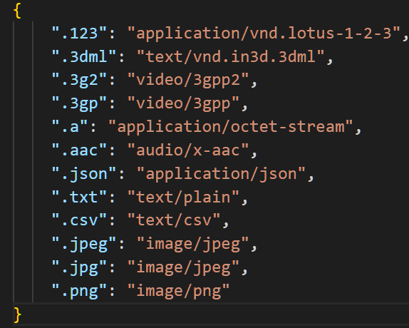
Basic Syntax Rules
Keys are strings in double quotes
Values can be strings, numbers, booleans, arrays, objects, or `null`
Commas separate key-value pairs
Notes:
JSON is structured as a collection of key-value pairs, where:
Keys must always be strings enclosed in double quotes ("key").
Values can be strings, numbers, booleans, arrays, objects, or null.
Commas are required to separate key-value pairs within objects and elements within arrays.
Braces {} define objects, and brackets [] define arrays.
Terraform JSON adheres to these rules strictly. Incorrect formatting, such as a missing comma or using single quotes, will result in parsing errors.

Slide 5
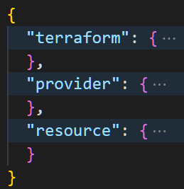
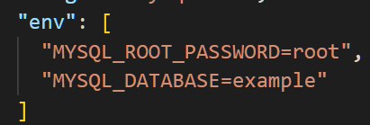
JSON Structure
Organized as key-value pairs
Uses braces `{}` for objects
Uses brackets `[]` for arrays

Slide 6
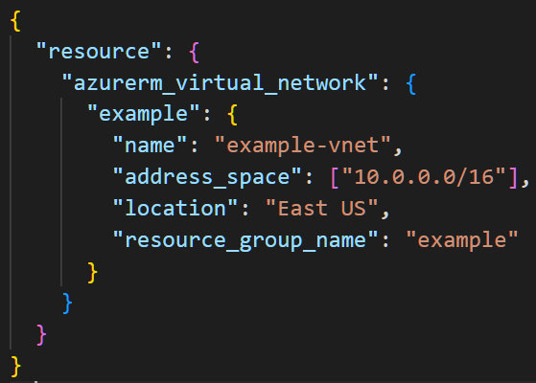
Blocks in JSON
Represented as nested objects
Example: Defining an Azure Virtual Network resource in JSON
Notes:
In Terraform JSON, blocks are represented as objects. Each block type (provider, resource, variable, etc.) is structured as a key-value pair, where:
The block type is the key (e.g., "provider", "resource").
The block contents are nested inside an object.
For example, defining an Azure Virtual Network in JSON requires specifying attributes like name, location, and address_space inside a nested resource block.

Slide 7
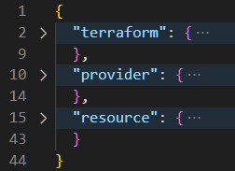
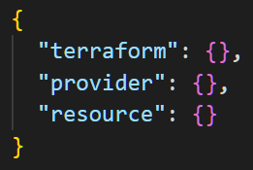


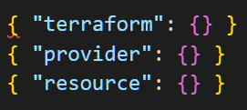
JSON Objects
Single Root-Level Object
object
object
object
Multiple Root-Level Objects
Keys defining top-level objects
Root-level object
Notes:
JSON (JavaScript Object Notation) is a lightweight, text-based data format widely used for configuration files and data exchange. In Terraform, JSON serves as an alternative syntax to HCL (HashiCorp Configuration Language), offering a structured format that is machine-readable and easier to automate. While JSON is more rigid compared to HCL, it is often used in scenarios where Terraform configurations need to be generated programmatically.

Slide 8
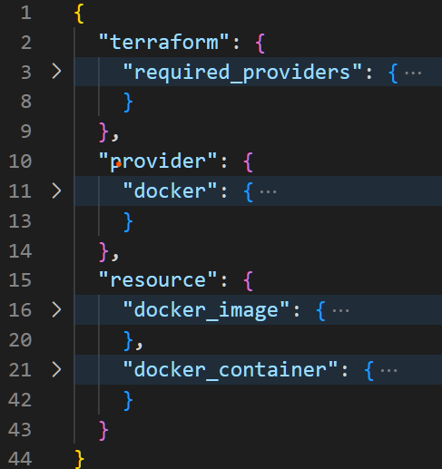
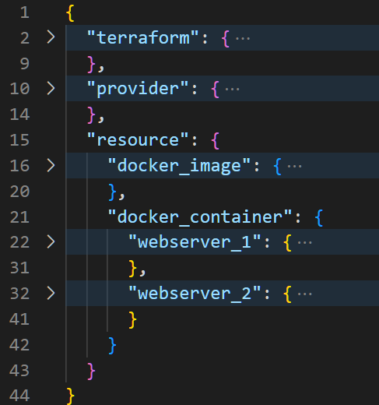
JSON Objects
Top-level objects
Object nesting
Object sub-nesting
Notes:
JSON follows a nested object hierarchy:
The root-level object is the entire JSON file.
Top-level objects include "provider", "resource", and "variable".
Nested objects represent configurations within resources.
This structure ensures Terraform can properly map configurations to cloud resources.

Slide 9
Object keys as Identifiers
Used for resources, variables, and modules
Must be unique within the same scope
{
"resource": {
"aws_instance": {
"my_vm": {
"ami": "ami-12345678",
"instance_type": "t2.micro"
}
}
}
}
resource "aws_instance" "my_vm" {
ami = "ami-12345678"
instance_type = "t2.micro"
}
Notes:
Identifiers in Terraform act as object keys that uniquely define resources, variables, and modules. In JSON:
An identifier is always a key inside the resource block.
It must be unique within the same scope.

Slide 10
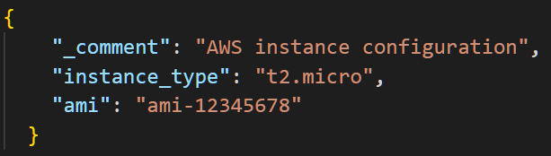
Comments in JSON
JSON does NOT support comments natively
Use descriptive keys or external documentation instead
The _comment key is ignored by Terraform but can provide human-readable context

Slide 11
Variables and Variable Types
Types: String, Number, Boolean, List (Array), Map (Object)
String → "example“
Number → 42
Boolean → true / false
List (Array) → ["item1", "item2"]
Map (Object) → { "key1": "value1", "key2": "value2" }
Notes:
Variables allow reusability and dynamic configuration in Terraform. JSON enforces strict typing, meaning a string cannot be used where a number is expected

Slide 12
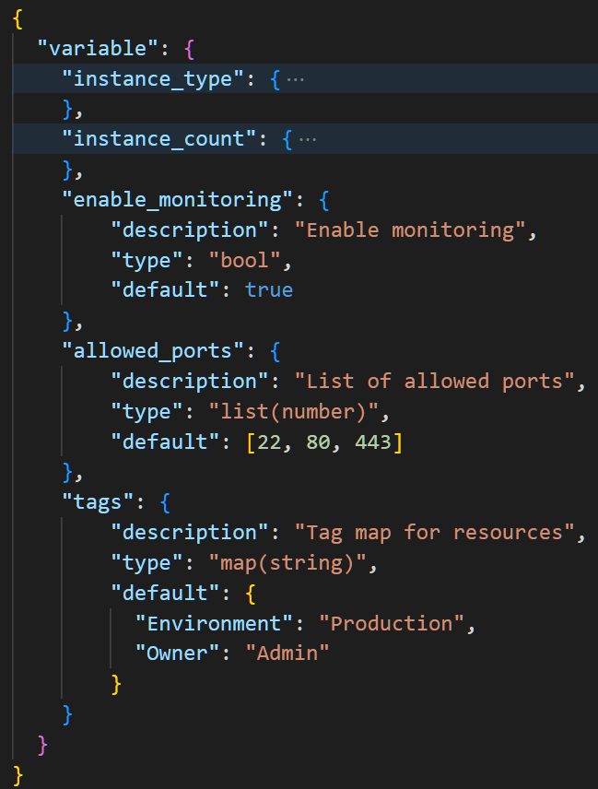
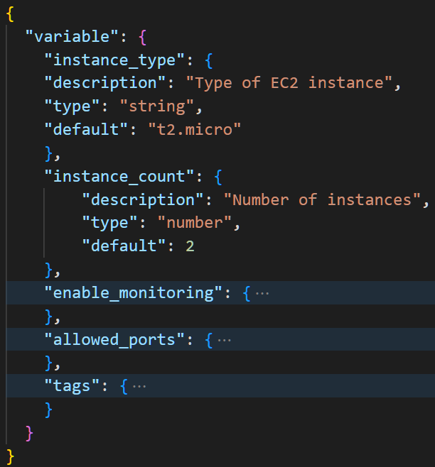
Variables and Variable Types - Examples

Slide 13
Arguments
Key-value pairs configuring resource properties
Example: Setting `address_space` in an Azure Virtual Network
{
"resource": {
"azurerm_virtual_network": {
"example": {
"name": "my-vnet",
"location": "West Europe",
"resource_group_name": "my-resource-group",
"address_space": ["10.0.0.0/16"]
}
}
}
}
resource "azurerm_virtual_network" "example" {
name = "my-vnet"
location = "West Europe"
resource_group_name = "my-resource-group"
address_space = ["10.0.0.0/16"]
}

Slide 14

Lab 2
In this lab you will deploy a Docker image and container as local resources on a Windows or Linux computer using JSON
A sample Terraform deployment using JSON

Slide 15

Any questions…

Slide 16

Quiz Time
* Logo designed by Freepik

Slide 17
1. What is a key difference between HCL and JSON in Terraform?
A) JSON supports comments, but HCL does not. B) HCL is machine-readable, while JSON is not. C) HCL supports inline comments, while JSON does not. D) JSON is the default format for writing Terraform configurations.

Slide 18
1. What is a key difference between HCL and JSON in Terraform?
A) JSON supports comments, but HCL does not. B) HCL is machine-readable, while JSON is not. C) HCL supports inline comments, while JSON does not. ✅ D) JSON is the default format for writing Terraform configurations.

Slide 19
2. How can you include comments in a Terraform JSON file?
A) Use // for single-line comments and /* ... */ for multi-line comments. B) Use a special _comment key that Terraform ignores. C) Add a "comments": true setting in the provider block. D) JSON natively supports comments, but they are optional.

Slide 20
2. How can you include comments in a Terraform JSON file?
A) Use // for single-line comments and /* ... */ for multi-line comments. B) Use a special _comment key that Terraform ignores. ✅ C) Add a "comments": true setting in the provider block. D) JSON natively supports comments, but they are optional.

Slide 21
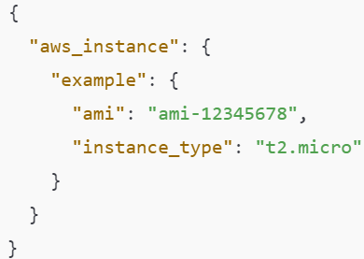
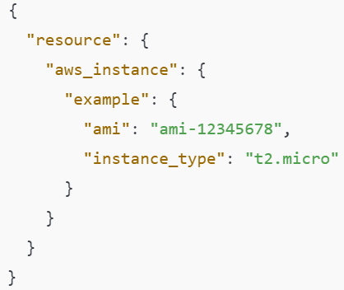
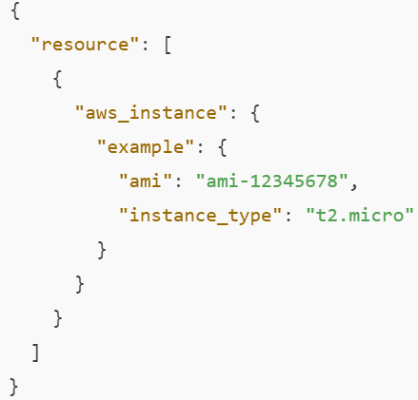
3. Which of the following is a valid JSON representation of a Terraform resource block?
A
B
C

Slide 22
3. Which of the following is a valid JSON representation of a Terraform resource block?
A
B
C
✅

