Slide 1
Module 3: Cloud Authentication Strategies
QATIP-Intermediate

Slide 2
Overview
Managing authentication credentials is critical in cloud environments.
Service Principals/Accounts vs. Managed Identities.
Balance security, ease of management, and automation.
Best practices for Terraform authentication in Azure, AWS, and Google Cloud.

Slide 3
Why Secure Authentication Matters?
Terraform needs authentication credentials to provision infrastructure.
Hardcoded credentials pose security risks.
Cloud-native authentication minimizes risks and manual management.
Enforce RBAC, least privilege, and audit logging.

Slide 4
Understanding Cloud Authentication Models
Service Principals / Service Accounts
Used for CI/CD, external automation.
Credentials must be securely stored and rotated.
Managed Identities / Instance Profiles / Workload Identity Federation
No need for stored credentials.
Limited to internal workloads.

Slide 5
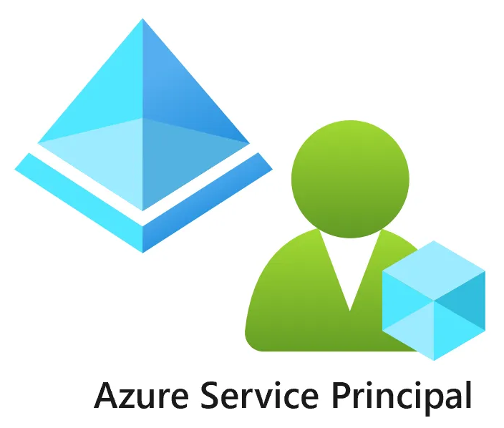
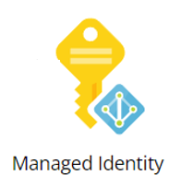
Azure: Service Principals vs. Managed Identities
Service Principals: Used for CI/CD, external authentication.
Managed Identities: For internal workloads, no credential storage.
Store SP credentials securely in Azure Key Vault.
Assign Managed Identities to VMs, App Services, Kubernetes.

Slide 6
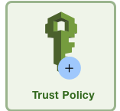
AWS: IAM Users/Roles vs. Instance Profiles
IAM Users & Roles: For CI/CD, external automation.
Instance Profiles: Used for EC2, Lambda authentication.
Store IAM credentials securely in AWS Secrets Manager.
Use STS for dynamic, short-lived credentials.

Slide 7
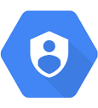
Google Cloud: Service Accounts vs. Workload Identity Federation
Service Accounts: Used for CI/CD, external automation.
Workload Identity Federation: No stored credentials, ideal for Kubernetes.
Store Service Account keys securely in Google Cloud Secret Manager.

Slide 8
Best Practices for Secure Terraform Authentication
Store credentials in secret management solutions.
Use short-lived credentials (AWS STS, Google WIF).
Enforce RBAC and least privilege.
Monitor and audit authentication events.

Slide 9

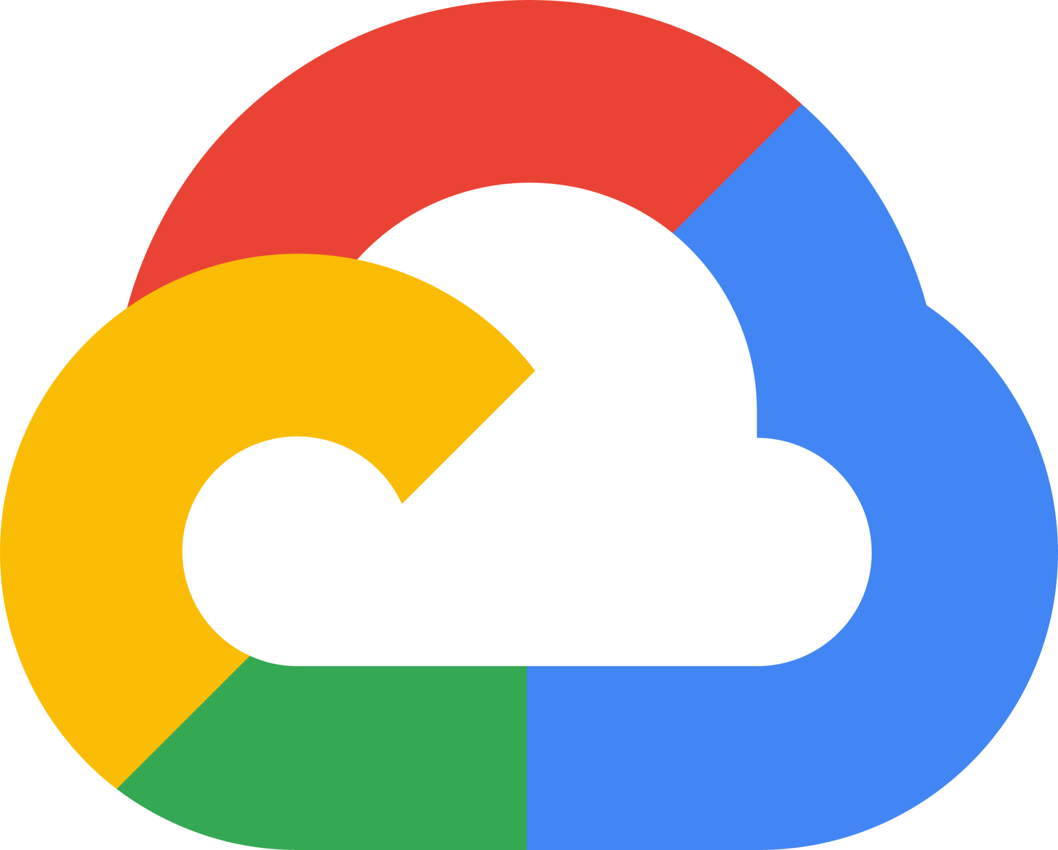

Terraform Authentication Examples
provider "azurerm" {
client_id = data.azurerm_key_vault_secret.client_id.value
client_secret = data.azurerm_key_vault_secret.client_secret.value
tenant_id = data.azurerm_key_vault_secret.tenant_id.value
subscription_id = "your-subscription-id"
features {}
}
provider "google" {
credentials = file(var.gcp_credentials)
project = "your-project-id"
region = "us-central1"
}
provider "aws" {
access_key = data.aws_secretsmanager_secret_version.access_key.secret_string
secret_key = data.aws_secretsmanager_secret_version.secret_key.secret_string
region = "us-east-1"
}
project = "your-project-id"
region = "us-central1"
}

Slide 10
Recommendations
Use Service Principals, IAM Users, or Service Accounts for CI/CD pipelines.
Store credentials securely in secret management solutions.
Use Managed Identities, Instance Profiles, and Workload Identity Federation for internal workloads.
Follow best practices for secure and scalable Terraform authentication.

Slide 11

Lab 3
This lab guides you through setting up a Key Vault for securely managing Terraform authentication when running Terraform from an external device
Cloud Authentication

Slide 12

Any questions…

Slide 13

Quiz Time
* Logo designed by Freepik

