Slide 1
Module 8: Cloud RDBMS
QATIP-Intermediate

Slide 2
Introduction to Relational Databases
Overview of RDBMS concepts
Differences between AWS RDS, Azure SQL, GCP Cloud SQL

Slide 3
Provisioning Databases
Creating managed database instances with Terraform
Configuring users, roles, and permissions

Slide 4
Database Configuration
Applying parameter groups and automated backups
Ensuring high availability settings

Slide 5
Lab Objectives
Provision RDBMS services across AWS, Azure, GCP
Standardize configurations using Terraform modules

Slide 6
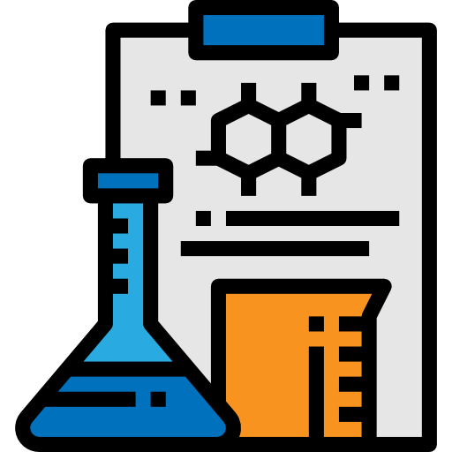
Lab 8
In this lab you will build a VM-hosted RDBMS solution and perform a database migration
Deploy and Manage RDBMS

Slide 7

Any questions…

Slide 8

Quiz Time
* Logo designed by Freepik

