Slide 1
Module 9: Kubernetes Management with Terraform
QATIP-Intermediate

Slide 2
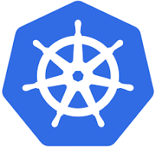
Introduction to Kubernetes
Kubernetes architecture and core concepts
Managing clusters and workloads with Terraform
Helm charts

Slide 3
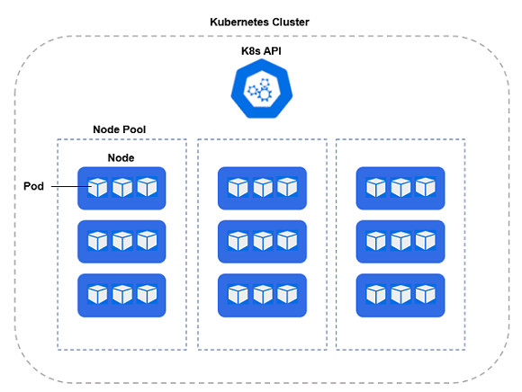
Kubernetes architecture and core concepts
An open-source platform for orchestrating and managing containerized applications
Clusters – Groups of nodes managed together as a single unit.
Nodes – Physical or virtual machines that run Kubernetes workloads.
Deployments & Services – Kubernetes objects used to manage application scaling and networking.
Pods – The smallest deployable unit in Kubernetes, consisting of one or more containers.

Slide 4
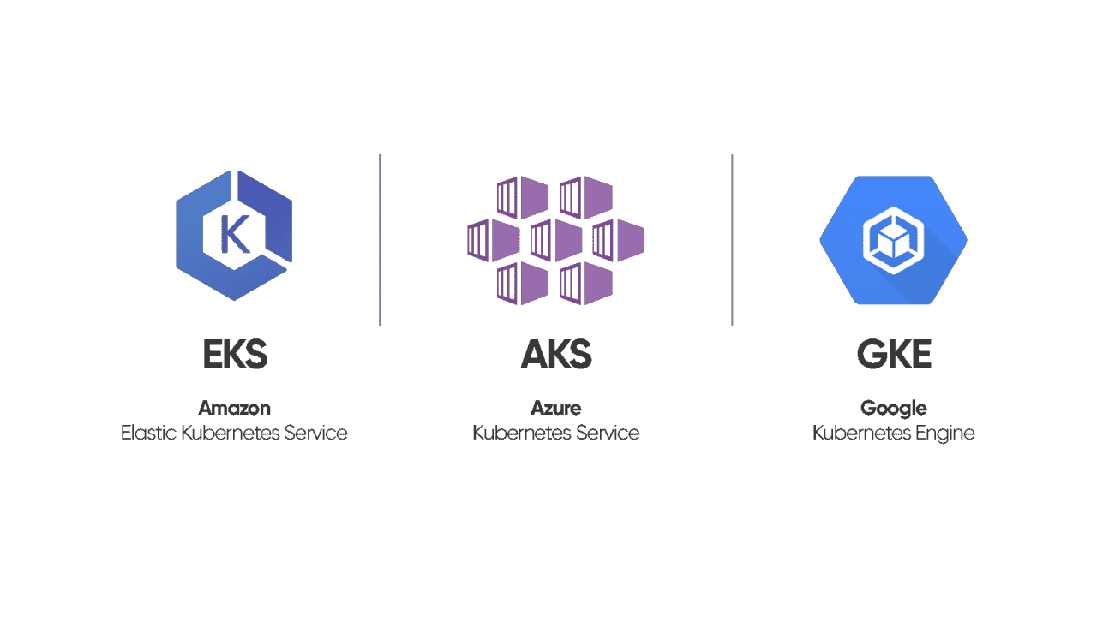
Terraform Kubernetes Provider
Configuring provider for EKS, AKS, GKE
Defining Kubernetes resources using Terraform

Slide 5
Terraform Kubernetes Provider - EKS
provider "kubernetes" {
host = …..
client_certificate = …..
client_key = …..
cluster_ca_certificate = …..
}
resource "aws_eks_cluster" "example" {
name = "example-eks"
role_arn = aws_iam_role.eks.arn
…..
resource "aws_eks_node_group" "example" {
cluster_name = aws_eks_cluster.example.name
node_role_arn = aws_iam_role.eks_nodes.arn
subnet_ids = aws_subnet.eks[*].id
scaling_config {
desired_size = 2
min_size = 1
max_size = 3
}
}

Slide 6
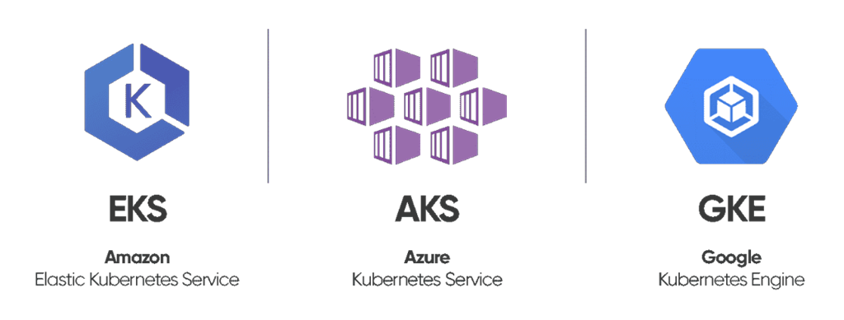
Terraform Kubernetes Provider - AKS
provider "kubernetes" {
host = …..
client_certificate = …..
client_key = …..
cluster_ca_certificate = …..
}
resource "azurerm_kubernetes_cluster" "example" {
name = "example-aks"
location = var.location
resource_group_name = var.resource_group_name
dns_prefix = "exampleaks"
default_node_pool {
name = "default"
node_count = 2
vm_size = "Standard_DS2_v2"
}
…..
}

Slide 7
Terraform Kubernetes Provider - GKE
provider "kubernetes" {
host = …..
client_certificate = …..
client_key = …..
cluster_ca_certificate = …..
}
resource "google_container_cluster" "example" {
name = "example-gke"
location = "us-central1"
initial_node_count = 2
node_config {
machine_type = "e2-medium"
}
}

Slide 8
Terraform and Kubernetes State Management
Terraform applies a static configuration, but Kubernetes can make real-time changes These changes can cause Terraform to detect 'drift' and potentially override Kubernetes’ adjustments.
Autoscaling Conflicts: Kubernetes can cause Terraform’s state to become outdated. Running terraform apply can unintentionally revert Kubernetes' scaling decisions.
Drift Between Terraform and Kubernetes: Kubernetes can recreate or reschedule pods for various reasons. Terraform does not track these changes unless explicitly refreshed.
Limited Control over Kubernetes-Specific Features: Terraform manages resources at the infrastructure level, while Kubernetes handles workloads at the application level.
Terraform is best suited for managing infrastructure, while Kubernetes is best suited for managing workloads

Slide 9
Terraform vs. Kubernetes - When to Use Which
Terraform is best for:
Provisioning clusters (EKS, AKS, GKE)
Defining networking and cloud infrastructure
Managing IAM roles and access policies
Kubernetes is best for:
Scaling applications dynamically
Managing rolling updates and rollbacks
Handling workload scheduling and pod lifecycles
Challenge: Terraform & Kubernetes have different views on "state," which can lead to unintended overrides

Slide 10
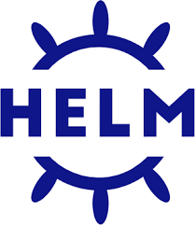
Helm
Package manager for Kubernetes
manages Kubernetes applications through reusable templates known as Helm charts
Charts bundle Kubernetes manifests (deployments, services, config maps etc) with default configuration values
Terraform's Helm provider allows you to deploy and manage Helm charts declaratively

Slide 11
Helm’s role in resolving Terraform-Kubernetes conflicts
Helm allows Kubernetes to manage its own resources dynamically, reducing Terraform's direct involvement in workload management.
By using Helm, Terraform can provision clusters, while Helm manages application deployments—aligning with Kubernetes’ best practices.
Helm avoids Terraform state conflicts by letting Kubernetes handle scaling and updates.

Slide 12
Demo: Application Deployment
Deploying applications to Kubernetes clusters

Slide 13
Lab: Managing Kubernetes Resources
This lab demonstrates how Terraform provisions Kubernetes infrastructure, but conflicts can arise when Kubernetes dynamically manages workloads. The lab also shows how Helm can mitigate these conflicts.
By the end of the lab, you will understand why Terraform struggles with autoscaling and why Helm is a better solution for workload management.

Slide 14
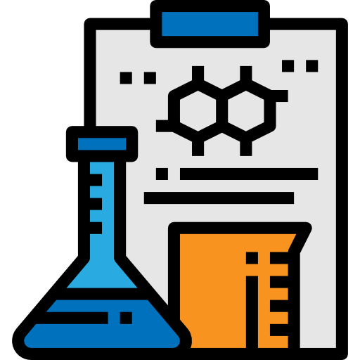
Lab 9
In this lab you will deploy and manage a kubernetes cluster using Terraform
Kubernetes

Slide 15

Any questions…

Slide 16

Quiz Time
* Logo designed by Freepik

Slide 17
Q1. What is the main challenge when using Terraform to manage Kubernetes resources?
Kubernetes does not support Terraform.
Terraform enforces a static state, while Kubernetes dynamically adjusts resources.
Terraform does not track any Kubernetes resources
Terraform can only be used with AWS, not Kubernetes.

Slide 18
Q1. What is the main challenge when using Terraform to manage Kubernetes resources?
Kubernetes does not support Terraform.
Terraform enforces a static state, while Kubernetes dynamically adjusts resources.
Terraform does not track any Kubernetes resources
Terraform can only be used with AWS, not Kubernetes.
Explanation: Terraform maintains a static state file, while Kubernetes dynamically creates, deletes, and scales resources based on demand. This mismatch can cause Terraform to override Kubernetes’ changes when running terraform apply

Slide 19
Q2. What problem can occur when Kubernetes automatically scales a deployment?
Terraform does not recognize the new pods and may revert them during terraform apply.
Terraform automatically scales its state to match Kubernetes.
Kubernetes prevents Terraform from overriding changes.
Terraform only manages Kubernetes workloads, not infrastructure.

Slide 20
Q2. What problem can occur when Kubernetes automatically scales a deployment?
Terraform does not recognize the new pods and may revert them during terraform apply.
Terraform automatically scales its state to match Kubernetes.
Kubernetes prevents Terraform from overriding changes.
Terraform only manages Kubernetes workloads, not infrastructure.
Explanation: Kubernetes autoscaling can create new pods outside of Terraform's knowledge. Since Terraform’s state file still expects the original number of pods, running terraform apply may scale down the pods back to the original count, overriding Kubernetes' autoscaling decisions

Slide 21
Q3. Why is Helm a better tool for managing Kubernetes workloads compared to Terraform?
Helm allows Kubernetes to manage application lifecycles without Terraform state conflicts.
Helm replaces the need for Terraform when managing cloud infrastructure.
Terraform is incompatible with Kubernetes, so Helm must be used.
Helm enforces a static state like Terraform, ensuring Kubernetes resources do not change.

Slide 22
Q3. Why is Helm a better tool for managing Kubernetes workloads compared to Terraform?
Helm allows Kubernetes to manage application lifecycles without Terraform state conflicts.
Helm replaces the need for Terraform when managing cloud infrastructure.
Terraform is incompatible with Kubernetes, so Helm must be used.
Helm enforces a static state like Terraform, ensuring Kubernetes resources do not change.
Explanation: Helm enables Kubernetes-native application management, reducing Terraform’s direct involvement in workload deployment. This prevents state drift issues and allows Kubernetes to handle autoscaling, updates, and pod rescheduling without Terraform interference.

Slide 23
Q4. Which of the following is NOT a recommended best practice when using Terraform and Kubernetes together?
Use Terraform to provision Kubernetes clusters, but let Kubernetes manage its own workloads.
Manage Kubernetes applications using Helm instead of defining them directly in Terraform.
Use Terraform to directly manage Kubernetes pods and scale them manually.
Define Kubernetes infrastructure (e.g., clusters, networking) in Terraform while delegating application lifecycle management to Kubernetes tools.

Slide 24
Q4. Which of the following is NOT a recommended best practice when using Terraform and Kubernetes together?
Use Terraform to provision Kubernetes clusters, but let Kubernetes manage its own workloads.
Manage Kubernetes applications using Helm instead of defining them directly in Terraform.
Use Terraform to directly manage Kubernetes pods and scale them manually.
Define Kubernetes infrastructure (e.g., clusters, networking) in Terraform while delegating application lifecycle management to Kubernetes tools.
Explanation: Terraform should NOT directly manage pods, as Kubernetes natively handles scheduling, scaling, and restarts. Instead, Terraform should provision the cluster, while tools like Helm should manage workloads inside the cluster.

