Slide 1
Module 3: Cloud Authentication Strategies
QATIP-Intermediate

Slide 2
Overview
Managing authentication credentials is critical in cloud environments.
Service Principals/Accounts vs. Managed Identities.
Balance security, ease of management, and automation.
Best practices for Terraform authentication in Azure, AWS, and Google Cloud.

Slide 3
Why Secure Authentication Matters?
Terraform needs authentication credentials to provision infrastructure.
Hardcoded credentials pose security risks.
Cloud-native authentication minimizes risks and manual management.
Enforce RBAC, least privilege, and audit logging.

Slide 4
Understanding Cloud Authentication Models
Service Principals / Service Accounts
Used for CI/CD, external automation.
Credentials must be securely stored and rotated.
Managed Identities / Instance Profiles / Workload Identity Federation
No need for stored credentials.
Limited to internal workloads.

Slide 5
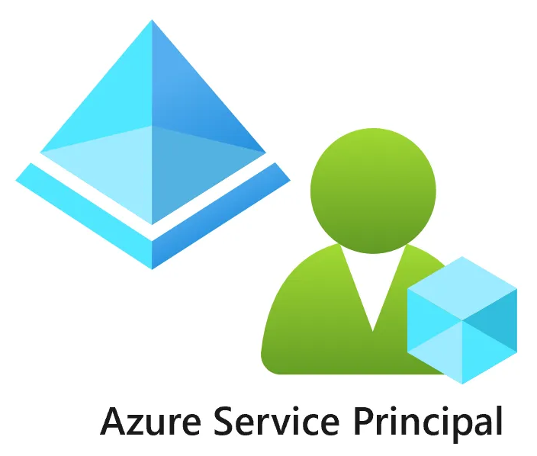
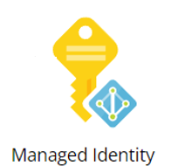
Azure: Service Principals vs. Managed Identities
Service Principals: Used for CI/CD, external authentication.
Managed Identities: For internal workloads, no credential storage.
Store SP credentials securely in Azure Key Vault.
Assign Managed Identities to VMs, App Services, Kubernetes.

Slide 6
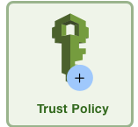
AWS: IAM Users/Roles vs. Instance Profiles
IAM Users & Roles: For CI/CD, external automation.
Instance Profiles: Used for EC2, Lambda authentication.
Store IAM credentials securely in AWS Secrets Manager.
Use STS for dynamic, short-lived credentials.

Slide 7

Google Cloud: Service Accounts vs. Workload Identity Federation
Service Accounts: Used for CI/CD, external automation.
Workload Identity Federation: No stored credentials, ideal for Kubernetes.
Store Service Account keys securely in Google Cloud Secret Manager.

Slide 8
Best Practices for Secure Terraform Authentication
Store credentials in secret management solutions.
Use short-lived credentials (AWS STS, Google WIF).
Enforce RBAC and least privilege.
Monitor and audit authentication events.

Slide 9



Terraform Authentication Examples
provider "azurerm" {
client_id = data.azurerm_key_vault_secret.client_id.value
client_secret = data.azurerm_key_vault_secret.client_secret.value
tenant_id = data.azurerm_key_vault_secret.tenant_id.value
subscription_id = "your-subscription-id"
features {}
}
provider "google" {
credentials = file(var.gcp_credentials)
project = "your-project-id"
region = "us-central1"
}
provider "aws" {
access_key = data.aws_secretsmanager_secret_version.access_key.secret_string
secret_key = data.aws_secretsmanager_secret_version.secret_key.secret_string
region = "us-central1"
}

Slide 10
Storage Methods for Service Principal (SP) Credentials
Storage Method | Persists ? | Scope | Requires Admin?
Temporary Environment Variables | No | Current session only | No
User Level Environment Variables | Yes | Only current user | No
Machine Level Environment Variables | Yes | System-wide | Yes
PowerShell/Bash Script () | No | Run manually | No
.env File | No | Run manually | No
Azure Key Vault | Yes | Centralized, cloud-managed | No
AWS Secrets Manager | Yes | Centralized, cloud-managed | No
GCP Secret Manager | Yes | Centralized, cloud-managed | No
Notes:
Intro (Opening Remarks)
“When working with service principals in Terraform or automation workflows, we need a secure and reliable method to store and access those credentials. This slide breaks down the common storage approaches, comparing whether they persist, who they affect, and whether admin privileges are needed.”
Temporary Environment Variables
“These are set for the current terminal session only—think export in Linux or $env: in PowerShell. They’re ideal for quick testing but vanish when the terminal closes. Good for demos, but not for persistent automation.”
User-Level Environment Variables
“These persist across sessions but are scoped to the current user. They’re stored in the user profile—so safer than temporary ones but still exposed to any process running as that user.”
Machine-Level Environment Variables
“These apply system-wide and affect all users. Because they touch global settings, they require admin rights. Useful on build servers or agents shared by multiple users or services.”
PowerShell/Bash Scripts
“These store credentials in a script file, and you manually run or ‘source’ them. They don’t persist unless you explicitly export the variables. The downside is that credentials could be exposed in the script—so it’s a short-term or dev-only solution.”
.env File
“Similar idea, but credentials are saved in a flat file like .env. Tools like dotenv or custom scripts can load them. Easy to use—but unless encrypted or secured, it's not safe for production.”
Azure Key Vault
“Now we move into centralized cloud-managed options. Azure Key Vault securely stores credentials, supports role-based access, logging, and rotation. It’s a best practice for production environments.”
AWS Secrets Manager
“Same principle—AWS’s native secret management service. Encrypts secrets, supports versioning and fine-grained IAM controls. Centralized and script-friendly.”
GCP Secret Manager
“And finally, Google’s equivalent. Again, secure, auditable, and integrated into GCP IAM. Ideal for Terraform, pipelines, and automation in Google Cloud.”
Wrap-Up / Summary
“As a rule of thumb—use local methods for dev and testing, and move to centralized secret managers for shared, secure environments. Avoid hardcoding, and always apply least privilege and rotation policies.”

Slide 11
Recommendations
Use Service Principals, IAM Users, or Service Accounts for CI/CD pipelines.
Store credentials securely in secret management solutions.
Use Managed Identities, Instance Profiles, and Workload Identity Federation for internal workloads.
Follow best practices for secure and scalable Terraform authentication.

Slide 12

Lab 3
This lab guides you through setting up a Key Vault for securely managing Terraform authentication when running Terraform from an external device
Cloud Authentication

Slide 13

Any questions…

Slide 14

Quiz Time
* Logo designed by Freepik

Slide 15
Question 1
Which of the following is the most secure method for storing Service Principal credentials used in Terraform automation?
Hardcoded in the Terraform script
Stored in a .env file in source control
Stored in Azure Key Vault or other cloud secret manager
Exported as environment variables during login session

Slide 16
Question 1
Which of the following is the most secure method for storing Service Principal credentials used in Terraform automation?
Hardcoded in the Terraform script
Stored in a .env file in source control
Stored in Azure Key Vault or other cloud secret manager
Exported as environment variables during login session
Correct Answer: C
Explanation: Cloud-native secret managers offer encryption, RBAC, audit logging, and rotation—ideal for securely storing credentials used by Terraform.

Slide 17
Question 2
Which authentication model eliminates the need to store credentials and is best suited for internal cloud workloads like VMs or Kubernetes?
A. Service Principals / IAM Users B. Managed Identities / Instance Profiles / Workload Identity Federation C. API Keys D. SSH Key Pairs

Slide 18
Question 2
Which authentication model eliminates the need to store credentials and is best suited for internal cloud workloads like VMs or Kubernetes?
A. Service Principals / IAM Users B. Managed Identities / Instance Profiles / Workload Identity Federation C. API Keys D. SSH Key Pairs
Correct Answer: B Explanation: These models allow cloud workloads to assume identities without manually managing or rotating credentials.

Slide 19
Question 3
What is a key limitation of using temporary environment variables for Terraform authentication?
A. They are encrypted and hard to retrieve B. They require admin permissions C. They do not persist once the session ends D. They automatically rotate every hour

Slide 20
Question 3
What is a key limitation of using temporary environment variables for Terraform authentication?
A. They are encrypted and hard to retrieve B. They require admin permissions C. They do not persist once the session ends D. They automatically rotate every hour
Correct Answer: C Explanation: Temporary environment variables exist only for the active session—once the terminal is closed, they are lost.

