Slide 1


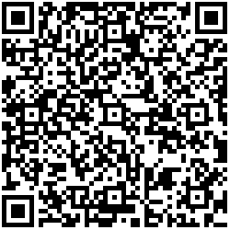




Scan/click QR code to save my number
91977742
90240033
WhatsApp
face book

