Slide 1




PITCH DECK
TEMPLATE
Pitch Deck By
National Incubation Center Hyderabad
E-mail
Website
hello@nichyderabad.com
www.nichyderabad.com

Slide 2


Place your Startup
logo here
FOR EXAMPLE
STARTUP NAME
FOR EXAMPLE: PAK WHEELS
TAGLINE
FOR EXAMPLE: THINK WHEELS, THINK PAKWHEELS!

Slide 3
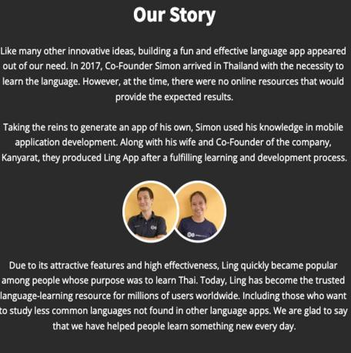
YOUR STARTUP
STORY
•Consider the picture as an example to describe your startup story
Storytelling is an effective method to start your pitch deck
Storytelling can be aided by graphics, video, or a brief template

Slide 4


Problem Statement
Identify what problem your startup is solving

Slide 5



SOLUTION
How is your startup solving the problem, mentioned in the previous slide?

Slide 6
COMPETITIVE EDGE / USP
Unique Selling Proposition
A unique selling point (USP) helps to differentiate your startup from its competitors.
For Example:
Indrive application promises a 'fair price' that you agree on.
Its key USP is that the app allows users to negotiate fares.

Slide 7
Competitors Analysis
Competitors Analysis is conducted to compare your startup with your competitors, considering multiple factors, for example: Open Platform, Marketing and Distribution, etc. Consider below picture as an example. You can edit it as per your startup criteria
Competitive Landscape
Criteria | Competitor 1 | Competitor 2 | Competitor 3 | Your Startup
Feature 1 (e.g: Price Range)
Feature 2
Feature 3

Slide 8
MARKET OPPORTUNITY
These figures give you a clear view of your startup’s immediate goals and of the space available for its future growth
$70B
$15B
$1.5B
Knowing how to calculate TAM SAM SOM is an important aspect of writing a successful pitch deck.
TAM
SAM
SOM
Global CRM industry
CRM companies with
$200m+ in revenue
Fortune 500
companies
Share your market research about the product
To calculate TAM-SAM-SOM, please refer to the guide

Slide 9

Business Model
Revenue
How does the company make money?
Pricing Strategy
Explain: Costing – Pricing - Profit Margin of your Product/Service.
Note: Refer to guideline document provided for better understanding of these concepts.

Slide 10

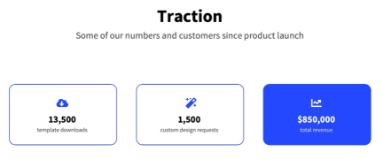
COMPANY TRACTION
Performance Metrics:
Startup must understand performance parameters to elaborate the performance of startup
With your traction data, you give investors evidence that your business will be successful.
For example
Return on Investment:
ROI is expressed as a percentage and is calculated by dividing an
investment's net profit (or loss) by its initial cost or outlay.
Key Milestone:
Formula of ROI
December 2023 | June 2024
MVP | Ready Product
Note: The parameters mentioned above are just examples so that your team can figure out relative details. Refer to the guideline document provided for clarity on these concepts.

Slide 11

Go-to-Market Strategy
Please refer to the picture to elaborate your Go-to-Market Strategy
Marketing
Analysis
Customer needs
Market and its dynamics
Company capabilities
Competion
Collaboration and partners
Marketing
Selection
Market segmentation
Market selection
Seagmant targating
Produc positioning
Marketing
Mix
Product
Price
Place/distribution
Promotion/advertising
People
Process
Physical evidence
Customer
Acquisition
Awareness
Interest
Evaluation
Commitment
Referral/Customer
loyalty/ Retention
What does the market look like?
Wom do we go after and how?
What do we sell?
Where and how do we sell?
How do we gain and retain customer?

Slide 12


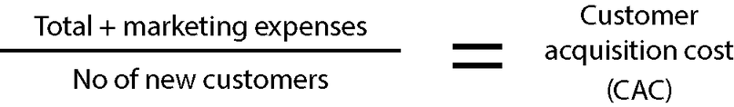

FINANCIAL SLIDE
Current Financial Status:
Profit And Loss Statement (If applicable)
Balance Sheet (if applicable)
Financial Projection
Forecast for the next 3 years
Lifetime Value (LTV):
A measure of how much revenue is generated from an individual customer.
Customer Acquisition Cost (CAC):
The amount it costs to acquire a new customer for the business.
Formula:
Formula:
Unit Economics Ratio:
A ratio that measures the profitability of each unit, calculated by dividing revenue by costs.
Note: The parameters mentioned above are just examples so that your team can figure out relative details. Refer to the guideline document provided for clarity on these concepts.
Formula:

Slide 13




Meet The Team
COO & FOUNDER
CTO & CO-FOUNDER
CFO
CMO
Founder Name
Co-Founder Name
CFO Name
CMO Name
*Note: These designations are just examples. Please replace as per your specific details

Slide 14

How NIC Hyderabad can help your startup?
State the top three of the following:
01
Startup Coaching & Mentoring
02
Industry Linkages
03
Investor Connections
04
Co-working Space
05
International Exposure Events
06
Other, Please Specify

Slide 15



Place your Startup
logo here
Thank You
Telephone
Website
+123-456-7890
www.reallygreatsite.com
Address
123 Anywhere St., Any City, ST 12345

Slide 16

Note: Optional Slide depending on if it is needed
Ask
Highlight your need in terms of
Funding:
With a complete breakdown aiming to categorically define the areas to be supported with the needed fund
Marketing
Product Development

