Slide 1

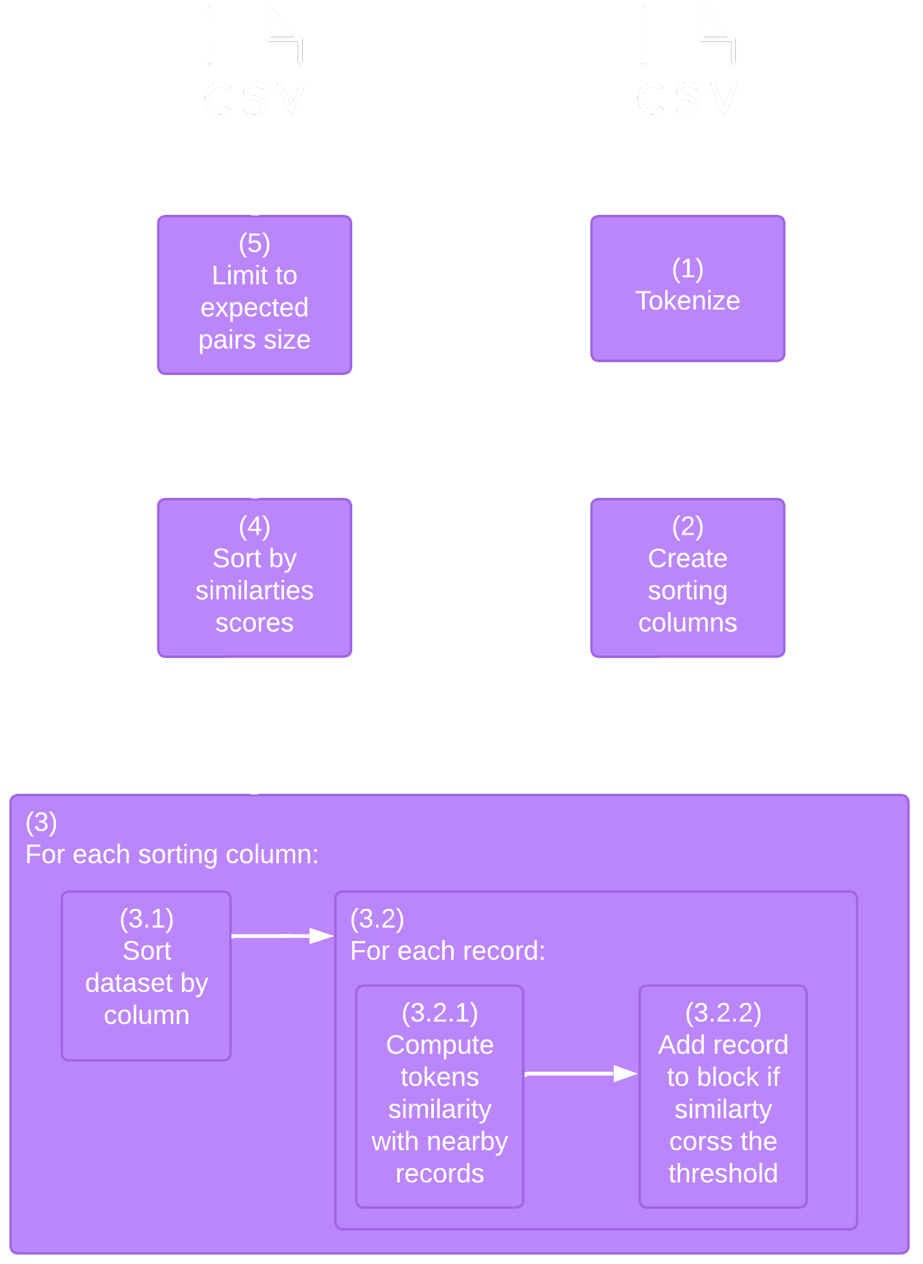
ACM SIGMOD PROGRAMMING CONTEST 2022
Team: QaisHousien (3rd place)
Member: Qais Abou Housien qaisabouhousien@gmail.com
Advisor: Tomer Sagi tsagi@is.haifa.ac.il
Data Management Lab @ University of Haifa
Contest Overview
Tokenization
Task: Perform blocking in a limited time to generate a candidate set that contains pairs for matching
Datasets:
Measurement: Average Recall
Made using the Spacy library
Stop words are discarded
Only nouns and pronouns are used
Lowercasing
Token lemmatization
Num of blocking pairs | Num of rows | Name | #
1,000,000 | 1,000,000 | Notebook | 1
2,000,000 | 1,000,000 | Altosight | 2
Sorted Neighborhood
The core solution is based on the sorted neighborhood algorithm
Similarity between two records is computed using the Jaccard similarity between the two sets of tokens
Two different variations of the algorithm were used based on the input dataset
The first one used an adaptive window size to adjust the size based on how many records are being detected (dataset 1)
The second one introduced the idea of tolerance, which is defined as the allowed number of pairs that are discarded before moving to the next record (dataset 2)
Solution Overview
Results
Average recall over the 2 datasets: 0.514
Recall | #
0.726 | 1
0.301 | 2

