Slide 1


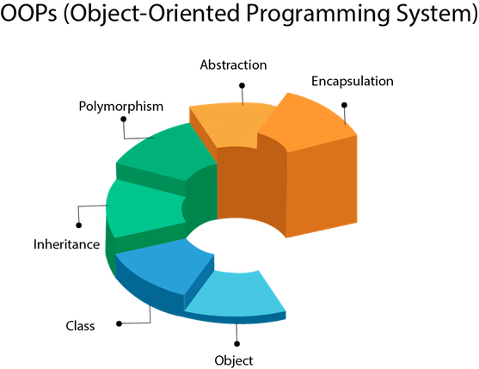

Slide 2
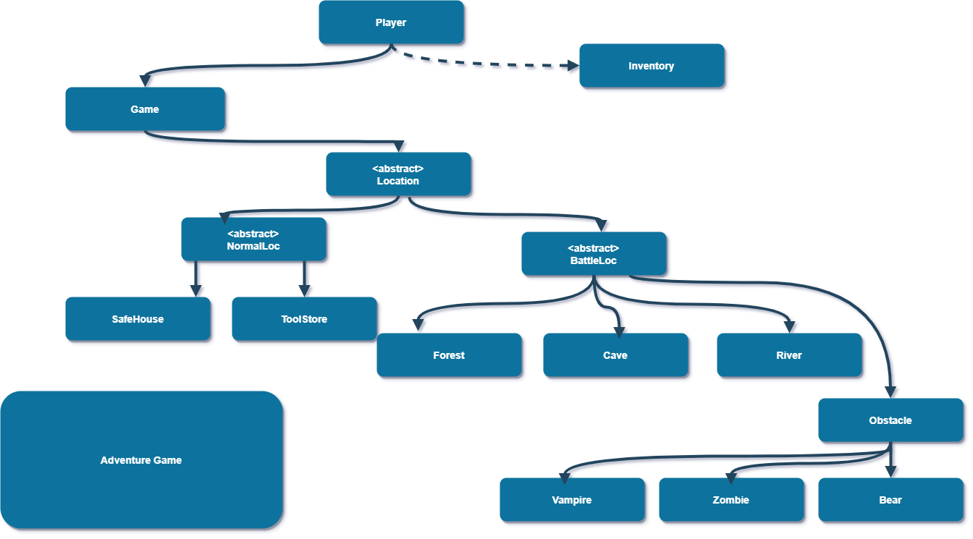
Flow Diagram

Slide 3
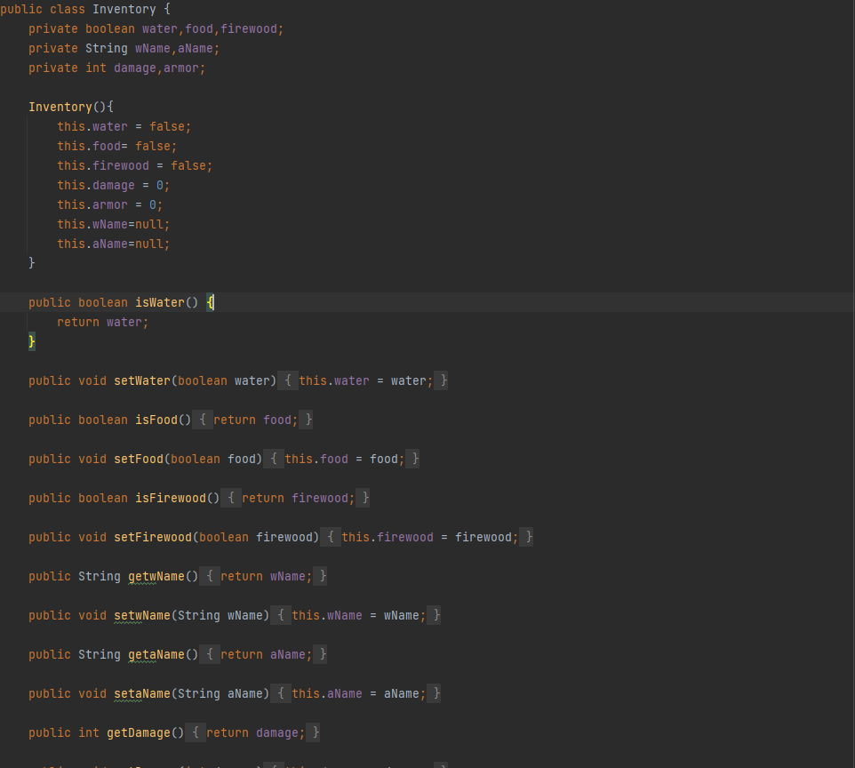
INVENTORY CLASS
Variables
Constructor
Getter and Setter

Slide 4
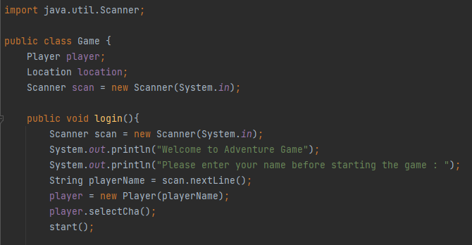
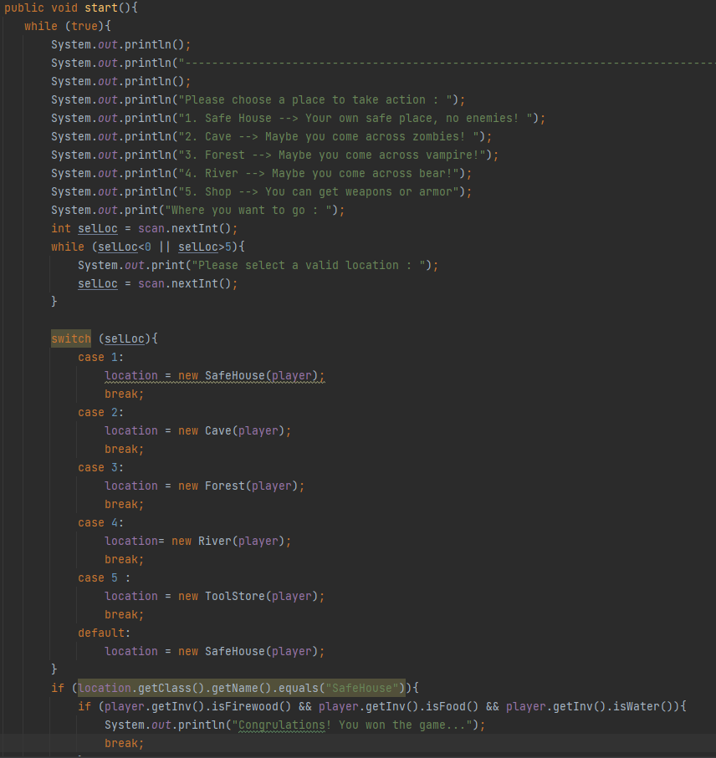
GAME CLASS
Taking Imput
Switch Case

Slide 5
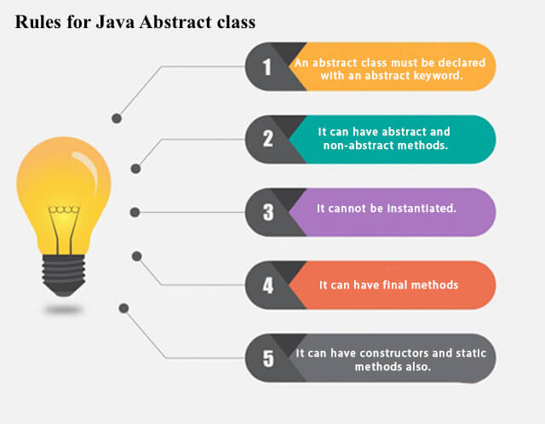
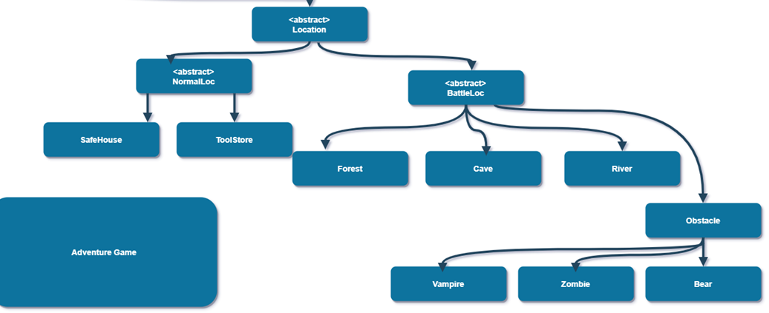
LOCATION ABSTRACT CLASS

Slide 6
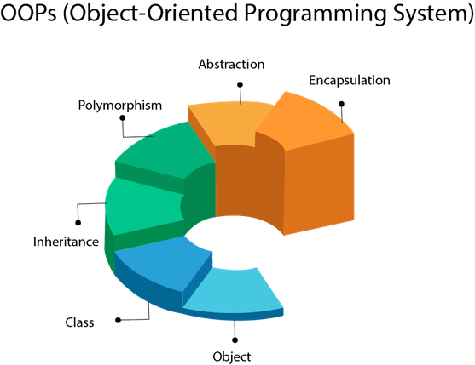

What is Java related in this example?
Loops
Scanner Class for taking input
Primitive Variables
Switch Case
Constructors
Overriding
Inheritance
OOP
What is OOP related in this example?
Inheritance is a mechanism in which one object acquires all the properties and behaviors of a parent object.
Abstraction is a process of hiding the implementation details and showing only functionality to the user.
Encapsulation is a process of wrapping code and data together into a single unit, for example, a capsule which is mixed of several medicines.

Slide 7




