Slide 1
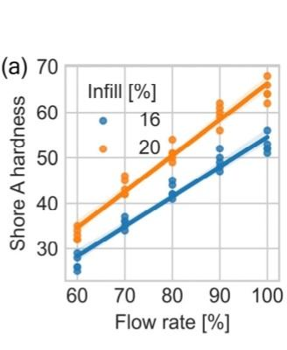
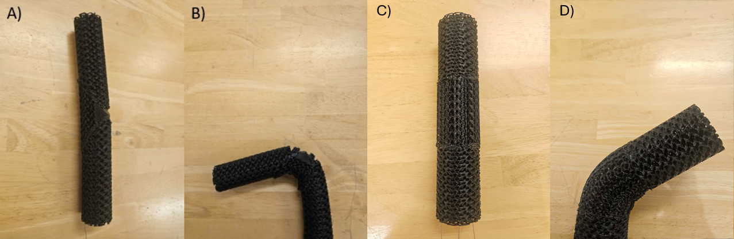
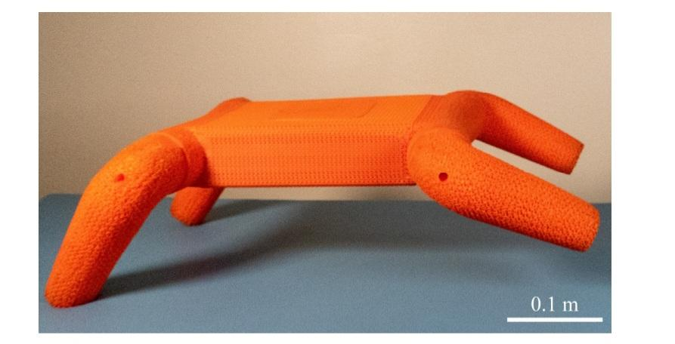
Simulation of soft joint: tendon-driven meta-material
Feng Xu
Fig. 1. Test print metamaterial with; a) one tendon b) tendon actuated c) three tendons d) one of the tendons actuated.
Flexipod Boxi, et. al

Slide 2
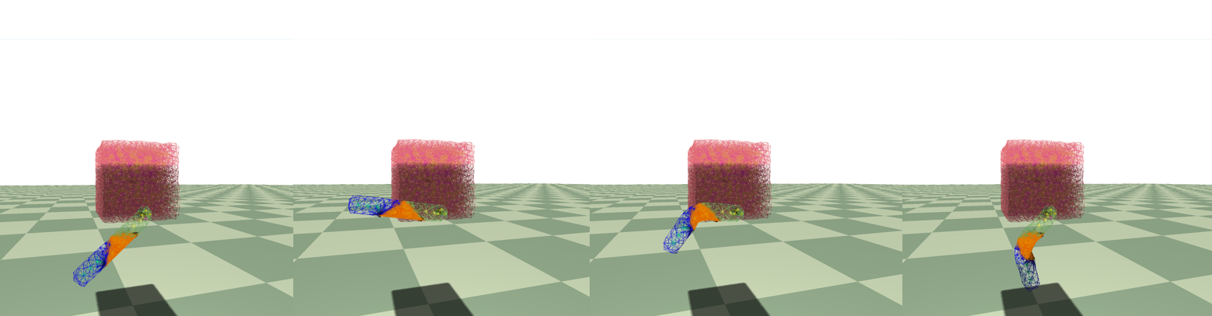
Simulation with Explicit Euler
Fig. 2: Simulation based on CUDA on soft metamaterial in real time for tendon driven joint
Fail for large dt, k or small m. So try to simulate with implicit Euler.

Slide 3
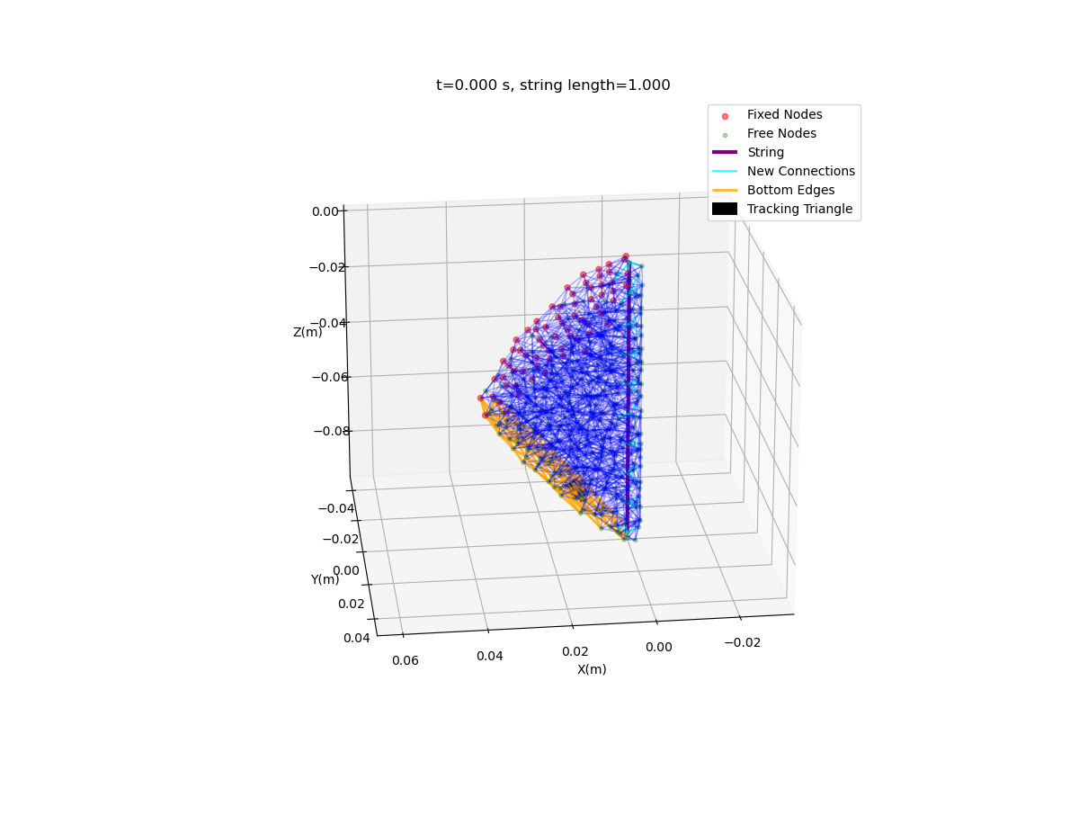
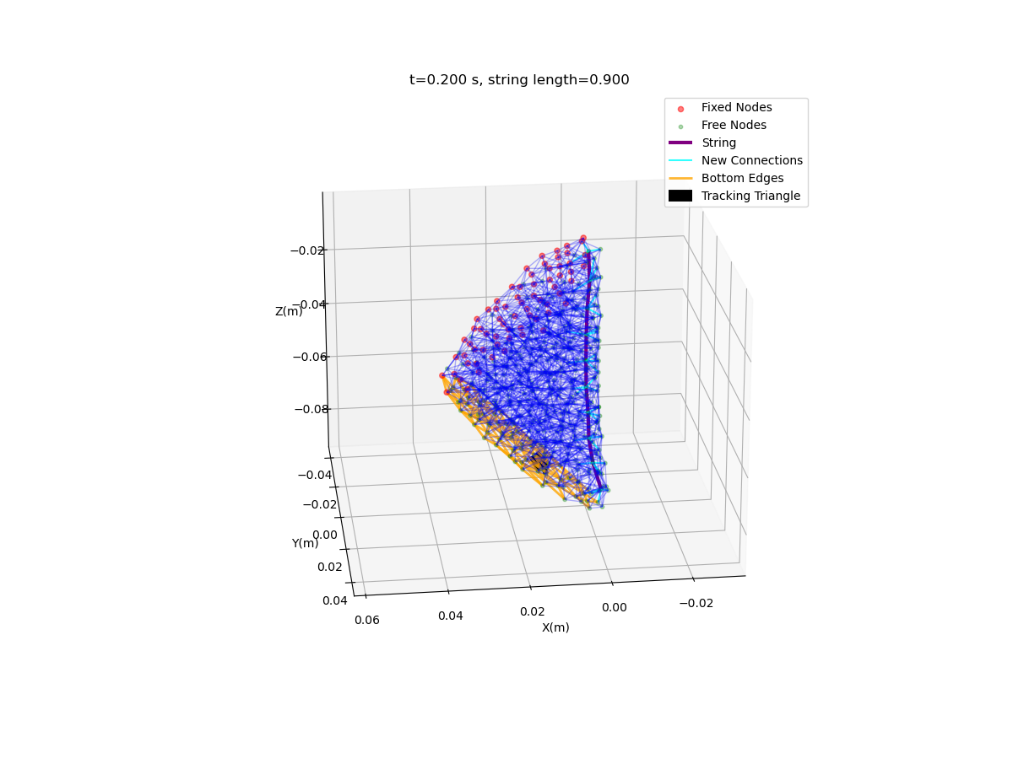
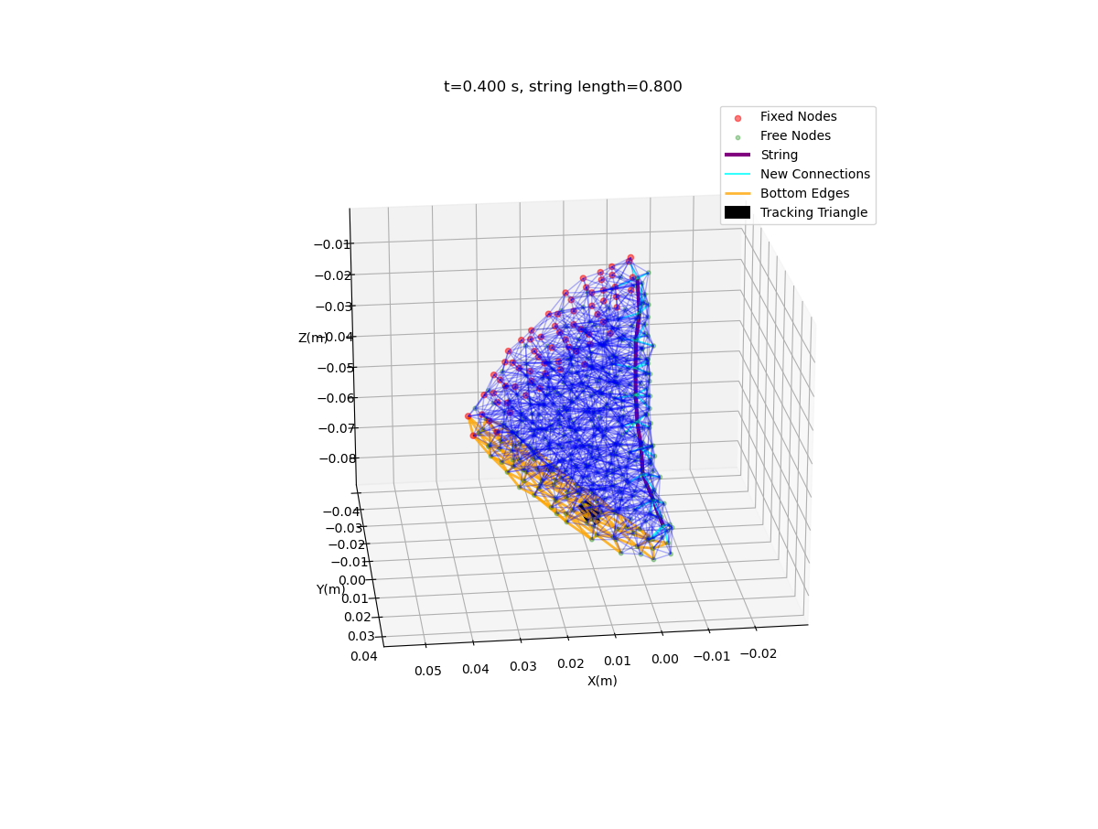
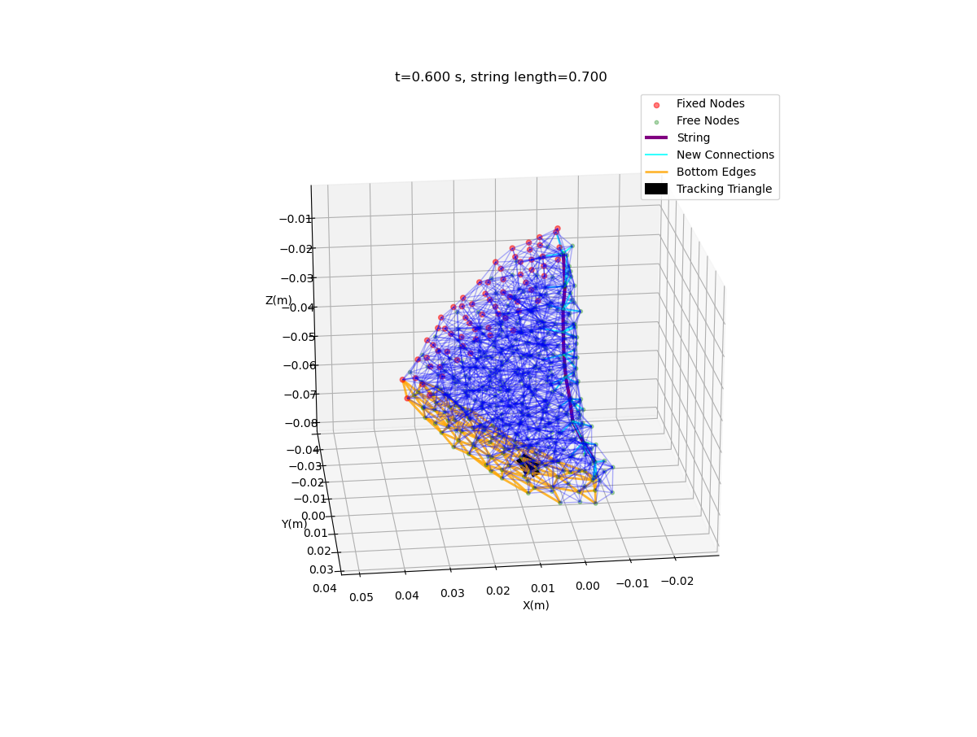
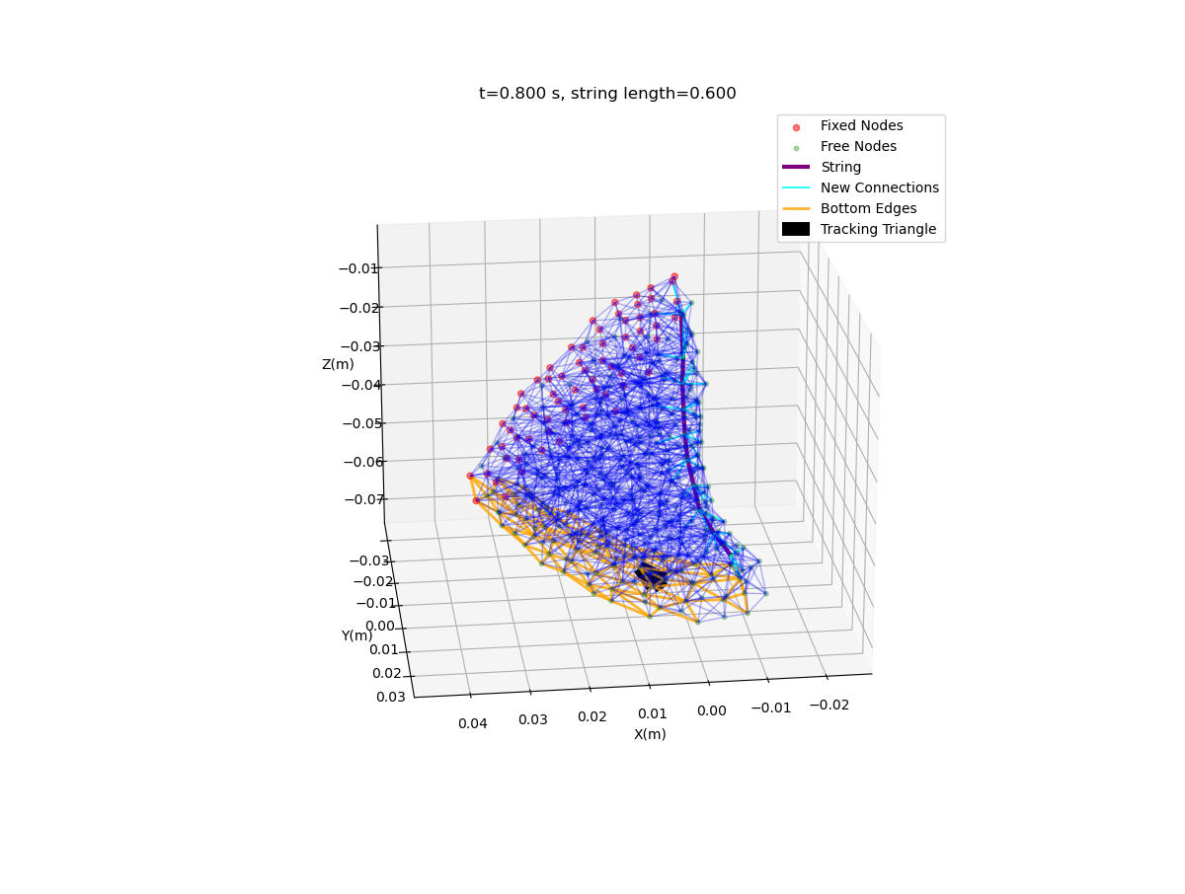


Slide 4
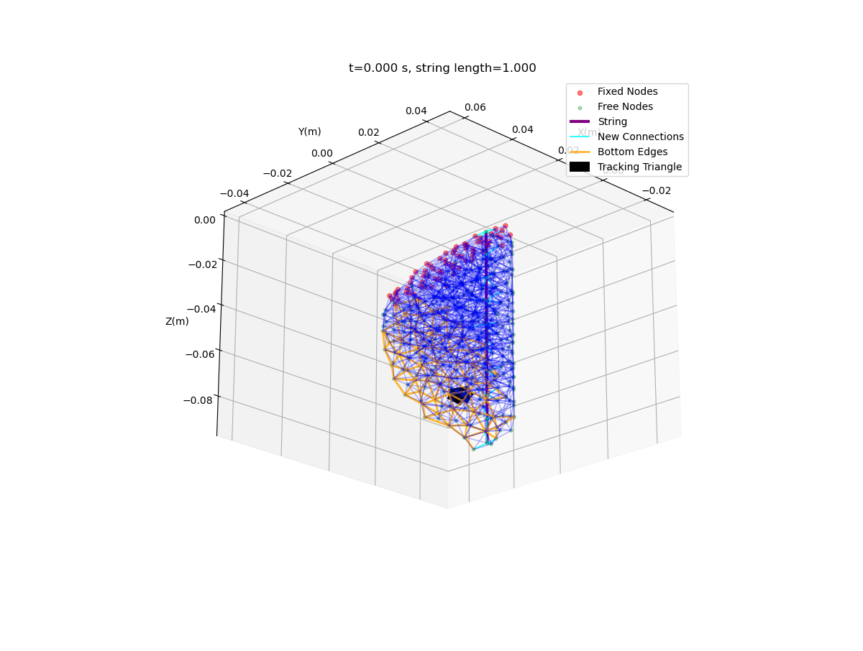
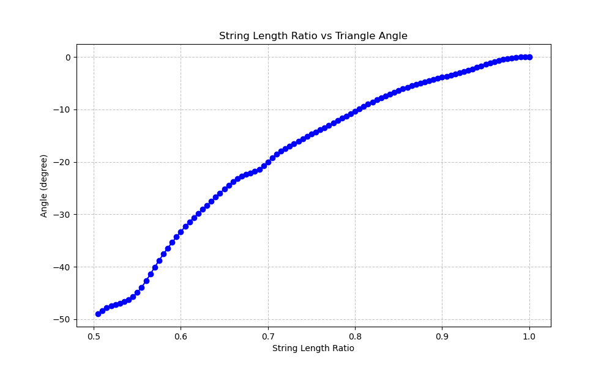
Next Step: Add links and analyze the angle between links/explore a faster implicit method(projective dynamics)
Anticipated final outcome: the mapping from string length to joint angle

