Slide 1
Using Fast DDS Discovery Server as discovery protocol
Date：2021.07.10
OS: Ubuntu 20.04 L.T.S
Version: Foxy
Author: Z.M. Zhang

Slide 2
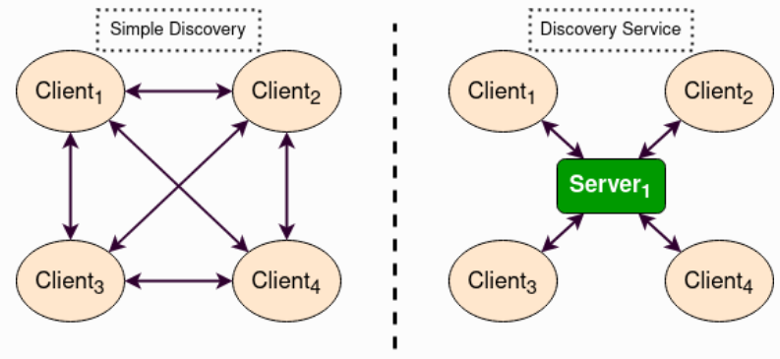
Background
Starting from ROS 2 Eloquent Elusor, the Fast DDS Discovery Server protocol is a feature that offers a centralized dynamic discovery mechanism, as opposed to the distributed mechanism used in DDS by default. This tutorial explains how to run some ROS 2 examples using the Fast DDS Discovery Server feature as discovery communication.
DDS Discovery Server Architecture

Slide 3
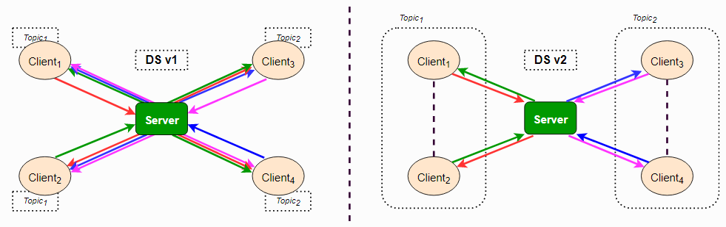
Fast DDS Discovery Server v2
The latest ROS 2 Foxy Fitzroy release (December 2020) included a new version, version 2 of the Fast DDS Discovery Server. This version includes a new filter feature that further reduces the number of discovery messages sent. This version uses the topic of the different nodes to decide if two nodes wish to communicate, or if they can be left unmatched (i.e. not discovering each other). The following figure shows the decrease in discovery messages:
Fast DDS Discovery Server Architecture

Slide 4
Launch node
Setup Discovery Server
Command:
fastdds discovery --server-id 0
## Launch Listener node.
export ROS_DISCOVERY_SERVER=127.0.0.1:11811
ros2 run demo_nodes_cpp listener --ros-args --remap
__node:=listener_discovery_server
## Launch talker node.
export ROS_DISCOVERY_SERVER=127.0.0.1:11811
ros2 run demo_nodes_cpp talker --ros-args --remap
__node:=talker_discovery_server

Slide 5
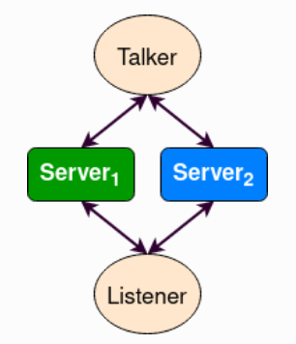
Server Redundancy
By using fastdds tool, multiple discovery servers can be created. Discovery clients (ROS nodes) can connect to as many servers as desired. This allows to have a redundant network that will work even if some servers or nodes shut down unexpectedly. The figure below shows a simple architecture that provides server redundancy.
Server Redundancy Architecture

Slide 6
Run Server Redundancy
Command:
fastdds discovery --server-id 0 --ip-address 127.0.0.1 --port 11811
fastdds discovery --server-id 1 --ip-address 127.0.0.1 --port 11888
export ROS_DISCOVERY_SERVER="127.0.0.1:11811;127.0.0.1:11888"
ros2 run demo_nodes_cpp talker --ros-args --remap __node:=talker
export ROS_DISCOVERY_SERVER="127.0.0.1:11811;127.0.0.1:11888"
ros2 run demo_nodes_cpp listener --ros-args --remap __node:=listener

Slide 7
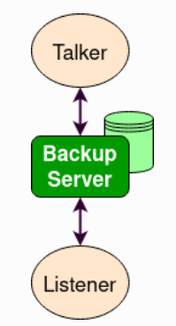
Backup Server
The Fast DDS Discovery Server allows creating a server with backup functionality. This allows the server to restore the last state it saved in case of a shutdown.
Command:
fastdds discovery --server-id 0 --ip-address 127.0.0.1 --port 11811 –backup
export ROS_DISCOVERY_SERVER="127.0.0.1:11811"
ros2 run demo_nodes_cpp talker --ros-args --remap __node:=talker
export ROS_DISCOVERY_SERVER="127.0.0.1:11811"
ros2 run demo_nodes_cpp listener --ros-args --remap __node:=listener

Slide 8
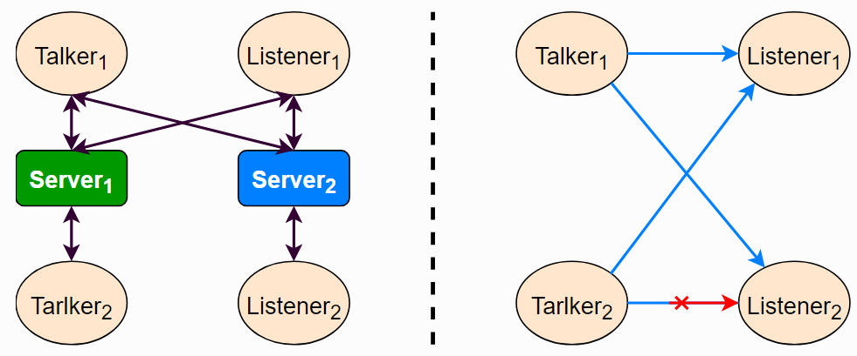
Discovery partitions
Communication with discovery servers can be split to create virtual partitions in the discovery information. This means that two endpoints will only know about each other if there is a shared discovery server or a network of discovery servers between them. We are going to execute an example with two independent servers. The following figure shows the architecture.

Slide 9
Discovery partitions
Command:
fastdds discovery --server-id 0 --ip-address 127.0.0.1 --port 11811
fastdds discovery --server-id 1 --ip-address 127.0.0.1 --port 11888
export ROS_DISCOVERY_SERVER="127.0.0.1:11811;127.0.0.1:11888"
ros2 run demo_nodes_cpp talker --ros-args --remap __node:=talker_1
export ROS_DISCOVERY_SERVER="127.0.0.1:11811;127.0.0.1:11888"
ros2 run demo_nodes_cpp listener --ros-args --remap __node:=listener_1
export ROS_DISCOVERY_SERVER="127.0.0.1:11811"
ros2 run demo_nodes_cpp talker --ros-args --remap __node:=talker_2
export ROS_DISCOVERY_SERVER=";127.0.0.1:11888"
ros2 run demo_nodes_cpp listener --ros-args --remap __node:=listener_2

