Slide 1
ROS2 package
Date：2021.05.25
OS: Ubuntu 20.04 L.T.S
Version: Foxy
Author: Z.M. Zhang

Slide 2
Creating a workcpace
A workspace is a directory containing ROS 2 packages. Before using ROS 2, it’s necessary to source your ROS 2 installation workspace in the terminal you plan to work in. This makes ROS 2’s packages available for you to use in that terminal.
run the ros2 command:
source /opt/ros/foxy/setup.bash
mkdir –p ~/dev_ws/src
cd ~/dev_ws/src
cd ..
colcon build # create 3 directories, build, install, log.
. install/local_setup.bash # run creating a workspace command.

Slide 3
Creating a package
A package can be considered a container for your ROS 2 code. If you want to be able to install your code or share it with others, then you’ll need it organized in a package. With packages, you can release your ROS 2 work and allow others to build and use it easily.
Command：
cd ~/dev_ws/src
## ros2 create a my package
ros2 pkg create --build-type ament_cmake <package_name>
Build : colcon build # build workspace
colcon build --packages-select <package_name> # only build <package_name>

Slide 4
publisher and subscriber (C++)
Command:
ros2 pkg create --build-type ament_cmake cpp_pubsub
Create a file publisher_member_function.cpp in ~/catkin_ws/src/cpp_pubsub/src
//publisher_member_function.cpp content.
//include ros2_cpp and std_msgs
#include <chrono>
#include <functional>
#include <memory>
#include <string>
#include "rclcpp/rclcpp.hpp"
#include "std_msgs/msg/string.hpp"
using namespace std::chrono_literals;
/* This example creates a subclass of Node and uses std::bind() to register a
* member function as a callback from the timer. */

Slide 5
publisher and subscriber (C++)
///The next line creates the node class MinimalPublisher by inheriting from rclcpp::Node.
class MinimalPublisher : public rclcpp::Node
{
public: MinimalPublisher(); //class MinimalPublisher code main
private: void timer_callback();
rclcpp::TimerBase::SharedPtr timer_; //timer
//publisher topic
rclcpp::Publisher<std_msgs::msg::String>::SharedPtr publisher_;
size_t count_;
};

Slide 6
publisher and subscriber (C++)
MinimalPublisher() : Node("minimal_publisher"), count_(0)
{
publisher_ = this->create_publisher<std_msgs::msg::String>("topic", 10);
timer_ = this->create_wall_timer(
500ms, std::bind(&MinimalPublisher::timer_callback, this));
}
void timer_callback() //publisher while loop
{
auto message = std_msgs::msg::String();
message.data = "Hello, world! " + std::to_string(count_++);
RCLCPP_INFO(this->get_logger(), "Publishing: '%s'", message.data.c_str());
publisher_->publish(message);
}

Slide 7
publisher and subscriber (C++)
int main(int argc, char * argv[]) //code int main()
{
rclcpp::init(argc, argv);
rclcpp::spin(std::make_shared<MinimalPublisher>());
rclcpp::shutdown();
return 0;
}
packege.xml:
<depend>rclcpp</depend> //Add rclcpp on depend
<depend>std_msgs</depend> //Add std_msgs on depend
CMakeList.txt:
find_package(rclcpp REQUIRED) #find rclcpp package
find_package(std_msgs REQUIRED) #find std_msgs package
# publisher_member_function.cpp nod is talker
add_executable(talker src/publisher_member_function.cpp)
ament_target_dependencies(talker rclcpp std_msgs)
6

Slide 8
publisher and subscriber (C++)
CMakeList.txt:
# add the install(TARGETS…) section so ros2 run can find your executable
install(TARGETS talker DESTINATION lib/${PROJECT_NAME})
Create a file subscriber_member_function.cpp in ~/catkin_ws/src/cpp_pubsub/src
// include rclcpp and std_msgs
#include <memory>
#include "rclcpp/rclcpp.hpp"
#include "std_msgs/msg/string.hpp"
using std::placeholders::_1;
class MinimalSubscriber : public rclcpp::Node
{
public: MinimalSubscriber(); //class MinimalSubscriber code main
private:
void topic_callback(const std_msgs::msg::String::SharedPtr msg);
rclcpp::Subscription<std_msgs::msg::String>::SharedPtr subscription_;
};

Slide 9
publisher and subscriber (C++)
MinimalSubscriber() : Node("minimal_subscriber")
{
subscription_ = this->create_subscription<std_msgs::msg::String>(
"topic", 10, std::bind(&MinimalSubscriber::topic_callback, this, _1));
}
//subscriber while loop
void topic_callback(const std_msgs::msg::String::SharedPtr msg) const
{
RCLCPP_INFO(this->get_logger(), "I heard: '%s'", msg->data.c_str());
}
int main(int argc, char * argv[]) // int main code
{
rclcpp::init(argc, argv);
rclcpp::spin(std::make_shared<MinimalSubscriber>());
rclcpp::shutdown();
return 0;
}

Slide 10
publisher and subscriber (C++)
CMakeList.txt:
# subscriber_member_function.cpp nod is talker
add_executable(listener src/subscriber_member_function.cpp)
ament_target_dependencies(listener rclcpp std_msgs)
install(TARGETS talker listener DESTINATION lib/${PROJECT_NAME})
Command:
## run ros2 talker and listener
colcon build --packages-select cpp_pubsub # build cpp_pubsub
. install/setup.bash
ros2 run cpp_pubsub talker # run talker
ros2 run cpp_pubsub listener # run listener

Slide 11
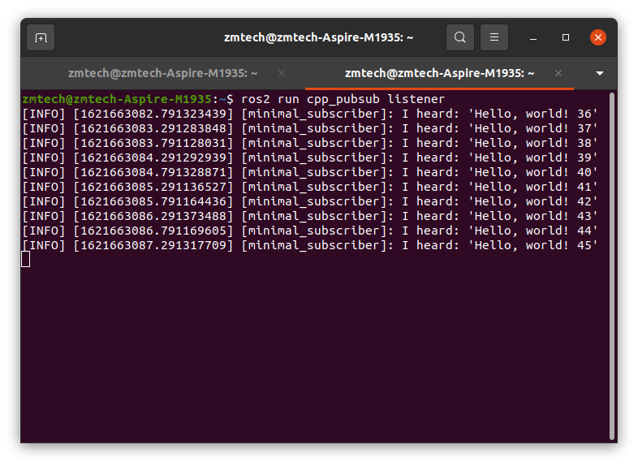
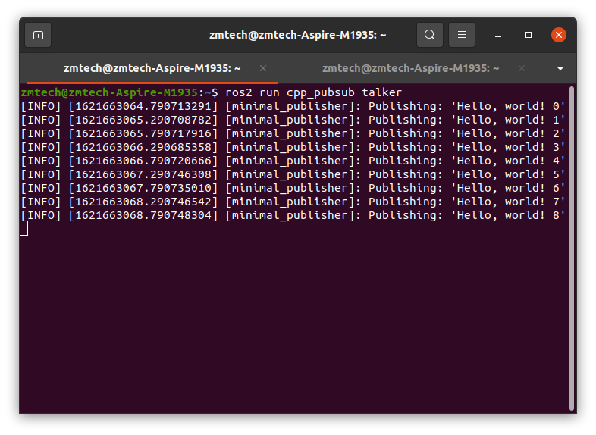
publisher and subscriber (C++)
Run talker and listener result.
talker
listener

Slide 12
publisher and subscriber (Python)
Command:
ros2 pkg create --build-type ament_python py_pubsub
Create a file publisher_member_function.py in ~/catkin_ws/src/cpp_pubsub/src
# import rclpy.node and std_msgs.msg.
import rclpy
from rclpy.node import Node
from std_msgs.msg import String
class MinimalPublisher(Node):
def __init__(self): #class MinimalPublisher main
super().__init__('minimal_publisher')
self.publisher_ = self.create_publisher(String, 'topic', 10)
timer_period = 0.5 # seconds
self.timer = self.create_timer(timer_period, self.timer_callback)
self.i = 0

Slide 13
publisher and subscriber (Python)
def timer_callback(self): # while loop publisher
msg = String()
msg.data = 'Hello World: %d' % self.i
self.publisher_.publish(msg)
self.get_logger().info('Publishing: "%s"' % msg.data)
self.i += 1
def main(args=None): # main
rclpy.init(args=args)
minimal_publisher = MinimalPublisher()
rclpy.spin(minimal_publisher)
minimal_publisher.destroy_node()
rclpy.shutdown()
if __name__ == '__main__': #Python int main()
main()

Slide 14
publisher and subscriber (Python)
Create a file subscriber_member_function.py in ~/catkin_ws/src/cpp_pubsub/src
# import rclpy.node and std_msgs.msg.
import rclpy
from rclpy.node import Node
from std_msgs.msg import String
class MinimalSubscriber(Node):
def __init__(self): #class MinimalSubscriber main
super().__init__('minimal_subscriber')
self.subscription = self.create_subscription(String, 'topic', self.listener_callback, 10)
self.subscription # prevent unused variable warning
def listener_callback(self, msg):
self.get_logger().info('I heard: "%s"' % msg.data)

Slide 15
publisher and subscriber (Python)
def main(args=None): # main
rclpy.init(args=args)
minimal_subscriber = MinimalSubscriber()
rclpy.spin(minimal_subscriber)
minimal_subscriber.destroy_node()
rclpy.shutdown()
if __name__ == '__main__': #Python int main()
main()
#Add talker and listener to entry_points in setup.py
entry_points={
'console_scripts': [
'talker = py_pubsub.publisher_member_function:main',
'listener = py_pubsub.subscriber_member_function:main',
],
},

Slide 16
publisher and subscriber (Python)
Command:
## run ros2 talker and listener
colcon build --packages-select py_pubsub # build py_pubsub
. install/setup.bash
ros2 run py_pubsub talker # run talker
ros2 run py_pubsub listener # run listener
Run talker and listener result.
talker
listener

Slide 17
service and client (C++)
When nodes communicate using services, the node that sends a request for data is called the client node, and the one that responds to the request is the service node. The structure of the request and response is determined by a .srv file.
Command:
ros2 pkg create --build-type ament_cmake cpp_srvcli
cd ~/dev_ws/src/cpp_srvcli
mkdir srv
cd srv
Create a Add_two_ints.srv file.
content：
int64 a
int64 b
---
int64 sum
cpp_srvcil build after finishing Add_two_ints.srv file.
Command:
colcon build --packages-select cpp_srvcli

Slide 18
service and client (C++)
Create a add_two_ints_server.cpp in ~/catkin_ws/src/cpp_pubsub/src
Content：
// include rclcpp and cpp_srvcli package
#include <rclcpp/rclcpp.hpp>
#include <cpp_srvcli/srv/add_two_ints.hpp>
#include <memory>
// cpp_srvcli service AddTwoInts function
void add(const std::shared_ptr<cpp_srvcli::srv::AddTwoInts::Request> request,
std::shared_ptr<cpp_srvcli::srv::AddTwoInts::Response> response)
{
response->sum = request->a + request->b;
RCLCPP_INFO(rclcpp::get_logger("rclcpp"), "Incoming request\na: %ld" " b: %ld",
request->a, request->b);
RCLCPP_INFO(rclcpp::get_logger("rclcpp"), "sending back response: [%ld]",
(long int)response->sum);
}

Slide 19
service and client (C++)
// int main function
int main(int argc, char **argv)
{
rclcpp::init(argc, argv);
std::shared_ptr<rclcpp::Node> node =
rclcpp::Node::make_shared("add_two_ints_server");
rclcpp::Service<cpp_srvcli::srv::AddTwoInts>::SharedPtr service =
node->create_service<cpp_srvcli::srv::AddTwoInts>("add_two_ints", &add);
RCLCPP_INFO(rclcpp::get_logger("rclcpp"), "Ready to add two ints.");
rclcpp::spin(node);
rclcpp::shutdown();
}

Slide 20
service and client (C++)
Create a add_two_ints_client.cpp in ~/catkin_ws/src/cpp_pubsub/src
Content：
//include rclcpp/rclcpp and cpp_srvcli/srv/add_two_ints
#include "rclcpp/rclcpp.hpp"
#include "cpp_srvcli/srv/add_two_ints.hpp"
#include <chrono>
#include <cstdlib>
#include <memory>
using namespace std::chrono_literals;
// int main function
int main(int argc, char **argv)
{
rclcpp::init(argc, argv);

Slide 21
service and client (C++)
if (argc != 3) {
RCLCPP_INFO(rclcpp::get_logger("rclcpp"), "usage: add_two_ints_client X Y");
return 1;
}
std::shared_ptr<rclcpp::Node> node = rclcpp::Node::make_shared("add_two_ints_client");
rclcpp::Client<cpp_srvcli::srv::AddTwoInts>::SharedPtr client =
node->create_client<cpp_srvcli::srv::AddTwoInts>("add_two_ints");
auto request = std::make_shared<cpp_srvcli::srv::AddTwoInts::Request>();
request->a = atoll(argv[1]);
request->b = atoll(argv[2]);

Slide 22
service and client (C++)
while (!client->wait_for_service(1s)) {
if (!rclcpp::ok()) {
RCLCPP_ERROR(rclcpp::get_logger("rclcpp"), "Interrupted while waiting for the service. Exiting.");
return 0;
}
RCLCPP_INFO(rclcpp::get_logger("rclcpp"), "service not available, waiting again...");
}
auto result = client->async_send_request(request);
// Wait for the result.
if (rclcpp::spin_until_future_complete(node, result) ==
rclcpp::FutureReturnCode::SUCCESS)
{
RCLCPP_INFO(rclcpp::get_logger("rclcpp"), "Sum: %ld", result.get()->sum);
} else {
RCLCPP_ERROR(rclcpp::get_logger("rclcpp"), "Failed to call service add_two_ints");
}

Slide 23
service and client (C++)
rclcpp::shutdown();
return 0;
}
CmakeList.txt：
find_package(cpp_srvcli REQUIRED)
find_package(rclcpp REQUIRED)
add_executable(server src/add_two_ints_server.cpp)
ament_target_dependencies(server rclcpp cpp_srvcli)
add_executable(client src/add_two_ints_client.cpp)
ament_target_dependencies(client rclcpp cpp_srvcli)
install(TARGETS server client DESTINATION lib/${PROJECT_NAME})
Package.xml：
<depend>rclcpp</depend>
<depend>cpp_srvcli</depend>

Slide 24
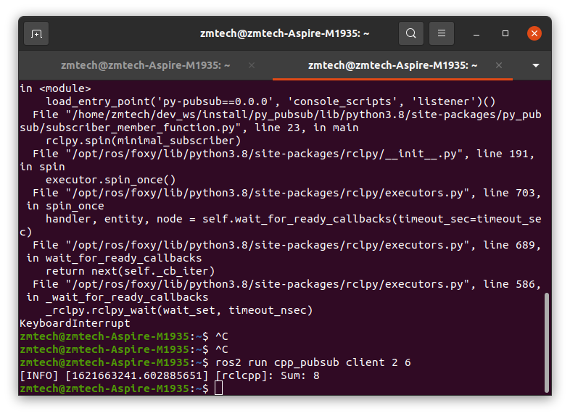
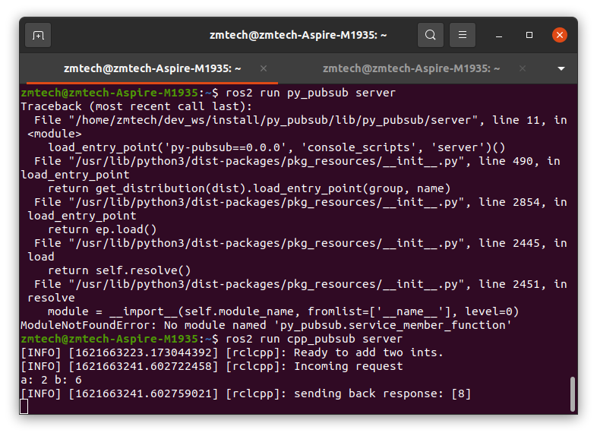
Run service and client (C++)
Command:
colcon build --packages-select cpp_srvcli
. install/setup.bash
ros2 run cpp_srvcli server
ros2 run cpp_srvcli client 2 3

Slide 25
service and client (Python)
Create a server_member_function.py in ~/catkin_ws/src/py_pubsub/py_pubsub
Content：
from cpp_srvcli.srv import AddTwoInts #import AddTwoInts
import rclpy #import rcly
from rclpy.node import Node #import Node
class MinimalService(Node):
def __init__(self):
super().__init__('minimal_service') # Node name
self.srv = self.create_service(AddTwoInts, 'add_two_ints',
self.add_two_ints_callback) //create ros2 service

Slide 26
service and client (Python)
def add_two_ints_callback(self, request, response): #service callback
response.sum = request.a + request.b
self.get_logger().info('Incoming request\na: %d b: %d' % (request.a, request.b))
return response
def main(args=None): #main function
rclpy.init(args=args)
minimal_service = MinimalService()
rclpy.spin(minimal_service)
rclpy.shutdown()
if __name__ == '__main__': #main
main()

Slide 27
service and client (Python)
Create a clientin ~/catkin_ws/src/py_pubsub/py_pubsub
Content：
import sys
from cpp_srvcli.srv import AddTwoInts
import rclpy
from rclpy.node import Node
class MinimalClientAsync(Node):
def __init__(self):
super().__init__('minimal_client_async')
self.cli = self.create_client(AddTwoInts, 'add_two_ints')
while not self.cli.wait_for_service(timeout_sec=1.0):
self.get_logger().info('service not available, waiting again...')
self.req = AddTwoInts.Request()

Slide 28
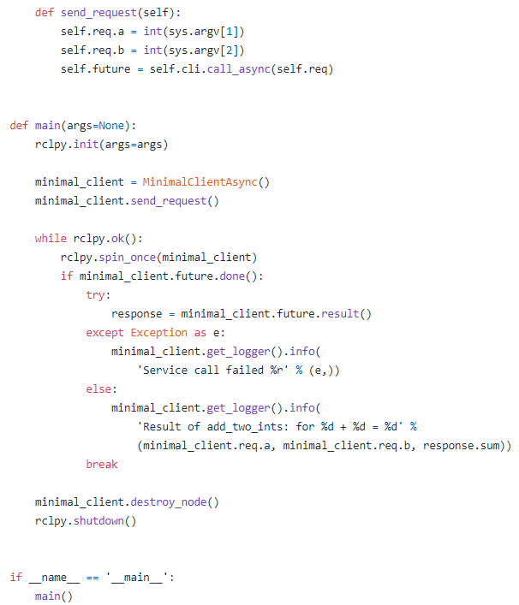
service and client (Python)

Slide 29
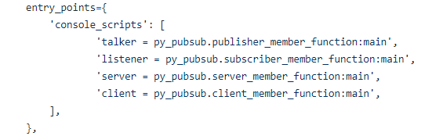
service and client (Python)
open a ~/catkin_ws/src/py_pubsub/setup.py

Slide 30
Using parameters in a class c++
When making your own nodes you will sometimes need to add parameters that can be set from the launch file.
This tutorial will show you how to create those parameters in a C++ class, and how to set them in a launch file
Command：
ros2 pkg create --build-type ament_cmake cpp_parameters --dependencies rclcpp
Create a ~/dev_ws/src/cpp_parameters/src/cpp_parameters_node.cpp
// ~/dev_ws/src/cpp_parameters/src/cpp_parameters_node.cpp
#include <rclcpp/rclcpp.hpp> //ros2 cpp lib
#include <chrono>
#include <string>
#include <functional>

Slide 31
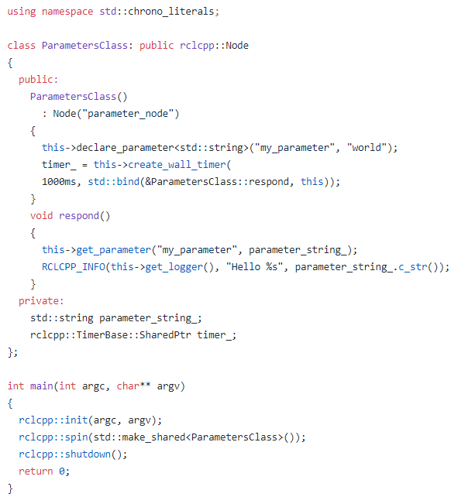
Using parameters in a class c++

Slide 32
Using parameters in a class c++
Create a ~/dev_ws/src/cpp_parameters/launch/cpp_parameters_launch.py
from launch import LaunchDescription
from launch_ros.actions import Node
def generate_launch_description():
return LaunchDescription([
Node(
package="cpp_parameters",
executable="parameter_node",
name="custom_parameter_node",
output="screen",
emulate_tty=True,
parameters= {"my_parameter": "earth"}]
)
])

Slide 33
Using parameters in a class c++
Open ~/dev_ws/src/cpp_parameters/CMakeLists.txt
if(BUILD_TESTING)
find_package(ament_lint_auto REQUIRED)
ament_lint_auto_find_test_dependencies()
endif()
# ------Add ------
add_executable(parameter_node src/cpp_parameters_node.cpp)
ament_target_dependencies(parameter_node rclcpp)
install(TARGETS
parameter_node
DESTINATION lib/${PROJECT_NAME}
)
install(
DIRECTORY launch
DESTINATION share/${PROJECT_NAME}
)

Slide 34
Run parameters in a class c++
Command：
colcon build --packages-select cpp_parameters
. install/setup.bash
ros2 launch cpp_parameters cpp_parameters_launch.py

Slide 35
Using parameters in a class py
Command：
ros2 pkg create --build-type ament_python python_parameters --dependencies rclpy
Create a ~/dev_ws/src/python_parameters/python_parameters/python_parameters_node.py
import rclpy
import rclpy.node
from rclpy.exceptions import ParameterNotDeclaredException
from rcl_interfaces.msg import ParameterType
class MinimalParam(rclpy.node.Node):
def __init__(self):
super().__init__('minimal_param_node')
timer_period = 2 # seconds
self.timer = self.create_timer(timer_period, self.timer_callback)
self.declare_parameter('my_parameter', 'world')

Slide 36
Using parameters in a class py
def timer_callback(self):
my_param = self.get_parameter('my_parameter').get_parameter_value().string_value
self.get_logger().info('Hello %s!' % my_param)
my_new_param = rclpy.parameter.Parameter(
'my_parameter',
rclpy.Parameter.Type.STRING, 'world')
all_new_parameters = [my_new_param]
self.set_parameters(all_new_parameters)
def main():
rclpy.init()
node = MinimalParam()
rclpy.spin(node)
if __name__ == '__main__':
main()

Slide 37
Using parameters in a class py
open a ~/catkin_ws/src/python_parameters/setup.py
entry_points={
'console_scripts': [
##### Add… #####
'param_talker = python_parameters.python_parameters_node:main',
],
},
create a ~/catkin_ws/src/python_parameters/launch/python_parameters_launch.py
from launch import LaunchDescription
from launch_ros.actions import Node
def generate_launch_description():
return LaunchDescription([ Node(package='python_parameters',
executable=‘param_talker’, name='custom_parameter_node',
output=‘screen’, emulate_tty=True,

Slide 38
Using parameters in a class py
parameters=[
{'my_parameter': 'earth'}
]
)
])
Build python_parameters Command：
colcon build --packages-select python_parameters
. install/setup.bash
ros2 launch python_parameters cpp_parameters_launch.py

Slide 39
Create an action
You learned about actions previously in the Understanding ROS 2 actions tutorial. Like the other communication types and their respective interfaces (topics/msg and services/srv), you can also custom-define actions in your packages. This tutorial shows you how to define and build an action that you can use with the action server and action client you will write in the next tutorial.
create a ~/catkin_ws/src/cpp_srvcli/action/Fibonacci.action
Content：
-------------------------------------------------------------------------
int32 order
---
int32[] sequence
---
int32[] partial_sequence

Slide 40
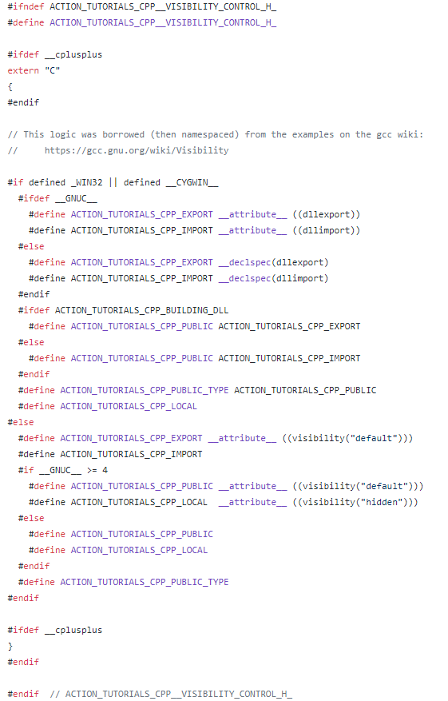
Writing an action server and client (C++)
Command：
cd ~/dev_ws/src
ros2 pkg create --dependencies cpp_srvcli rclcpp rclcpp_action rclcpp_components -- action_tutorials_cpp
Create a /action_tutorials_cpp/include/action_tutorials_cpp/visibility_control.h

Slide 41
Writing an action server and client (C++)

Slide 42
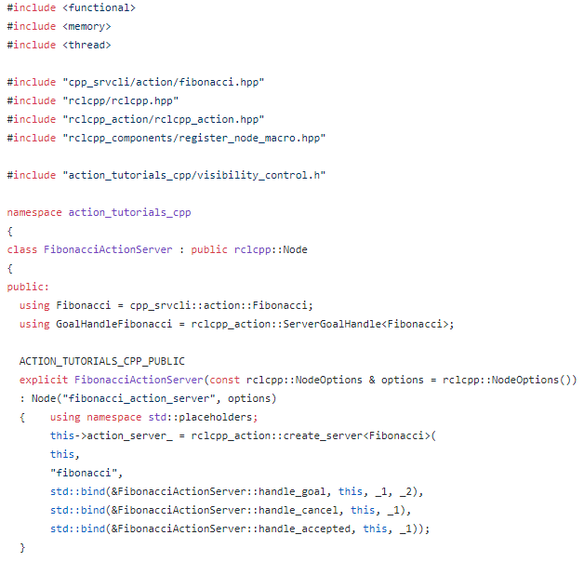
Writing an action server and client (C++)
Create a dev_ws/src/action_tutorials_cpp/src/fibonacci_action_server.cpp

Slide 43
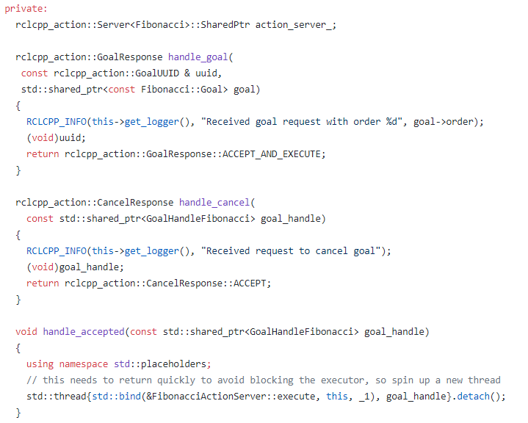
Writing an action server and client (C++)

Slide 44
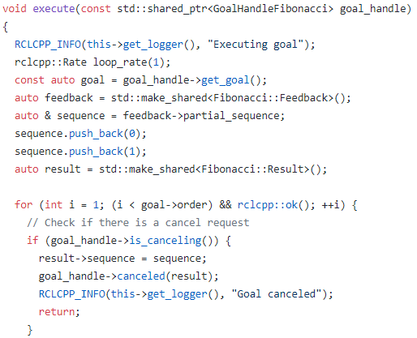
Writing an action server and client (C++)

Slide 45
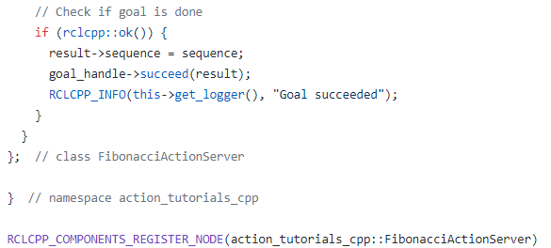
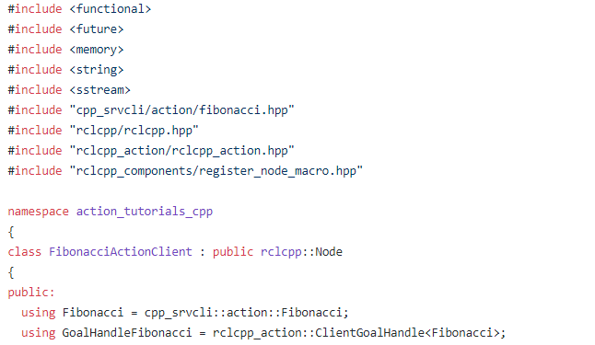
Writing an action server and client (C++)
Create a dev_ws/src/action_tutorials_cpp/src/fibonacci_action_client.cpp

Slide 46
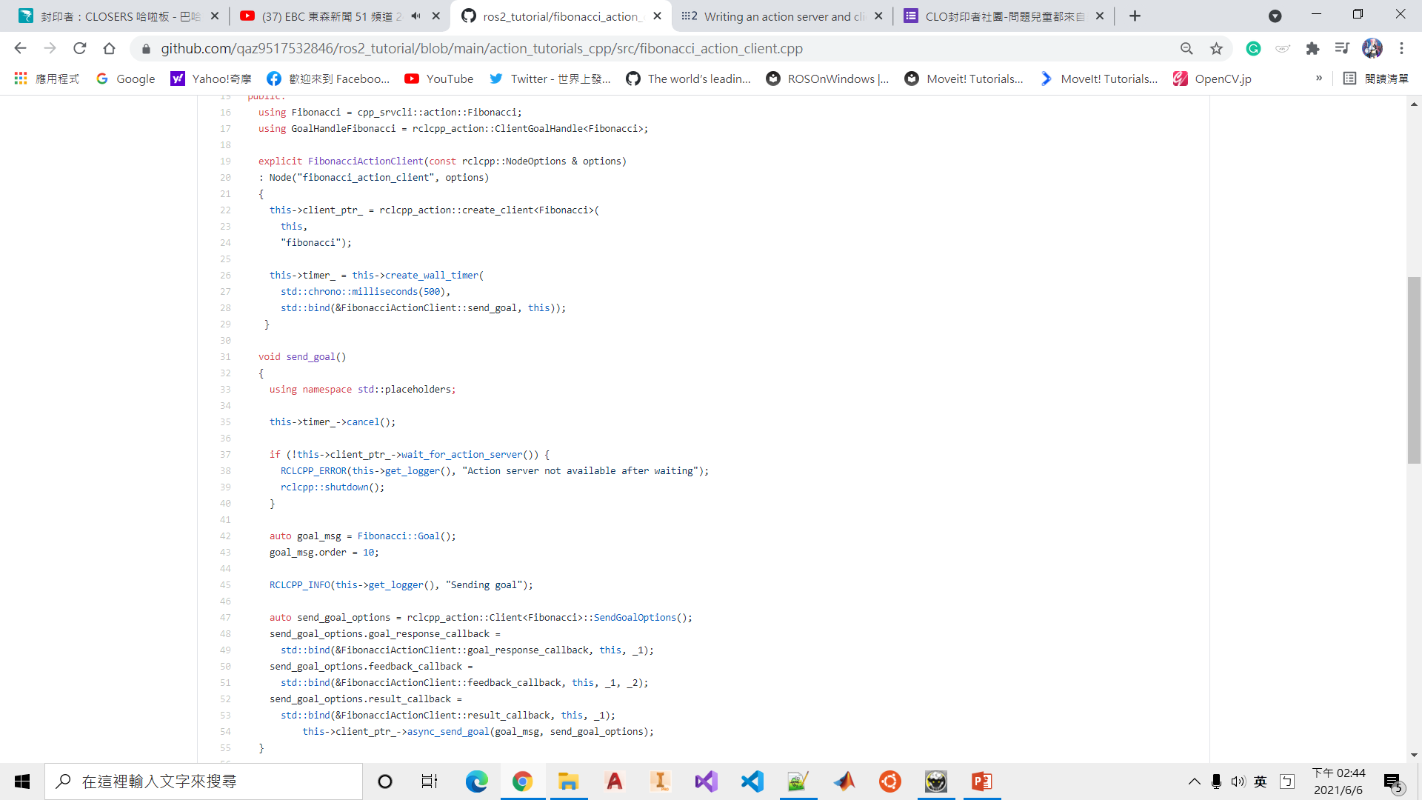
Writing an action server and client (C++)

Slide 47
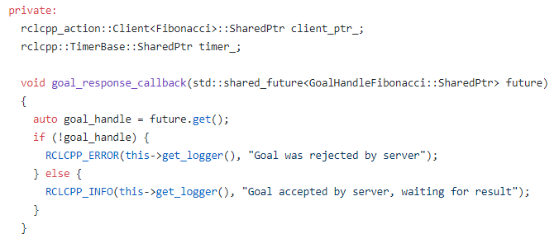
Writing an action server and client (C++)

Slide 48
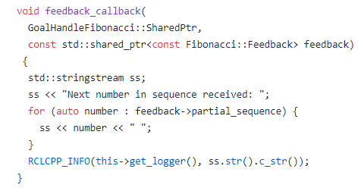
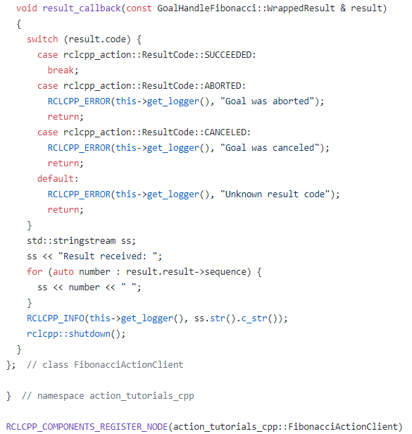
Writing an action server and client (C++)

Slide 49
Writing an action server and client (C++)
if(NOT CMAKE_C_STANDARD)
set(CMAKE_C_STANDARD 99)
endif()
if(NOT CMAKE_CXX_STANDARD)
set(CMAKE_CXX_STANDARD 14)
endif()
Create CMakeList.txt file in action_tutorials_cpp.
cmake_minimum_required(VERSION 3.5)
project(action_tutorials_cpp)
if(CMAKE_COMPILER_IS_GNUCXX OR CMAKE_CXX_COMPILER_ID MATCHES "Clang")
add_compile_options(-Wall -Wextra -Wpedantic)
endif()
find_package(ament_cmake REQUIRED)
find_package(cpp_srvcli REQUIRED)
find_package(rclcpp REQUIRED)
find_package(rclcpp_action REQUIRED)
find_package(rclcpp_components REQUIRED)

Slide 50
Writing an action server and client (C++)
if(BUILD_TESTING)
find_package(ament_lint_auto REQUIRED)
ament_lint_auto_find_test_dependencies()
endif()
add_library(action_server SHARED
src/fibonacci_action_server.cpp)
target_include_directories(action_server PRIVATE
$<BUILD_INTERFACE:${CMAKE_CURRENT_SOURCE_DIR}/include>
$<INSTALL_INTERFACE:include>)
target_compile_definitions(action_server
PRIVATE "ACTION_TUTORIALS_CPP_BUILDING_DLL")

Slide 51
Writing an action server and client (C++)
ament_target_dependencies(action_server "cpp_srvcli" "rclcpp“ "rclcpp_action"
"rclcpp_components")
rclcpp_components_register_node(action_server PLUGIN "action_tutorials_cpp::FibonacciActionServer" EXECUTABLE fibonacci_action_server)
add_library(action_client SHARED
src/fibonacci_action_client.cpp)
target_include_directories(action_client PRIVATE
$<BUILD_INTERFACE:${CMAKE_CURRENT_SOURCE_DIR}/include>
$<INSTALL_INTERFACE:include>)
target_compile_definitions(action_client
PRIVATE "ACTION_TUTORIALS_CPP_BUILDING_DLL")

Slide 52
Writing an action server and client (C++)
ament_target_dependencies(action_client "cpp_srvcli“ "rclcpp“ "rclcpp_action"
"rclcpp_components")
rclcpp_components_register_node(action_client PLUGIN "action_tutorials_cpp::FibonacciActionClient" EXECUTABLE fibonacci_action_client)
install(TARGETS action_server action_client
ARCHIVE DESTINATION lib
LIBRARY DESTINATION lib
RUNTIME DESTINATION bin)
ament_package()

Slide 53
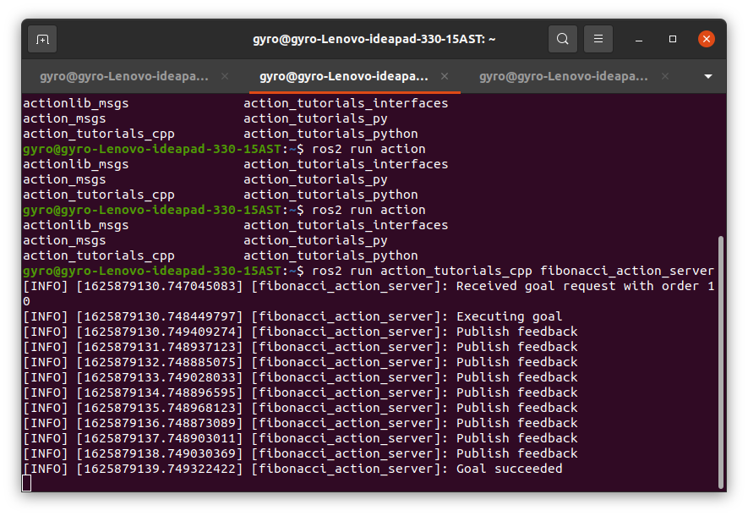
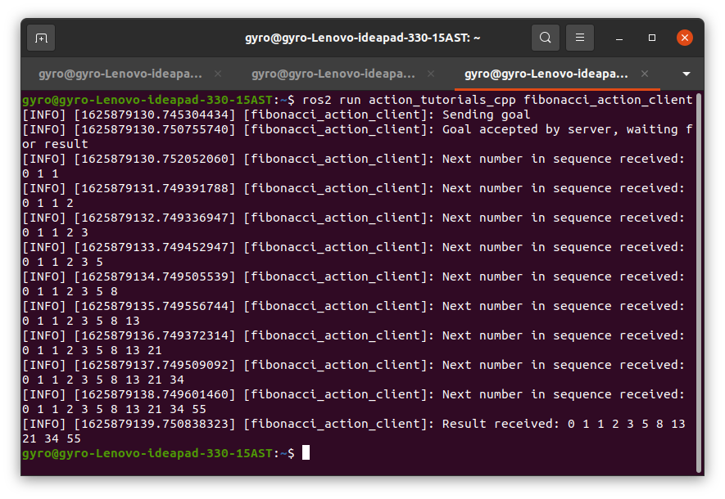
Writing an action server and client (C++)
Run action_tutorials_cpp
Command：
colcon build
ros2 run action_tutorials_cpp fibonacci_action_server
ros2 run action_tutorials_cpp fibonacci_action_client

Slide 54
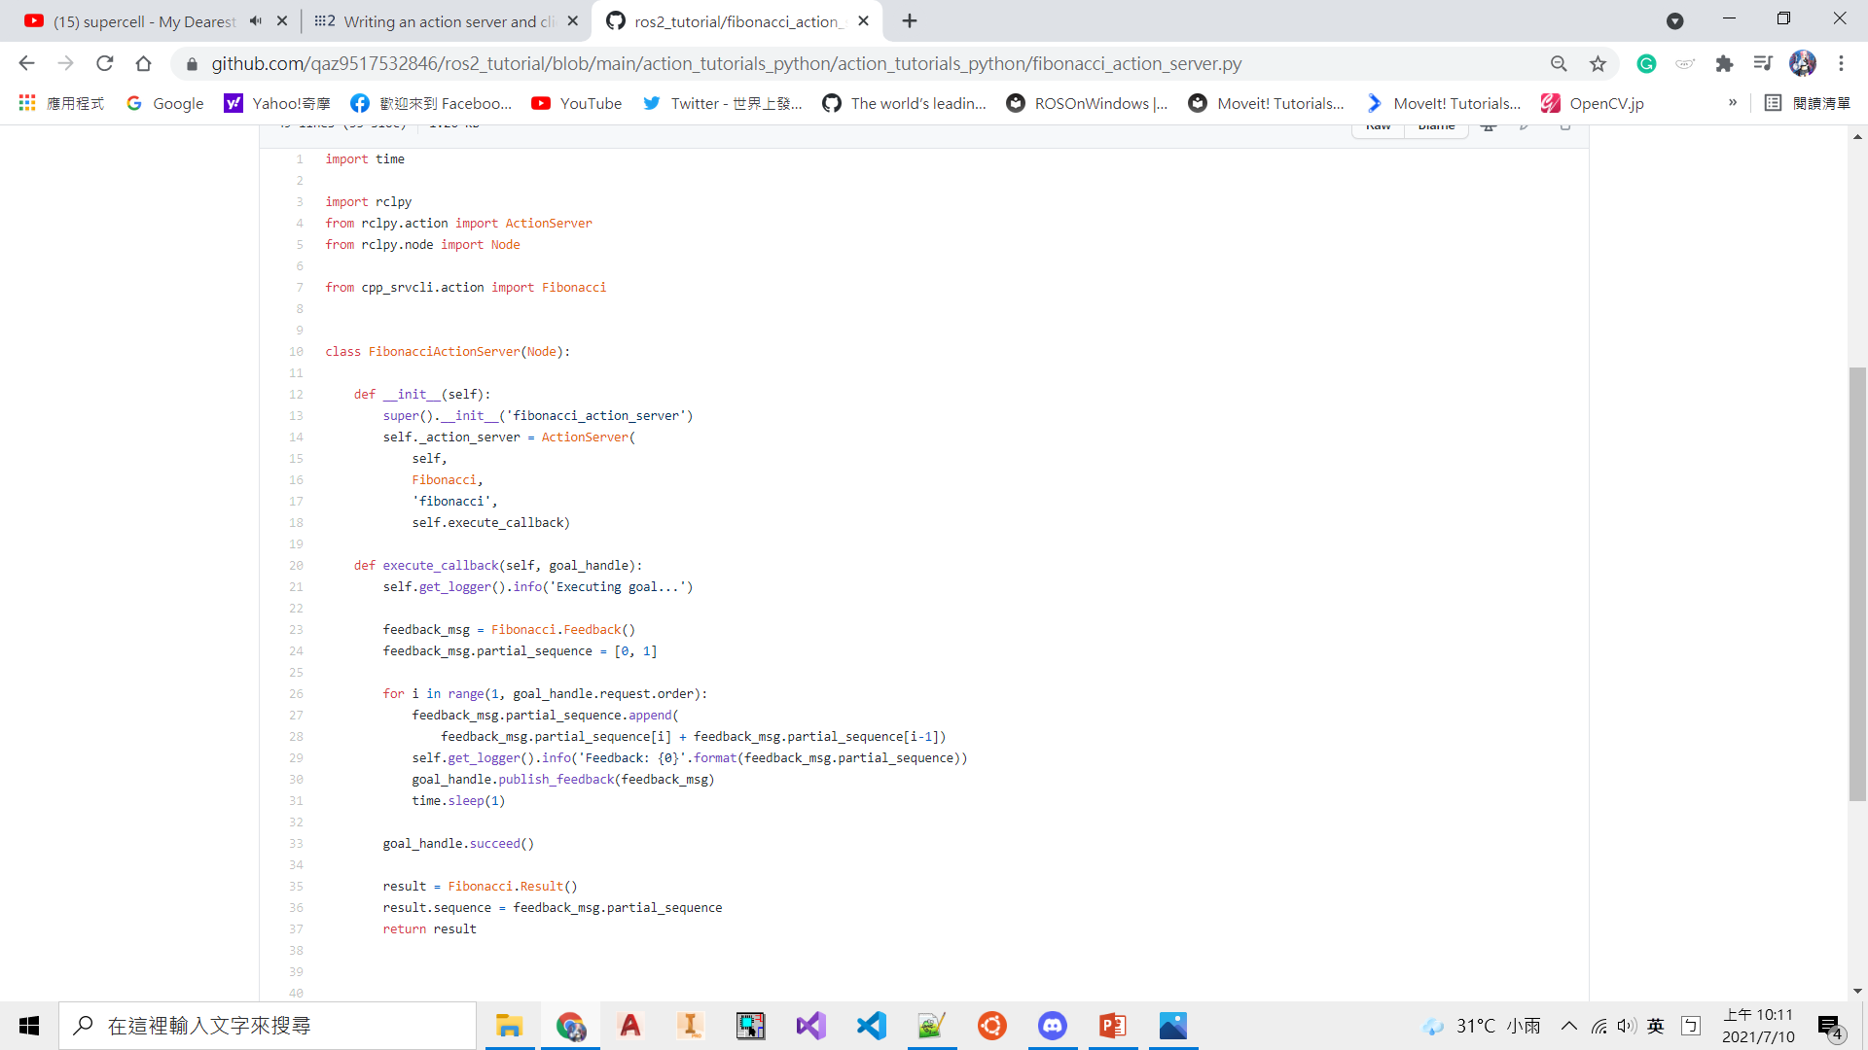
Writing an action server and client (Python)
Command：
cd ~/dev_ws/src
ros2 pkg create --dependencies cpp_srvcli ament_python -- action_tutorials_cpp
Create a fibonacci_action_server.py in a
~/dev_ws/src/action_tutorials_python/action_tutorials_python
-------------------------------------------------------------------------------------------------

Slide 55
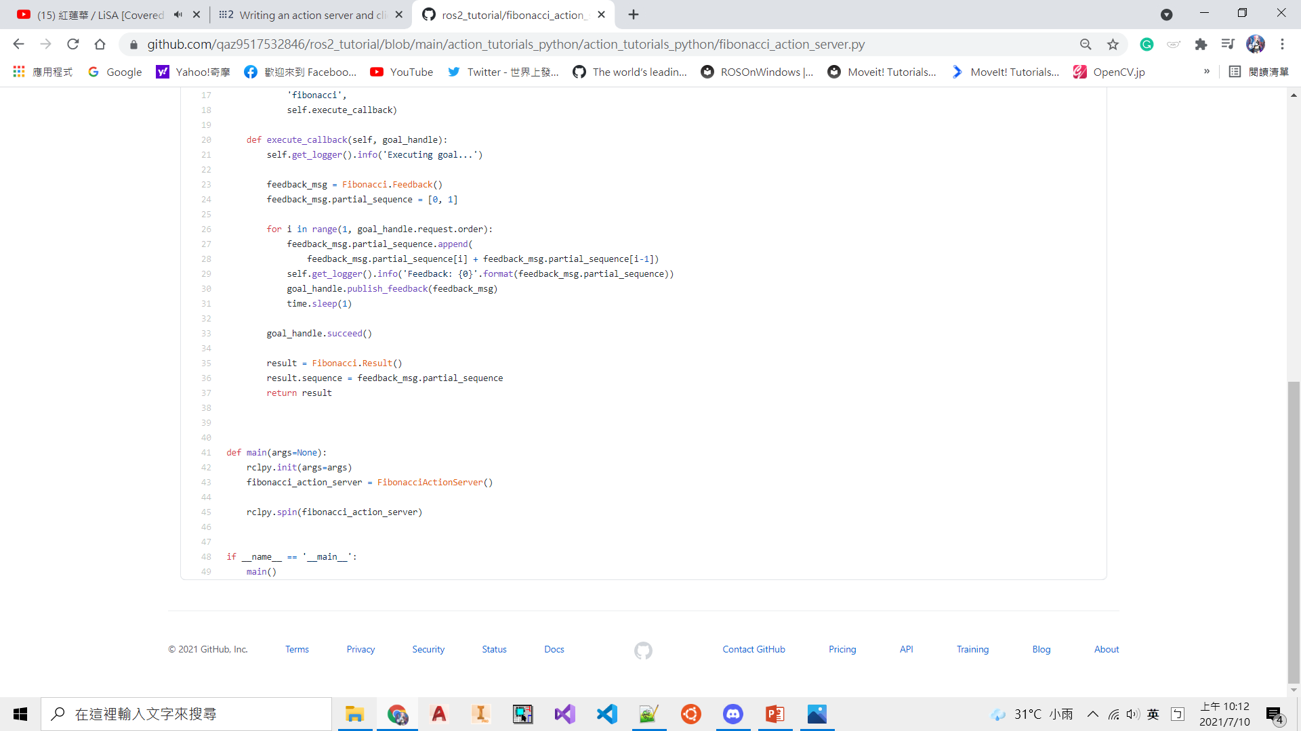
Writing an action server and client (Python)

Slide 56
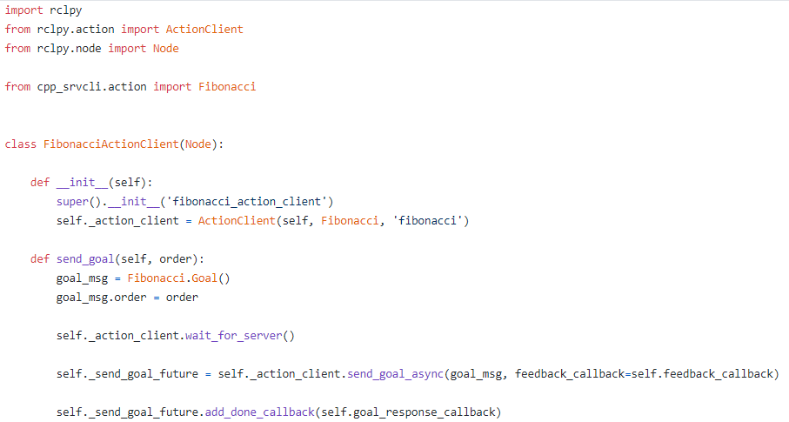
Writing an action server and client (Python)
Create a fibonacci_action_server.py in a
~/dev_ws/src/action_tutorials_python/action_tutorials_python

Slide 57
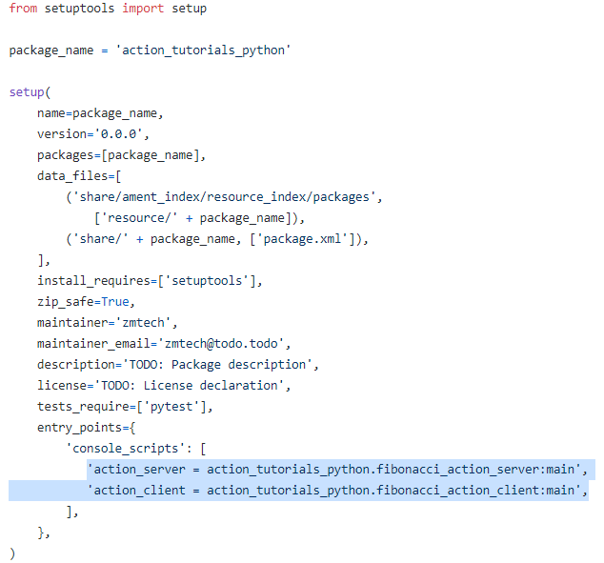
Writing an action server and client (Python)
Edit package a action_tutorials_python/setup.py

Slide 58
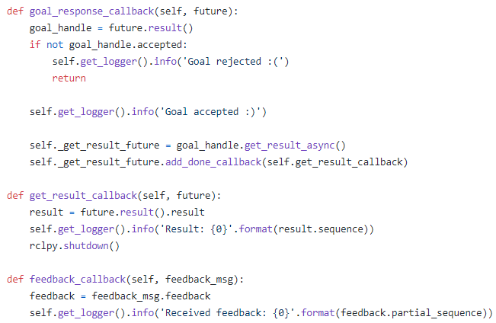
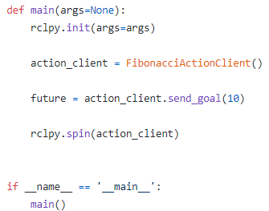
Writing an action server and client (Python)

Slide 59
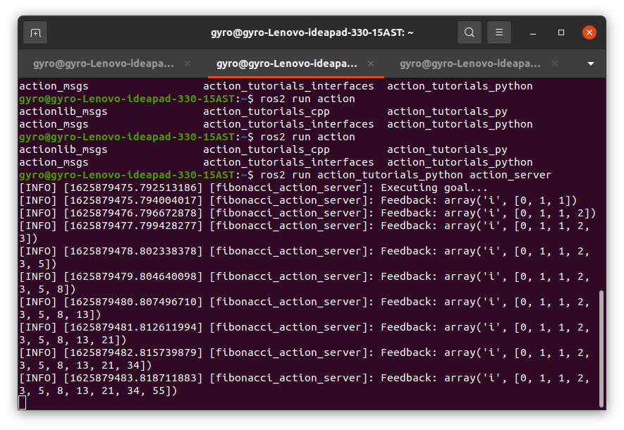
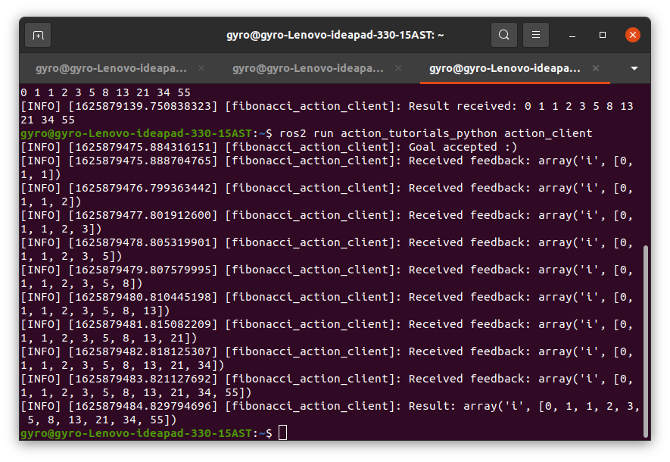
Writing an action server and client (Python)
Run action_tutorials_python
Command：
colcon build
ros2 run action_tutorials_python action_server
ros2 run action_tutorials_python action_client

Slide 60
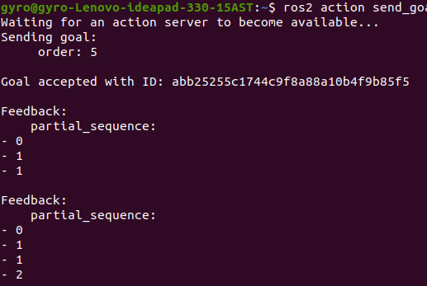
Check action feedback message
Command：
colcon build
ros2 action send_goal --feedback fibonacci cpp_srvcli/action/Fibonacci
"{order: 5}“

