Slide 1
ROS2 Tutorial
Date：2021.05.25
OS: Ubuntu 20.04 L.T.S
Version: Foxy
Author: Z.M. Zhang

Slide 2
ROS2 Installation
Command:
# set locale
locale # check for UTF-8
sudo apt update && sudo apt install locales
sudo locale-gen en_US en_US.UTF-8
sudo update-locale LC_ALL=en_US.UTF-8 LANG=en_US.UTF-8
export LANG=en_US.UTF-8
locale # verify settings
# setup Source
sudo apt update && sudo apt install curl gnupg2 lsb-release
sudo curl -sSL https://raw.githubusercontent.com/ros/rosdistro/master/ros.key -o
/usr/share/keyrings/ros-archive-keyring.gpg

Slide 3
ROS2 Installation
Command:
# Install ROS2 package
sudo apt-get update
sudo apt install ros-foxy-desktop
sudo apt install -y python3-argcomplete # optional
# Environment setup
echo “source /opt/ros/foxy/setup.bash” >> ~/.bashrc
# finished ROS2 foxy Installation.

Slide 4
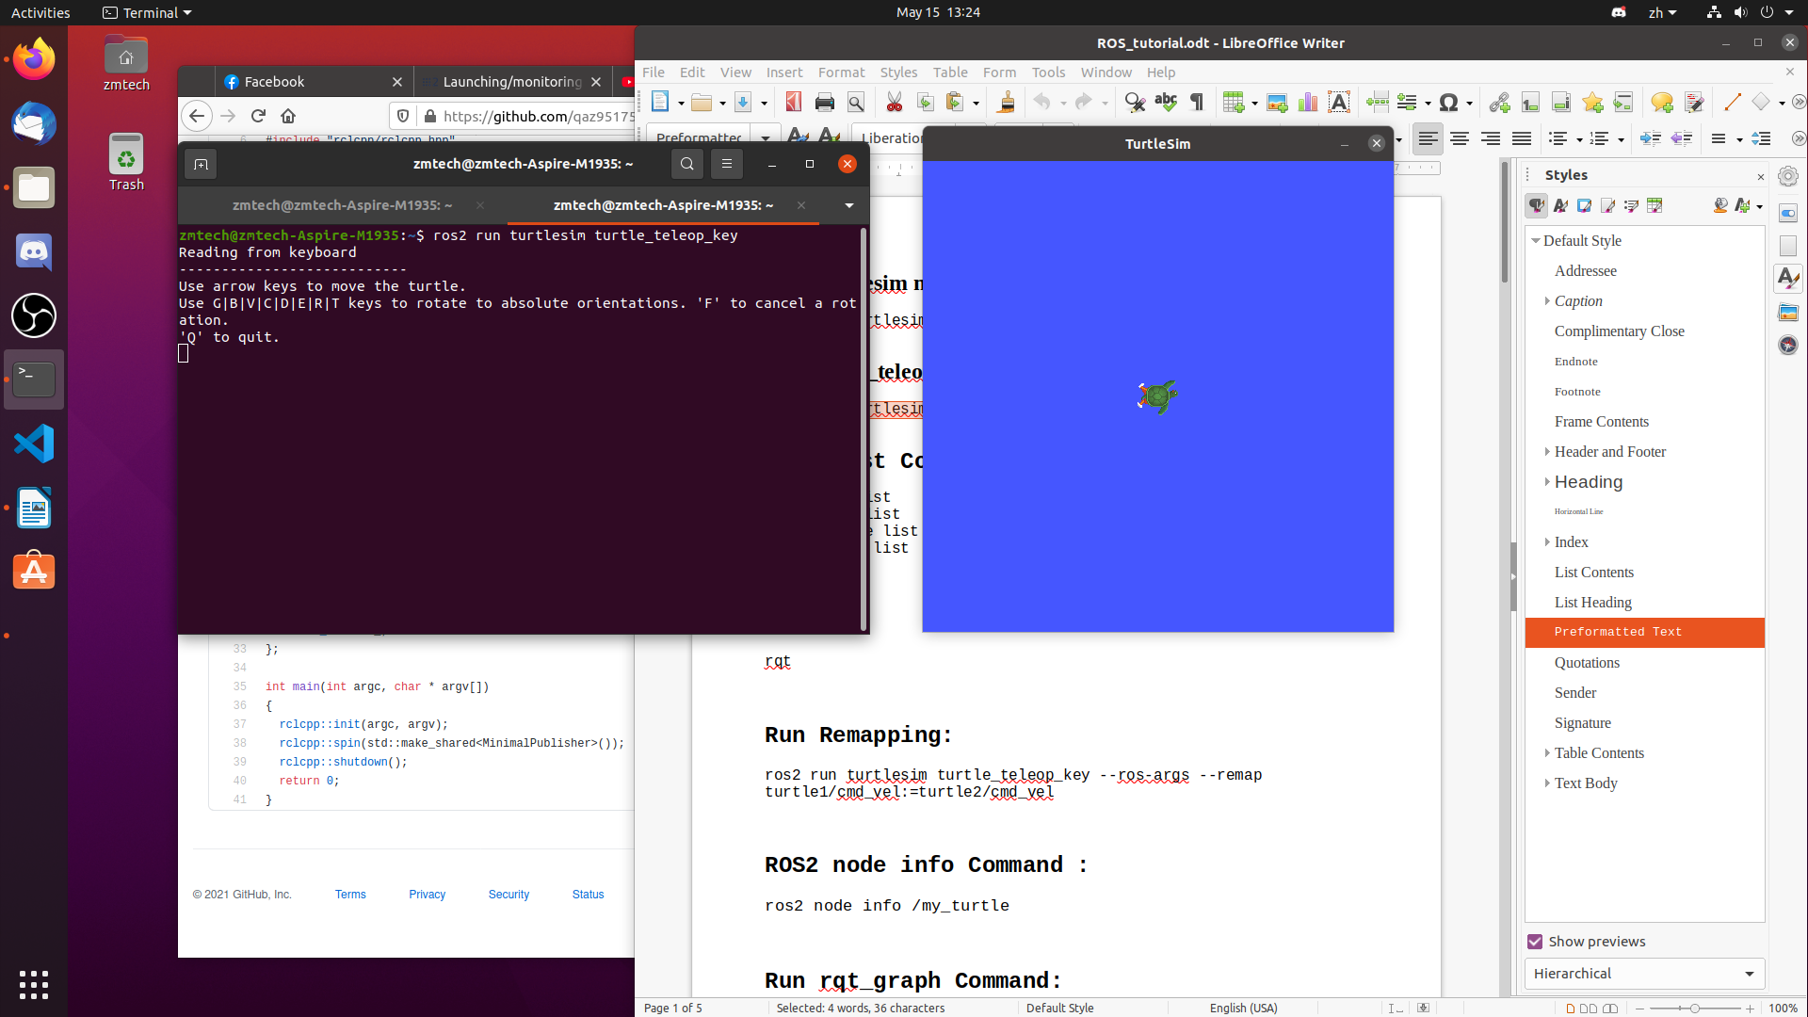
ROS2 turtlesim_node
Connamd：
# Open two terminal.
# Start turtlesim node
ros2 run turtlesim turtlesim_node
# Run turtle_teleop_key
ros2 run turtlesim turtle_teleop_key
turtlesim_node
Terminal

Slide 5
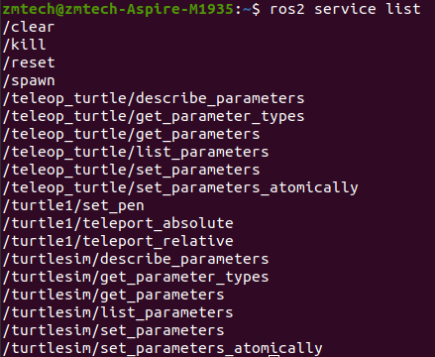
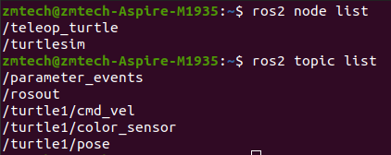
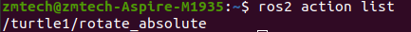
ROS2 Simple Command
Command:
ros2 node list # running node show under ROS2.
ros2 topic list # running topic show under ROS2.
ros2 service list # running service show under ROS2.
ros2 action list # running action show under ROS2.

Slide 6
ROS2 node Command
ros2 node list will show you the names of all running nodes. This is especially useful when you want to interact with a node, or when you have a system running many nodes and need to keep track of them.
Node Remapping:
ros2 run turtlesim turtlesim_node --ros-args --remap __node:=my_turtle
Node info:
ros2 node info <node_name>
ros2 node info /my_turtle

Slide 7
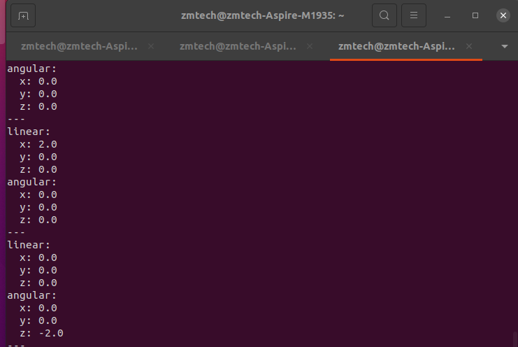
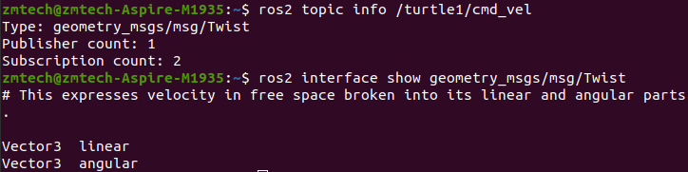
ROS2 topic Command
Running the ros2 topic list command in a new terminal will return a list of all the topics currently active in the system.
ROS2 topic echo Command:
ros2 topic echo <topic_name>
ros2 topic echo /turtle1/cmd_vel
ROS2 topic info Command:
ros2 topic info <topic_name>
ros2 topic info /turtle1/cmd_vel
ROS2 interface show Command:
ros2 interface show geometry_msgs/msg/Twist
Topic echo
Topic info and interface show

Slide 8
ROS2 topic Command
ROS2 topic publish Command:
ros2 topic pub <topic_name> <msg_type> '<args>'
ros2 topic pub --once /turtle1/cmd_vel geometry_msgs/msg/Twist
"{linear: {x: 2.0, y: 0.0, z: 0.0}, angular: {x: 0.0, y: 0.0, z: 1.8}}"
ros2 topic pub --rate 1 /turtle1/cmd_vel geometry_msgs/msg/Twist
"{linear: {x: 2.0, y: 0.0, z: 0.0}, angular: {x: 0.0, y: 0.0, z: 1.8}}"
ROS2 topic frequency Command:
ros2 topic hz <topic_name>
ros2 topic hz /turtle1/pose

Slide 9
ROS2 service topic
Some concepts mentioned in this tutorial, like nodes and topics, were covered in previous tutorials in the series.
ROS2 service type Command:
ros2 service type <service_name>
ros2 service type /clear
ROS2 service find Command:
ros2 topic info <type_name>
ros2 service find std_srvs/srv/Empty
ROS2 interface show Command:
ros2 interface show <type_name>.srv

Slide 10
ROS2 service topic
ROS2 service call Command:
ros2 service call <service_name> <service_type> <arguments>
ros2 service call /clear std_srvs/srv/Empty
ros2 service call /spawn turtlesim/srv/Spawn "{x: 2, y: 2, theta: 0.2,
name: ''}"

Slide 11
ROS2 parameter
A parameter is a configuration value of a node. You can think of parameters as node settings. A node can store parameters as integers, floats, booleans, strings and lists. In ROS 2, each node maintains its own parameters. All parameters are dynamically reconfigurable, and built off of ROS 2 services.
Paramter set Command:
ros2 param set /turtlesim background_r 150
Paramter dump Command:
ros2 param dump /turtlesim
Load Parameter to /turtlesim node.
ros2 run turtlesim turtlesim_node --ros-args --params-file ./turtlesim.yaml

Slide 12
ROS2 action
Actions are one of the communication types in ROS 2 and are intended for long running tasks. They consist of three parts: a goal, feedback, and a result.
ROS2 action list Command:
ros2 action list
ros2 action list –t
ROS2 action info Command:
ros2 action info /turtle1/rotate_absolute
ROS2 action interface show Command:
ros2 interface show turtlesim/action/RotateAbsolute

Slide 13
ROS2 action
ROS2 action send goal Command:
ros2 action send_goal <action_name> <action_type> <values>
ros2 action send_goal /turtle1/rotate_absolute turtlesim/action/RotateAbsolute "{theta: 1.57}"
ros2 action send_goal /turtle1/rotate_absolute turtlesim/action/RotateAbsolute "{theta: -1.57}" --feedback

Slide 14
ROS2 Launch
Step1. mkdir launch # create launch directory.
Step2. touch launch/turtlesim_mimic_launch.py # create python file.
### ROS2 Launch format
from launch import LaunchDescription from launch_ros.actions import Node
def generate_launch_description(): return LaunchDescription([
Node(package='turtlesim', namespace='turtlesim1', executable='turtlesim_node', name='sim'), ])

Slide 15
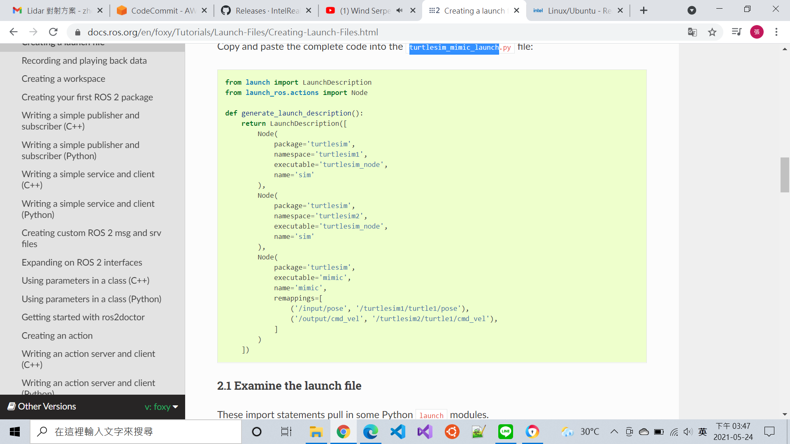
turtlesim_mimic_launch.py

Slide 16
Run ROS2 Launch
Command:
cd launch ros2 launch turtlesim_mimic_launch.py
It is possible to launch a launch file directly (as we do above), or provided by a package. When it is provided by a package, the syntax is:
ros2 launch <package_name> <launch_file_name> #run ros2 launch command

Slide 17
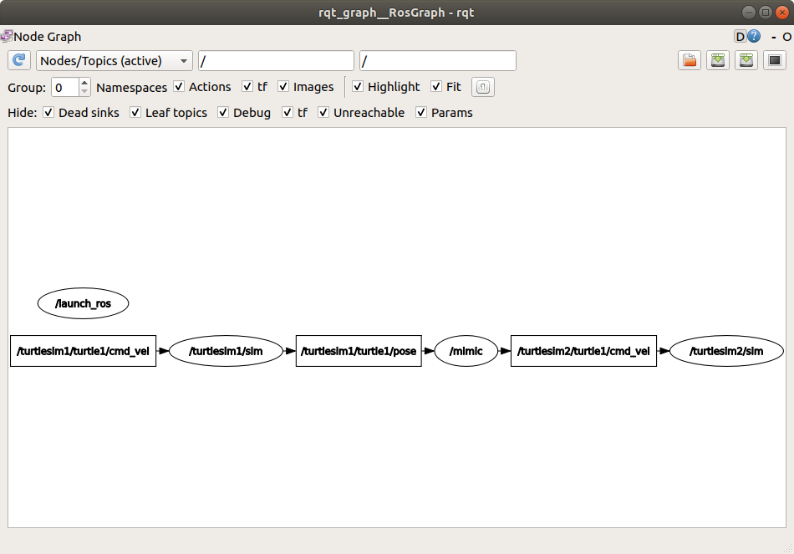
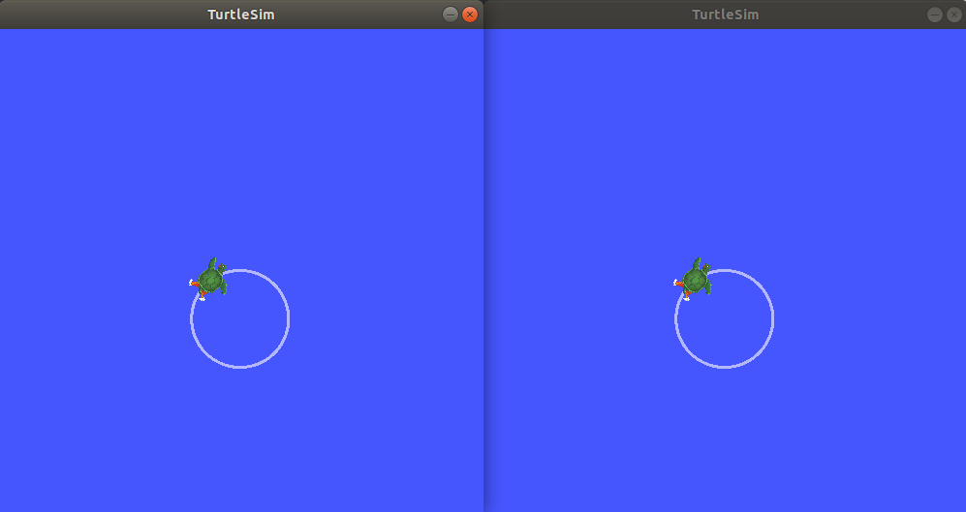
topic pub and rqt_graph
Command:
ros2 topic publish command
ros2 topic pub -r 1 /turtlesim1/turtle1/cmd_vel geometry_msgs/msg/Twist "{linear: {x: 2.0, y: 0.0, z: 0.0}, angular: {x: 0.0, y: 0.0, z: -1.8}}“
rqt_graph # run rqt_graph
Ros2 topic publish
rqt_graph

Slide 18
ROS2 bag
ros2 bag is a command line tool for recording data published on topics in your system. It accumulates the data passed on any number of topics and saves it in a database.
ros2 bag Installation:
sudo apt-get install ros-foxy-ros2bag \
ros-foxy-rosbag2-converter-default-plugins \
ros-foxy-rosbag2-storage-default-plugins
ros2 bag record (one topic)：
ros2 bag record <topic_name> (ex.ros2 bag record /turtle1/cmd_vel)
ros2 bag record (multiple topics)：
ros2 bag record -o subset <topic_name> <topic_name>
ros2 bag file info： ros2 bag info <bag_file_name>
ros2 bag file play： ros2 bag play <bag_file_name>

