Slide 1
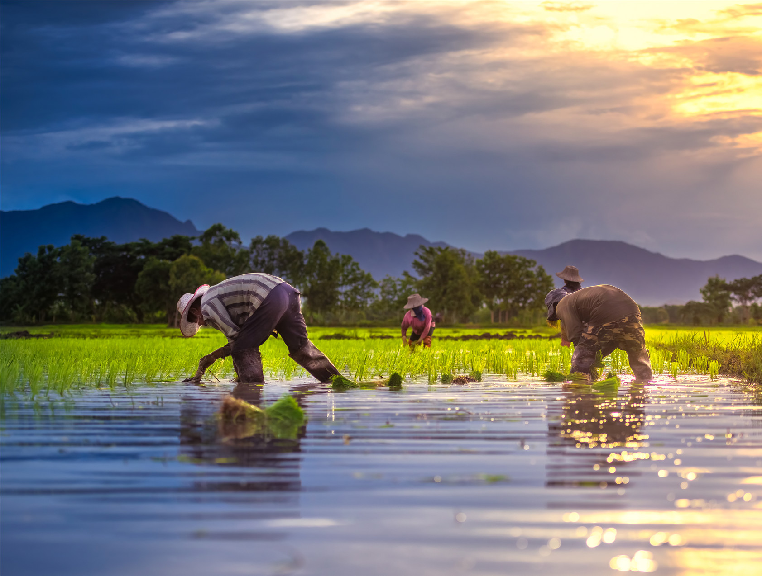





Unit 2 A
Message of the Land

Slide 2



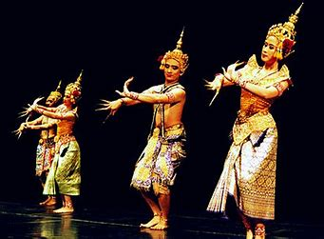
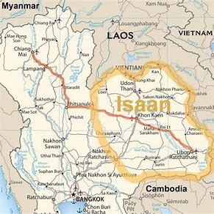
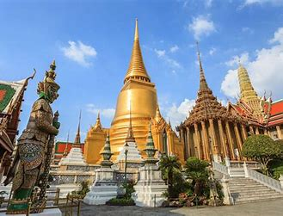
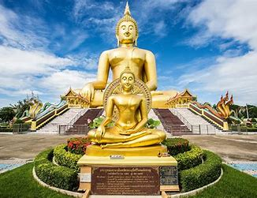
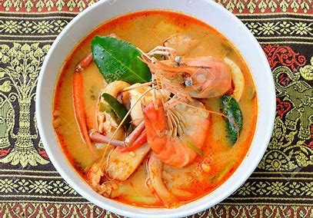
Lead-in
Thailand
Southeast Asia
Buddhism
tourism

Slide 3
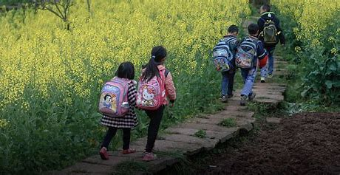
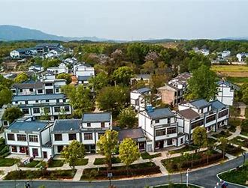
Lead-in
Warming-up questions
What changes have happened in the Chinese countryside in recent years? How do you feel about the changes?
fewer young farmers (urbanization城市化, rural-urban migration)
left behind children and elderly
old customs fading away
newly-built roads and houses
less impoverished rural residents
4G or 5G network

Slide 4

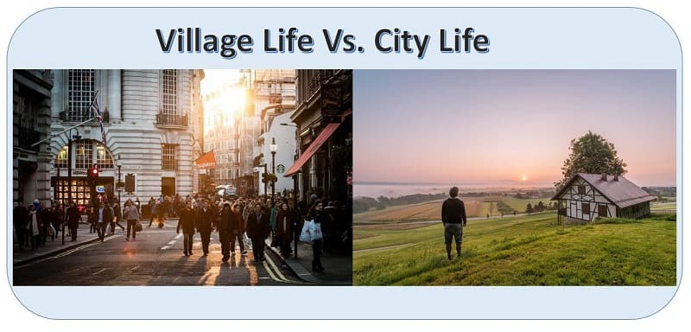
主观题
20分
If you could choose, would you like to live in a village or in a big city in future? Please give a brief reason. (No more than 15 words)
作答

Slide 5

Text Analysis
My husband moved into our house, as is the way with us in Esarn.
(When we got married) my husband came to live in our house. It was the tradition here in Esarn that the bridegroom should come to live with the bride’s family. 按照我们伊萨的习俗……
1. As is the case with many men, he seems to be having a midlife crisis.
他好像正处于中年危机之中，不少男人都有这样的经历。
2. 从他的口音就能明显听出来，他是个外国人。
He is a foreigner, as _________________________
is evident from his accent.

Slide 6
单选题
15分
What does the sentence mean?
He has ears which don’t hear, a mouth which doesn’t speak, and eyes that don’t see. (para. 2)
A
He is a bit deaf, dumb and blind.
B
He’s unsatisfied with their children for seldom coming back home.
C
Their children’s hardships don’t seem to bother him.
提交

Slide 7
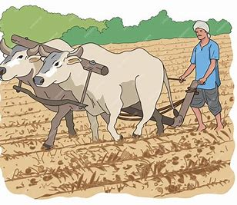
Text Analysis
... but in a bad year, it’s not only the ploughs that break, but our hearts, too.
... but when there is a drought, the soil is so hard that the ploughs break. And we become very sad.
Figure of speech: Zeugma 轭式搭配（一个词以不同的词义同时与两个词搭配使用，其中一个为自然搭配，另一个为比喻或牵强搭配）
1. He lost his money and his temper.
2. A young widow and a fortune fell in love with him.
3. "Yes, my teeth and ambitions are bared." ("The Lion King")
4. He's got a one-hand feel on the steering wheel/ The other on my heart. ("Our Song" by Taylor Swift)

Slide 8
填空题
15分
What do the underlined words mean? Choose the correct answer from A, B, C, D, or E.
a. 春天 b.弹簧 c. 泉 d. 跳跃 e. 涌现
1. New buildings are springing up everywhere. [填空1]
2. The deer were drinking from a spring [填空2], not knowing that there was a tiger hiding in the nearby bushes, and in one spring [填空3] it would be on one of them.
作答

Slide 9
填空题
20分
What changes in the village does the wife dislike?
1. Instead of bartering for things, now it’s all [填空1].
2. Plastic bags [填空2] the village.
3. Young girls put on [填空3] and look like boys.
4. Young people seldom go to the temple.
5. Some boys become [填空4] (不孝的).
作答

Slide 10
Text Analysis
This question has never occurred to me.
I’ve never asked myself/thought about the question—whether or not I am happy.
occur to sb.: (of an idea or thought) come into sb.’s mind
The idea occurred to him in a dream. 这个主意是他在梦中想到的。
It occurs to sb. that
It suddenly occurs to me that I forgot to lock the door!
我突然想到我忘记锁门了！
她没有想到她的行为可能会对别人产生意想不到的后果。
It didn't occur to her that her actions might have unintended consequences on others.

Slide 11
主观题
10分
Make a sentence with “It occurs to sb. that ...”.
e.g.
It occurs to me that I forgot to lock the door!
It never occurred to me that she was a spy.
It didn’t occur to me that he would refuse the invitation.
作答

Slide 12
Text Analysis
My eyes do see—they see more than they should. My ears do hear—they hear more than is good for me.
I do see and hear—I see and hear too much evil, too many ugly and terrible things, things that I wish I did not have to see and hear. And this is not good for me. 我的眼睛能看——看到了太多本不该看到的事情；我的耳朵能听——听到了太多对我不好的事情。
They hear more than is good for me = They hear more than what is good for me to hear.
e.g. He bought more than was needed.

Slide 13
填空题
20分
Chinese to Englihs translation:
1. 狠揍他一顿：to give hime a good [填空1]
2. 衣衫褴褛：dressed in [填空2]
3. 万恶之源：the [填空3] of all evils
4. 和谐相处，安心接受：be at [填空4] with
5. 这片狭长的土地：this [填空5] of land
作答

Slide 14
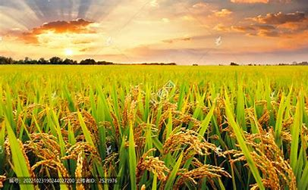
Text Analysis
The soft cool breeze moves the sheaves, which ripple and shimmer like waves of gold.
ripple: 泛起涟漪；如波浪般起伏。shimmer: 泛着微光；闪烁
清凉的微风吹动着地里密密的稻禾，掀起了层层稻浪，像金色的波涛闪闪发光。

Slide 15
投票
最多可选3项
What are the secret messages of the land that he wishes to pass on to his grandchildren?
A
The inner peace and reconciliation(和解；调和)
B
The virtue of working hard
C
The virtue of staying with parents when they are old
D
The virtue of loving one’s home and hometown
提交

