Slide 1
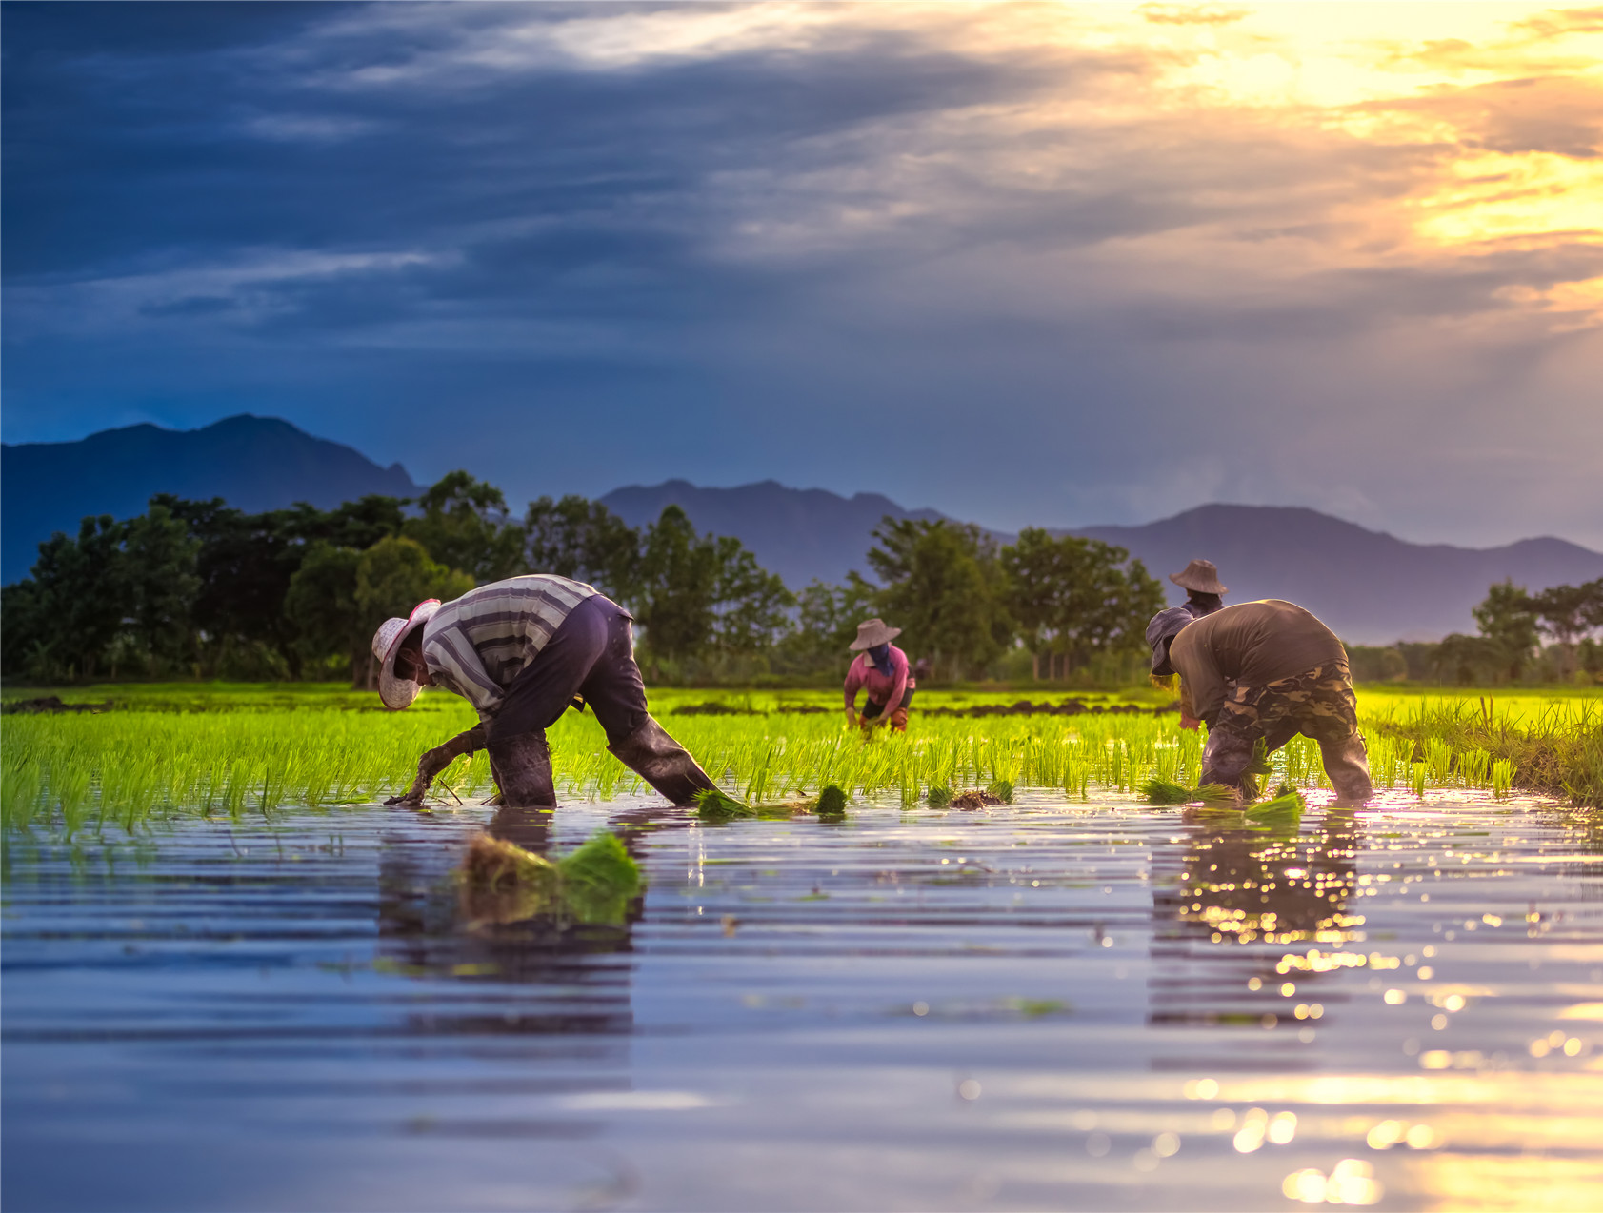





Unit 2

Slide 2
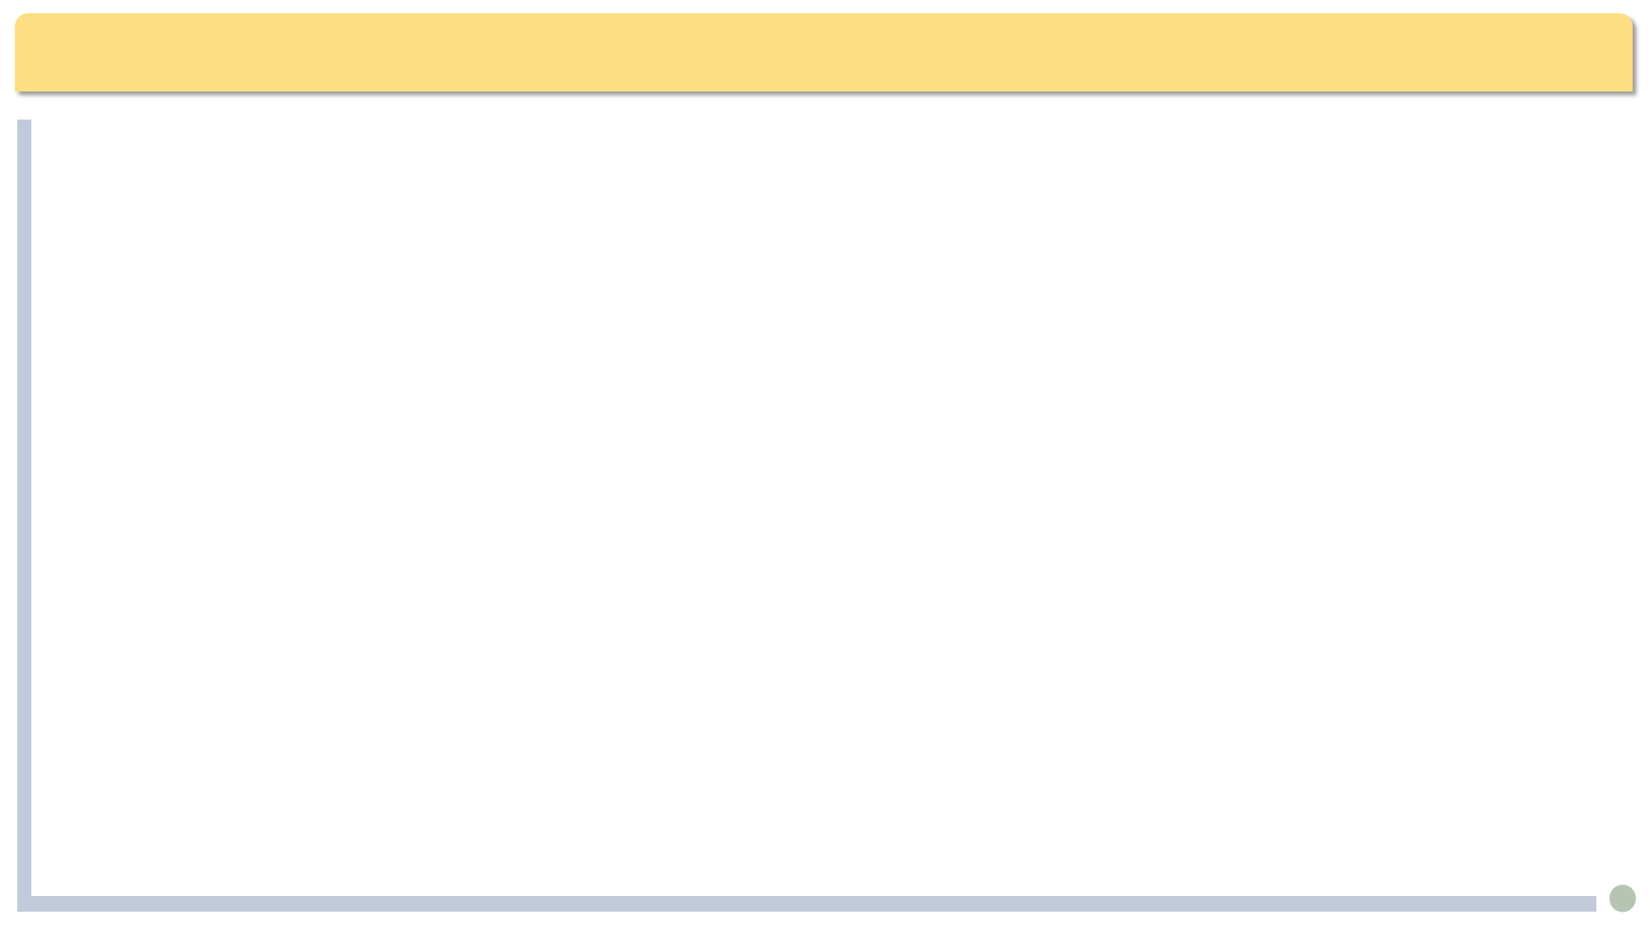


Glossary
condemn craft infancy ripple scarcity scent shimmer textile
infancy
craft / handicraft
textile
ripple
condemn
scent
(water) scarcity
shimmer

Slide 3

Translation
Chinese to English translation.
1) 该行动受到人权组织的普遍谴责。(condemn)
2) 这一地区矿产丰富、农田肥沃、气候温和。(fertile)
3) 这个雄心勃勃的太空旅游项目目前还处于起步阶段，需要大量投资和广泛测试才能迎来第一批乘客。(in one’s infancy)
English to Chinese translation.
1) A good class is a fertile soil in which the student grows.
2) It was raining heavily, and then to add insult to injury, a gust of wind blew away my umbrella.
3) Her sudden scream pierced the tranquil night, startling everyone who was peacefully asleep.

Slide 4

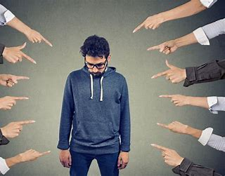
Glossary
condemn v.
1. say very strongly that you do not approve of sb. or sth., esp. because you think it is morally wrong 谴责
1) 他们因为约翰的背信弃义谴责他.
They condemned John for his treacherous behaviour.
2) 这一行动受到人权组织的普遍谴责。
The action has been widely condemned by human rights groups.
2. 给……判罪；给……判刑
He was found guilty and condemned to death.
他被裁定有罪，判了死刑。
n. condemnation

Slide 5

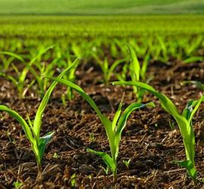
Glossary
fertile a.
1. (of land or soil) that plants grow well in 肥沃的；富饶的
2. 能生育的；可繁殖的 3. 丰富的；富于思想的
1) 这一地区矿产丰富、农田肥沃、气候温和。
The region is rich in mineral resources, with fertile farmland and moderate climate.
The region boasts rich mineral resources, fertile farmland and moderate climate.
2) A good class is a fertile soil in which the student grows.
一个好的班级体是学生成长的沃土。
3) fertile imagination 丰富的想象力
Word family: fertility n. 富饶；丰产；生育力
fertilize v. 使授粉；使肥沃 fertilizer n. 肥料
Antonym: barren 贫瘠的

Slide 6

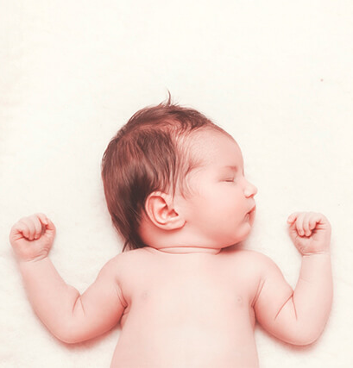
Glossary
infancy n.
婴儿期。初期；初创期
1) 人工智能的研究仍然处于初期阶段。
Artificial intelligence research is still in its infancy.
2) 这个雄心勃勃的太空旅游项目目前还处于起步阶段，需要大量投资和广泛测试才能迎来第一批乘客。
The ambitious space tourism project is currently in its infancy, requiring substantial investment and extensive testing before it can welcome its first passengers.

Slide 7

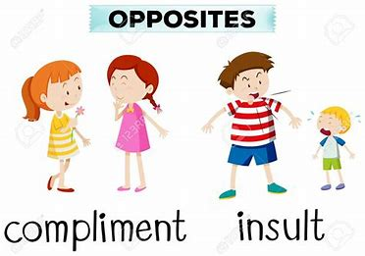
Glossary
insult
1. v. offend; say or do sth. that is rude; act offensively to sb. 侮辱
2. n. 辱骂；侮辱；冒犯
1) 她没请我参加会议，我感到深受侮辱。
I felt deeply insulted that she hadn’t invited me to the meeting.
2) The questions were an insult to our intelligence.
那些问题（简单得）有辱我们的智慧。
add insult to injury: 伤害之外又加以侮辱；雪上加霜，更糟的是
It was raining heavily, and then to add insult to injury, a gust of wind blew away my umbrella.
雨下得很大，更糟的是，一阵狂风把我的伞吹走了。

Slide 8


Glossary
pierce v. make a hole through sth. 刺入；刺穿；刺破
1) One bullet pierced the left side of his chest.
一颗子弹射入了他的左胸。
2) Her sudden scream pierced the tranquil night, startling everyone who was peacefully asleep.
她突然的尖叫声划破了宁静的夜空，惊醒了所有安睡的人。
3) Her memories sometimes pierced her heart.
回忆有时让她心如刀割。
ear piercings

Slide 9
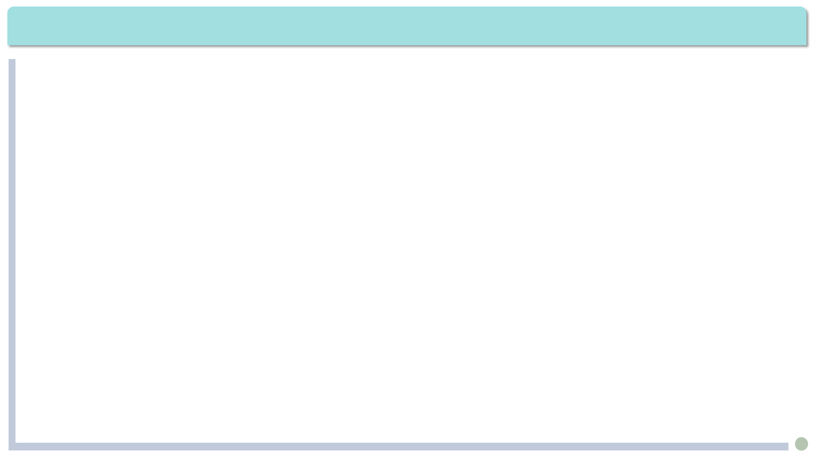
Exercises · Language Exercises
2. Fill in the blanks with the correct prepositions or adverbs, paying attention to the verb phrases with “get.”
  1. I know that ____ spite _____ the progress we have made in all these years, many people are still unhappy because their life is filled _____ worries and anxiety. But _____ my age, I am already at peace _____ the world. I have stopped complaining _________ things. I know I have done my best, and the world belongs _____ the young. When I die _____ old age(终其天年), I will have no regret because I know what I have left unfinished will be passed _____ _____ them.
in
of
with
at
with
about/of
to
of
on
to

Slide 10
Exercises · Language Exercises
2. Fill in the blanks with the correct prepositions or adverbs, paying attention to the verb phrases with “get.”
  2. When I think ____ my great grandfather, I always feel pity ____ him. My father told me that he used to work ______ morning _______ dusk, ______ a strip of land, year _____ year, but he was never able to protect his family ____________ hunger and cold. Actually his first two children died ____ infancy(夭折).
of
for
from
till/to
on
after
against/from
in

Slide 11
Exercises · Language Exercises
2. Fill in the blanks with the correct prepositions or adverbs, paying attention to the verb phrases with “get.”
  3. Does it occur ____ you that _____ my day, nobody I knew ever complained _________ being overweight because we were always short _____ food? As _____ me, I belonged _____ the lucky ones. I never really starved, but I never was full either. As _____ clothes, we were usually _____ rags. Now and then, my father would buy a new pair of trousers. After a few years, they would be passed _____ the first-born child(长子、长女), and then to the next and still the next until they became rags.
to
in
of/about
of
for
to
for
in
to

Slide 12
Exercises · Language Exercises
2. Fill in the blanks with the correct prepositions or adverbs, paying attention to the verb phrases with “get.”
  4. We haven’t got much time. Let’s get _______ to business. I hate to leave the others to finish the job. Let’s get it ______ and done ______ (结束).
  5. Her son didn’t get paid very much, but mother and son managed to get _____(勉强过活) . So her son’s sudden death was a terrible blow to her. She just couldn’t get _____ it(从……恢复过来).
  6. She was very easy to get ______ ______. She knew a bit of Chinese, and I knew a bit of Russian, so we managed to get our ideas ______(被理解; 把…讲清楚). We soon became good friends.
down
over
with
by
over
along
with
across

Slide 13
Exercises · Language Exercises
2. Fill in the blanks with the correct prepositions or adverbs, paying attention to the verb phrases with “get.”
  7. The news of the scandal(丑闻) got _____________ quickly, and he was condemned by public opinion. But he still thought that with his lawyer’s effort he would get _______ _______ it(逃脱惩罚).
  8. I found it challenging to start a company of my own. Sometimes, I barely had enough money to get ____________(熬过). It was my team members’ support that got me ____________ those difficult days. We must get _________ for a dinner once the company starts to bring in some profit.
around/round
away
with
through/by
through/over
together

Slide 14
Exercises · Language Exercises
3. Fill in the blanks with the correct form of the appropriate words or phrases in the brackets. Note that more than one of them may be appropriate.
  1. She ________ (hope; wish) her sister great success, and kissed her goodbye.
  2. He told me that he was ________ (hope; wish) to find a job in Beijing.
  3. — I _______ (hope; wish) you can join us this Sunday. I assure you we’ll have great fun.
  — I ______ (hope; wish) I could, but I’m not feeling very well.
  4. Many people _______ (hope; wish) that we had paid more attention to global warming.
wished
hoping
hope
wish
wished

Slide 15
Exercises · Language Exercises
3. Fill in the blanks with the correct form of the appropriate words or phrases in the brackets. Note that more than one of them may be appropriate.
  5. They ______ (hope; wish) that the rate of exchange (汇率) would not drop any further.
  6. Mark Twain said that he was different from George Washington in that Washington _________ (can’t; won’t) lie. He _______ (can; will), but he _________ (can’t; won’t).
  7. She insisted that they _______ (should; would; could; might) have given their mother the operation because it __________________ (should; would; could; might) have prolonged her life for a few months.
hope
couldn’t
could
wouldn’t
should
would/could/might
(“Would” would mean certainty while “could” and “might” would mean possibility.)

Slide 16
Exercises · Language Exercises
3. Fill in the blanks with the correct form of the appropriate words or phrases in the brackets. Note that more than one of them may be appropriate.
  8. The event ___________________ (happen; occur) in broad daylight. There were hundreds of people who saw this _____________ (happen; occur).
  9. Has it ever _________ (happen; occur) to you that all these changes have ____________________________ (happen; occur; take place) in the past three decades?
  10. Do you ________ (happen; occur) to know when and where the first Winter Olympics ___________ (happen; occur; take place)?
happened/occurred
happen/occur
occurred
happened/occurred/taken place
happen
took place

Slide 17
Exercises · Language Exercises
4. Translate the following sentences, paying attention to the words in bold type which may have different meanings in different contexts.
  1. Shortly after my wound was dressed, my fever was gone, but a dull pain still remained near my temples, and the doctor told me that I had to rest for the rest of the week.
  我的伤口包扎完不久烧就退了，但太阳穴处仍然感到隐隐作痛。医生告诉我在这周余下的几天内要多休息。
  2. Well, they dug three wells last spring, but all turned out to be dry. Many began to doubt that they would ever strike oil in this desert.
  嗯，去年春天他们挖了三口井，结果都是干的。很多人开始怀疑他们在这片沙漠里能否打出石油。

Slide 18
Exercises · Language Exercises
4. Translate the following sentences, paying attention to the words in bold type which may have different meanings in different contexts.
  3. The color of that dress strikes me as a bit too loud.
  我觉得那条连衣裙的颜色有点太花哨。
  4. I saw the snake lying in the grass, perfectly still. I thought it was dead. I did not expect it to suddenly strike me.
  我看到一条蛇躺在草地里，一动也不动。我以为它死了，没想到它会突然攻击我。
  5. I don’t know how old she is; she must be well over 90, but she is still well and strong.
  我不知道她多大年纪了，肯定有九十好几了吧，但她依然健硕。

Slide 19
Exercises · Language Exercises
4. Translate the following sentences, paying attention to the words in bold type which may have different meanings in different contexts.
  6. Even the monks in the Buddhist temple showed their support for the bus drivers’ strike.
  就连寺庙里的和尚也对公交车司机的罢工表示支持。
  7. Tears began to well up in my eyes when she described how they used to have only one dress between her mother and all the grown-up sisters.
  当她说到她妈妈曾经与她们几个成年姐妹共穿一件衣服时，我的泪水不禁涌上眼眶。

Slide 20
Exercises · Language Exercises
4. Translate the following sentences, paying attention to the words in bold type which may have different meanings in different contexts.
  8. Look at the new buildings springing up. I’m sure life here will be still better in future.
  看看这拔地而起的座座新大楼，我相信这里的生活将会更加美好。
  9. The deer were drinking from a spring, not knowing that there was a tiger hiding in the nearby bushes, and in one spring it would be on one of them.
  那群鹿正饮着泉水，全然不知附近的灌木丛里躲着一只老虎。它只要一扑，就能扑到一只小鹿身上。

Slide 21
Exercises · Language Exercises
5. Study the following examples and complete the sentences by translating the Chinese in the brackets.
  Example 1: … it was I who stayed with my parents till they died. (para. 1)
  1. Maybe ______________（是命运）sent them away.
  2. I don’t believe that ___________________（是他的儿子）took his money.
  3. I remember that ___________________（是在法国的时候）I first got interested in baking.
it was fate that
it was/is his son who
it was in France that

Slide 22
Exercises · Language Exercises
5. Study the following examples and complete the sentences by translating the Chinese in the brackets.
  Example 2: … it is like a knife piercing my heart. (para. 2)
  4. It’s like a man _______________________________（拿着金饭碗要饭）.
  5. It’s like a man _________________________（想抓自己头发让自己飞起来）.
  6. It’s like the blind _______________（给盲人领路）.
begging for food with a golden bowl
trying to fly by lifting his hair
leading the blind

Slide 23
Exercises · Language Exercises
5. Study the following examples and complete the sentences by translating the Chinese in the brackets.
  Example 3: Men used to make things with bamboo pieces, but no longer. (para. 4)
  7. ________________________________（她过去英语方面相当弱）, but now she is one of the top students in our class.
  8. ____________________________________（我们国家以前被称为一个自行车国家）, but now there are almost as many cars in our cities as in any modern city in the world.
  9. _________________________________________（过去我们有很多鱼、虾和螃蟹）, in our rivers and lakes and ponds, but now no longer.
She used to be rather weak in English
Ours used to be called a country of bicycles
There used to be lots of fish, shrimps, and crabs

Slide 24
Exercises · Language Exercises
6. Study the sentence pattern and rewrite each of the sentences.
  Example: Pattern: if subject + verb (past perfect), subject + would/should/could/might + main verb (have done)
  If that kind of thing had happened when I was young, the whole village would have condemned such an ungrateful son … (para. 6)
  (used when you are talking about something that might have happened in the past but did not happen)
  1. The patient wasn’t sent to the hospital soon enough, and he died on the way.
  If the patient had been sent to the hospital soon enough, he wouldn’t have died on the way.

Slide 25
Exercises · Language Exercises
6. Study the sentence pattern and rewrite each of the sentences.
  2. The firefighters arrived in time, and the fire did not spread to other rooms.
  If the firefighters hadn’t arrived in time, the fire might have spread to other rooms.
  3. He was aware of the danger, so he ran out of the house in time.
  If he hadn’t been aware of the danger, he wouldn’t have run out of the house in time.
  4. They didn’t know Professor Ji was in town last week, and, therefore, they missed the chance to invite him to speak at the university.
  If they had known Professor Ji was in town last week, they would have invited him to speak at the university.

Slide 26
Exercises · Language Exercises
7. Study the use of “as” in the example and translate the sentences into Chinese.
  Example: My husband moved into our house, as is the way with us in Esarn. (para. 1)
  (“As” can take the place of subjects in clauses, rather like a relative pronoun.)
  1. As so often happens, the darkest hour comes just before dawn.
  黎明前往往是最黑暗的时刻。
  2. As is known to all, China remains a developing country in many ways in spite of her rapid economic development.
  众所周知，尽管经济发展很快，中国仍然是个发展中国家。

Slide 27
Exercises · Language Exercises
7. Study the use of “as” in the example and translate the sentences into Chinese.
  3. As is the case with many men, he seems to be having a midlife crisis.
  他好像正处于中年危机之中，不少男人都有这样的经历。
  4. As is announced in the newspaper, the conference will be held next month.
  正如报上所宣布的那样，这次会议将于下月召开。
  5. He is a foreigner, as is evident (=clear) from his accent.
  他是个外国人，他的口音很清楚地表明这点。
  6. The boy is interested in the game, as can be seen from the expression on his face.
  从这个男孩脸上的表情可以看出，他对这个游戏很感兴趣。

Slide 28
Exercises · Language Exercises
8. Study the use of the “link verb + predicative” pattern in the example and translate the sentences into English.
  Example: Pattern: link verb + predicative
  Our piece of land gets old and exhausted.
  1. 那个人从来没见过这么漂亮的丝绸。他说：“这东西看着好，摸着也好，的确就是好！”
  The man had never seen such beautiful silk. He said, “It looks good, feels good, and it is good!”
  2. 树叶都变黄，变红，变紫了。这里看起来真是如天堂一样美。
  Leaves had turned/gone/become yellow, red, and purple. It really looked heavenly (beautiful like heaven) here.

Slide 29
Exercises · Language Exercises
8. Study the use of the “link verb + predicative” pattern in the example and translate the sentences into English.
  3.随着年纪越来越大，她开始很容易感到疲惫。
  As she grew older, she began to feel tired more easily.
  4.他的话听起来很有说服力，但好听的理由并不等于好的理由，两者之间存在很大的区别。
  What he said sounded very convincing, but reasons that sound good do not always equal/equate to sound reasons. There is a big difference between the two.
  5.他爱说话，他永远无法保持沉默，而他说的往往被证明是错的。
  He likes to talk. He can never keep quiet, but what he says often proves (turns out to be) incorrect.

Slide 30
Exercises · Language Exercises
9. Translate the following sentences, using the words in the brackets.
  1. 祝英台虽然不愿意嫁给马家少爷，但在她父亲的压力下她不得不服从。她的心都碎了。(force)
  Zhu Yingtai was forced to obey her father and marry the young master of the rich Ma family although she was extremely unwilling. She was heartbroken.
  2. 他在战斗中受了伤，流了很多血。他的领导命令他留在医院，直到他完全痊愈。(heal)
  He got wounded in battle and lost a lot of blood. His leader ordered him to stay in the hospital until he was completely healed.
  3. 许多鸟类年复一年地回到同一个栖息地。(year)
  Many birds return to the same habitat year after year.

Slide 31
Exercises · Language Exercises
9. Translate the following sentences, using the words in the brackets.
  4. 尽管下着大雨，我们还是去医院探望了祖母。(spite)
  We went to the hospital to visit our grandma in spite of the heavy rain.
  5. 当地人过去一向用谷物换取食盐。(barter)
  The local people used to barter grain for salt.
  6. 快餐店一家家地涌现出来，遍布整个城镇。(spring)
  Fast-food restaurants sprang up all over the town.
  7. 你要是对你父亲说了实话，他肯定会原谅你的。(would)
  Your father would have forgiven you if you had told him the truth.

Slide 32
Exercises · Language Exercises
9. Translate the following sentences, using the words in the brackets.
  8. 祸不单行，事情往往如此。(as)
  As so often happens, misfortunes never come singly.
  9. 我国南方常遭水灾，北方则常遭旱灾。(strike)
  We are often stricken by floods in the south and droughts in the north.
  10. 我非常感激帮助我适应新环境的邻居们。(adapt)
  I was extremely grateful to the neighbors who helped me adapt to the new conditions.

Slide 33
Exercises · Language Exercises
10. Fill in each blank of the passage with ONE suitable word.
Jack Hawkins was the football coach at an American college, and he was always (1) ______ to find good players, but they weren’t always smart (2) _______ to be accepted by the college. One day the coach (3) ________ an excellent young player to the dean of the college and asked that the student be allowed to enter the college (4) ________ an examination. “Well,” the dean said after some persuasion, “I’d better ask him a few questions (5) ____ .” Then he turned to the student and asked him some very (6) ________________ questions, but the student didn’t know (7) ____of the answers. Finally, the dean said, “Well, what’s five (8) ______ seven?” The student thought for a long time and then said, “Thirty-six.” The dean threw up his hands and looked at the coach (9) ___ despair, but the coach said earnestly, “Oh, please let him in, sir! He was (10) _____ wrong by two.”
trying
enough
brought
without
first
simple/basic/easy
any
times
in
only

Slide 34
Exercises · Language Exercises
11. Find and correct the TWO mistakes in each sentence.
1. I had been reading for three hours and felt rather exhausting. Therefore, I determine to take a little walk and stretch my arms and legs.
I had been reading for three hours and felt rather exhausted. Therefore, I determined to take a little walk and stretch my arms and legs.
2. The old lady finds that the shops are filled with goods and plastic craft that she has no use for them.
The old lady finds that the shops are filled with goods and plastic crafts that she has no use for them.

Slide 35
Exercises · Language Exercises
11. Find and correct the TWO mistakes in each sentence.
3. If it wasn’t for my bad cold, I would certainly join you for that trip the other day.
If it hadn’t been for my bad cold, I would certainly have joined you for that trip the other day.
4. The old couple told me that they have nothing to complain.
The old couple told me that they had nothing to complain about/of.
5. My grandfather suggested me to apply for a local university for admission.
My grandfather advised me to apply to a local university for admission.
[My grandfather suggested (that) I (should) apply to a local university for admission./My grandfather suggested my apply to a local university for admission.]

Slide 36

Exercises · Language Exercises
11. Find and correct the TWO mistakes in each sentence.
6. He promised that he will pass the message onto all his friends.
He promised that he would pass the message on to all his friends.
7. Sooner or later, a country will fall back if it fails to keep up with the time.
Sooner or later, a country will fall behind if it fails to keep up with the times.
8. May be it was fate that brought all my children away from our hometown.
Maybe it was fate that sent/took all my children away from our hometown.

Slide 37
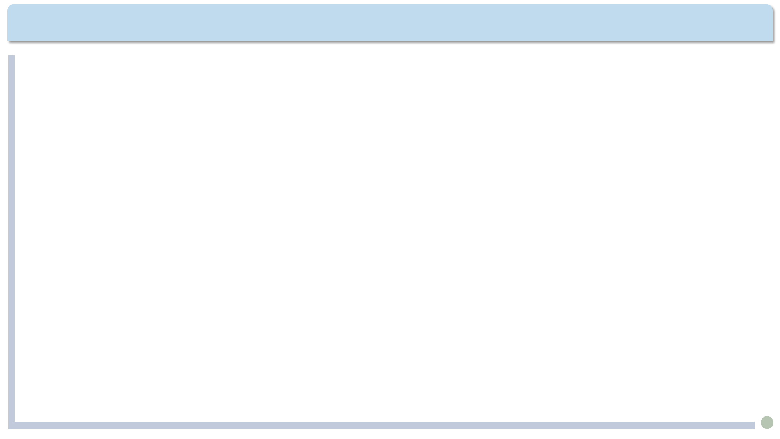
Extension Activities
  Memorable Quotes
  We could never learn to be brave and patient, if there were only joy in the world.
  ——Helen Keller
  A pessimist sees the difficulty in every opportunity; an optimist sees the opportunity in every difficulty.
  ——Winston Churchill
  The happiest of people don’t necessarily have the best of everything; they just make the most of everything that comes along their way.
  ——Source unknown

