Slide 1


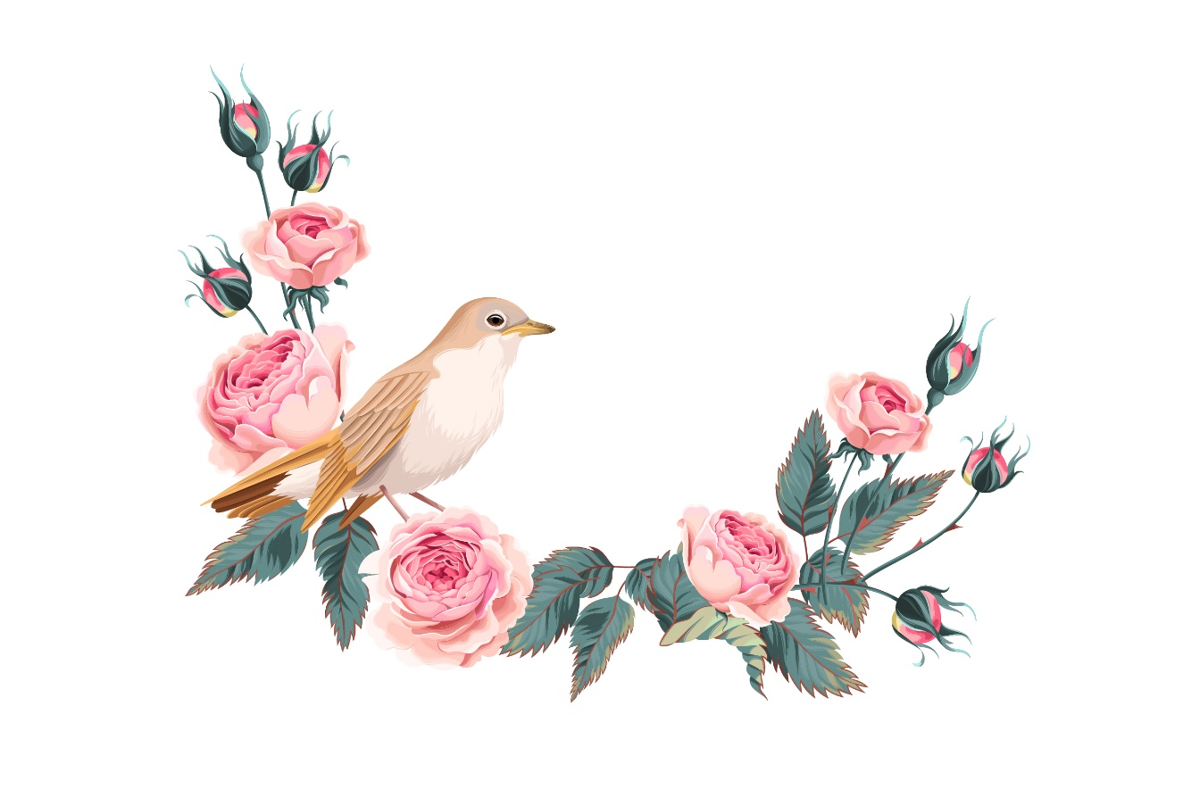



The Nightingale and the Rose
Unit 4

Slide 2
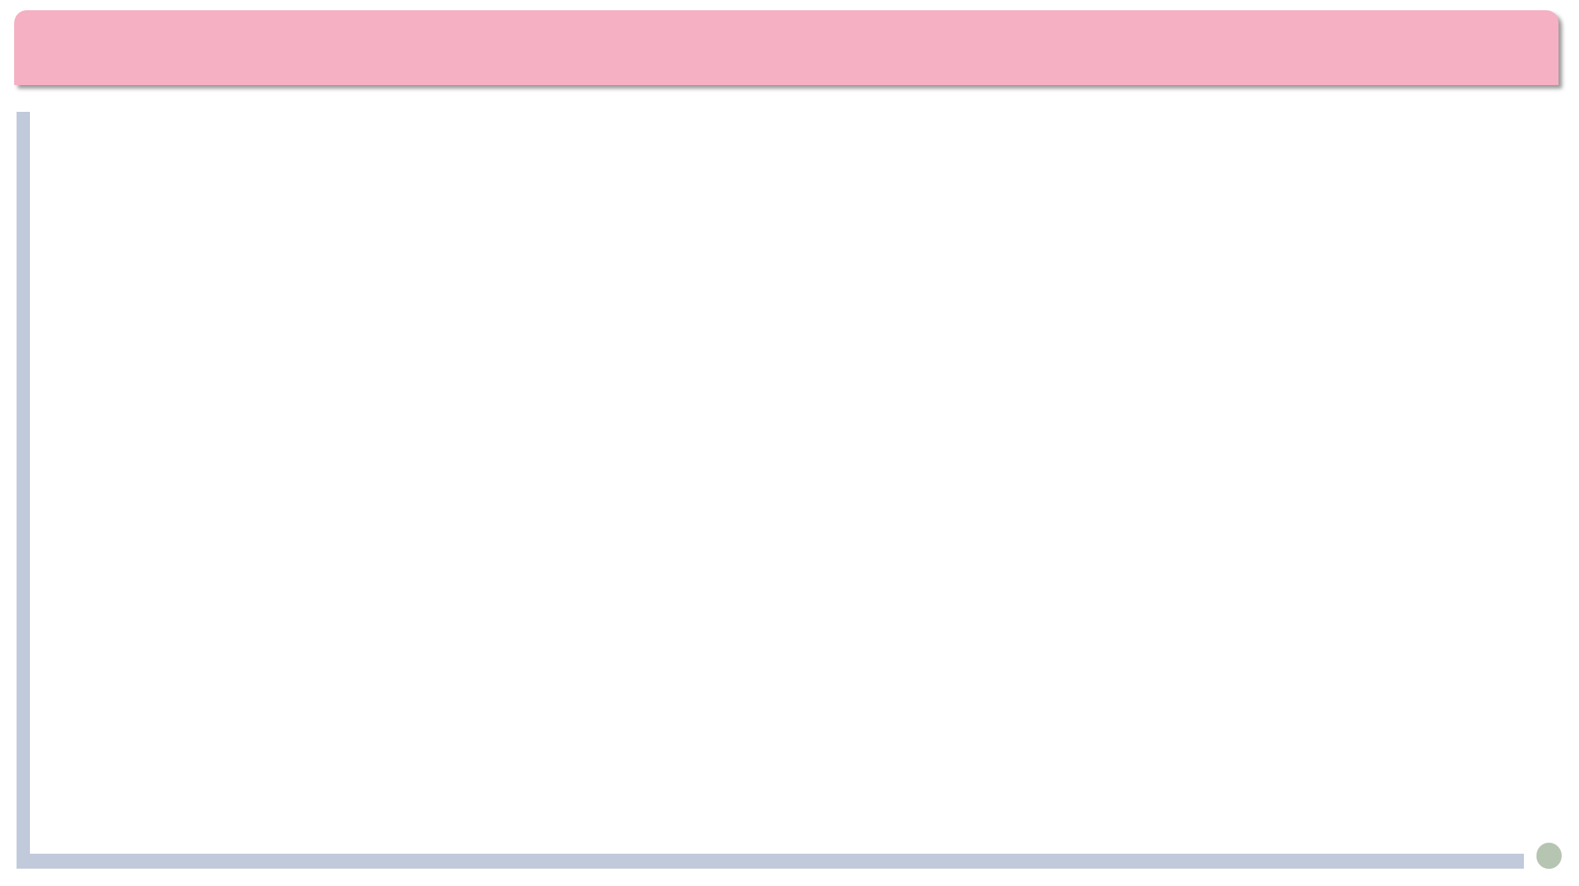

Lead-in
Which fairy tales(童话) were written by Oscar Wilde(王尔德) ？
A. The Happy Prince
B. The Little Match Girl
C. The Selfish Giant
D. Snow White

Slide 3
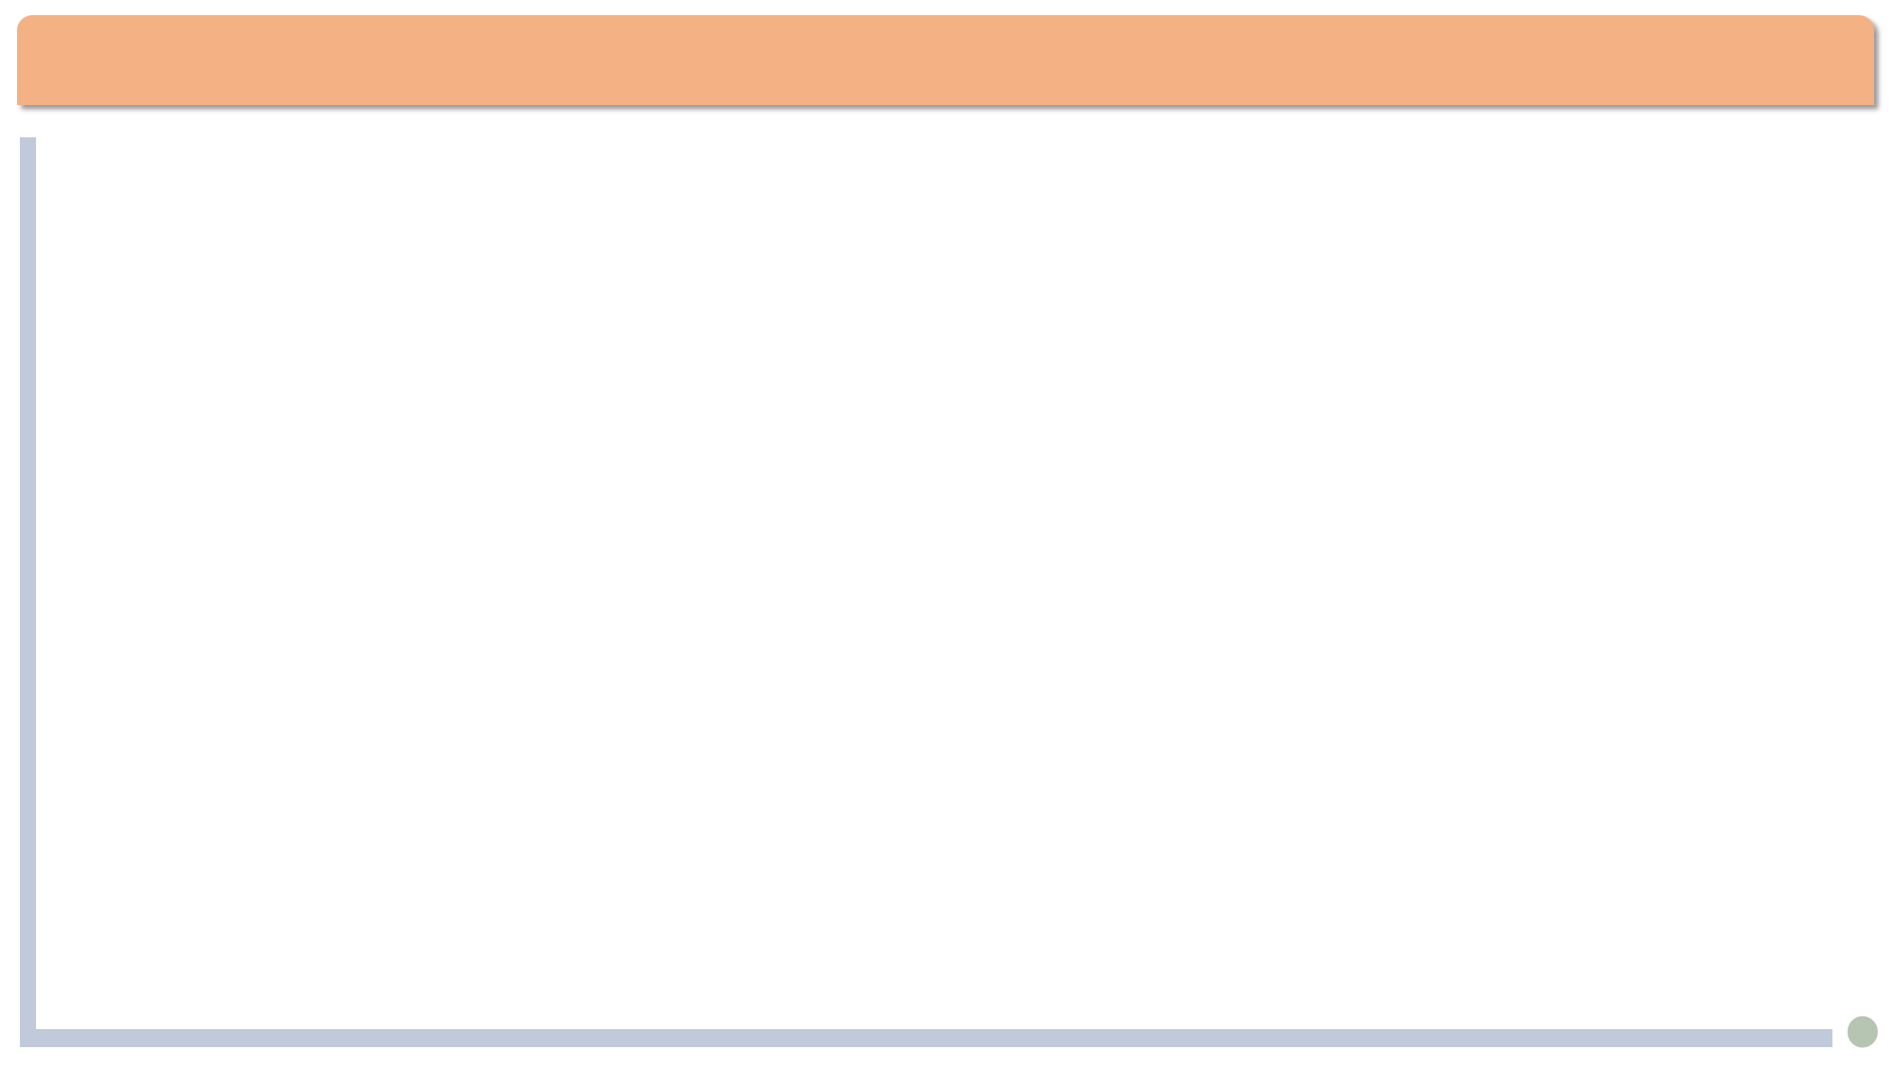

Text
Oscar Wilde (1854-1900), Irish poet and playwright.
An advocate of aestheticism(唯美主义) --- “art for art's sake”(art serves no other purpose than to be beautiful).
His famous works include The Picture of Dorian Gray, The Importance of Being Earnest, An Ideal Husband.
A master of the epigram(警句，隽语)

Slide 4

投票
最多可选4项
Which sayings about love do you approve of?
A
All is fair in love and war. (情场如战场)
B
Absence makes the heart grow fonder.(小别胜新婚)
C
Out of sight, out of mind.(久别情疏)
D
In true love you want your partner to be happy. In false love you want your partner.
Women are made to be loved, not understood.(Oscar Wilde)
E
提交

Slide 5
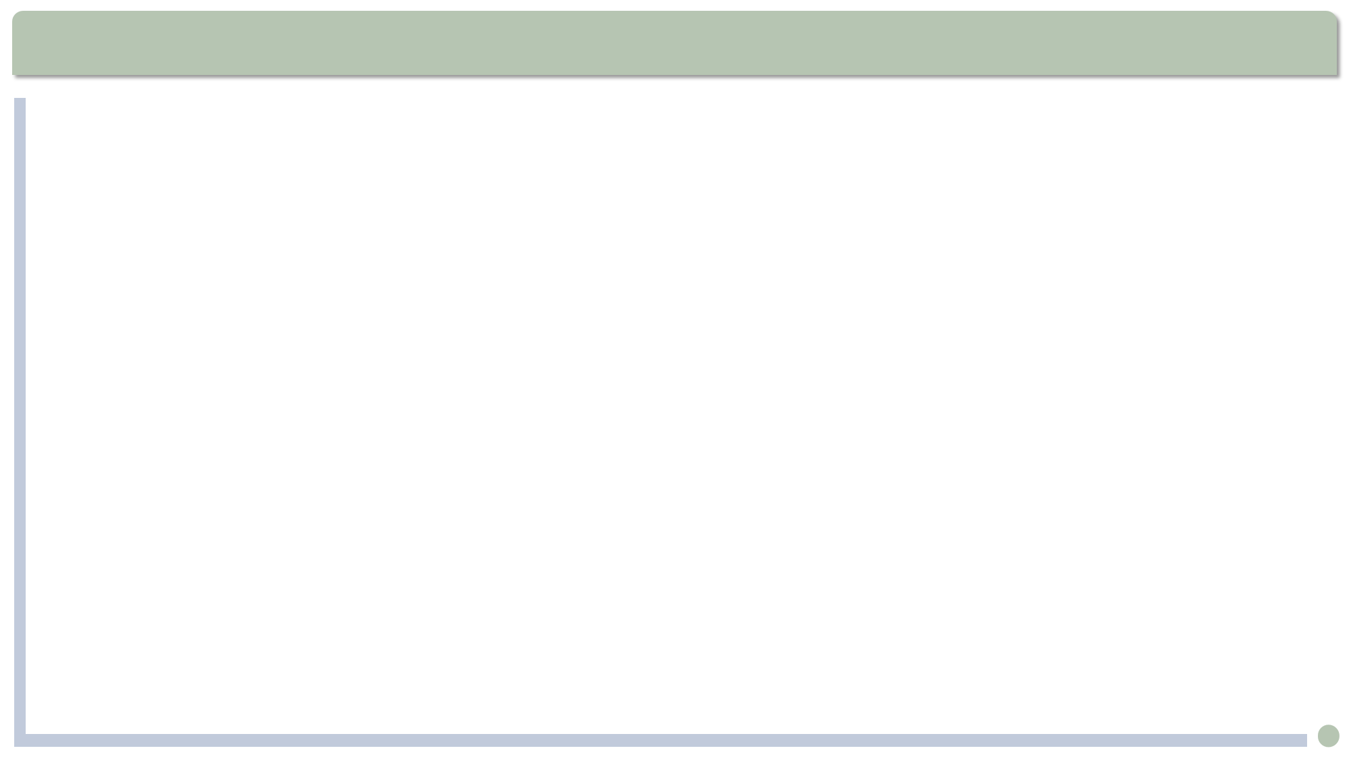
Text Analysis
“..., yet for want of a red rose my life is made wretched.” (Para.3)
for want of: for the lack of; because of the lack of
1) For want of something better to do, she decided to try gardening.
2) For want of a better word, let’s call it Me-firstism.
3) 这个项目由于缺少资金而告吹。
The project failed for want of funding.
in want of: in need of
It is universally acknowledged that a single young man with a large fortune is in want of a wife. (from Pride and Prejudice)

Slide 6
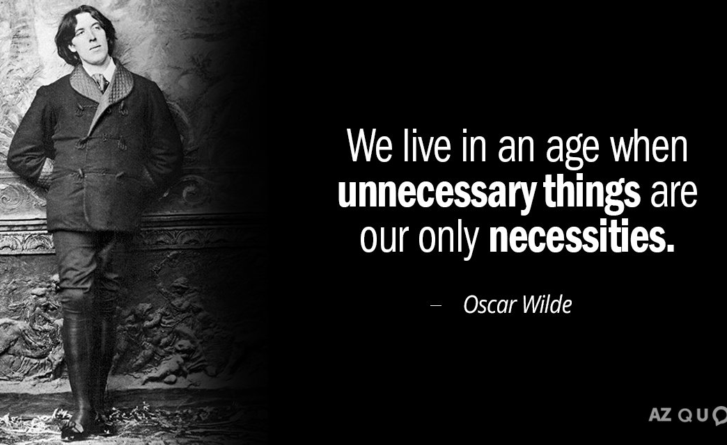
单选题
20分
Which explanation of the underlined words is incorrect?
A
my life is made wretched -- pitiful
B
for want of a red rose -- because of the lack of
C
flung himself down on the grass -- threw
D
murmured the young Student -- cried
提交

Slide 7
Text Analysis
... and the little Lizard, who was something of a cynic, laughed outright. (Para.12) 那只有些愤世嫉俗的小蜥蜴当即大笑起来。
something of: to some degree; not fully deserving the name
1. He is something of an economist among us because his grandfather used to own a little store.
2. 她在我们村里算是个牙医，不过她用的方法相当粗糙。
She is something of a dentist in our village although the method she uses is quite crude.
cynic: a person who distrusts the goodness of others, believing that people are motivated purely by self-interest.
opal

Slide 8
填空题
20分
Fill in the blanks with the words given.
fluttered, soared, bloomed, chilled
1. The rocket [填空1] up into the air.
2. I'm [填空2] to the bone by the icy wind.
3. Their business [填空3] in the golden age.
4. Flags [填空4] in the breeze.
sundial
fans of coral
daffodil
作答

Slide 9
Text Analysis
“She has form... That cannot be denied. But has she got feeling? I’m afraid not. In fact, she is like most artists: She is all style without any sincerity” (Para.52)
她懂得一点音乐的形式。这点不可否认。但是她有真正的感情吗 ? 恐怕未必。实际上她同大多数艺术家一样，只有花哨的表现形式，就是缺乏真情。
Why did the student say this? What does this imply?
1. The Student didn’t understand emotions or the sacrifice of the Nightingale; in a sense he didn’t understand love and was not likely to be a true lover.
2. “All style without any sincerity” is similar to what people at that time said about Oscar Wilde’s views on art. (art for art’s sake)

Slide 10
填空题
20分
What do they refer to? Choose from a, b, and c.
1.“Love in the heart of a boy and a girl” refers to [填空1] ;
2.“Passion in the soul of a man and a maid” refers to [填空2] ;
3. “Love that dies not in the tomb” refers to [填空3]
a. immortal(不朽的) love between lifelong couples
b. a more mature kind of love between adults
c. sweet, first love, or puppy love
作答

Slide 11
填空题
20分
Fill in the blanks with the words given.
denied, ebbed, lingered, flushed
1. As night fell, our enthusiasm [填空1] away.
2. She [填空2] when people talked about her boyfriend.
3. The spokesman [填空3] the rumor.
4. The scent of her perfume [填空4] in the room.
作答

Slide 12
Text Analysis
“It is not half as useful as logic.” (Para.52)
爱情赶不上逻辑学的一半儿有用。
not half as... as...
The sequel(续集) is not half as interesting as the original movie.
这个牌子的流行程度不如十年前的一半了。
This brand isn't half as popular as
it was a decade ago.

Slide 13
主观题
20分
Make a sentence with“not half as ... as...”
e.g.
The sequel is not half as interesting as the original movie.
This brand isn't half as popular as it was a decade ago.
In autumn, the mountains are not half as crowded as they are in summer.
作答

Slide 14
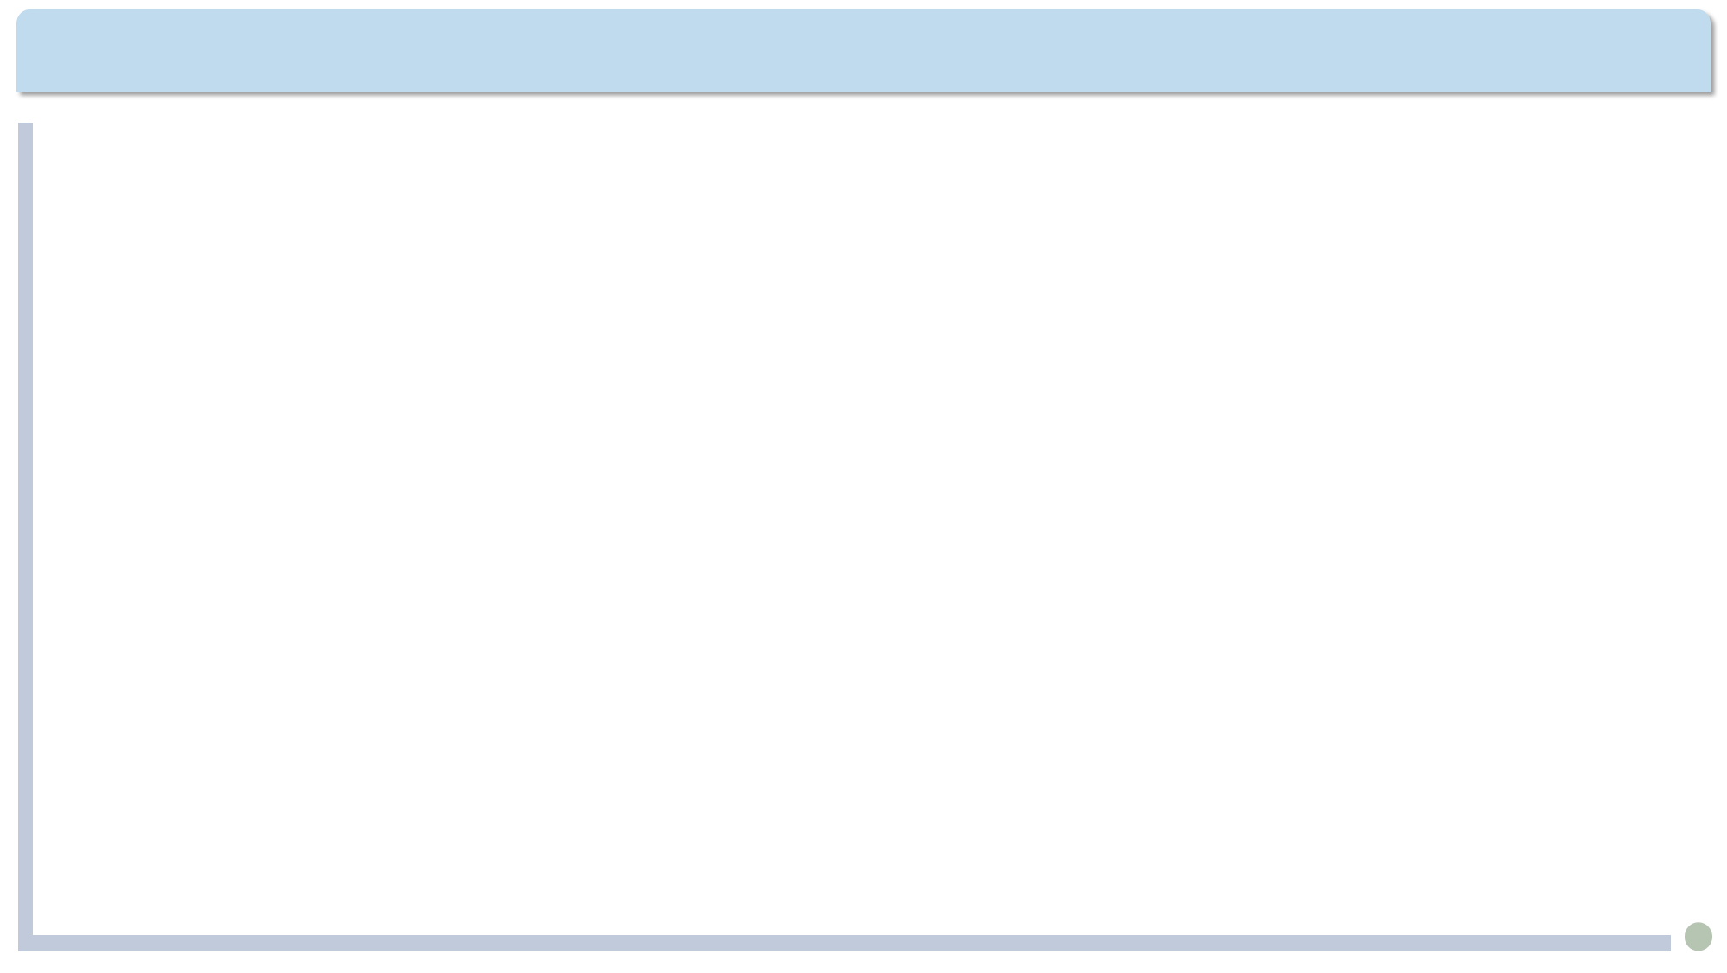
Summary
What are their different attitudes toward love?
The Student
The Professor’s daughter
The Nightingale
Love is a sweet fancy, the joy and perhaps vanity of being able to dance with the girl he likes.
Love is materialistic and can be measured by the value of the gift she receives.
Love is the greatest and most valuable and perfect of all things, even more important than life.

